Slide 1

Welcome
St. Wilfrid’s R.C. College
Mental Health Toolkit
Mental health and wellbeing services at St. Wilfrid’s provide effective strategies and support for students, families and staff to improve the wellbeing and progress of the school environment.
Secondary School mental health services allow St. Wilfrid’s to follow a graduated response to crises. This document outlines how processes are formalised for identifying and providing students with the most appropriate mental health and wellbeing support.

Slide 2
Contents Page
Mission | 3
Vision | 4
Mental Health Framework | 5
Mental Health Referral Pathway | 6
Mental Health Referral Checklist | 7–8
Mental Health Monitoring Procedure | 9
St Wilfrid’s R.C. College Referrals Overview | 10
St Wilfrid’s R.C. College Internal Referrals | 11–12
St Wilfrid’s R.C. College External Referrals | 13
Useful Contacts | 14

Slide 3
Mission
We believe that every child, with the right support, is capable of anything.
Our pastoral system and our curriculum are underpinned by Gospel Values and mental well-being is a key priority of our school’s development plan. Mental health education within school develops students’ understanding of mental health and emotional well-being, providing them with tools to self-care and with clear access to support mechanisms when required.
St. Wilfrid’s Mental Health Toolkit supports our strategic plan and implementation to ensure all members of the St. Wilfrid’s community receive the support needed to meet their full potential.

Slide 4
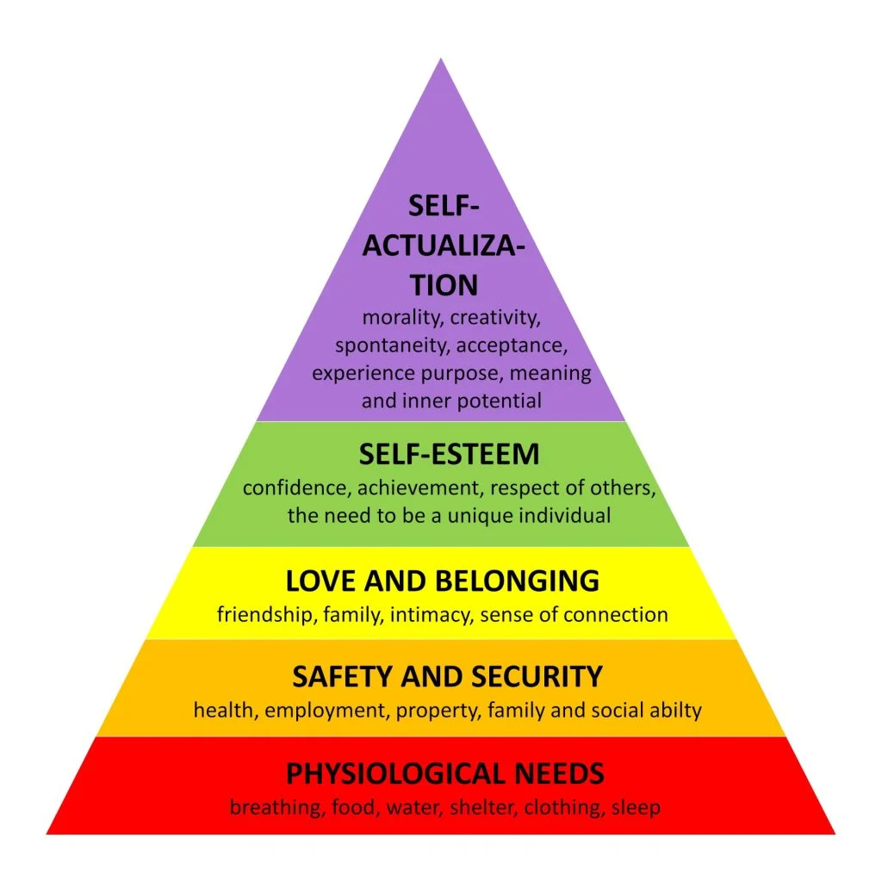
Vision
Our Mental Health strategy takes guidance from academics such as Maslow (1943) and Boxall (1960) as without support for our psychological and wellbeing needs, it is difficult to reach our God given potential.
The strategy adopted within St. Wilfrid’s R.C. College is as follows;
We respect one another’s differences and work to raise awareness of Mental Health and wellbeing throughout the school community
We are responsible for supporting others around mental health and wellbeing with the guidance of the pastoral team and external services, where appropriate.
We provide support for members of our school community in challenging times to not give up and build resilience. We celebrate successes and constantly review our processes to ensure the best for the community of St. Wilfrid’s R.C. College.

Slide 5
St. Wilfrid’s R.C. College
Mental Health Framework
Tier 3
External counselling; Healthy Minds, The Road Centre, Bereavement services
Early Help
Clennell
Social Services
Tier 2
Additional support with stakeholders needed e.g. PSP, attendance meeting
Individual and group intervention with staff and peers
Use of graduated response; monitoring and review processes
Tier 1
Mental Health and Wellbeing via PSHE curriculum/ form time and assemblies
Access to self-help material via the school website, Kooth
Access to Head of House/ Form Tutor
Trauma-informed and restorative behaviour policy and practices
The above strategies are used in collaboration with the following;
Restorative behaviour policy
Catholic culture and ethos based upon mutual respect
Multi-stakeholder collaboration
Data based monitoring
A collaborative approach with all members of the St. Wilfrid’s community towards mental health and wellbeing.

Slide 6
St. Wilfrid’s R.C. College
Mental Health Referral Pathway
Step 1
Identify school Mental Health Lead and wellbeing team
Step 2
Gather information on Mental Health and Wellbeing issues using a variety of data
Step 3
Gather necessary information and develop procedure for managing internal and external referrals.
Step 4
Utilise a secure student record management system
Step 5
Outline available resources and interventions
Step 6
Create decision making criteria to determine most appropriate intervention route
Step 7
Ensure school based monitoring of effectiveness of intervention

Slide 7
St. Wilfrid’s R.C. College
Mental Health Referral Checklist
Step 1- School wellbeing team
Identify members of the team responsible for escalation of Mental Health and wellbeing issues
Assessment and monitoring of understanding of team
Step 3- Information gathering
Contextual information collected regarding relevant information related to mental health referral
Communication with relevant stakeholders- pastoral team, teachers, caregiver (s), external agencies where appropriate
Step 4- Student management system
Determine secure location for storing records
Step 2- Mental Health referral procedure
Meetings at regular intervals
Referral pathway adopted- triage system
Consideration of how the referrals are accessed
Determination of reviewing of referral forms
Identify contacts for external agencies
Referral procedures shared with key stakeholders
Determine levels of permission for appropriate team members to access files.

Slide 8
St. Wilfrid’s R.C. College
Mental Health Referral Checklist
Step 5- Resources and intervention
Identify team member responsible for mapping available resources and intervention
Step 7- Development of effective school based monitoring of intervention
Ensure that a system is developed to monitor student receiving intervention and a clear plan should any barriers arise.
Step 6- Determine most suitable intervention
Determine a triage system to identify when a student needs tier 1, tier 2 or tier 3 intervention.
Identify resources available within St. Wilfrid’s R.C. College to support students. This can range from extracurricular activities to individual counselling.
Ensure clear guidelines to establish when an intervention is complete or should be discontinued
Ensure clear identification of positive outcome data. If positive outcome data is not identified, consider appropriate next steps.
Ensure clear communication and structure to support and remove, where appropriate referral.
Ensure a process of feedback from external provider, student and caregiver (s).
Ensure a plan for sharing effectiveness of intervention with key stakeholders.

Slide 9
St. Wilfrid’s R.C. College
Mental Health Monitoring and Reviewing procedure
CRISIS
Immediate intervention identified and required. DSL and external agencies made aware.
Student to follow Tier 3 pathway
Triage stage- consent to be gained from caregiver for initial pastoral intervention to take place. Observations and conversations to occur.
Level of need determines appropriate next steps
Student referral
Academic, SEMH concerns. Conversation with pastoral team in the first instance to be investigated
Caregiver referral-Academic, SEMH concerns raised via communication with pastoral team. Pastoral team responsible for logging communication and managing further referral, where needed.
Tier 3-More in depth observations and conversations to be had with key stakeholders to arrange a suitable plan for student.
Initial conversation to be held between Head of House, caregiver and student. Information gathered from teaching staff, form tutor and external agencies where necessary due to level of need
Tier 2- More in depth observations and conversations to be had with key stakeholders to arrange a suitable plan for student.
Initial conversation to be held between Head of House, caregiver and student. Information gathered from teaching staff and form tutor.
Tier 1- No further intervention needed at this stage.
The student will have regular check ins with member of the pastoral team and form tutor.
Teacher referral- Academic, SEMH concerns. Referred via electronic triage system. Pastoral team responsible for the referral
Informal awareness
The student is provided with online self-help guides via the school website,
Students will have access to pastoral team for their check ins.
Planning Stage
Planning for next steps with key staff, caregiver and student.
Further information gathered analysed and appropriate steps put in place. This stage is used following short term intervention and counselling with a need to continue on review of service.
Planning Stage
Planning for next steps with key staff, caregiver and student. Access to Kooth given
Further information gathered analysed and appropriate steps put in place. This could include short term 1:1 counselling or group intervention
Monitoring Stage
The case is monitored over a period of time.
Meetings with key stakeholders are help to discuss the wellbeing and progress of the student. All meeting information logged securely electronically
Monitoring Stage
Student engagement and support is monitored over a period of time.
Updates are provided to and from the pastoral team during pastoral meetings and verbally, where needed.

Slide 10
St. Wilfrid’s R.C. College
Referrals
Internal Referrals
School Nursing Team
Group Workshops
Living Life to the Full
Healthy Minds
The Road Centre
Bereavement Counselling
Peer support group
Young Carers
EAL
Safe Space
Form Tutor Mentoring
Clennell
Referrals
External Referrals
CAMHS
Virtual School
Kooth
South Tyneside Children’s Services and Early Help

Slide 11
St. Wilfrid’s R.C. College
Internal Referrals
Form tutor mentoring
What is Form Tutor mentoring? Students to check in with their tutees at agreed times and generally act as a support in the initial instance.
Why refer? A student is in need of short term support and care. This is initial early stage intervention that can be managed over time. This is suitable in cases of stress, anxiety and sleeping habits.
Group Workshops
What are group workshops? Group workshops include students who have been suggested and referred to take part in group activities to develop strategies. Groups currently include Living Life to the Full, SafeSpace and Young Carers
Peer support groups
The Road Centre
How to refer? Heads of House have initial conversation with student, caregiver and form tutor. This is actioned and recorded by the form tutor to feedback to Head of House at appropriate intervals. Head of House to continue to monitor attendance and attainment in Arbor in short term.
Why refer? This support is appropriate for students who may need a short term intervention with strategies and resources for this. The presenting student will not have a chronic difficulty, but rather something that can be managed over short period of time.
How to refer? Heads of House work with the Mental Health lead to produce a list of students who may benefit from these groups and interventions. Students are allocated the most appropriate intervention and support is given for 6-8 weeks.
.
What is Road Centre Counselling? Road Centre Counselling Is a service bought in by St. Wilfrid’s to support students with a variety of ongoing mental health and wellbeing needs such as bereavement, anxiety, stress, self-harm and suicidal ideation. The Road Centre have two different counsellors over four days.
Why refer? A student is referred for Road Centre support once Tier 1 intervention has been tried and more ongoing support is needed. Students who are referred to Road Centre are often struggling to manage academically, behaviourally and socially in school.
How to refer? The pastoral team provide details to the Mental Health lead of ongoing and developing needs of the student. The Mental Lead triages the student to the most appropriate mental health support. If this is Road Centre, a referral form is completed and placed securely electronically until an appointment becomes available. A student has between 6-10 sessions with the counsellor then this is reviewed
What are Peer Support groups? Students referred by the Pastoral team are able to work with other students on mental health and wellbeing issues. They are able to discuss and develop strategies as a group to feedback. Currently, groups in school include Mental Health Ambassadors, SafeSpace and Young Carers.
Why refer? This support is appropriate for students who may need a short term intervention with strategies and resources for this. The presenting student will not have a chronic difficulty, but rather something that can be managed over short period of time.
How to refer? Heads of House work with the Mental Health lead to produce a list of students who may benefit from these groups and interventions. Students are allocated the most appropriate intervention and support is given on an ongoing basis. This however, is regularly reviewed to ensure this is adequate support for the student.

Slide 12
St. Wilfrid’s R.C. College
Internal Referrals
Bereavement Counselling
What is Bereavement Counselling? Bereavement Counselling is a service that is provided in school by the Local Authority. The support takes place once per week at agreed times. This will be a one-to-one service and their progress will be monitored by the counsellor throughout and a report produced.
School Nursing Team
What are the School Nursing Team? School nurses are specialist community nurses who work with school-aged children, young people and their families to improve their wellbeing outcomes and reduce any present or emerging vulnerability. The school nurse team are able to visit school or the student’s home if it is preferred.
Healthy Minds
What is Healthy Minds? Healthy Minds is a service run by the NHS and is made up initially under the Healthy Minds service of mental health professionals. Should a student’s need be greater than the short term intervention provided by Healthy Minds or they need additional support following Healthy Minds involvement, they can be transferred to Lifecycle then CYPS.
Why refer? Healthy Minds provides initial short term intervention focused on Cognitive Behavioural Therapy (CBT) or additional counselling. Students work with Healthy Minds around emotions, bullying and low-mood.
How to refer? The pastoral team provide details to the Mental Health lead of ongoing and developing needs of the student. The Mental Lead triages the student to the most appropriate mental health support. If this is Healthy Minds, a referral form is completed and sent to the NHS who will inform the Mental Health lead when an appointment becomes available. The Healthy Minds link has a weekly meeting with the Mental Health lead to discuss student progress and upcoming appointments.
How to refer? Heads of House and SEND team can refer to the school nursing service via an NHS referral form. The school nursing team then contact home and school with the most appropriate time to visit the student and give strategies and support. Updates regarding the school nursing team are logged on CPOMS and actioned where updates are given.
Why refer? The school nursing team can support with the following; sexual health, sleep hygiene, personal hygiene, puberty, headlice, emotional wellbeing and smoking.
Why refer? A student has been recognised as needing support when close relations or friends have either died or are receiving end of life care. Students appear to be struggling to cope with what has happened and what is happening. Signs vary from changing behaviours externally or students becoming introverted.
The pastoral team provide details to the Mental Health lead of ongoing and developing needs of the student. The Mental Lead triages the student to the most appropriate mental health support. If this is Bereavement Services, a referral form is completed and sent to the Local Authority who will inform the Mental Health lead when an appointment becomes available.
Clennell
What is Clennell? Clennell provide safeguarding advice and additional support to students in need of significant intervention.
Why refer? Clennell provide safeguarding advice to senior members of the pastoral team and provide intervention for students for significant events such as domestic violence, sexual assault and behaviour. Counselling support for students via Clennell is completed on a 1:1 basis in rare instances of significant need.
How to refer? Heads of House and the Designated Safeguarding Lead refer students in need directly to Clennell. Clennell will then come into school to work with the student.

Slide 13
St. Wilfrid’s R.C. College
External Referrals
What is CAMHS? CAMHs is a service run by the NHS that is made up of medical and mental health professionals.
Virtual School
Kooth
Children’s Services- Early Help
CAMHS
Why refer? CAMHS referrals can be made by schools and GP services. In school, students would be referred to Lifecycle for long term issues regarding their mental health such as anxiety, depression, hearing voices, suicidal thoughts and self-harm. Students are usually however referred to additional agencies in the first instance such as Road Centre if awaiting Lifecycle support. If needed students can be referred from Lifecycle to CYPS for further support on the Neurodevelopment pathway or Mental Health.
How to refer? Heads of House and SEND team can refer to the school nursing service via an NHS referral form. Lifecycle then contact home and school with the most appropriate time to visit the student and give strategies and support. Updates regarding the school nursing team are logged on CPOMS and actioned where updates are given.
What is Virtual School? This is a Local Authority support service with oversight for vulnerable students and has a statutory responsibility for “Looked After Children” and those who are “Home Educated”.
Why refer? Referrals are completed by the Local Authority and they provide advice and guidance to school as a additional method of support.
How to refer? Referrals are completed at Local Authority level, but anyone can contact the service for advice and support about an existing student. The leader of the service is Helen Hall.
What is Kooth? The Kooth team provides free, safe and anonymous advice online. The team are made up of welcoming advisors who want to help young people. Students have to join and may need some support doing this which their Head of House can do.
How to refer? Students need to join Kooth on their own device- the website for this is www.kooth.com. Once joined students can access resources including chatting via a variety of means to professionals that can provide some support.
Why refer? Students who feel more comfortable speaking to someone online at their own pace are able to access the service. Heads of House can give students Kooth support cards and can help them to join whilst they are awaiting support from additional services too.
What is Early Help? They provide support for students and families to resolve a number of issues.
How to refer? Pastoral staff can complete a MASH referral form and send it to frontdoor@southtyneside.gov.uk . Alternatively caregivers can contact the Early Help team directly on 0191 424 6210
Why refer? They provide support to resolve issues so that they do not escalate. The referral, entered by the Head of House or member of the pastoral team can be for a number of reasons such as routines and boundaries, financial difficulties, substance misuse, or mental health issues.

Slide 14
Useful contact details
If you have any queries or your child requires any support, please do not hesitate to get in touch with our Heads of House:
If in immediate danger please contact 999
If you or your child is experiencing a mental health crisis, please contact;
Initial Response (Crisis) Team
24 hour referral line-0800652 2867
Deaf service users-Please text 07889036280
Samaritans
Offers 24 hour telephone support
116 123
Aidan | Bede | Cuthbert | Hilda | Clitherow | Columba [6th Form]
aidanhouse@st-wilfrids.org | bedehouse@st-wilfrids.org | cuthberthouse@st-wilfrids.org | hildahouse@st-wilfrids.org | clitherowhouse@st-wilfrids.org | columbahouse@st-wilfrids.org

