Slide 1


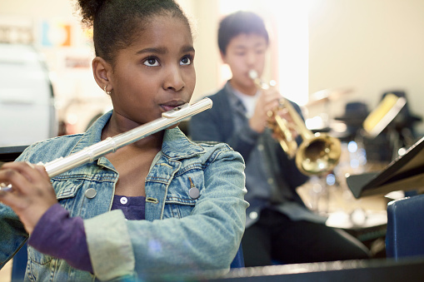
GCSE Music
Performance 30%
Composing 30%
Listening and Appraising 40%
Coursework

Slide 2

Should I choose Music?
Why choose Music?
Creative subject
An opportunity to express yourself and have control of your learning.
Group and independent work
Small class size so a lovely classroom dynamic and lots of 1-2-1 support.
Explore and learn about a variety of different types of music in greater depth than Key Stage 3.
If you enjoy Music lessons
If you enjoy making music in your free time.
If you would like to learn to play an instrument
If you can already play an instrument
If you take part in Choir or Orchestra or a music group outside of school.

Slide 3



Performing 30%
Composing 30%
Listening 40%
Record a solo and group piece on any instrument.
Create your own music in any style for any instruments.
Answer questions about musical extracts.
One exam lasting 1h15 in June of Y11
Completed by March of Y11
Completed by March of Y11

