Slide 1


Bring Your Parents to School Day
Maths: Number Workshop
Friday 2nd February 2024

Slide 2
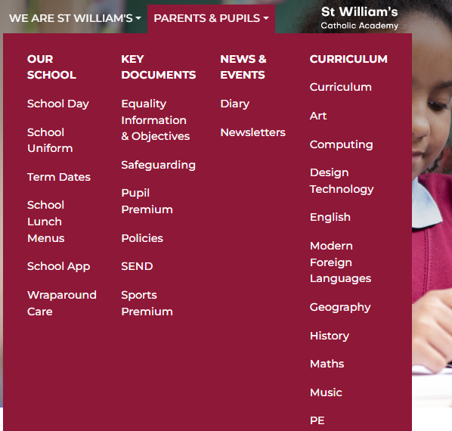
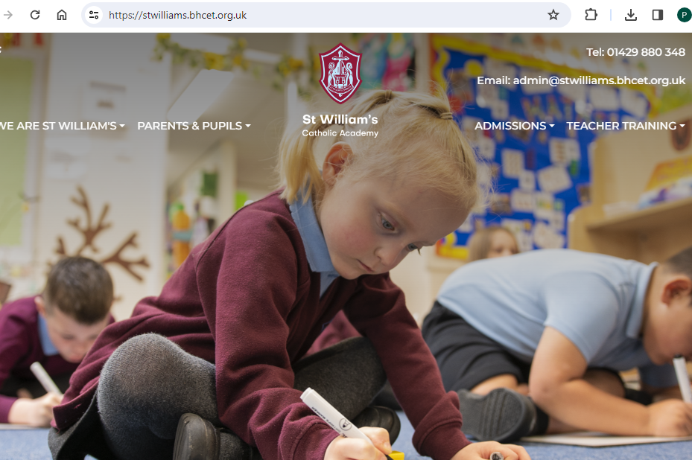

Information you will find on our website:

Slide 3

Important documents on the website
Calculation Policy
Progression Documents & Assessment information
Information regarding White Rose Maths (small steps)

Slide 4


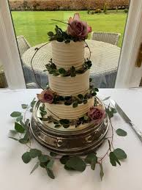
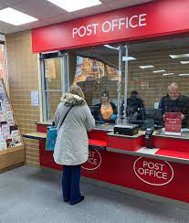
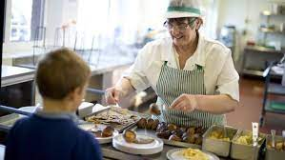
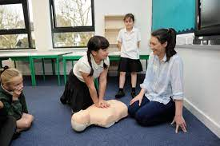
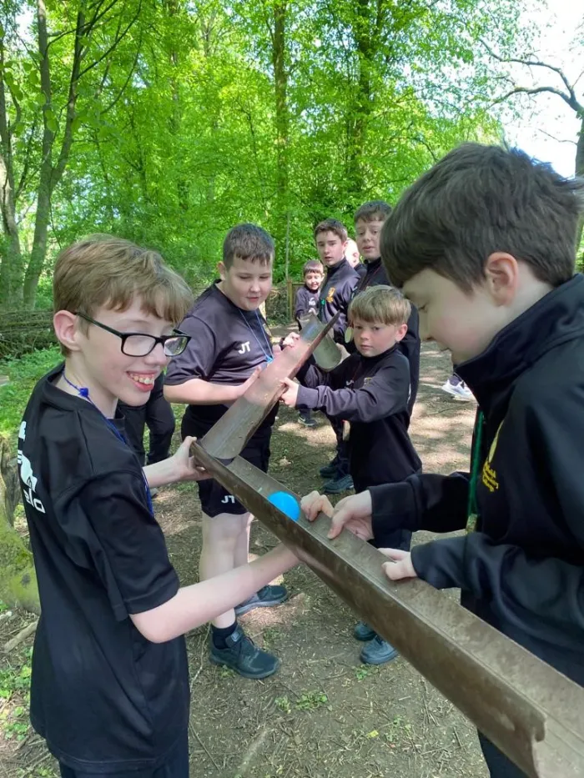
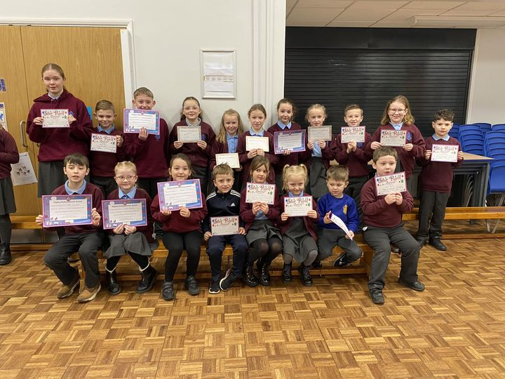

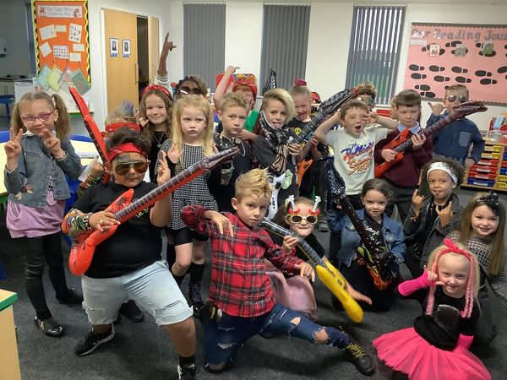
How we use extra-curricula opportunities To make maths real and exciting…
Theme Days – like ‘Who needs numbers anyway?’ Day
Transition
Competition:
Atom Bank
STEM
Carmel Shield
Educational Visits:
Problem solving
Rockstar club
Magical Maths Awards
Rockstar Days / Competitions

Slide 5
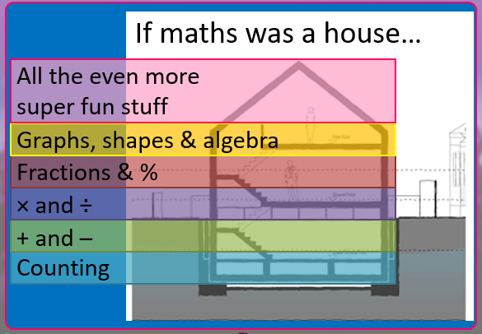
Why Number Day?
Number, including
counting and multiplication tables, are the foundations of maths.
We believe if you master the basics - the rest becomes much easier!
(We will also be supporting
The NSPCC campaign today)
Slide taken from Times Table Rock stars Presentation

Slide 6




What resources are available at home:
Numbots
Times Tables Rockstars
SuperMovers (BBC Teach)
Maths Shed
In School Only
Learning By Questions / SATs BootCamp
For more practical number ideas, Oxford Owl website is an excellent starting point!

Slide 7
Practical ideas on how can you help at home:
Reception into Y1
1. Building with bricks
How many red bricks are there? How many blue bricks are there? How many are there altogether?
Using blocks will also help your child practise using the language of maths. For example:
Hmm, I wonder which is the longest brick? Could you pass me the cube over there?
2. Count everything!
Practising counting on trips – this will help them with all sorts of number problems they encounter as they get older.
How many buses have we seen?
3. Spot patterns:
Look for repeating patterns on curtains, wallpaper, or clothing. Ask your child:
Can you see a pattern? Tell me about it. What will come next?
Start patterns with blocks, beads, playing cards, and toys. Encourage your child to build on the pattern to make it longer
4. Practise forming numerals
You could have fun forming numbers in sand with a stick, or making numbers out of modelling clay.

Slide 8
Practical Ideas on how can you help at home:
Key Stage 1
Count objects around the house
2. Use toys
Explore fractions for example with teddies. Ask your child to halve their toys by splitting them into two equal groups
3. Partition numbers
Partitioning means to break numbers into parts. How many different ways can you split 34?
4. Tell stories
Make up addition and subtraction stories together.
For example: Two dogs, three pigs and a rabbit are on the farm. How many animals are there altogether?
5. Play shops
To help your child get used to the value of different coins and notes, use real money

Slide 9
Practical Ideas on how can you help at home:
Key Stage 2
Times Tables Games and Songs
Cut your food into fractions eg. Discuss the slices of a pizza or cake made
Look for large numbers
Talk about large numbers in the real world, such as house prices, electricity meter readings or football transfer values
Rewrite the recipe book
Cooking is a great way to explore ratio and proportion
Play Battleship games
Play Battleships by drawing ships on coordinate grids
Hit the sales
Sales in shops, catalogues or online are great for working with percentages.

Slide 10
So, What You might SEE in classrooms today?
A huge focus on number – we’re celebrating number day!
Use of manipulatives (practical maths apparatus such as multilink cubes, counters and bead strings that children can pick up and manipulate) This helps children to understand the relationship between numbers and the number system
An opportunity to see resources being used – many of which you could use at home too!
Practical activities and a whole lot of fun

