Slide 1
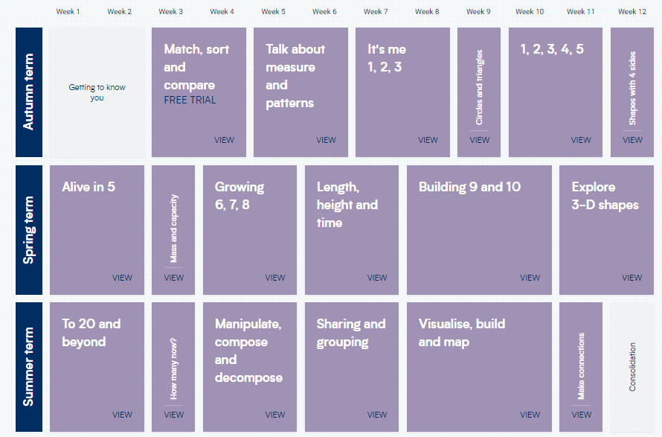
We are embedding
White Rose Maths
into Nursery and
Reception. Small steps will
be published as the
year develops.
This document outlines
the teaching blocks that
will be covered.

