Slide 1




Marking and Feedback Policy (2021)
Commitment Kindness Excellence
Stakesby Primary Academy
Effective feedback is a thoughtful dialogue between student and teacher.
Purpose
For effective feedback to function formatively, the results have to be used to adjust teaching and learning.
All feedback should focus on particular strengths and improvements the individual could make, inline with a specific learning objective, never making explicit comparisons with other children.
There should be opportunities for children to express their understanding of the feedback received planned in to all teaching sessions – this will promote dialogue.
The dialogue between our children and staff should be thoughtful, reflective and focused to evoke and explore understanding – promoting positive steps towards improvement and excellence.
A combination of written (shorthand) and verbal feedback (live) is most effective and are mutually supportive.
Feedback is one of the most powerful influences on learning and achieving excellence, but this impact can be either positive or negative dependent on the quality and regularity of this feedback.
As such, we must ensure our feedback is something the children are learning from.
We must clarify the purpose and expected outcomes of the tasks we design for our children. Followed up promptly with specific, clear and constructive feedback, and the chance to use that feedback to improve their own work.
It is the quality of your feedback rather that its existence or absence that determines its power.
Outcomes of Marking & Feedback
Accurate assessment of pupils’ responses to learning objectives.
Actionable responses which progress children’s learning.
Acknowledging and valuing children's efforts, celebrating excellence.
Providing a platform for teacher → child dialogue.
Timely verbal feedback which impacts learning within a session.
“I enjoy spending time to make sure my work is always excellent!”

Slide 2



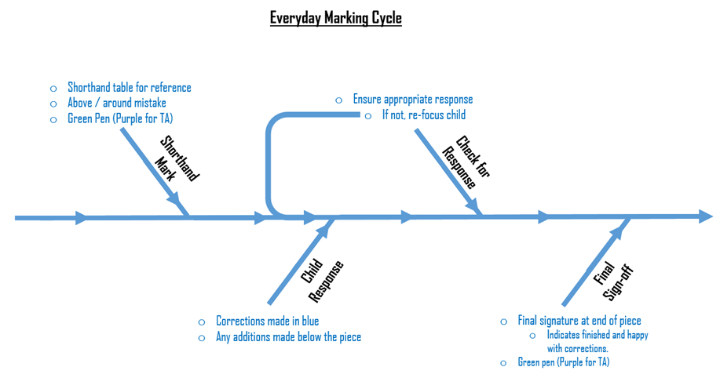
Marking and Feedback Policy (2021)
Commitment Kindness Excellence
Stakesby Primary Academy
Effective feedback is a thoughtful dialogue between student and teacher.
Formats of Learning
Working with an adult as part of a guided group(s) within a lesson. These groups may change during a lesson.
Working independently of an adult (solo, paired or in groups).
Working with support staff alongside teacher led input (solo, paired or in a group).
Stick Man Indicators
When working with a teacher, a green stick man is used. When working with a teaching assistant, a purple stick man is used. This is recorded in the top margin box, if the whole piece is completed with a teacher or teaching assistant.
If a teacher or teaching assistant must intervene, the green or purple stick man is drawn in the margin at the point of intervention. When the support ceases, their initials will be recorded in the margin to denote that independent working has commenced.
.
No stick man indicates that the work has been completed independently.
Daily Marking Criteria
The following 4-step cycle should be followed daily for all marking and feedback of children’s work.
Appendix 4:
Shorthand Mark: Reference shorthand table for specific notations to demarcate improvements in work. This shorthand should be recorded above or around the mistake (specified in the table) in green pen for teachers or purple pen for teaching assistant or other support staff.
“I enjoy spending time to make sure my work is always excellent!”

Slide 3
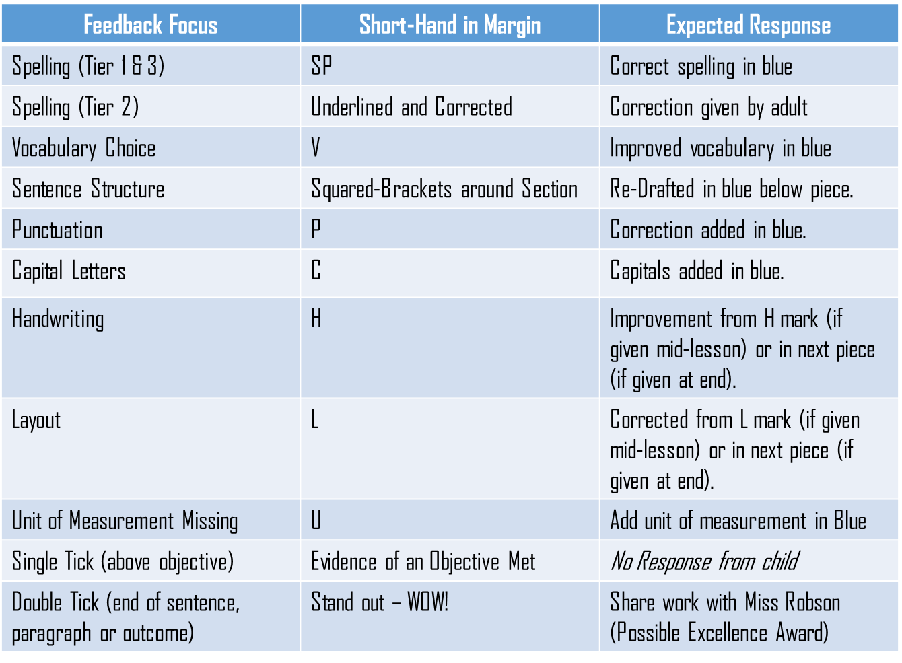


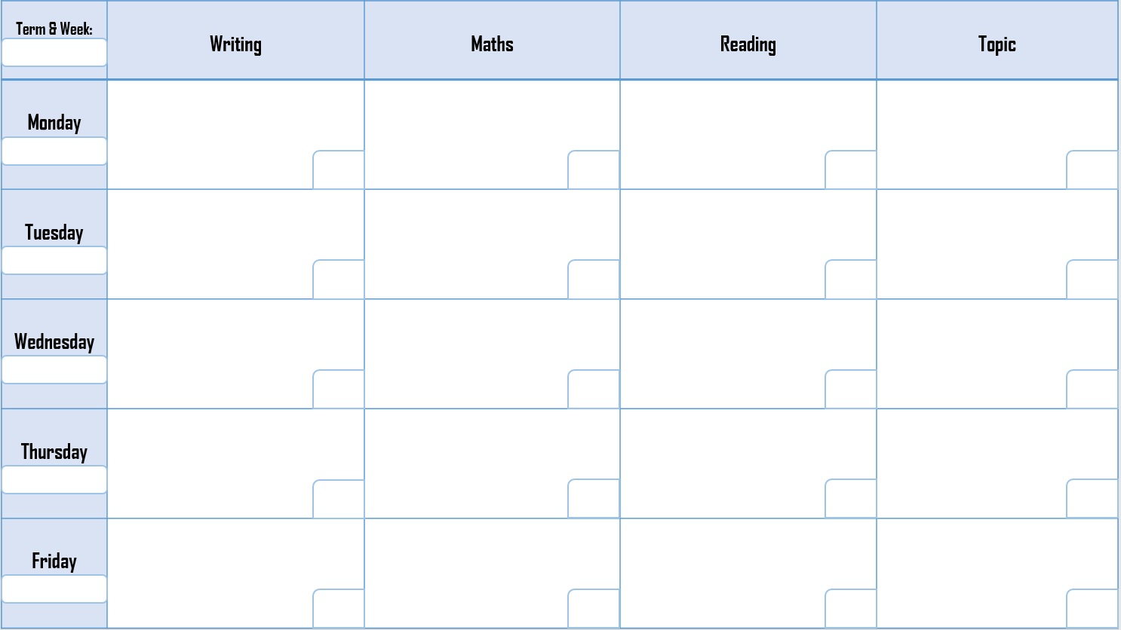
Marking and Feedback Policy (2021)
Commitment Kindness Excellence
Stakesby Primary Academy
Effective feedback is a thoughtful dialogue between student and teacher.
Child Response: all children should be given opportunity to respond to the feedback given. Child responses to feedback will be recorded in blue pen with any longer lengths additions recorded below the piece of work.
Check for Response: Teacher will check the response of every child is appropriate and corrections and/or additions have been made. If they have not, the teacher will direct the child to return to the child response stage and take appropriate action.
Final Sign-Off: Once the teacher is happy with the child’s response to their feedback. They will sign the work of with their initials, indicating that the piece of work is now complete. The final sign off will be in green pen for a teacher and purple pen if completed by a teacher assistant or other support staff.
Shorthand Marking and Feedback Table
A copy of this table should be stuck in to the front of all work books, on the back of the front cover. This gives easy access for reference when children are interpreting their feedback.
Appendix 2:
Distance Marking Sheet (DM)
Our distance marking sheet is a tool to focus subsequent teacher input and/or teaching assistant support given to individuals or groups.
They are a record of children who will require additional subsequent input in order to achieve a learning objective, over and above that provided through verbal and written feedback.
Appendix 3:
“I enjoy spending time to make sure my work is always excellent!”

Slide 4

Marking and Feedback Policy (2021)
Commitment Kindness Excellence
Stakesby Primary Academy
Effective feedback is a thoughtful dialogue between student and teacher.
These sheets should be shared with all adults working within the class, keeping everyone informed and directed. You should keep a date ordered record of these sheets in a file, which can be reviewed by subject leaders as part of an enquiry and by SLT.
Ensure you pay attention to any patterns that emerge across these DM sheets, informing SLT and our SENDCo of any concerns you have if a problem persists past regular additional intervention.
Keep the format of these sheets clear, simple and specific:
Date each sheet with the term and week number in the top left corner.
Date each feedback box with the day’s date.
Within each box, note the initial of any children who require subsequent additional support alongside a brief indication of the area in which they require further support.
Then initial each box with the member of staff who will subsequently support those children.
Improvement Cycle of Written Outcomes
There are key outcomes planned at regular intervals throughout our writing curriculum. These outcomes are an opportunity for children to produce writing which is an embodiment of their excellence.
In order to support children in reaching excellence, these outcomes progress through a specific improvement cycle. This comes after the outcome has been marked in line with the daily marking cycle.
Stage 1 – SPaG: children will correct spelling, punctuation and grammar in line with feedback given by their teacher. This may be completed independently or with peers. If there are children requiring specific support, this will be done with support of a teacher or TA.
Stage 2 – Outcome Key Features: In this stage, children will develop their outcomes in line with the specific features of the outcome, making sure they are first included and then if they have been implemented correctly with sufficient evidence.
“I enjoy spending time to make sure my work is always excellent!”

Slide 5


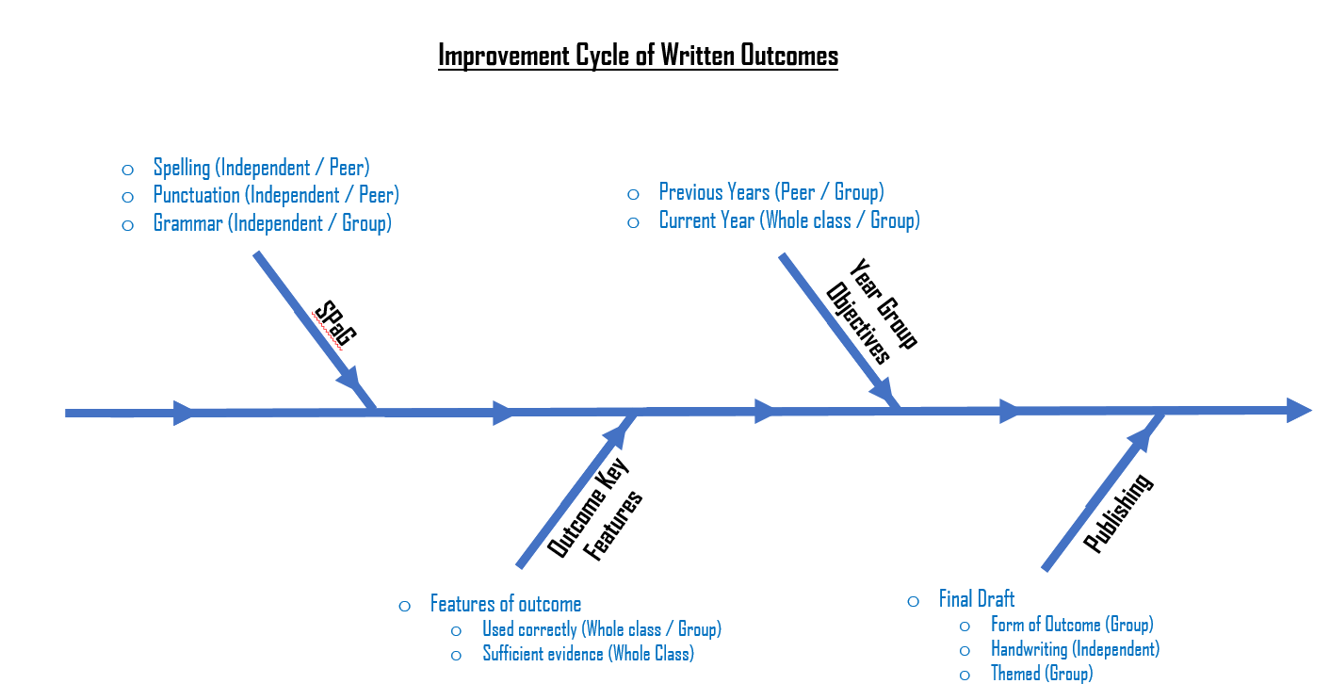
Marking and Feedback Policy (2021)
Commitment Kindness Excellence
Stakesby Primary Academy
Effective feedback is a thoughtful dialogue between student and teacher.
Stage 3 – Year Group Objectives: in their stage, children will ensure they have accurately included and used features of their year group expectations. This may have to be completed in groups with support or as a whole class if the majority of children require support.
Stage 4 – Publishing: in this stage the children produce their final draft of their outcome. Decisions should be made by the teacher to ensure the form of the outcome and the theme are appropriate to the text type and content. Children should be given enough time to produce their best handwriting and finish with an excellent outcome, ready to share and display.
Appendix 1:
Digital Learning Feedback
When providing feedback during digital learning, we use a desktop application called snip & sketch. This allows teachers to snip work from their Teams pages and apply our usual marking policy in an online setting. Verbal feedback will be given as part of online learning sessions. DM sheets will still be used to keep track, where children may receive subsequent support using break out rooms.
Verbal Feedback
Verbal feedback should be given to children throughout all learning sessions. It should be specific and progress children towards achieving excellence in line with learning objectives (WALT).
“I enjoy spending time to make sure my work is always excellent!”

Slide 6
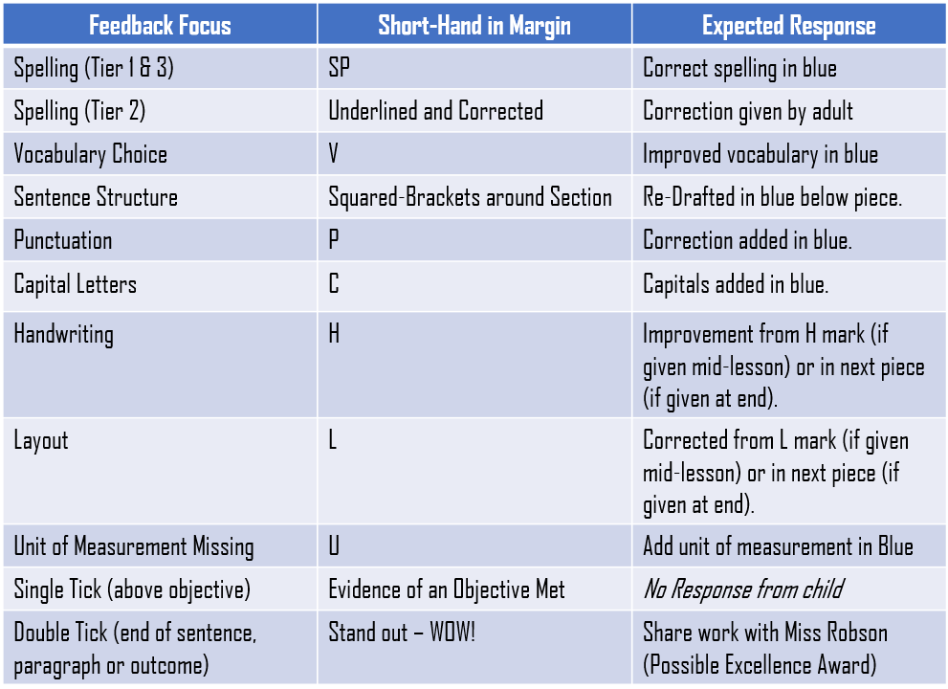
Marking and Feedback Policy (2021)
Commitment Kindness Excellence
Stakesby Primary Academy
Effective feedback is a thoughtful dialogue between student and teacher.
Appendix 1:
Appendix 2:
“I enjoy spending time to make sure my work is always excellent!”

Slide 7

Marking and Feedback Policy (2021)
Commitment Kindness Excellence
Stakesby Primary Academy
Effective feedback is a thoughtful dialogue between student and teacher.
Appendix 3:
Appendix 4:
“I enjoy spending time to make sure my work is always excellent!”

