Slide 1
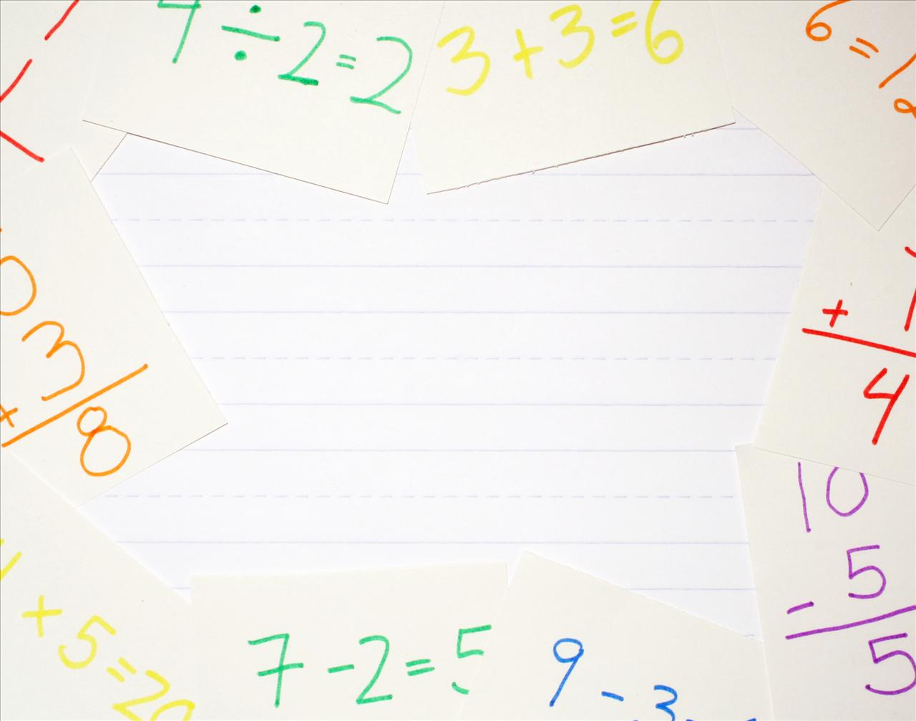
Maths Parent Workshop
October 2013
Stakesby Community Primary School

Slide 2
What would you like to get out of today’s session?
Notes:
Gather ideas for the session – Are parents there for the same reasons we hope the session will cover? What else do they need support in? Can it be addressed this session?

Slide 3
Aims of today:
To make everyone aware of the methods used for addition, subtraction, multiplication and division in school.
To offer/discuss a range of ways to help your child at home.
Identify any other areas we can offer you support in.

Slide 4
Calculation Strategies
“The Four Operations” – addition, subtraction, division and multiplication
A progressive approach across the school.
Children are expected to apply their understanding of the strategies to a range of problems (word, money etc.)
Children will move through the strategies based on their own skill, not the year group they are in.
Notes:
Children taught simple skills that we develop across their time in the school.
Children are taught the calculation strategy based on their individual skill. It doesn’t mean that when they hit a particular year group they are certainly going to be taught that way. They may not be ready for it yet, they may already have covered it.

Slide 5
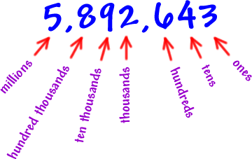
Place Value
In order to add, subtract, divide and multiply, children need to understand what each digit/number represents. This is called ‘place value’
Notes:
Go over the idea of place value and ensure everyone is happy with the concept.

Slide 6
Addition +
We may also say…
Altogether, Add, Combine,
Sum, Plus, Put with
Notes:
What methods are parents already using?

Slide 7
Addition +
Adding using concrete objects (counters, cubes, fingers)
Number sticks and Number lines
Partitioning (breaking a number up – using place value)
Column addition (“How we did it!”)
Notes:
What methods are parents already using?

Slide 8
Concrete objects
Adding single digits together may be completed by using ‘concrete/real’ objects.
2 + 5 =
To solve this you could use any objects at home (counters, cubes… even your fingers!)

Slide 9
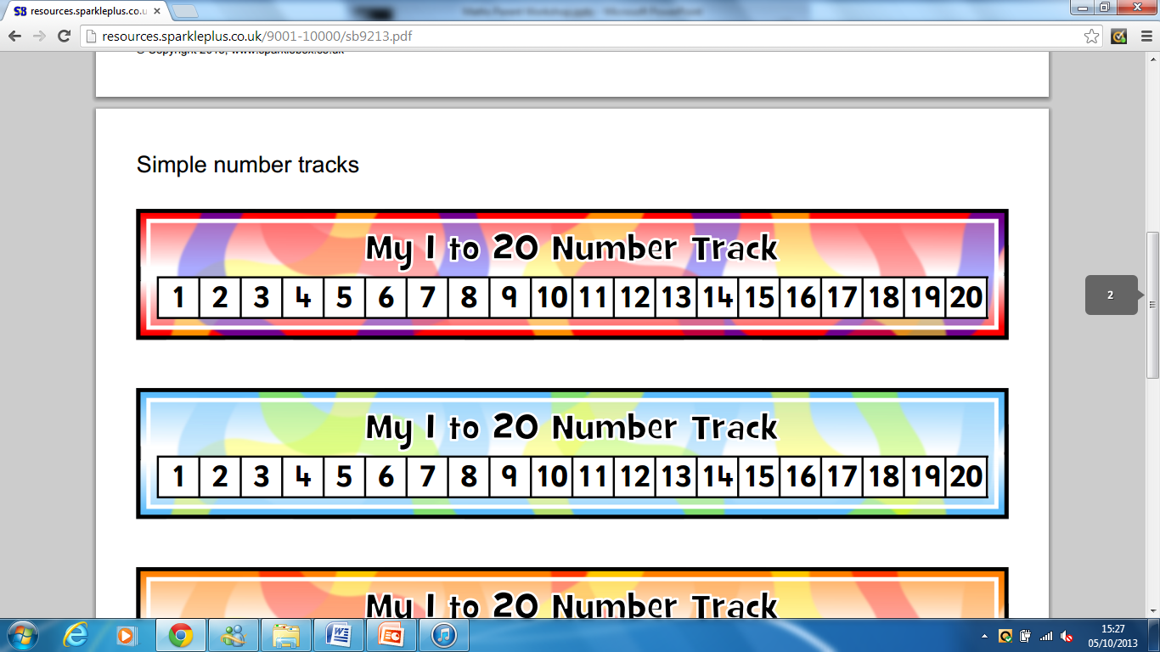
Number stick
A Number stick gives children an opportunity to visualise the order of numbers and begin to ‘count on’ – something that is explored further using a number line a little later on.
8 + 3 =
At home, your number stick could be a ruler.
Notes:
Demonstrate using the meter stick (with post it notes etc.)

Slide 10
Number line
A number line asks children to “jump up” to show their calculations.
48 + 36 =
+30
+6
48 78 84
Notes:
Demonstrate using the meter stick (with post it notes etc.)

Slide 11
How to use the number line… 48 + 36
First draw your number line, with the first number from your sum on the left hand side of the line.
You will now “jump up” the second number from your sum (in our example, 36) Breaking this number down into simpler chunks makes adding up easier. This means that rather than one jump of 36, children may choose to jump 30 and 6 or 10, 10, 10 and 6.
Once you have “jumped up”, children should check they have added the intended number. To find the answer of the sum, children will now record the number that they have “jumped up” to.
48
+10 +10 +10 +6
48 58 68 78 84
Notes:
Demonstrate using the meter stick (with post it notes etc.)

Slide 12
Partitioning
When partitioning, it is important that children can grasp the concept of place value and recognise what each digit shown actually represents.
When we partition, we break our numbers up so that we are only adding numbers with the same value (e.g. just adding the units, then only the tens etc.)

Slide 13
For example…
56 + 12 =
When partitioned becomes…
50 + 10 =
6 + 2 =
60
8
60 + 8 =

Slide 14
Your turn…
78 + 45 =
(Number line)
434 + 221 =
(Partitioning)

Slide 15
Column Method
This is the way I was taught!
Column method looks at adding vertically and
‘carrying over’. It is important to discuss with children
what they are carrying (place value, again!)
48
36
___
143
89
___
+
+
8
4
2
3
2
1
1
1

Slide 16
Subtraction -
We may also say…
Take away, Minus, Difference
Less than, Subtract
Notes:
What methods are parents already using?

Slide 17
Subtraction -
Subtracting using concrete objects (counters, cubes, fingers)
Number sticks and Number lines
Column subtraction (“How we did it!”)
Notes:
What methods are parents already using?

Slide 18
Concrete objects
Subtracting single digits together may be completed by using ‘concrete/real’ objects.
5 - 3 =
To solve this you could use any objects at home (counters, cubes… even your fingers!)

Slide 19
Number stick
As with addition, children can use a number stick to visualise numbers in relation to each other. Children can use the stick to count backwards when subtracting.
8 - 3 =
At home, your number stick could be a ruler.
Notes:
Demonstrate using the meter stick (with post it notes etc.)

Slide 20
Number line
When subtracting using a number line, children will count up from the lowest number of the sum up to the highest. Children will reach their answer by then adding up the jumps they have made – this is the difference between the two numbers.
38 – 17 =
+3
+10
+8
17 20 30 38
Notes:
Demonstrate using the meter stick (with post it notes etc.)

Slide 21
How to use the number line… 38 - 17
First draw your number line, with the smallest number on the left hand side of the line and the largest number on the right. You will then “jump” to find the difference.
Begin by jumping to reach “easy” numbers (those that end in a zero) Begin by jumping to the nearest ten, then hundred, then thousand and so on…
Once they have “jumped up”, children should check over their work. They will then add all of their jumps together. This shows the difference between the two numbers and is therefore the answer to the problem.
17 38
+3
+10
+8
17 38
20
30
Notes:
Demonstrate using the meter stick (with post it notes etc.)

Slide 22
Column Method
This is the way I was taught!
Column method looks at subtracting vertically
and ‘borrowing’. It is important to discuss with children
what they are borrowing (place value, again!)
3
/
1
48
36
___
343
229
___
-
-
1
2
1
1
4

Slide 23
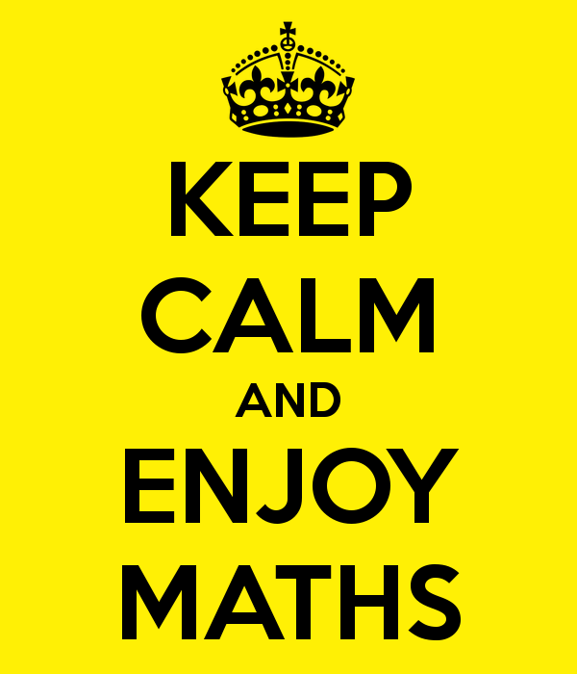
Time to have a go…

Slide 24
Multiplication x
We may also say…
Multiply, Times, Product,
Groups of, Lots of
Learn your times tables!!
Notes:
What methods are parents already using?

Slide 25
Multiplication x
Repeated addition / “Lots of…”
Grid method
Notes:
What methods are parents already using?

Slide 26

Repeated Addition / How many “lots of…?”
5 x 3 =
This simple view of multiplication may be used for some children to introduce them to this operation.
Repeated addition:
5 x 3 =
5 + 5 + 5
How many in…
three lots of five?

Slide 27
Grid Method
Once again, the grid method relies on children understanding place value. The grid partitions numbers to allow children to multiply smaller chunks of a problem.
x
20
3
200
40
30
+6
276
10
200
30
2
40
6
23 x 12 = 276

Slide 28
How to use the grid method
Solving … 23 x 12 =
1. Begin by drawing a grid with your multiplication symbol in the top right corner.
2. Next, look at the number of digits in figures you have. You then need to draw the same number of rows/columns (e.g. a two digit number needs two columns)
3. Now partition your numbers, breaking them up and displaying them on your grid (e.g. 23 becomes 20 and 3)
4. Now multiply your numbers. Your answers should go in the space where your two numbers meet (for example, read across from 2 and down from 3. The space you meet in will show the answer to 2 x 3
x
20
3
200
40
30
+6
276
10
200
30
2
40
6
5. Now add all of your answers together. You’re done!
23 x 12 = 276

Slide 29
Your turn…
32 x 45 =
21 x 34 =
434 x 221 =

Slide 30
Division ÷
We may also say…
Divisible by, Divide,
Shared between, Groups
Notes:
What methods are parents already using?

Slide 31
Division ÷
Sharing / Grouping
Number line
“Bus Stop”
Notes:
What methods are parents already using?

Slide 32
Sharing and Grouping
15 ÷ 3 =
This simple view of division may be used for some children to introduce them to this operation.
Share 15 between 3:
Group 15 into 3 groups…

Slide 33
Number line
When dividing on a number line, children are working out how many of one number goes into another (with 81÷3, how many 3s are in 81) Rather than counting each, individual 3 in 81, a number line helps us to count groups of 3s. Your total number of groups shows how many 3s there will be in 81.
81 ÷ 3 = 27
KFC
1 x 3 = 3
10 x 3 = 30
5 x 3 = 15
x10
x10
x5
x2
0 30 60 75 81
Notes:
Demonstrate using the meter stick (with post it notes etc.)

Slide 34
Using a number line 81 ÷ 3 = 27
Always draw out your number line with 0 on the left and the first number of your problem (81) at the right hand side. You will be jumping from 0 to 81.
2. Now record your known facts (KFC) These will be about the number you are dividing by and will help you when solving your problem later. Begin by finding x10, x1 and x5. There may be other useful facts you could also record.
3. Using your known facts, begin the “jumping”. We start by jumping up 30. This is recorded on the number line. The jump will then be shown by writing x 10. This means 10 jumps. We do this rather than 10 small jumps of 3.
KFC
1 x 3 = 3
10 x 3 = 30
5 x 3 = 15
x10
x10
x5
x2
30
60
75
0 81
4. We continue our jumps in the same way as described. We continue, using our known facts, until we reach our target number.
5. The answer to the problem is found by adding the total number you’ve jumped. In this case we add 10 + 10 + 5 + 2 to find our answer of 27.
Notes:
Demonstrate using the meter stick (with post it notes etc.)

Slide 35
But, what about if we have a remainder?
Remainders are nothing to panic about. We would do exactly the same as what has previously been described until we get as close as possible to our target number. We do not go over it.
Imagine we were solving 83 ÷ 3. We would do the same process from the previous slide and hopefully reach 81. If I was to jump another 3 I would be going too far and go over the target of 83.
A jump of 2 is remaining. This is therefore our remainder.
x10
x10
x5
x2
0 30 60 75 81 83
So… 83 ÷ 3 = 27 r 2

Slide 36
The ‘Bus Stop’ method
This method is the traditional style (probably the one we were all taught at school!) Using the bus stop, we see how many of one number goes into another.
We work through our number (252) to see how many 7s go into each digit
0 3 6
7
2 5 2
2
4
Notes:
Demonstrate using the meter stick (with post it notes etc.)

Slide 37
How to do the bus stop
We begin by drawing our bus shelter with our largest number (252) underneath it. The smallest number goes on the outside (7)
Now work through the large number to see how many 7s go into each digit.
How many 7s are in 2?
0
3
6
7
2 5 2
2
4
As there are 0 7s in 2, carry the 2 over to make the question, How many 7s in 25?
Continue through this process.
Notes:
Demonstrate using the meter stick (with post it notes etc.)

Slide 38
Time to have a go…

Slide 39
How have we done?
To make everyone aware of the methods used for addition, subtraction, multiplication and division in school.
To offer/discuss a range of ways to help your child at home.
Identify any other areas we can support you further in.

Slide 40
Thank you!
www.stakesbyschool.net
(Supporting your child at home)
October 2013
Stakesby Community Primary School

