Slide 1
ACTIVE
Support and resources for Manchester schools

Slide 2
SUPPORTING YOU TO BE MORE ACTIVE
These anxious and unusual times bring unforeseen difficulties. With everyone spending a lot more time at home, it could have a significantly negative impact on Manchester’s physical, mental and emotional well-being. We don’t want that to happen.
It has therefore never been more important to provide trusted advice and guidance on the ‘what’ and the ‘how’ to support and encourage everyone to manage their well-being and move more.
Across Manchester, we’re promoting daily messages of support, inspiration, guidance and updates to the city around physical activity and moving more across our Facebook, Twitter & Instagram channels – tagging in #MCRactive.
If you don’t do so already, follow and connect with us and pass this message to anyone wanting to stay informed and supported.

Slide 3
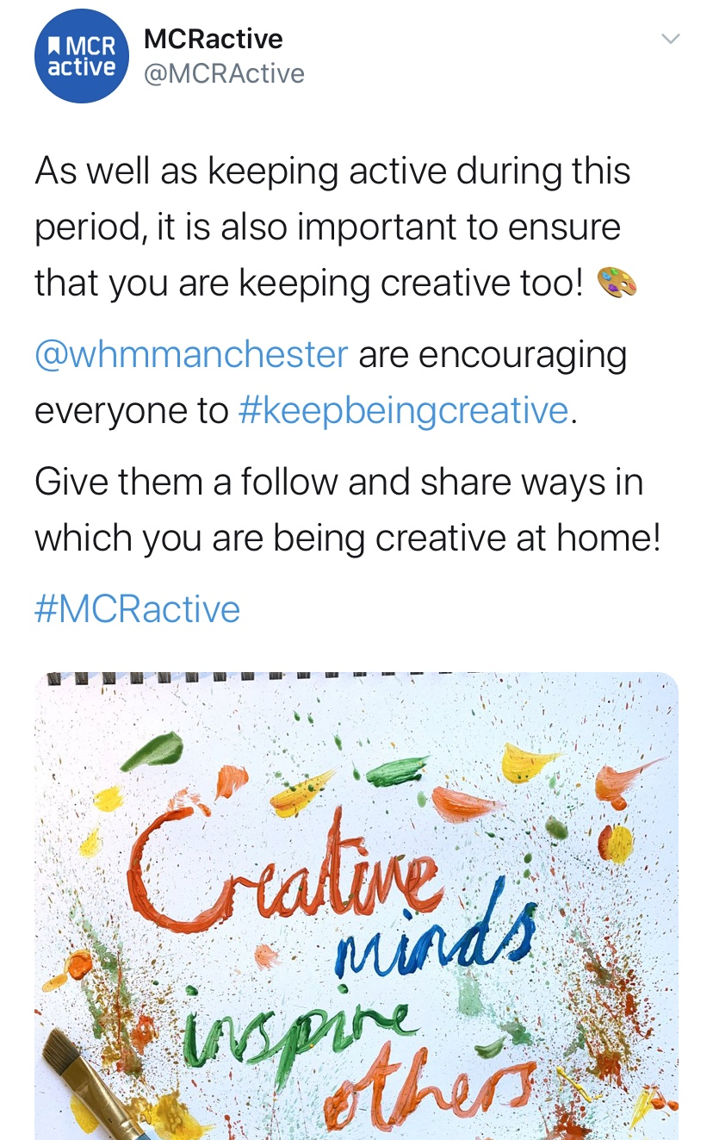
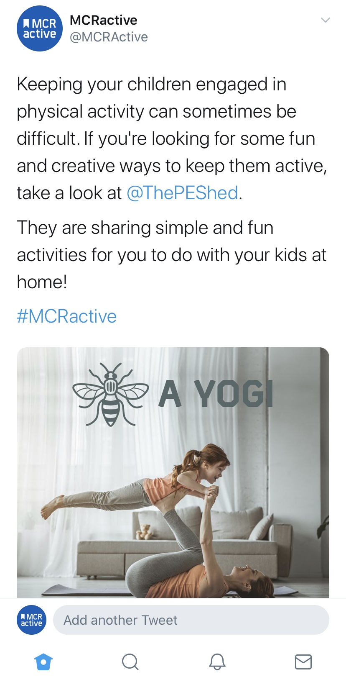
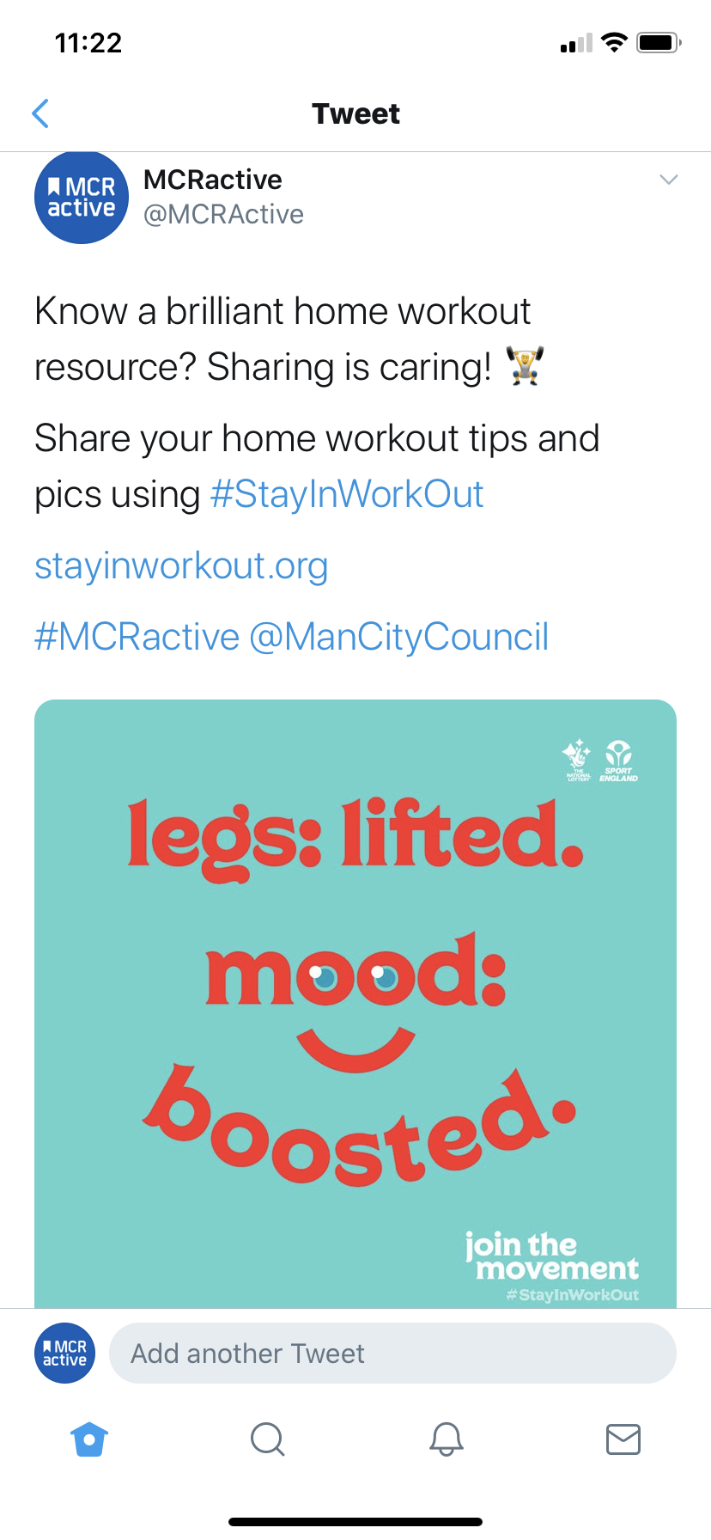
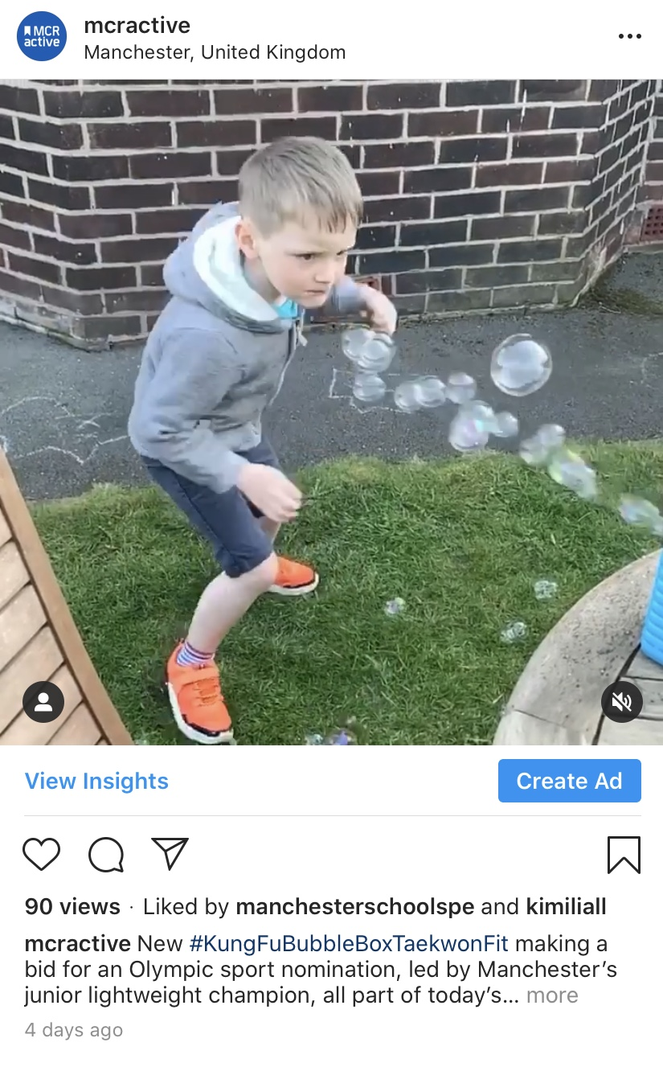
Social Messages

Slide 4
SHARE YOUR CONTENT
We’d also love to hear from you with the innovative ways on how Mancunians are being active to share with others.
If you have content to share – be that a short video, image, creative idea or message, MCRactive are happy to receive this either direct by sending to: info@mcractive.com or you can connect and share through their social channels.
Now, more than ever, is the time for us to be proactive around our levels of physical activity whilst recognising and sharing those small moments of happiness in our days.
Stay safe, move more when and where you can, widen and embrace your virtual social connections, and look after yourself and your loved ones.
We can do this!

Slide 5
YouTube Links
Along with the rest of the nation, we’ve been sharing and promoting the P.E session with the Body Coach
Morning P.E session - Joe Wicks LIVE active workout - https://www.youtube.com/user/thebodycoach1
CBeebies – Andy's Wild Workouts - https://www.youtube.com/watch?v=DqAOMrZkht0
Healthy Futures – Fun Games - https://www.youtube.com/channel/UC080YLDsIDdHBgYDYenP3Zg?view_as=subscriber
Please send on any other links or content you have found useful for sharing

Slide 6
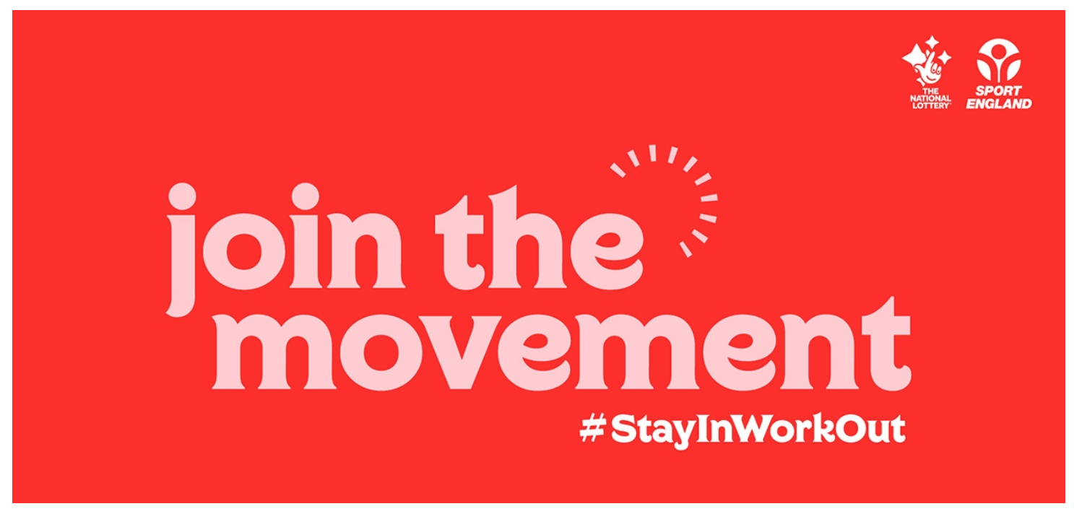
Sport England
Stay in, work out
Sport England have launched a tips, advice and guidance campaign on how to keep or get active in and around your home.
https://www.sportengland.org/stayinworkout
Join the Movement and use #StayInWorkOut to share how you're getting active during this time.
Keeping Active at Home - https://www.sportengland.org/news/how-stay-active-while-youre-home

Slide 7
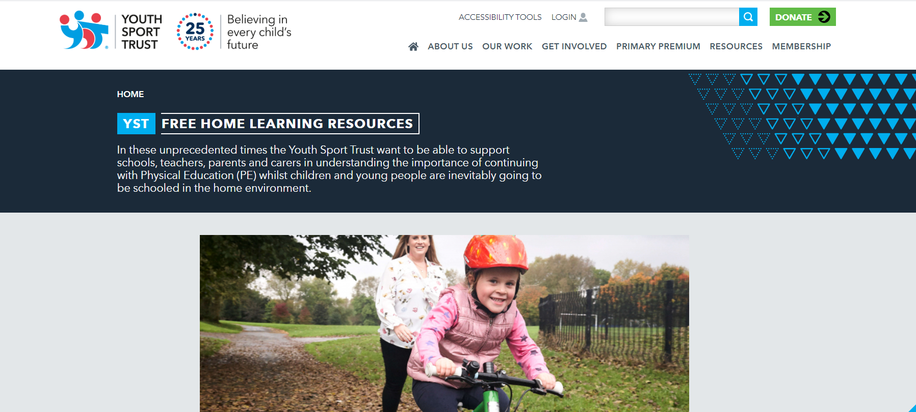
Youth Sport Trust
Free online learning & physical activity resources - https://www.youthsporttrust.org/free-home-learning-resources-0

Slide 8
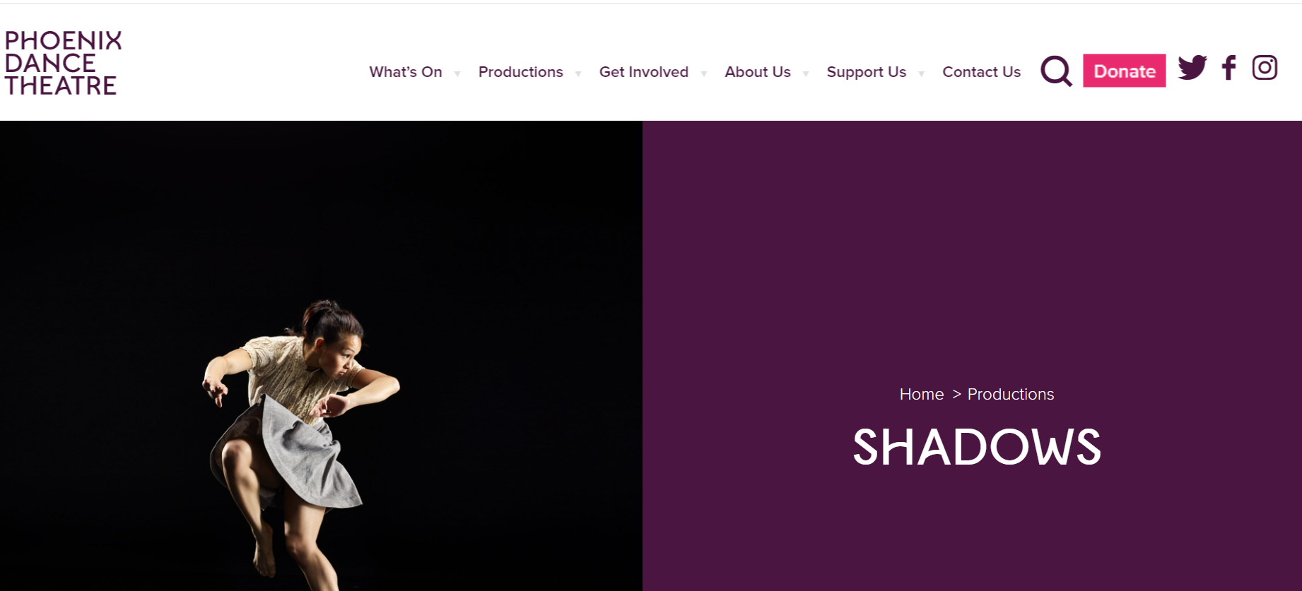
GCSE / BTEC / RSL Resources
Within Her Eyes - YouTube videos to support BTEC Component 1 - https://www.youtube.com/playlist?list=PLJehfcMUHPzri7jN_k-alBSqemEsi5w69
Emancipation of Expressionism - http://boyblueent.com/?page_id=16352
Shadows - https://www.phoenixdancetheatre.co.uk/production/shadows/
Infra –
https://learning-platform.roh.org.uk/unit/infra/%20Choreographer%20site%20https://waynemcgregor.com/

Slide 9
Facebook Links
Creative home school ideas - https://www.facebook.com/Bound-2B-Theatre-312773288759883/
Please send on any other links or content you have found useful for sharing

Slide 10
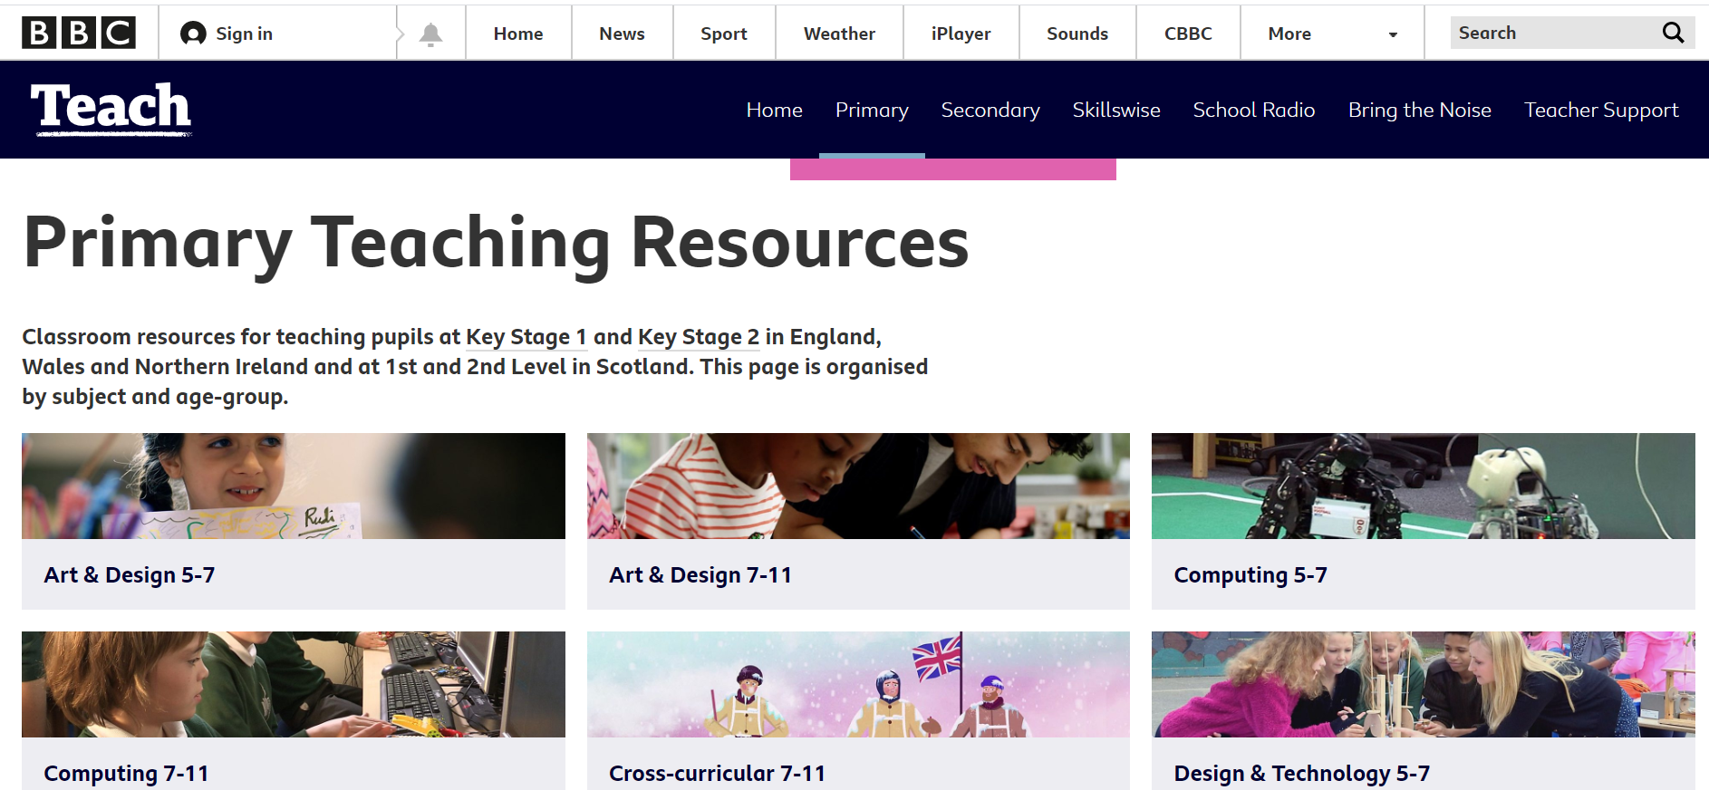
BBC Teach
All kinds of resources for teaching various subjects, including P.E for pupils at Key Stage 1 and Key Stage 2 - https://www.bbc.co.uk/teach/primary/zd7p47h
Physical Education KS2: Street dance - https://www.bbc.co.uk/teach/class-clips-video/physical-education-ks1-ks2-street-dance-masterclass-on-b-boying-and-footwork/zkmf47h

Slide 11
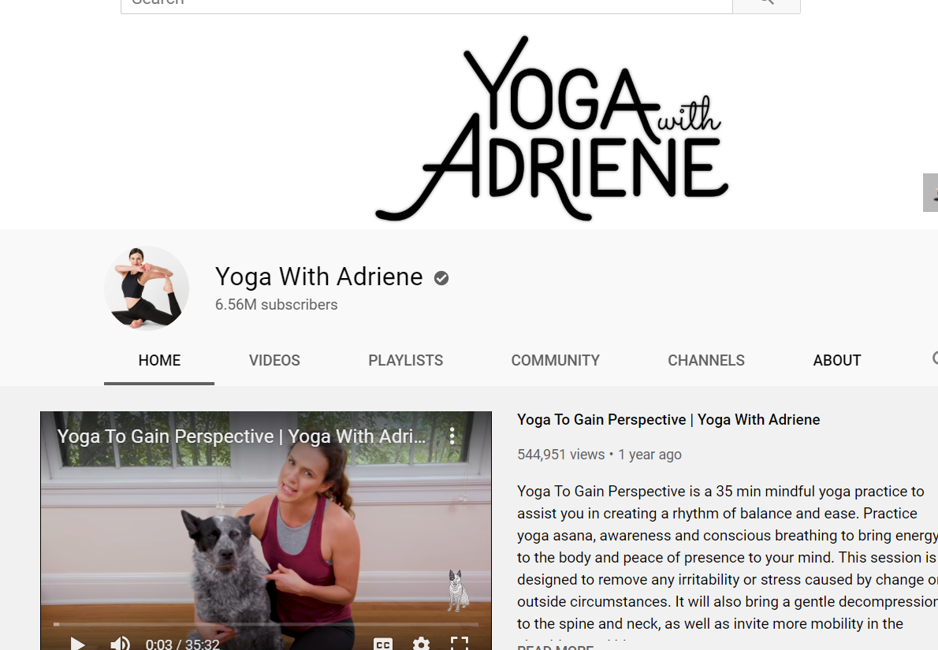
School Dance
Online Resource with Youtube links to various dance & wellbeing tutorials - https://t.co/syfeV55RuL?ssr=true
11 + dance strength and conditioning program - https://www.strengthmotionmind.com/11-dance
Yoga & Dance at home - https://www.youtube.com/channel/UC_LDd2BYU5TwJGcBw3gbStA/videos
Online Gaga Classes - https://www.youtube.com/channel/UC_LDd2BYU5TwJGcBw3gbStA/videos
Online Yoga classes - https://www.youtube.com/user/yogawithadriene

Slide 12
Healthy Futures
Food and activity log plus daily exercise videos - https://healthyfutures.us4.list-manage.com/subscribe?u=35a57192e9ec6a559eaaa6cf9&id=492f01d6de

Slide 13
British Cycling
Ready Set Ride – lots of videos available to share and free app for parents etc to teach children to ride their bike through games and fun activities.
www.readysetride.co.uk
Go-Ride – our North West Go-Ride team are publishing regular videos on their Facebook page aimed at cyclists but many are accessible to everyone too. @John Wych (copied in) will be able to provide more details of their content.
https://www.facebook.com/NorthWestGoRide/
We also have our set of Commute Smart videos that can be shared
https://www.britishcycling.org.uk/commuting
And some bike maintenance videos too
https://www.britishcycling.org.uk/knowledge/bike-kit/maintenance

Slide 14
Thank-you
Nathan Kirwan
Active Schools Program Lead
n.kirwan@mcractive.com
+44 0161 974 7841
MCRactive
Head office: c/o National Squash Centre & Regional Arena,
Etihad Campus, Gate 13, Rowsley Street, Manchester M11 3FF.
Office: 0161 223 2244 Email: info@mcractive.com
Company Registration no. 03747112 Registered Address - PO Box 532, Town Hall, Manchester M60 2LA

