Slide 1
Facts About Big Cat's
By Lola

Slide 2
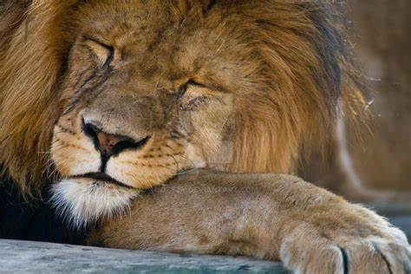
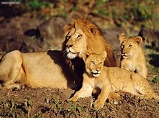
Lions
Did you know That lions sleep for 20 hours a day?
When a Lion walks on its heels, they do not touch the ground . Whenever a Lion is called "King Of The Jungle" it really doesn't live in a jungle it actually lives in a Savanna . This type of big cat can run short distances of around 50 mph. The lion is a carnivore and will go hunting anywhere as long as it's near the lion pack or near the watering hole .

Slide 3
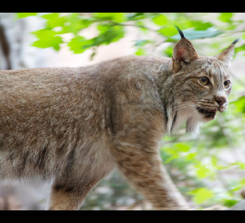
Lynx
Lynx is a type of cat breed and comes from the Greek word leukosis meaning bright. Lynx breeds are the Eurasian-Lynx they live around the North side of Europe also Western Siberia . Iberian/Spanish Lynx. This Lynx breed lives in Spain and also Portugal. Iberian Lynx are actually listed as an endangered species and there are around 156 left in the wild. This is because of the lack of food . Canada/American Lynx lives in Canada or America.
Did you know that there are 4 types of lynx breeds?

Slide 4
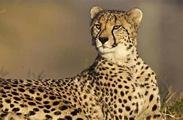
cheetah
Did you know that when Cheetahs are running at max speed they travel over 20 feet?
Cheetahs are the smallest big cat throughout the world. This big cat can see prey from at least 3 miles away! Cheetah cubs weigh about 3.2kg when they are born. Cheetah cubs are also born blind but after 12 days they are not blind anymore. When the cubs are born, they are born with manes which might confuse predators.

Slide 5
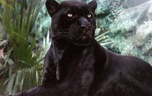
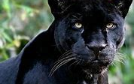
Panther
Did you know that Panthers are excellent swimmers and sometimes dive in to have a dip or relax?
Black Panthers may look all black (pitch black) from a distance but when you look closer there are leopard print or maybe spots on their body. Panthers have a keen sense of hearing with jaws that take a serious bite. This big cat can leap up to 20 feet.

Slide 6
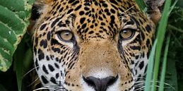
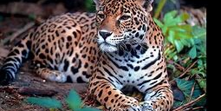
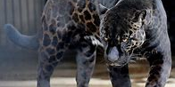
Jaguar
Did you know that Black Jaguars have Jaguar print sometimes called Panther but they are not a Panther?
Jaguars lounge all day but hunt at night. Jaguars love to swim in rivers and lakes and wave their tails over water to attract fish. This big cats native South American word for Jaguar is "Yaguara".

Slide 7
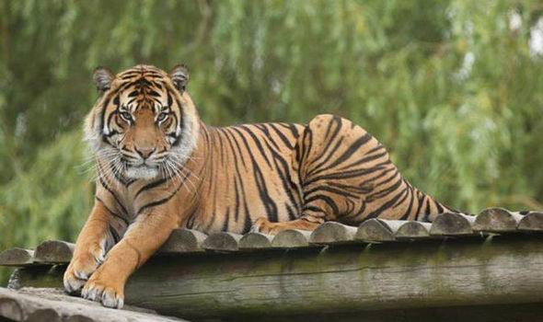
tiger
Did you know that Tigers like to go to a lagoon to have a dip or to bathe?
Tigers are capable of eating around 5 kilograms of food a day. This big cat is the biggest of the cat species and is a member of the genus Panthera.

Slide 8
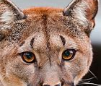
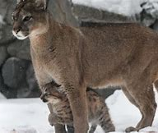
puma
Pumas are mainly a tan colour and can also be up to 9 feet long but average length is 6 –8 feet .
This big cat’s head is round and its ears are erect. Pumas have five retractable claws on its fore-paws.
Did you know that female Pumas weigh around 29-90kg but the males are much more larger?

Slide 9
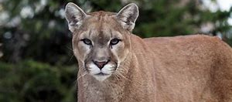
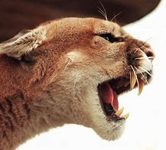
Cougar
Did you know that cougars were considered to be of the genus Felis (Felis Concolor)?
Cougars are the largest amongst small cats and also it is from the sub family felinae however, it behaves much like big cats from the sub family just like the cheetah. Cougars range from the Canadian Yukon to the southern Andes in south America .

Slide 10
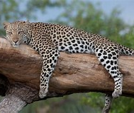
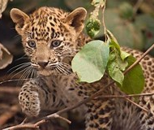
Leopard
Leopards hunt during the night but mostly lounge in the daytime. This big cat can also carry heavy animals and can run 36 miles per hour and jump around 10 feet high.
Leopards eat monkeys, deer, wild pigs, fish, birds, lizards and porcupines .
Did you know that Leopards take their prey up into the trees so that it is safe?

