Slide 1
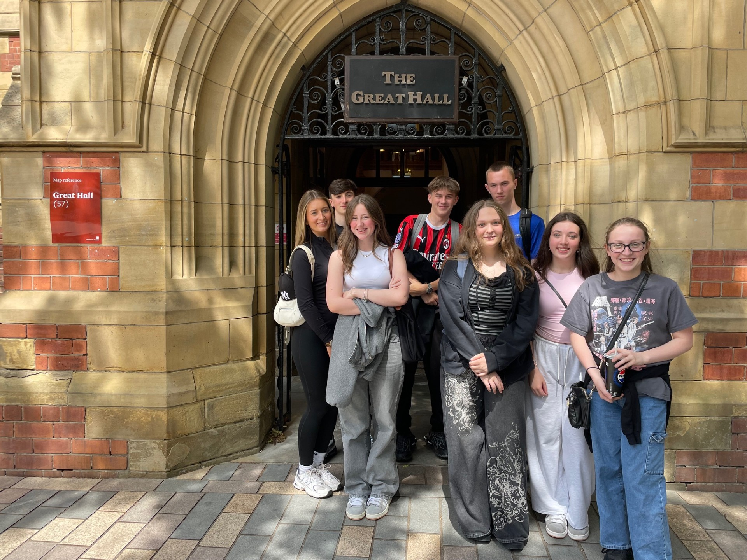
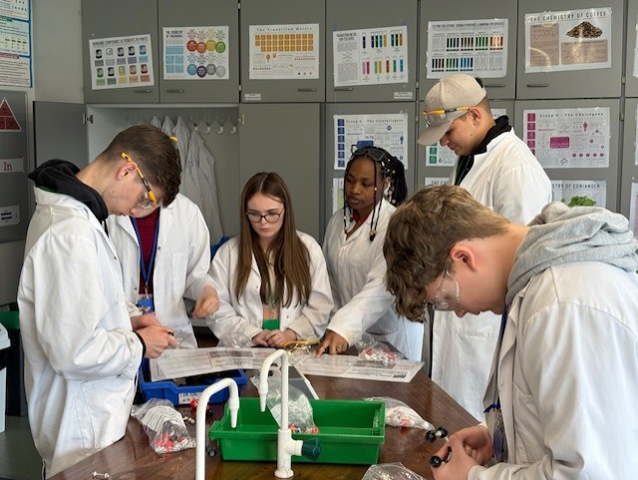
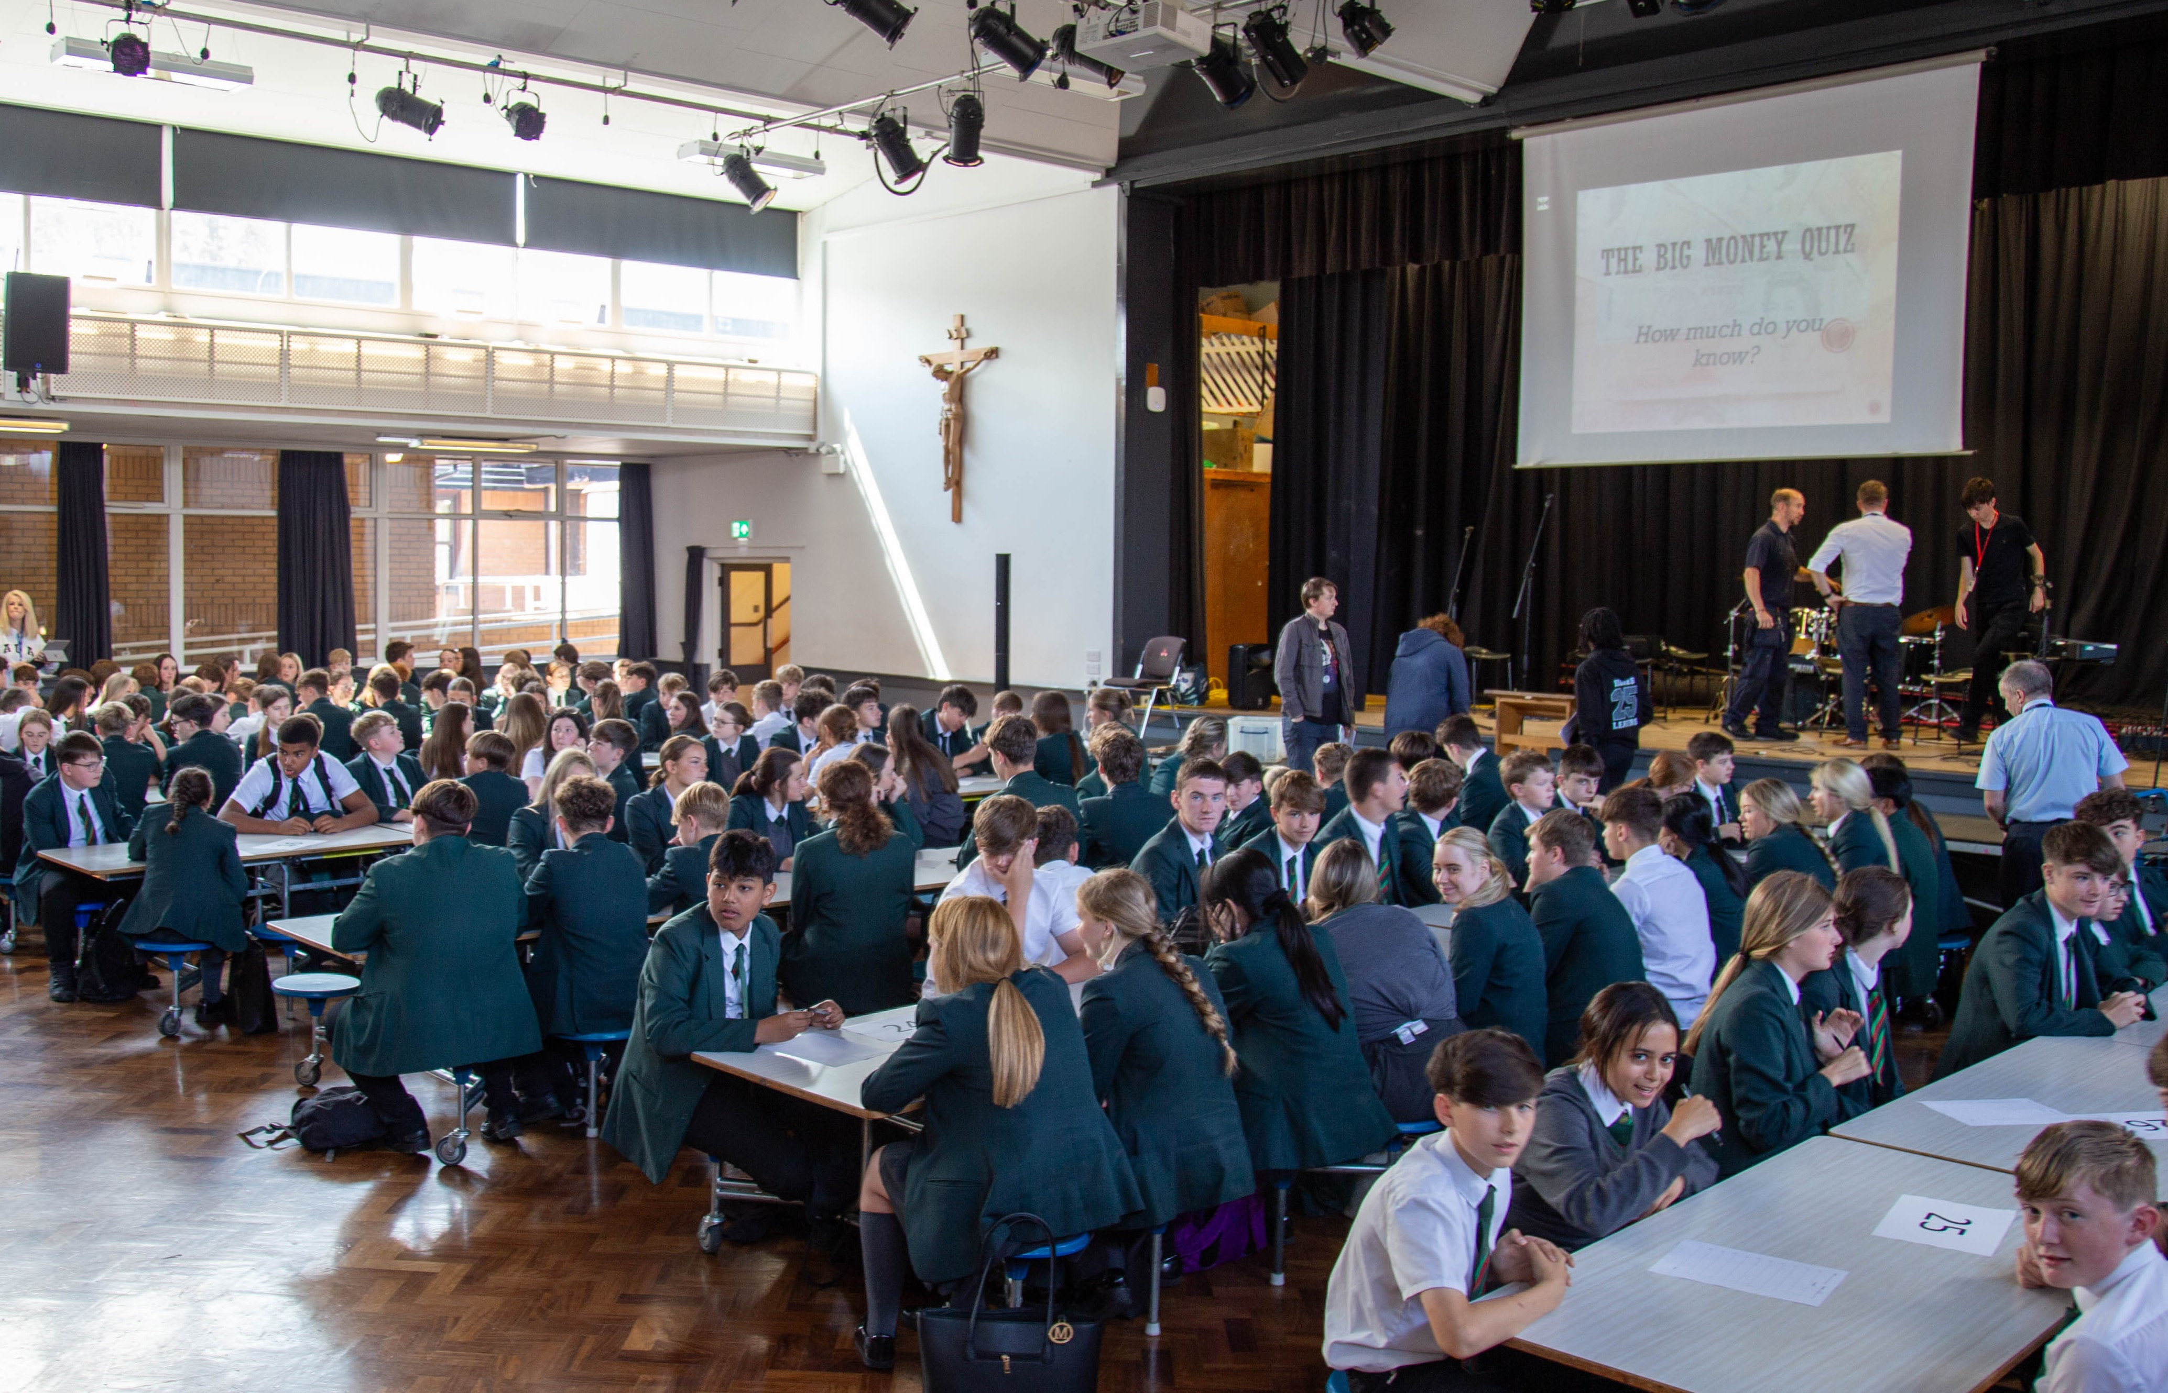
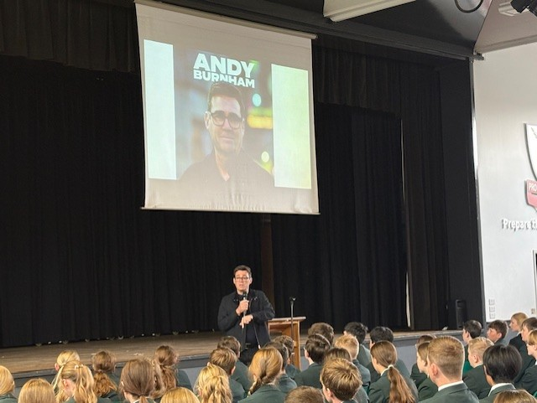
PERSONAL DEVELOPMENT CURRICULUM
ST EDMUND ARROWSMITH CATHOLIC HIGH SCHOOL
AUTUMN TERM 2025
The Personal Development Curriculum aims to reinforce and develop positive attitudes and values in students and thereby enhance their Spiritual, Moral, Social and Cultural development.
Highlights from the Summer Term
Key Dates – PDC Events
September
Y10 Careers Progress Questionnaire
Y7-9 Citizenship in RE (Community/Vocation/Messiah)
Y10, 11 & SEND Careers Fair
School Council Assemblies & Elections
Y11 RSE (in Core PE)
Y11 Choosing Options Post 16 (Pathways)
Year & Whole School Council Elections
Y11 Completion of CVs & Personal Statements
Y7 Future Skills Questionnaire
October
Extended Pastoral Curriculum 1
Year & Whole School Council Meetings
Y11 Guidance Evenings (Post 16 Providers attending)
Y11 Interview Preparation
Y10 Workplace Experience Launch
Y8 Fire Safety
Y7 & 8 Citizenship in History (How is Britain Governed/How to become an MP)
Y7 Citizenship in Geography (Designing a sustainable settlement)
November
Y11 Mock Interview Day
Y7 Anti-bullying, performance of HOPE
Extended Pastoral Curriculum 2
December
Y7-9 Citizenship in Geography
Y9 Options – Introduction to Future Pathways
Extended Pastoral Curriculum 3
Y9 Citizenship in History (What kinds of governments exist in the world?)
Y7 Citizenship in Geography (Global Citizenship Development)
Y11 Future Skills Questionnaire
Year 10 students visited the University of Leeds for an inspiring and eye-opening experience that offered them a real taste of university life, from exploring the campus and facilities to speaking with current students. The trip boosted their confidence and aspirations, helping many envision higher education as a real possibility for their future.
Year 10 pupils recently enjoyed a taster day at St John Rigby College, where they explored a wide range of subjects, engaged with specialist staff, and experienced the college’s dynamic learning environment. The visit helped them gain valuable insight into post-16 education, easing anxieties and supporting future decision-making.
Year 9 students developed essential money management and financial capability skills during a week of dedicated maths lessons focused on real-life budgeting, saving, and spending. The week concluded with an engaging money quiz, allowing pupils to consolidate their learning in a fun and interactive way.
Year 8 students participated in presentations from professionals in sectors such as government and politics, architecture, cyber security, and medicine. These sessions provided valuable insight into a range of career pathways and helped students understand the skills and routes needed to enter different professions.
“I never really thought university was for me, but now I can actually imagine myself going.”
A Year 10 Student commenting about their day at Leeds University

Slide 2
Pastoral and Extended Pastoral Curriculum Schedule
Pastoral Curriculum | Focus: | Sessions will cover:
Year 7 Tuesdays | Relationships | Making friends Teamwork Respect Targets Friends & School Relationships
 | Study Skills | Getting ready How do I learn?
Year 8 Wednesdays | Relationships | What are values? Different types of relationships Key to a good relationship Dealing with tricky relationships How do we feel about ourselves? Qualities admired in a person
 | Physical Health | What is self-worth? What am I worth to society? The sleep factor Tobacco and Nicotine What is the difference between tobacco and nicotine? Spotting influences
Year 9 Mondays | Relationships | Identifying unhealthy relationships Managing unwanted attention Reducing inappropriate behaviours
 | Physical Health | Risks and consequences of alcohol Short and long term risks Influences of alcohol
Year 10 Fridays | Relationships | What is bullying? Banter or Bullying? Social bullying Cyber bullying
 | Study Skills | Getting ready How do I learn? How to recognise exam stress Dealing with exam stress
Year 11 Thursdays | Study Skills | Different ways to study Exploring revision techniques
 | Personal Safety | What is exploitation? What is sexual grooming? County Lines
 | Careers | Future Skills Questionnaire
Extended Pastoral Curriculum | Year 7 | Year 8 | Year 9 | Year 10 | Year 11
Tues 7th Oct (Wk B) P1 – 8:55am | Preparation for Assessments | Preparation for Assessments | Preparation for Assessments | Preparation for Assessments | Preparation for Assessments
Wed 26th Nov (Wk A) P1 – 8:55am | Attitudes to Mental Wellbeing | Promoting Mental Wellbeing | Healthy & Unhealthy Coping Strategies | New challenges and reframing negative thinking | Promoting mental wellbeing
Mon 8th Dec (Wk B) P1 – 8:55am | Review Data for Assessments | Review Data for Assessments | Review Data for Assessments | Anti-social behaviour | Exploring Substance Misuse

