Slide 1
WIGAN MHST
SUPPORTING YOUR CHILD WITH ANXIETY

Slide 2
WIGAN MHST
SUPPORTING YOUR CHILD IN Y11
AGENDA
UNDERSTANDING ANXIETY
TOP TIPS FOR ANXIETY
KEEPING SAFE & WELL
SIGNPOSTING AND FURTHER SUPPORT

Slide 3
CORE FUNCTIONS OF MHST
To give timely advice to school and college staff, and liaise with external specialist services to help children and young people to get the right support and stay in educationol approach
To deliver evidence-based interventions for mild-to-moderate mental health issues
To support the senior mental health lead (where established) in each school to introduce or develop their whole school approach

Slide 4
MHST BRIEF INTERVENTIONS
SPECIFIC ANXIETY
WORRY (GENERALISED ANXIETY)
LOW MOOD
SLEEPING HYGIENE
PHOBIAS

Slide 5
WIGAN MHST
UNDERSTANDING
ANXIETY

Slide 6
“Anxiety is caused by our perception of threat.
Anxiety put simply is the overestimation of a perceived threat and underestimation our ability to cope. “

Slide 7
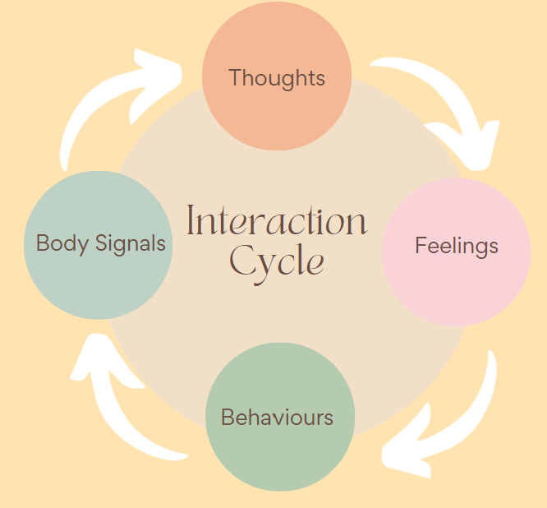
THOUGHTS, FEELINGS & BEHAVIOUR CYCLE

Slide 8
OUR BODIES RESPONSE TO ANXIETY
When we have a thought, our bodies respond to what we are thinking.
Fearful thoughts set off a warning alarm in the body to give us a better chance of survival (fight, flight or freeze response).
The fight, flight or freeze response causes changes in our body (adrenaline, faster heart and breathing, muscle tension, decreased digestive activity, movement of blood to key muscles and the brain). These changes help us to run and think faster, see better, be stronger and heal quicker.
If you don’t know why you these changes in your body happen it can feel frightening.

Slide 9
THE FIGHT, FLIGHT, FREEZE RESPONSE
FREEZE
WE NEED ANXIETY
IT IS A NORMAL ALARM SYSTEM THAT
EVERYONE HAS.
THE EMOTIONS WE FEEL COME AND GO BUT IS ​NOT DANGEROUS ​
Fight Flight Freeze – Anxiety Explained For Teens (youtube.com)
FIGHT
FLIGHT

Slide 10
THE AMYGDALA HIJACK

Slide 11
Our brains are not fully developed until we are between 22 - 25 years old. It is normal during adolescence for there to be lower reasoned/rational thinking, more impulsiveness and a tendency to respond emotionally. In addition, taking another person's perspective into account can be difficult.

Slide 12
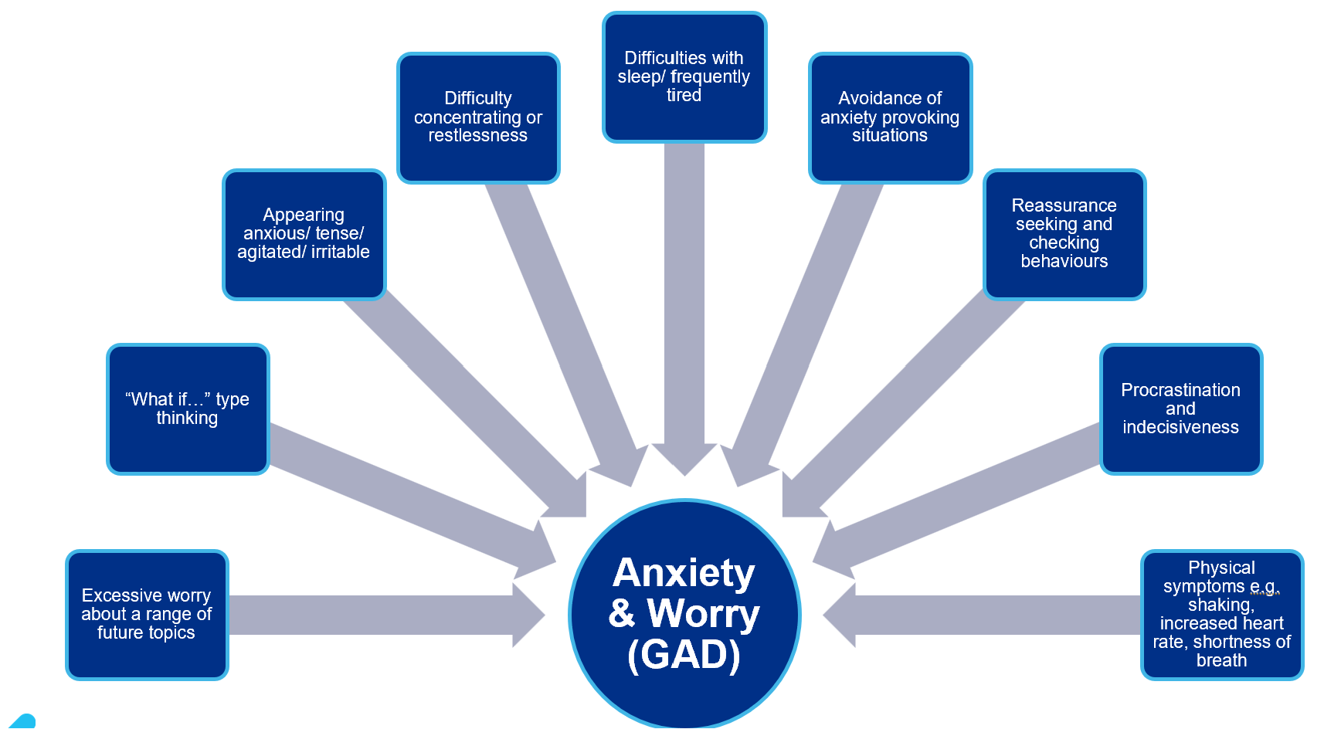
SIGNS OF ANXIETY

Slide 13
HABITUATION
Anxiety is caused by our perception of threat. Anxiety put simply is the overestimation a perceived threat and underestimation our ability to cope.

Slide 14
HABITUATION
Anxiety is caused by our perception of threat. Anxiety put simply is the overestimation a perceived threat and underestimation our ability to cope.

Slide 15
HABITUATION
Anxiety is caused by our perception of threat. Anxiety put simply is the overestimation a perceived threat and underestimation our ability to cope.

Slide 16
WIGAN MHST
TOP TIPS TO HELP WITH ANXIETY

Slide 17
HEALTHY HABITS

Slide 18
HEALTHY HABIT - SLEEP
Good sleep is essential for a young person’s wellbeing and has proven advantages for memory and performance.
However, during adolescence, changes in the brain can mean that teenagers’ body clocks are not set for early starts. Over time this can lead to ‘sleep debt’ (lack of sleep accumulating) which might impact on their everyday functioning.
Sleep problems can also be associated with mental health difficulties, and life stressors at school and/or home. They can signal that something is not right for that young person, and they need help.
(Reference: Anna Freud Centre)

Slide 19
TIPS FOR SLEEP
Have a one hour break from technology before you go to bed.
Try to avoid using screens, eating etc while in bed so that your brain associates your bed with sleep.
Naps should be 20 minutes (Max) and not too close to when you want to go to sleep.
Have a hot drink before bedtime (Hot milk, herbal tea, water – no caffeine/sugary drinks!)
Have a relaxing bath or shower before bedtime.
Ensure your bedroom is cool, dark and comfortable.
Avoid visible clocks and have your phone charging away from you.

Slide 20
2 TYPES OF WORRY
Practical worries
Something that will definitely happen or has happened.
I am starting a new school
I have a test
I have to get an injection
Someone is being unkind
Hypothetical worries
Something that has not happened yet, ‘what if’ or ‘might’ worries.
What if I forget something
What if I fail the test
My friends might fall out with me
What if I get in trouble

Slide 21
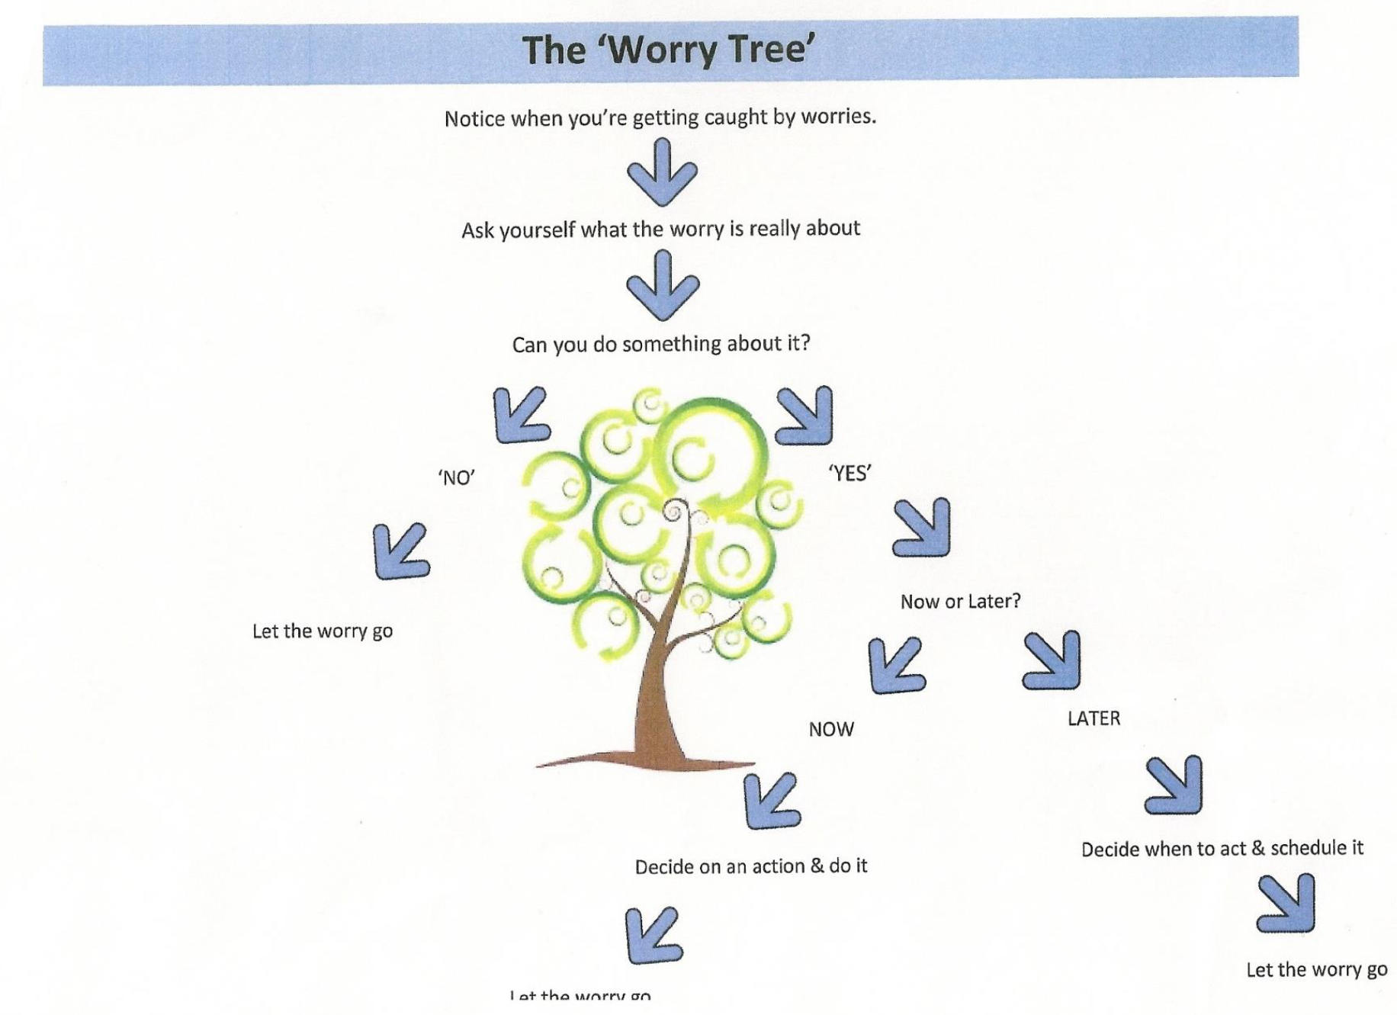
THE WORRY TREE

Slide 22
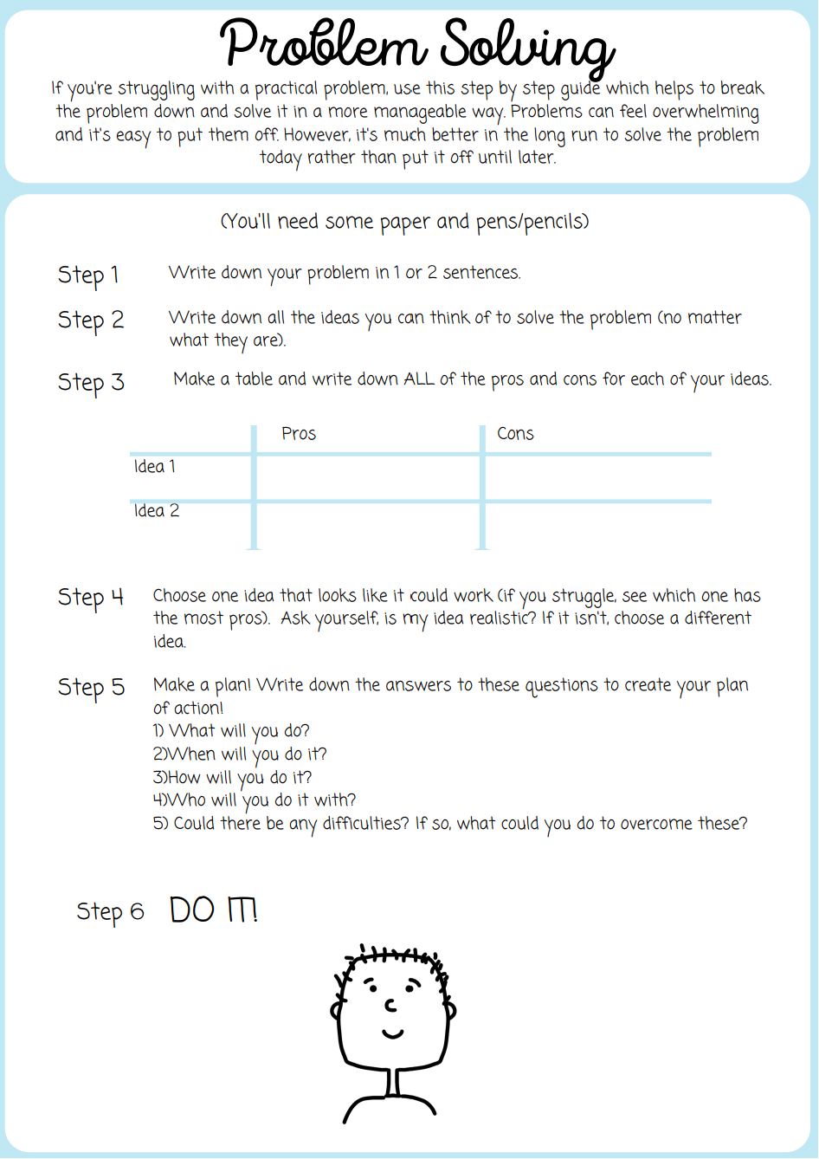
PROBLEM SOLVING

Slide 23
WIGAN MHST
SUPPORTING YOUR CHILD IN Y11
COPING
SELF-TALK
When faced with a threatening or stressful situation, young people tend to think very negatively about themselves and their performance, predicting the worst.
Coping Self-Talk aims to replace worrying thoughts with more helpful thoughts that are likely to support resilience.

Slide 24
WIGAN MHST
SUPPORTING YOUR CHILD IN Y11
COPING SELF-TALK
“I am proud of myself for what I have already achieved”
“This might be tricky, but I will be able to cope”
“I have coped with difficult things before, I can do it now”
COPING SELF-TALK NEEDS TO BE REALISTIC. NOT “EVERYTHING ALWAYS GOES WELL.”
“Although I feel scared, I am not in danger”
“It is ok not to know everything. I am still learning”

Slide 25
BREATHING & DISTRACTION TECHNIQUES

Slide 26
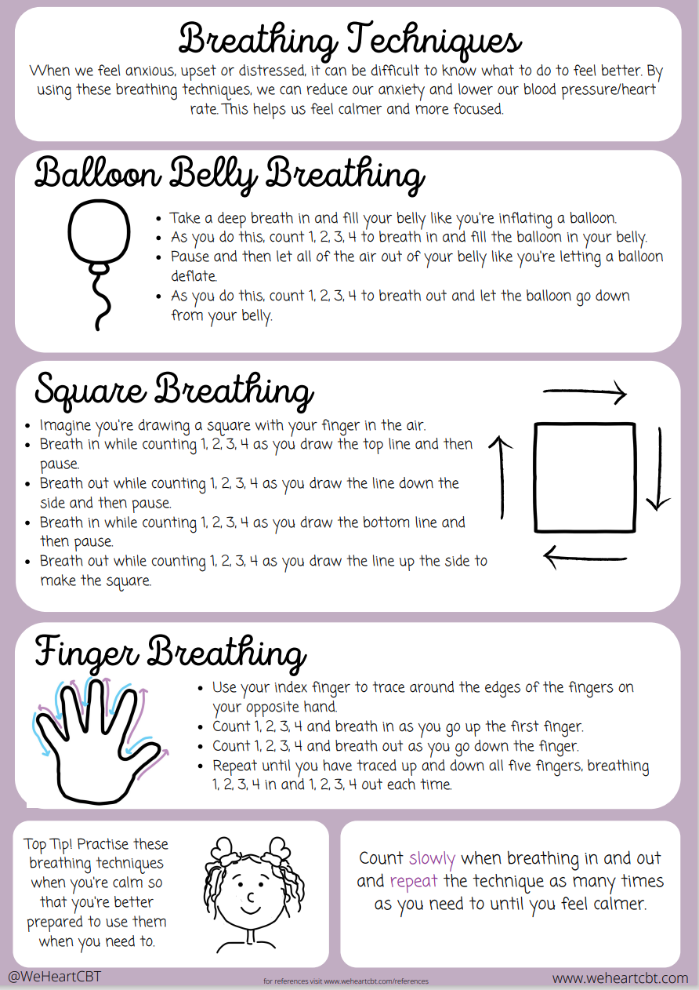
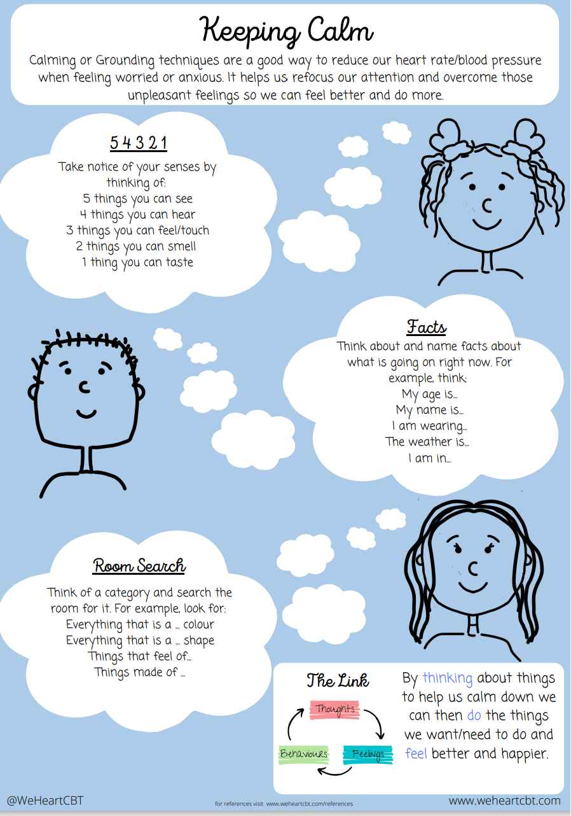
BREATHING & DISTRACTION TECHNIQUES

Slide 27
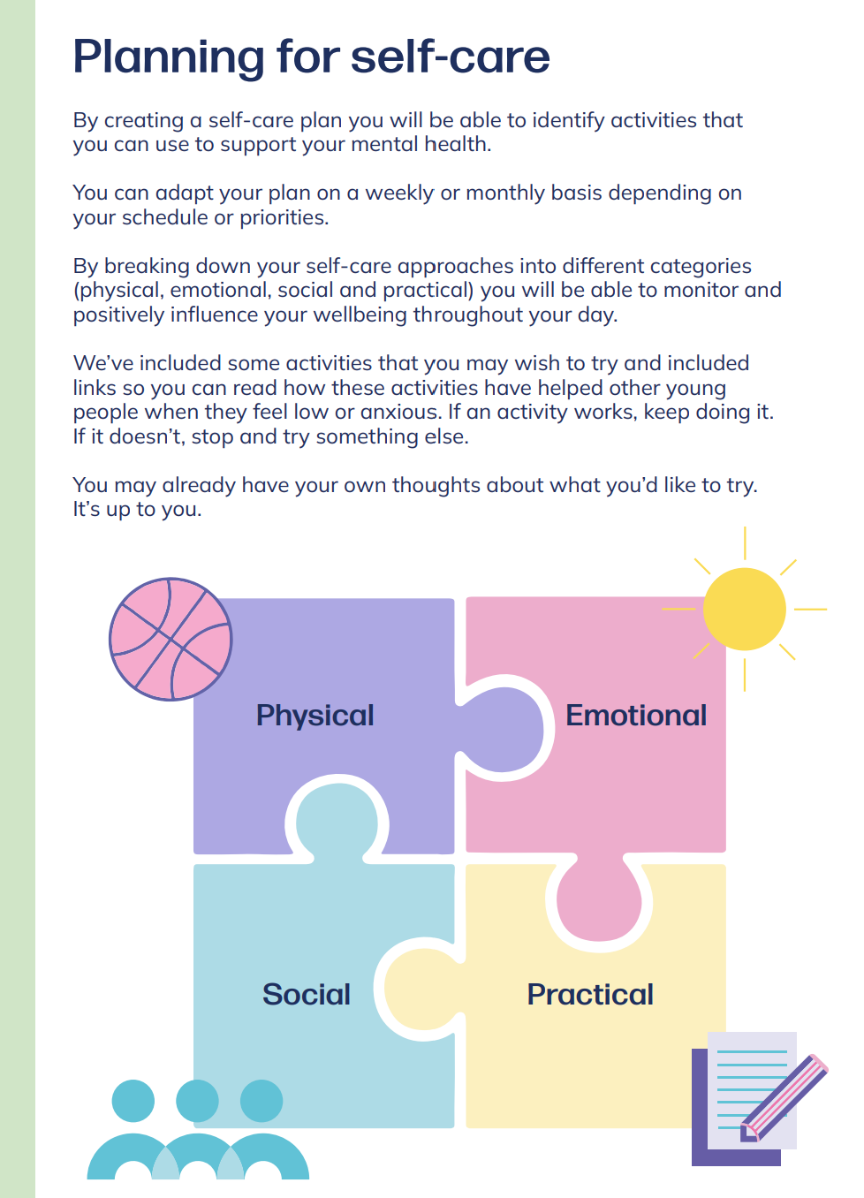
CREATING A SELF-CARE PLAN
my-self-care-plan-secondaryfe.pdf (d1uw1dikibnh8j.cloudfront.net)

Slide 28
WIGAN MHST
KEEPING SAFE AND WELL

Slide 29
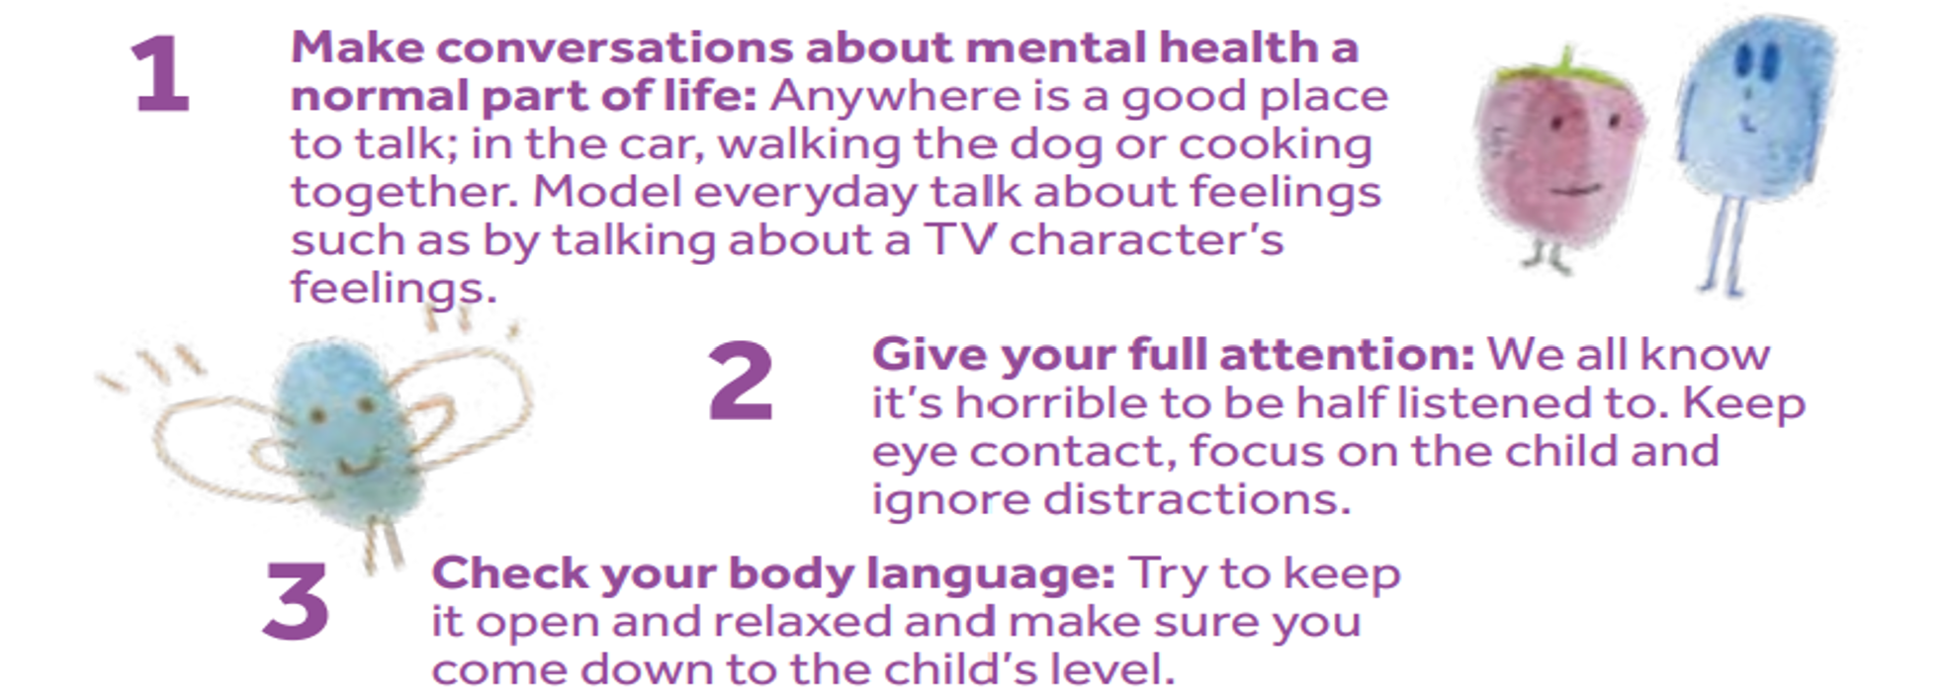
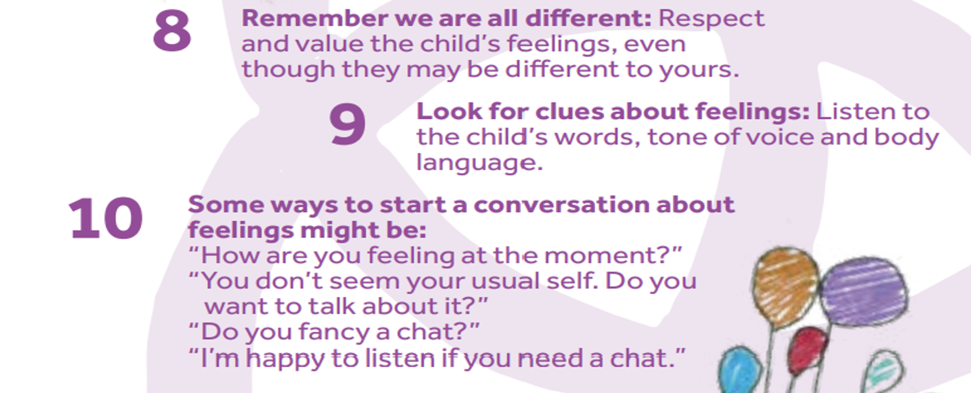
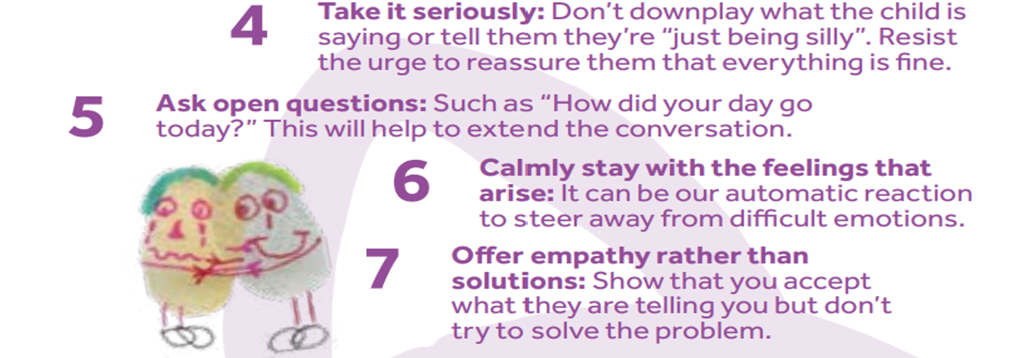
COMMUNICATION

Slide 30
Unhelpful Language
Attention seeking
Helpful Language
Can you tell me a bit more about how you are feeling?
Just a cry for help
Failed suicide
It’s not that serious
You’re not thinking of doing something are you?
Take your time
Have you felt like hurting yourself?
Have you had any thoughts/plans about wanting to die?
Sounds like things are really difficult at the moment
What would your… (parent/carer) think?

Slide 31
SIGNS & SYMPTOMS
Irritable | Mood changes
Poor concentration | Tiredness
Withdrawn (may isolate self away from others) | Excessive worrying
Sleep difficulties | Physical symptoms (noticeably faster heart rate, breathing quicker, shaking…)
Lack of appetite or eating more than usual | Decline in schoolwork
Lack of enjoyment in activities | Thoughts, actions or plans of self-harm and suicide

Slide 32
HOW CAN I HELP MY CHILD?
Look out for signs of change - notice when they seem upset, withdrawn or irritable. Help them to stay healthy, including getting enough sleep, eating well, and balancing schoolwork with hobbies. Encourage them to use online advice and support lines if they need to.
Encourage them to talk about their worries - don’t worry if your child doesn’t want to say much. Sometimes just knowing their parent or carer is there and willing to listen is enough. They may open up more later when they feel confident enough to do so. Try to avoid asking your child lots of questions all at once
Keep Calm - Try not to get into a hostile confrontation.
Increase supervision - Keep an eye on your child but avoid 'policing' them because this can increase their risk of self-harming.
Seek professional help. Your child may need a risk assessment from a qualified mental health professional. Talk to your GP and explore whether your child can be referred to your local Child and Adolescent Mental Health Services (CAMHS).
Keep the house safe - some young people may have urges to harm themselves in a crisis so it’s important to keep all medicines locked away, including painkillers like paracetamol. Remove sharp objects like razor blades from communal areas such as the bathroom, and store chemicals like bleach and tools like craft knifes away safely, in a locked cupboard or drawer if possible.
Read the Young Minds Parents Guide to Self-Harm: www.youngminds.org.uk/parents/parents-a-z-mental-health-guide/self-harm/

Slide 33
WHAT TO DO IN A CRISIS OR EMERGENCY
If you have urgent concerns about your child but they are not an immediate or life-threatening risk, we advise contacting CAMHS duty on 01942 764473 (9am - 5pm) or 111.
If it is an emergency and you feel your child cannot keep themselves safe, or if they have harmed themselves or are making serious threats/plans to harm themselves, we advise calling 999 and/or visiting your nearest A&E department to get immediate help.
Out of hours: Parents/young people can contact Wigan Mental Health Urgent Response Team: 0800 051 3253 (24/7 mental health crisis line for people of all ages in Wigan).

Slide 34
SELF-HARM COPING STRATEGIES
Draw on yourself with red pen
Hold an ice cube
Squeeze a stress ball or punch a pillow
Use a MH Support chat service (e.g. Kooth or Shout)
Speak to someone important to you

Slide 35
Support for parents/carers
PARENT/CARER SUPPORT
Think Wellbeing – offers free NHS therapy for people registered with a Wigan GP with common mental health problems like anxiety or low mood. It is a self-referral service. Visit www.gmmh.nhs.uk/think-wellbeing
Qwell – access free, safe and anonymous mental wellbeing support for adults. Access online messaging, general information, personal development tools or book a drop-in session as and when you need it. Visit www.qwell.io
Young Minds Parent Helpline – offers support and advice to parents/carers who are supporting a young person with a mental health problem. Call 0808 802 5544 (9:30am - 4pm during the week). Also a Webchat service, access through www.youngminds.org.uk/parent/parent-helpline-and-webchat/

Slide 36
WIGAN MHST
SIGNPOSTING & FURTHER HELP

Slide 37
FURTHER SUPPORT
Home
Reach out to family members or trusted friends for their support and shared experience.
Services
Access your GP, MHST and other young people's services.
School
Speak to a member of staff (head of year or pastoral lead) if you have concerns.

Slide 38
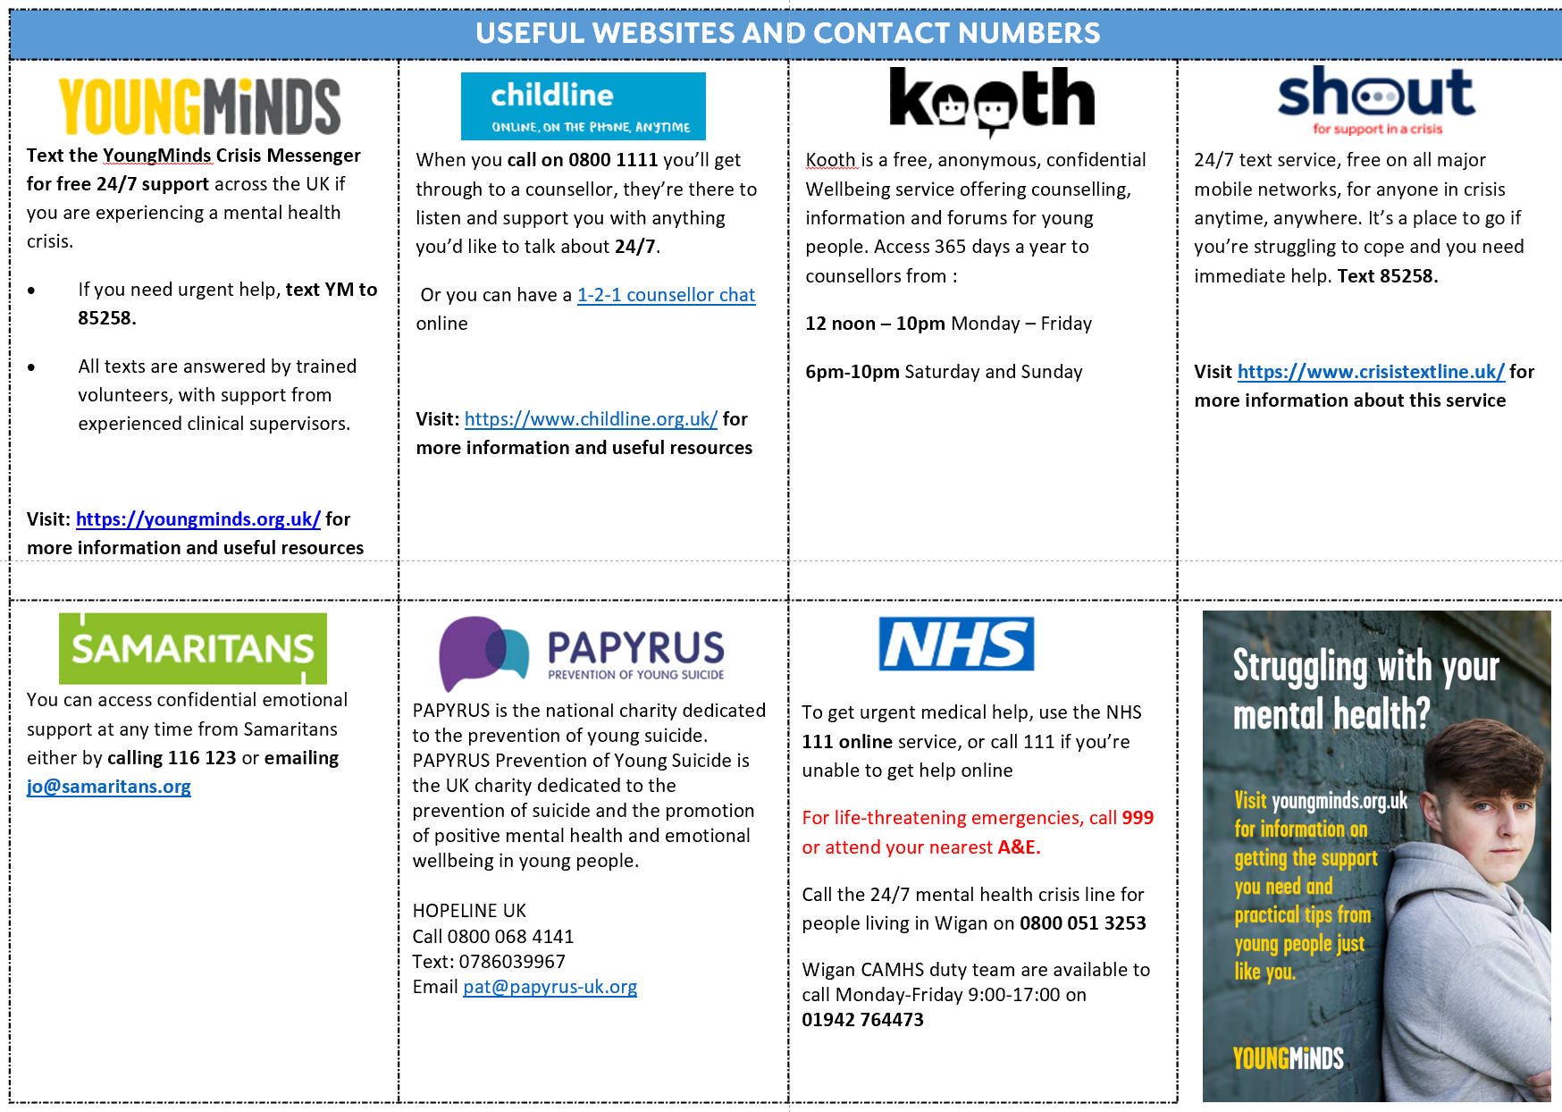
SIGNPOSTING
WHERE TO GET EXTRA SUPPORT

Slide 39
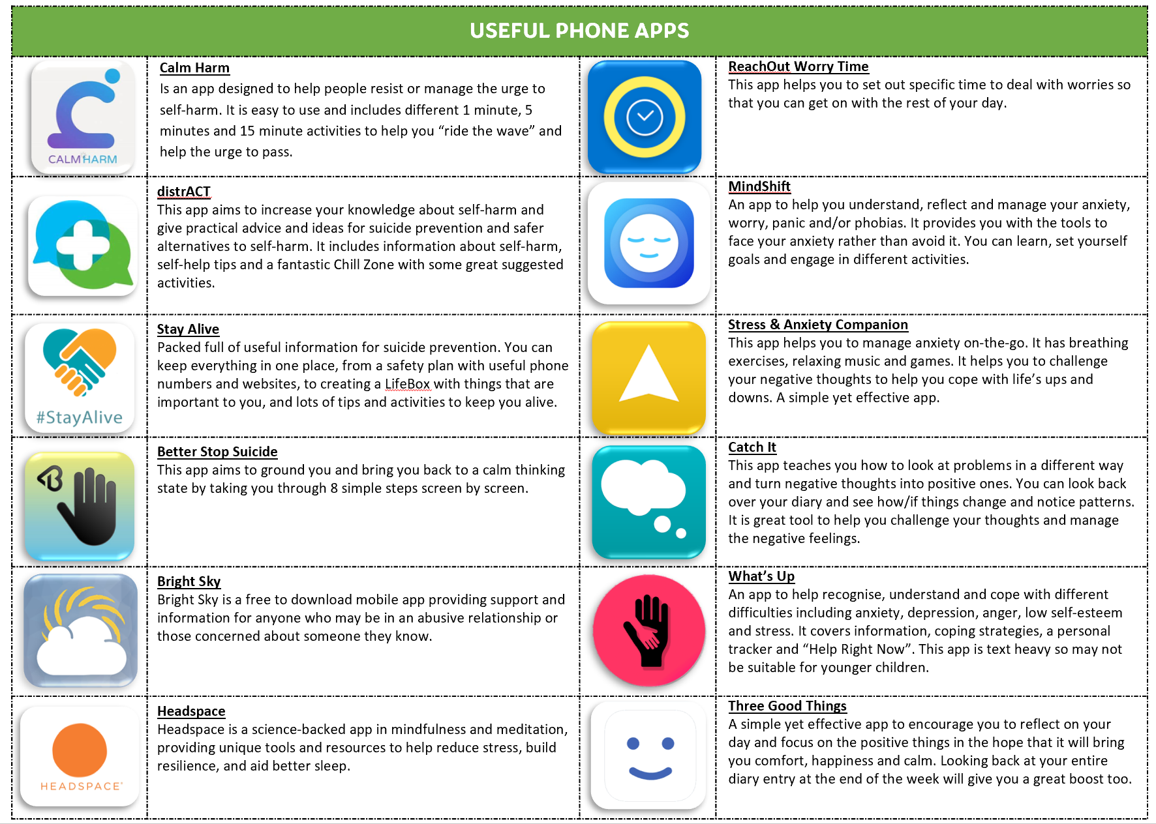
SIGNPOSTING
WHERE TO GET EXTRA SUPPORT

Slide 40
THANK YOU & QUESTIONS

