Slide 1
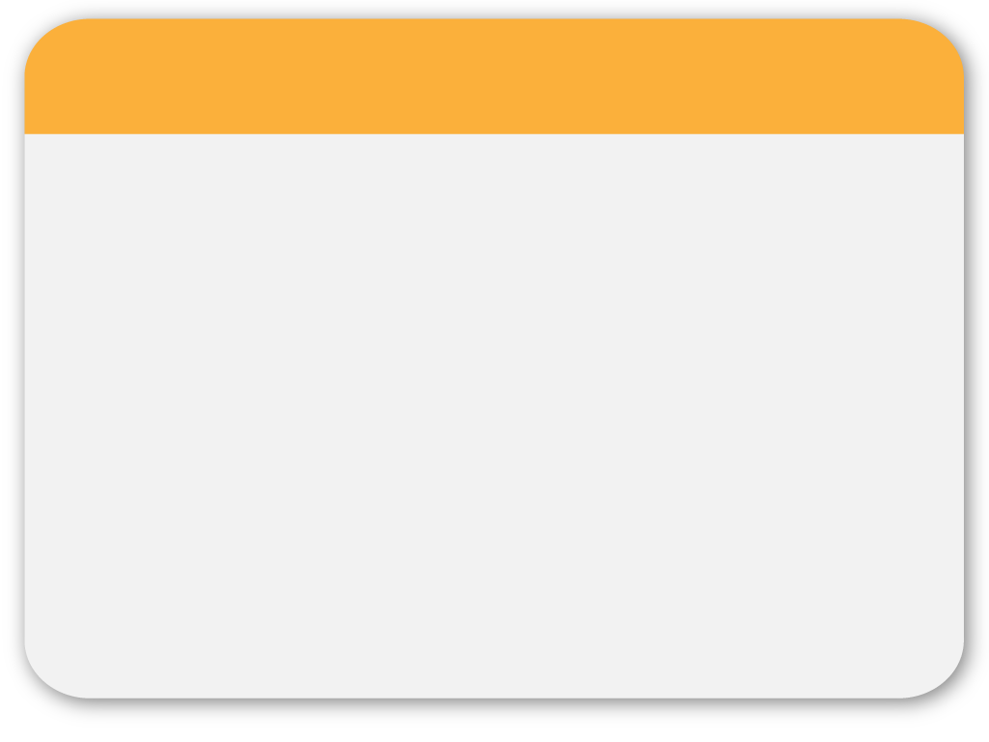
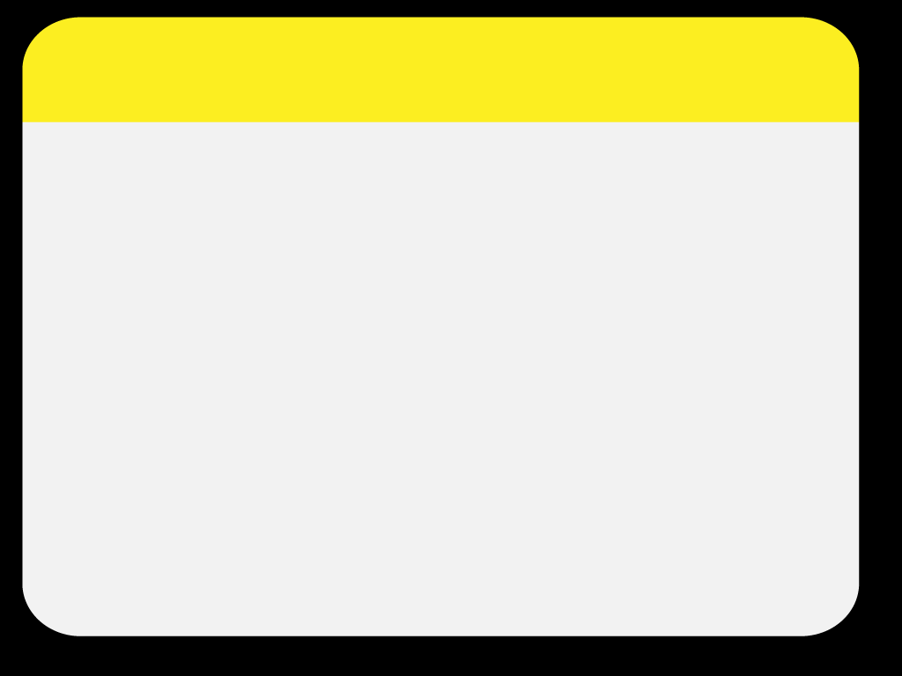
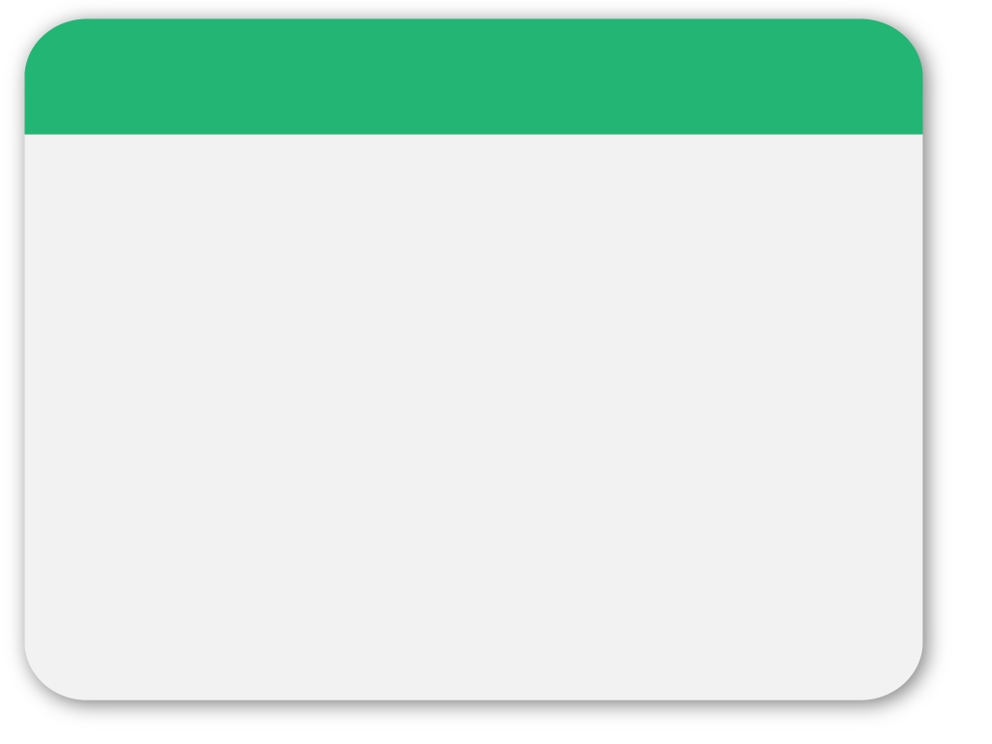
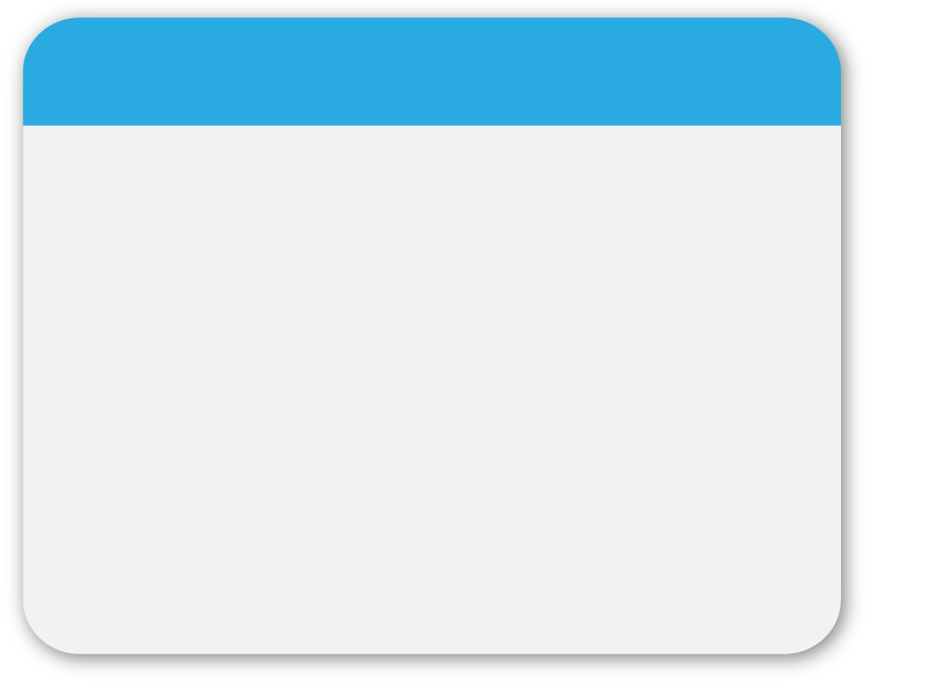
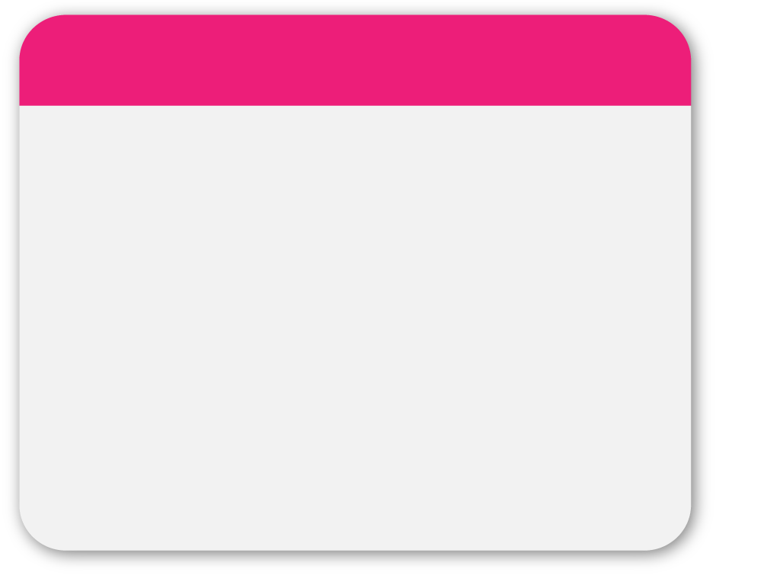
01
WINTER
Preparing for your
Maths Exam
Template

Slide 2
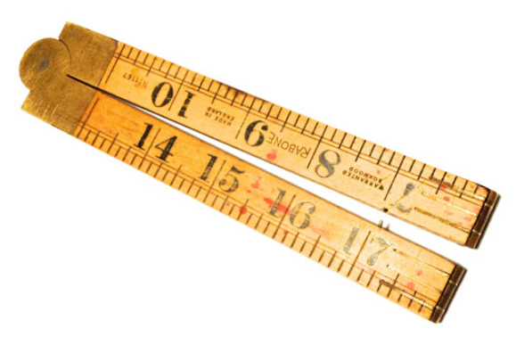
02
Be prepared …
THIS
Clear plastic marked with cm and mm
NOT THIS
Wooden or with only inches on it

Slide 3
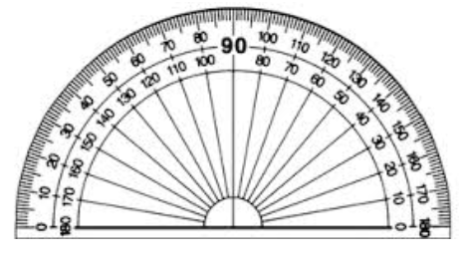
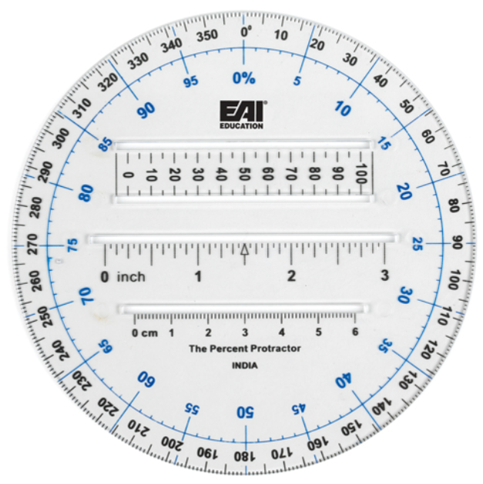
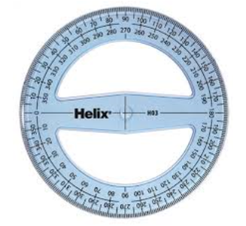
03
Be prepared …
Either of THESE
NOT THIS

Slide 4
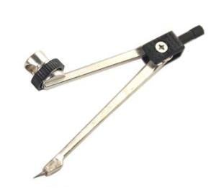
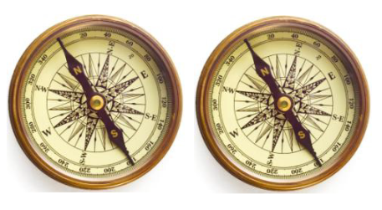
04
Be prepared …
THESE
NOT THESE

Slide 5
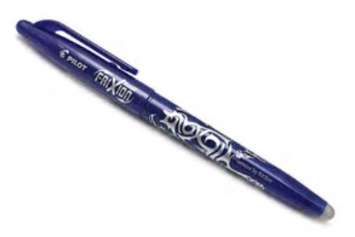
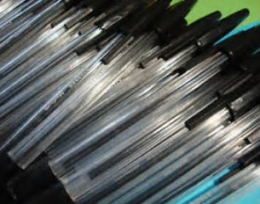
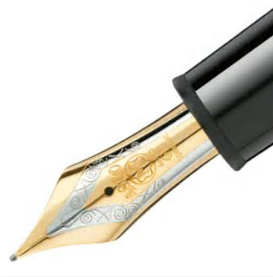
05
Be prepared …
NOT THESE
THESE
Have a spare
…and a “spare” spare

Slide 6
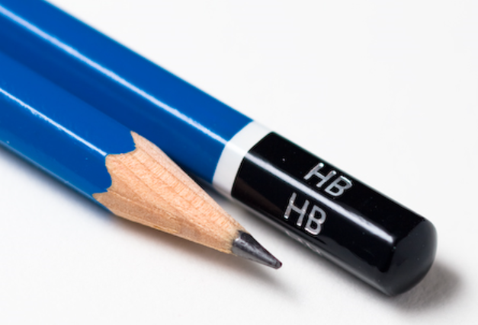
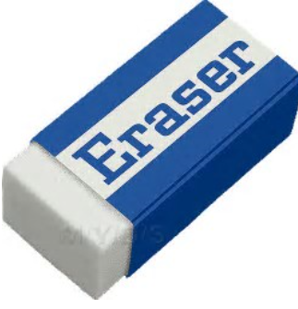
06
WINTER
Be prepared …
Template
Use these for drawing … remember
Pen for writing
Pencil for drawing (that includes graphs!)

Slide 7
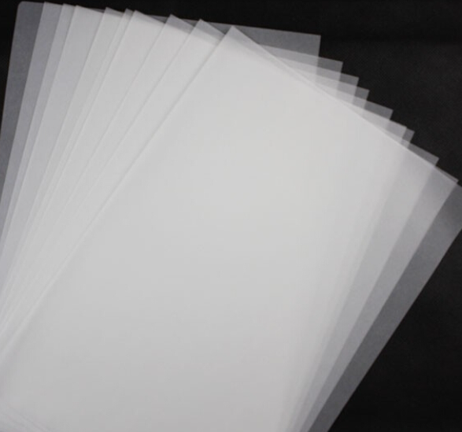
07
Be prepared …
If you aren’t given any and you think you need to use it … i.e. for “transformations”
ASK FOR SOME
Do not use it for working out … it will not get marked

Slide 8
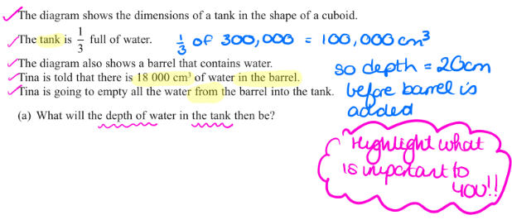
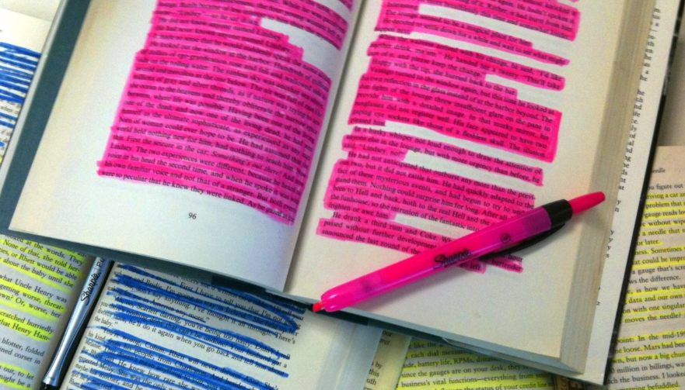
08
During the exam…
If you are going to highlight or underline key words:
LIKE THIS…
Or this …
NOT like this…

Slide 9
09
During the exam…
Show all your working out
Show all your working out
Show all your working out
Show all your working out
Show all your working out
Show all your working out
Show all your working out
Show all your working out
Show all your working out
Show all your working out
Show all your working out
Have I said ??
Show all your working out
Show all your working out

Slide 10
10
During the exam…
DON’T cross anything out UNLESS it is being replaced by something else … but if you have to …
Like this
NOT like this…

Slide 11
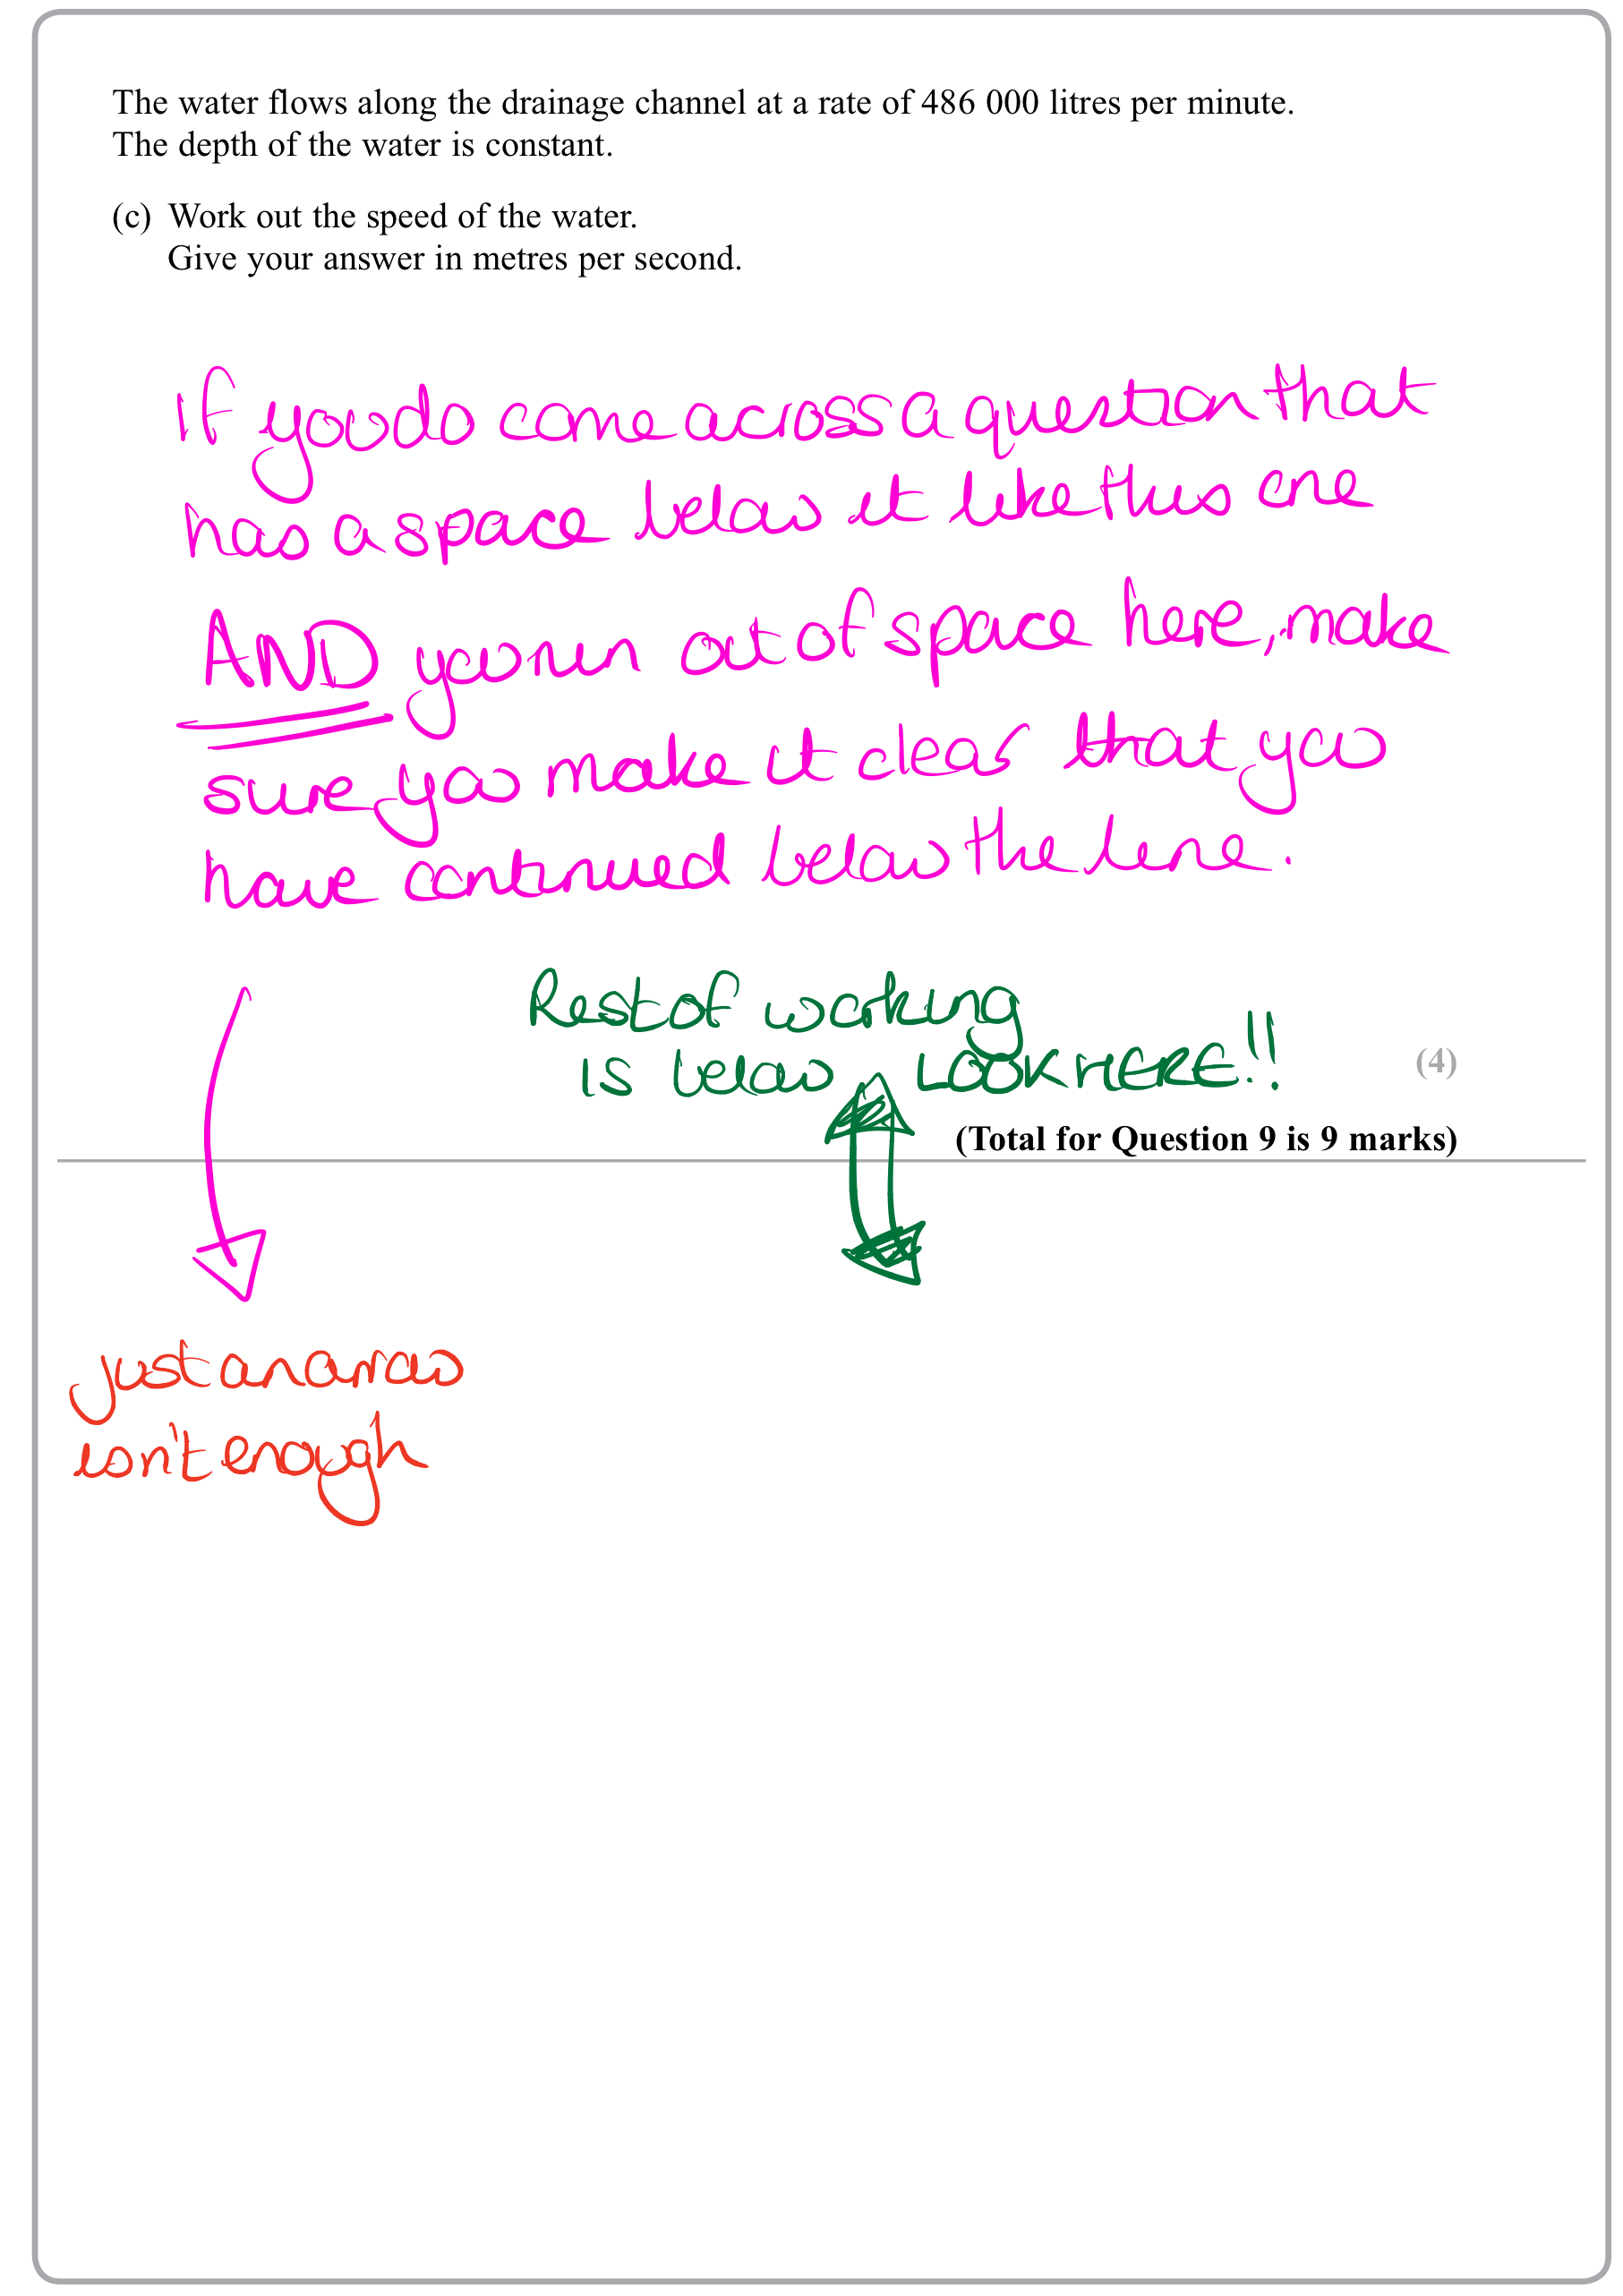
11
WINTER
During the exam
Write your answers in the space provided …
never go below the line (if there is one)…
if you have to because you’ve run out of space … make it clear that there is working out below THE GIVEN SPACE!
Template

Slide 12
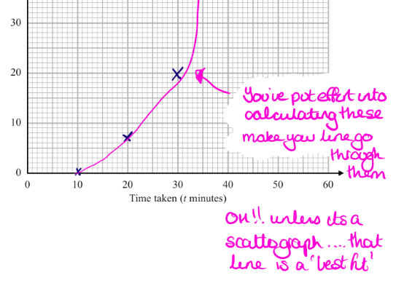
12
During the exam …
In general, take pride in your work.
In particular, be accurate when drawing graphs.
Consider the exam as an opportunity to “show what you know”
Check your answers
(do I have to repeat this one??)
Does the answer make sense?

Slide 13
13
During the exam…
Don’t panic .. You can do this!
Keep an eye on the time – think about using 1 minute per mark. Where you are faster than this, the extra time can be used for trickier questions
Check your answers! Show all your working out!
ALWAYS check the back page and the end of the paper will say :

Slide 14
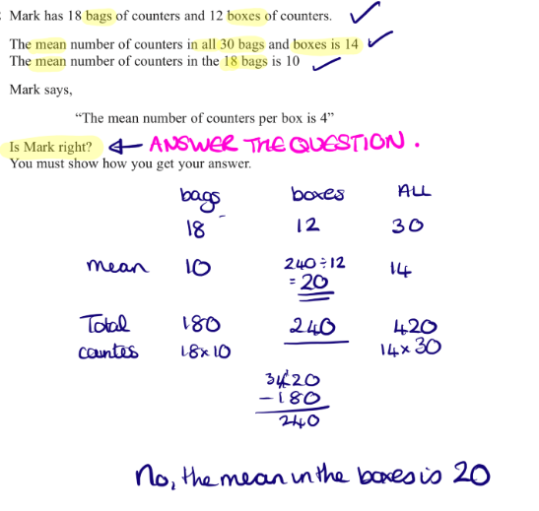
14
During the exam…
Check you’ve answered the question .. Make a statement with your final answer if appropriate.
Circling the “best buy” or just writing “No” is not enough!
Is there an answer line? Is your answer on it ?

Slide 15
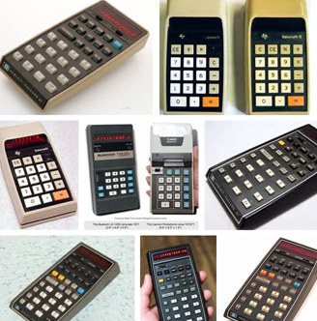
15
During the exam…
On the calculator papers … check your calculator:
WORKS!
is suitable and can be used for the exam
is in degrees mode
You know how to use it!
Remember … SYNTAX ERROR .. means
ERROR ..
so … Try again!

Slide 16
16
WINTER
GOOD LUCK
Template

