Slide 1





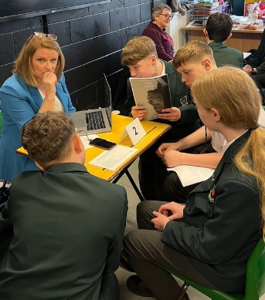

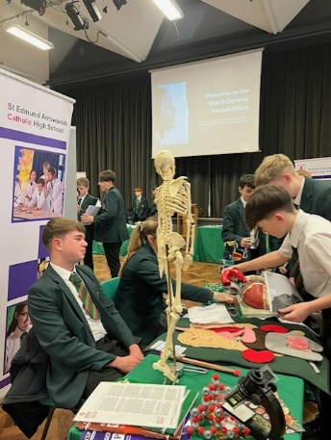
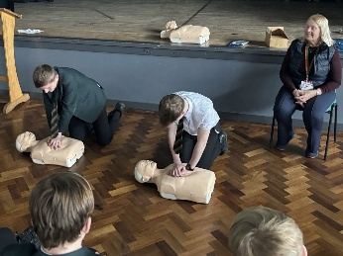
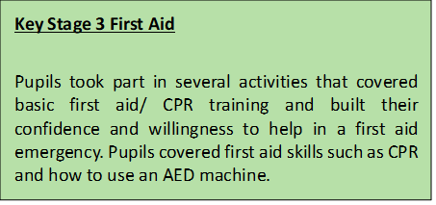
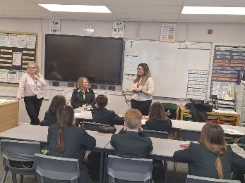
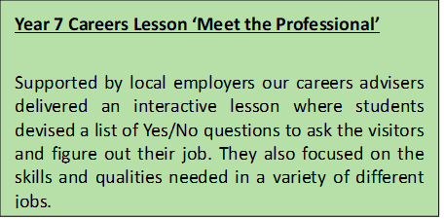
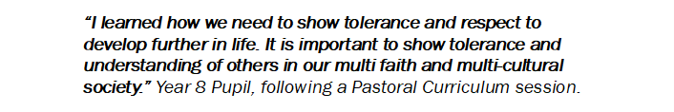
PERSONAL DEVELOPMENT CURRICULUM
ST EDMUND ARROWSMITH CATHOLIC HIGH SCHOOL
SUMMER TERM 2025
At St Edmund Arrowsmith CATHOLIC High School, in addition to a broad academic curriculum, every one of our students can experience a wealth of personal development activities. This bulletin contains useful information about the Personal Development provision for our pupils this term.

