Slide 1
Understanding Autism & Anxiety
Wigan Mental Health Support Team
Parent Information Evening
Notes:
Welcome - Meg

Slide 2
Sarah Abbott
EMHP
Wigan Mental Health Support Team
Meg Jones
EMHP
Wigan Mental Health Support Team
Notes:
Meg & Sarah

Slide 3
Wigan Mental Health Support Team
MHSTS (Mental Health Support Teams in Schools) aim to prevent mental health difficulties developing for children and young people by supporting schools to identify and respond to emerging mental health needs.
We work alongside a selection of schools in Wigan to provide 3 core functions:
To deliver evidence-based interventions for mild-to-moderate mental health issues
To support the senior mental health lead (where established) in each school to introduce or develop their whole school approach
To give timely advice to school and college staff, and liaise with external specialist services to help children and young people to get the right support and stay in education
Notes:
Sarah

Slide 4
Is the anxiety due to a change in routine?
Does the anxiety seem to happen when things don't go according to plan?
Does the anxiety happen when the young person is asked to stop an activity without advance notice?
Does the anxiety happen when there is a major break in the schedule or routines?
Is the anxiety higher when the child believes that rules have been broken?
Is the anxiety higher when you try to divert from their intense interests?
Understand Autism and the difficulties autistic people experience.
Explore anxiety and the link with Autism.
Discuss the main causes of anxiety in young people and share strategies to help support young people.
Explore calming techniques
Information for Services & Support
Aims of the Session:
Notes:
Meg

Slide 5
What is Autism?
Notes:
Sarah

Slide 6
https://youtu.be/Lk4qs8jGN4U
Notes:
Sarah
https://youtu.be/Lk4qs8jGN4U

Slide 7
Autism Acceptance
Autism is a lifelong developmental disability.
Autism affects how people communicate and interact with the world.
Autism is a spectrum condition and affects people in different ways.
Like all people, autistic people have their own strengths and weaknesses.
Notes:
Sarah

Slide 8
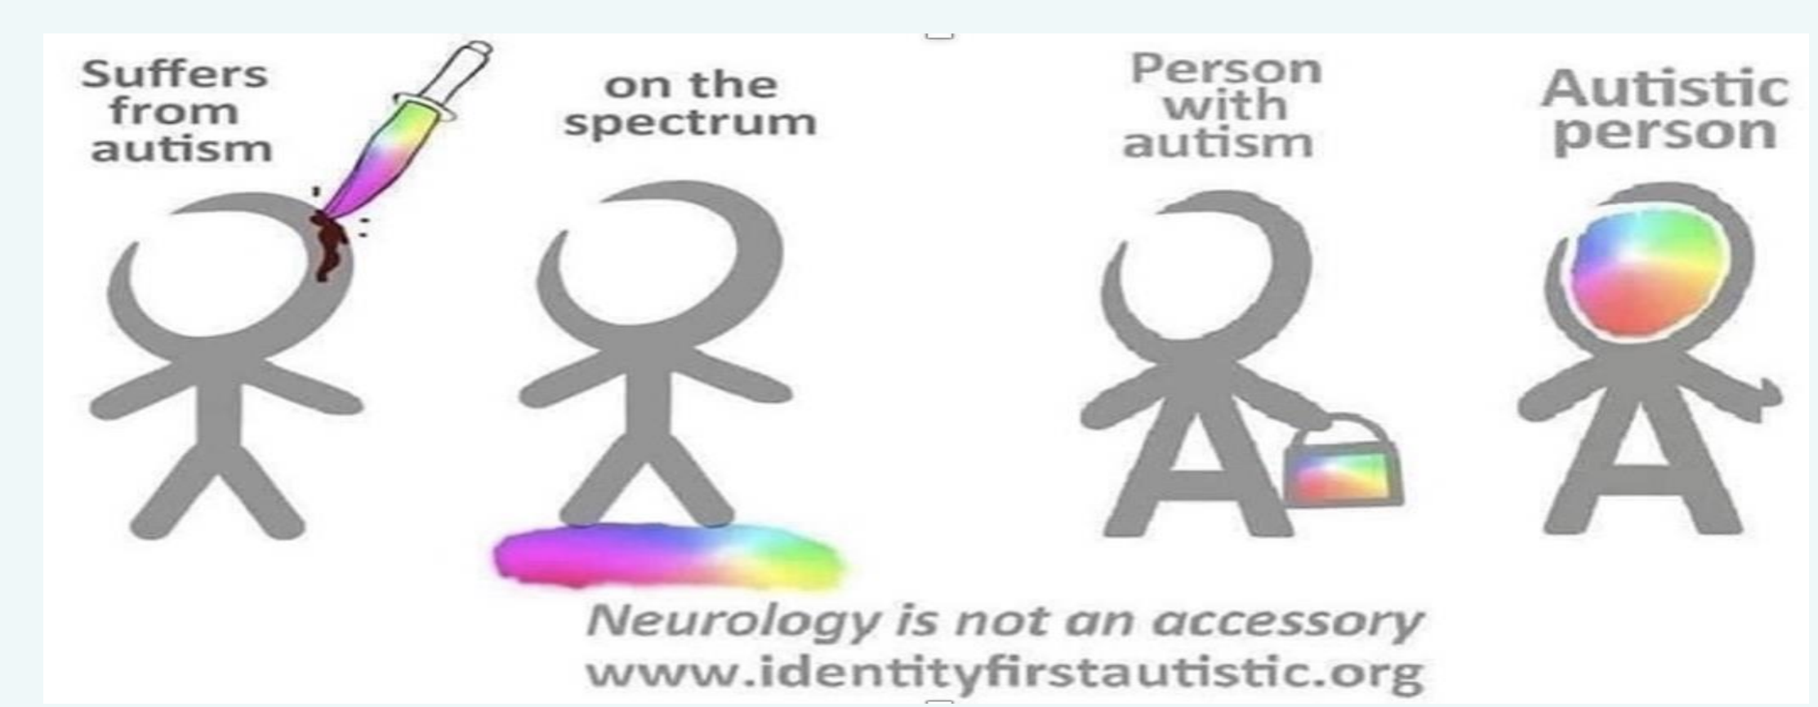
Talking Positively about Autism
Research shows that many autistic adults prefer to use “identity-first” language to describe themselves.
Being described as an autistic person is generally favoured by those who view autism as a central and defining element of their identity, similar to gender or race.
Person with autism is favoured by those who see autism forming just one element of their identity.
As these terms can be emotive for individuals, it is best to follow the lead of the person you are speaking to using terminology that they prefer and giving them control over how they are spoken about.
For this presentation we have chosen to use identity first language throughout.
Notes:
Meg

Slide 9
Autism & Girls
In the past, it was assumed that autistic people were overwhelmingly men and boys, and only very rarely women and girls.
This is incorrect.
There are many women, girls and non-binary people on the autism spectrum.
Girls in the UK are often diagnosed autistic on average 2-3 years later than boys (Russell et al., 2021).
Because of the damage a late diagnosis and subsequent camouflaging of autistic traits can do to an autistic person’s mental health, confidence and self-esteem this needs to change.
Notes:
Sarah

Slide 10
Internal Vs External Presentation of Autism.
EXTERNAL PRESENTATION
Is probably more recognisable to the majority of people.
They might stim (move, perform an action or make a noise in a repetitive way) by rocking or flapping their hands.
They might be non- or minimally-speaking.
They might exhibit distressed behaviour.
Autistic children who present in an external way will be noticed and referred early, partially because they are causing disruption in school, and the school is invested in helping that disruption to stop or be more controlled.
Where the person behaves in a way which is visibly different to their non-autistic peers.
Notes:
Meg

Slide 11
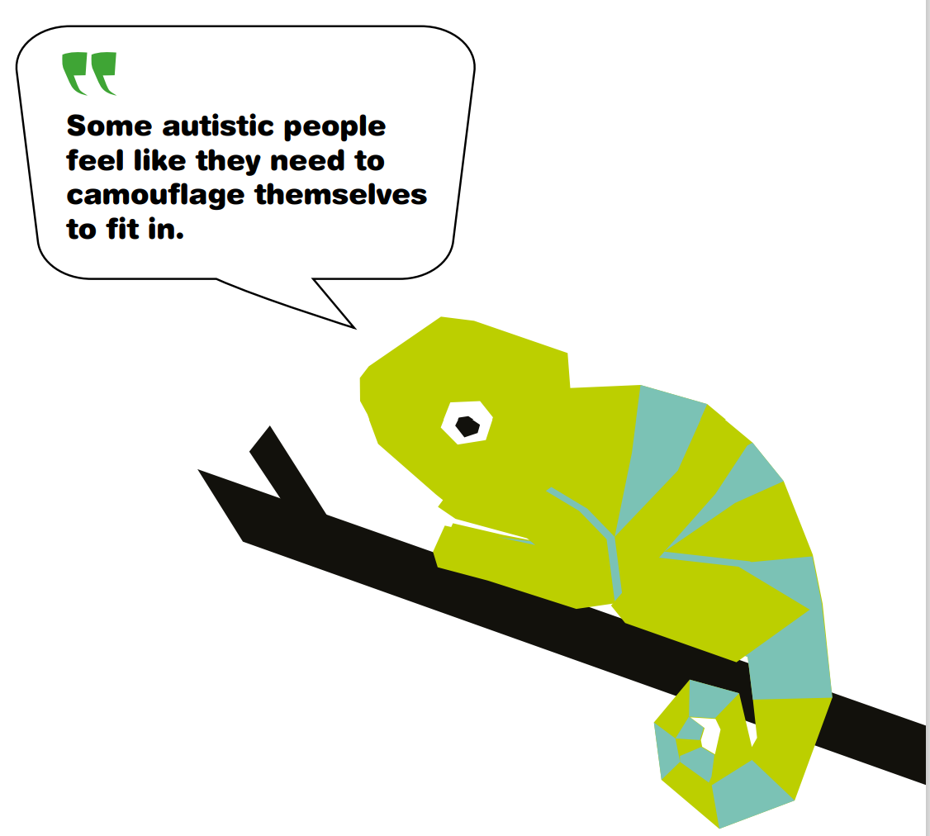
INTERNAL PRESENTATION
Autistic traits are camouflaged (masked) and internalised to help them fit in with their peers.
Can be a conscious or unconscious decision to avoid the stigma of being autistic or different.
Masking comes with a high cost in terms of mental health and keeping a strong sense of identity.
It’s no coincidence that children and young people who present in an internal way are often diagnosed autistic because they have reached breaking point.
Autistic children who present in an internal way tend to behave much more passively as the aim is to be ignored.
They are not causing a disruption, so the added incentive is not there for them to be referred, and frequently the signs are not spotted until mental health has deteriorated.
Notes:
Sarah

Slide 12
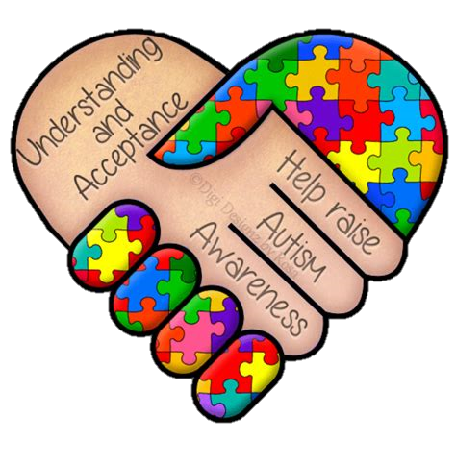
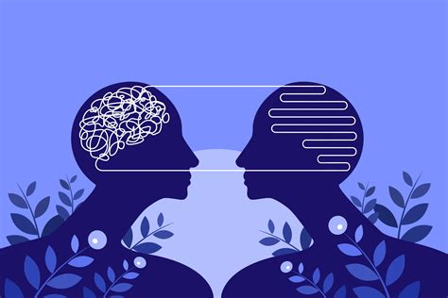
Possible Traits of an Internal Presentation of Autism
Repetitive behaviours like re-reading the same book or re-watching the same film because it provides a sense of comfort and predictability.
Re-doing homework until it’s ‘perfect’ (as it is common for some autistic people to be perfectionists).
Increased anxiety and situational mutism (being unable to speak in situations which cause high anxiety or feeling unsafe).
Keep it together all day at school, so to teachers there doesn’t seem to be a ‘problem’. This emotion and anxiety may all be released in meltdowns, shutdowns or anxiety attacks when they get home.
Friendships can be very important and can also cause a great deal of anxiety, especially if there is conflict (Sedgewick, Hill and Pellicano, 2019).
It is common for them to have one or two strong friendships, but struggle socialising in groups.
Notes:
Meg

Slide 13
Difficulties Autistic People Experience
Notes:
Sarah

Slide 14
Difficulties Autistic People may experience:
Social Communication
Taking things literally and not understanding abstract concepts.
Needing extra time to process information or answer questions.
Repeating what others say to them (this is called echolalia).
Some autistic people are unable to speak or have limited speech while other autistic people have very good language skills but struggle to understand sarcasm or tone of voice. Autistic people can also have difficulties with interpreting both verbal and non-verbal language like gestures or tone of voice.
Other challenges include:
Notes:
Sarah

Slide 15
Social Interaction
Autistic people often have difficulty 'reading' other people - recognising or understanding others' feelings and intentions - and expressing their own emotions. This can make it very hard to navigate the social world. Autistic people may:
Appear to be insensitive.
Seek out time alone when overloaded by other people.
Not seek comfort from other people.
Appear to behave 'strangely' or in a way thought to be socially inappropriate.
Find it hard to form friendships.
Notes:
Meg

Slide 16
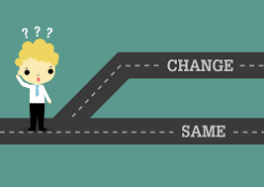
Repetitive and Restrictive Behaviour
With its unwritten rules, the world can seem a very unpredictable and a confusing place to autistic people. This is why people with autism often prefer to have routines so that they know what is going to happen.
Autistic people may want to travel the same way to and from school or work, wear the same clothes or eat exactly the same food for breakfast.
Autistic people may also repeat movements such as hand flapping, rocking or the repetitive use of an object such as twirling a pen or opening and closing a door.
Autistic people often engage in these behaviours to help calm themselves when they are stressed or anxious, but many autistic people do it because they find it enjoyable.
Changes to routine can also be very distressing for people with autism and can make them very anxious.
It could be having to adjust to big events like Christmas, school holidays , family holidays or changing schools, facing uncertainty at work, or something simpler like a bus detour that can trigger their anxiety.
Notes:
Sarah

Slide 17
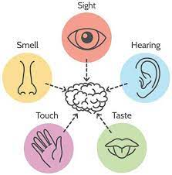
Sensory Difficulties
Autistic people may experience over- or under-sensitivity to sounds, touch, clothing, tastes, smells, light, colours, temperatures or pain.
They may find certain background sounds like music in a restaurant, general chatter in classrooms which other people ignore or block out, unbearably loud or distracting.
This can cause anxiety or even physical pain.
Many autistic people prefer not to hug due to discomfort, which can be misinterpreted as being cold and aloof.
Many autistic people avoid everyday situations because of their sensitivity issues.
Schools, workplaces and shopping centres can be particularly overwhelming and cause sensory overload.
But there are many simple adjustments that can be made to make environments more autism-friendly.
Notes:
Meg

Slide 18
Intense and Highly Focused Interests
Many autistic people have intense and highly focused interests, often from a fairly young age. These can change over time or be lifelong.
Autistic people can become experts in their special interests and often like to share their knowledge. A stereotypical example is trains but that is one of many. Greta Thunberg's intense interest, for example, is protecting the environment.
Like all people, autistic people gain huge amounts of pleasure from pursuing their interests and see them as fundamental to their wellbeing and happiness.
Being highly focused helps many autistic people do well academically and in the workplace but they can also become so engrossed in particular topics or activities that they neglect other aspects of their lives.
Notes:
Sarah

Slide 19
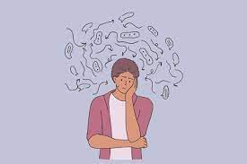
Extreme Anxiety
Anxiety is a real difficulty for many autistic people, particularly in social situations or when facing change.
It can affect a person psychologically and physically and impact quality of life for autistic people and their families.
It is very important that autistic people learn to recognise their triggers and find coping mechanisms to help reduce their anxiety.
Many autistic people have difficulty recognising and regulating their emotions.
Notes:
Meg

Slide 20
What is Anxiety?
Notes:
Sarah

Slide 21
The principle emotion experienced by autistic people is fear.
Temple Grandin
Like many others with autism, it leaves me fearful and anxious whenever I must deal with new people or strange situations. I know this anxiety is shared by countless others on the spectrum. I hide it well, but the fear and anxiety is always with me.
John Elder Robison
Notes:
Meg

Slide 22
Anxiety is…
Anxiety is a feeling of worry or fear that we experience when we expect that a situation might have adverse consequences for our psychological or physical well-being.
This may include situations such as:
preparing for an exam or test (fear of failure);
travelling during rush hour (fear of being late or having an accident);
preparing for a public speech (fear of being judged negatively);
travelling to new places and meeting new people (fear of the unknown).
Notes:
Sarah

Slide 23
In many situations, feelings of anxiety are completely normal and important because the increase in our levels of arousal (e.g. increased heart rate) prepares us for dealing with whatever a situation might throw at us.
Unfortunately, for some people, feelings of anxiety can arise so frequently, persistently and with such unusual intensity, that they interfere with a person’s day-to-day functioning and general quality of life.
For instance, children may be so worried about failing a test or being teased that they resist going to school or any social events.
Others may have such persistent fears of dogs that they refuse to go to parks or visit friends who own a dog.
And others may generally worry so much about something bad happening that they are constantly in a state of heightened arousal and vigilance.
Notes:
Meg

Slide 24
Anxiety & Autism
Notes:
Sarah

Slide 25
There are around 500 000 autistic adults and children in the UK.
Notes:
Meg

Slide 26
There are around 500 000 autistic adults and children in the UK.
There are actually, around 700 000 autistic adults and children in the UK. That’s more than 1 in 100 people.
Notes:
Meg

Slide 27
Approximately 10-15% of the general population have an anxiety disorder at some point in their life.
Notes:
Sarah

Slide 28
Approximately 10-15% of the general population have an anxiety disorder at some point in their life.
Notes:
Sarah

Slide 29
Around 25% of autistic children, adolescents and adults are thought to have at least one and often more anxiety disorders.
Notes:
Meg

Slide 30
Around 25% of autistic children, adolescents and adults are thought to have at least one and often more anxiety disorders.
Around 40% of autistic children, adolescents and adults are thought to have at least one or more anxiety disorders. 94% of autistic adults have reported struggling with anxiety and 1 in 6 of those report their anxiety impacts their day to day with life.
Notes:
Meg

Slide 31
Signs of Anxiety
Notes:
Meg

Slide 32
Behavioural signs of Anxiety
When young people can't express something with words they often express it through their behaviour.
Because autistic young people have difficulty with communication, they may use behaviours to express anxiety.
This may include (but are not limited to):
Nail biting;
Hair pulling;
Self-injurious behaviours such as biting themself or headbanging;
Compulsive behaviours like lining up toys, pulling at strings on clothing, excessive hand washing;
Increases in tics including head twitching or throat clearing;
Increase in repetitive motor movements (Stimming);
Social withdrawal.
Notes:
Meg

Slide 33
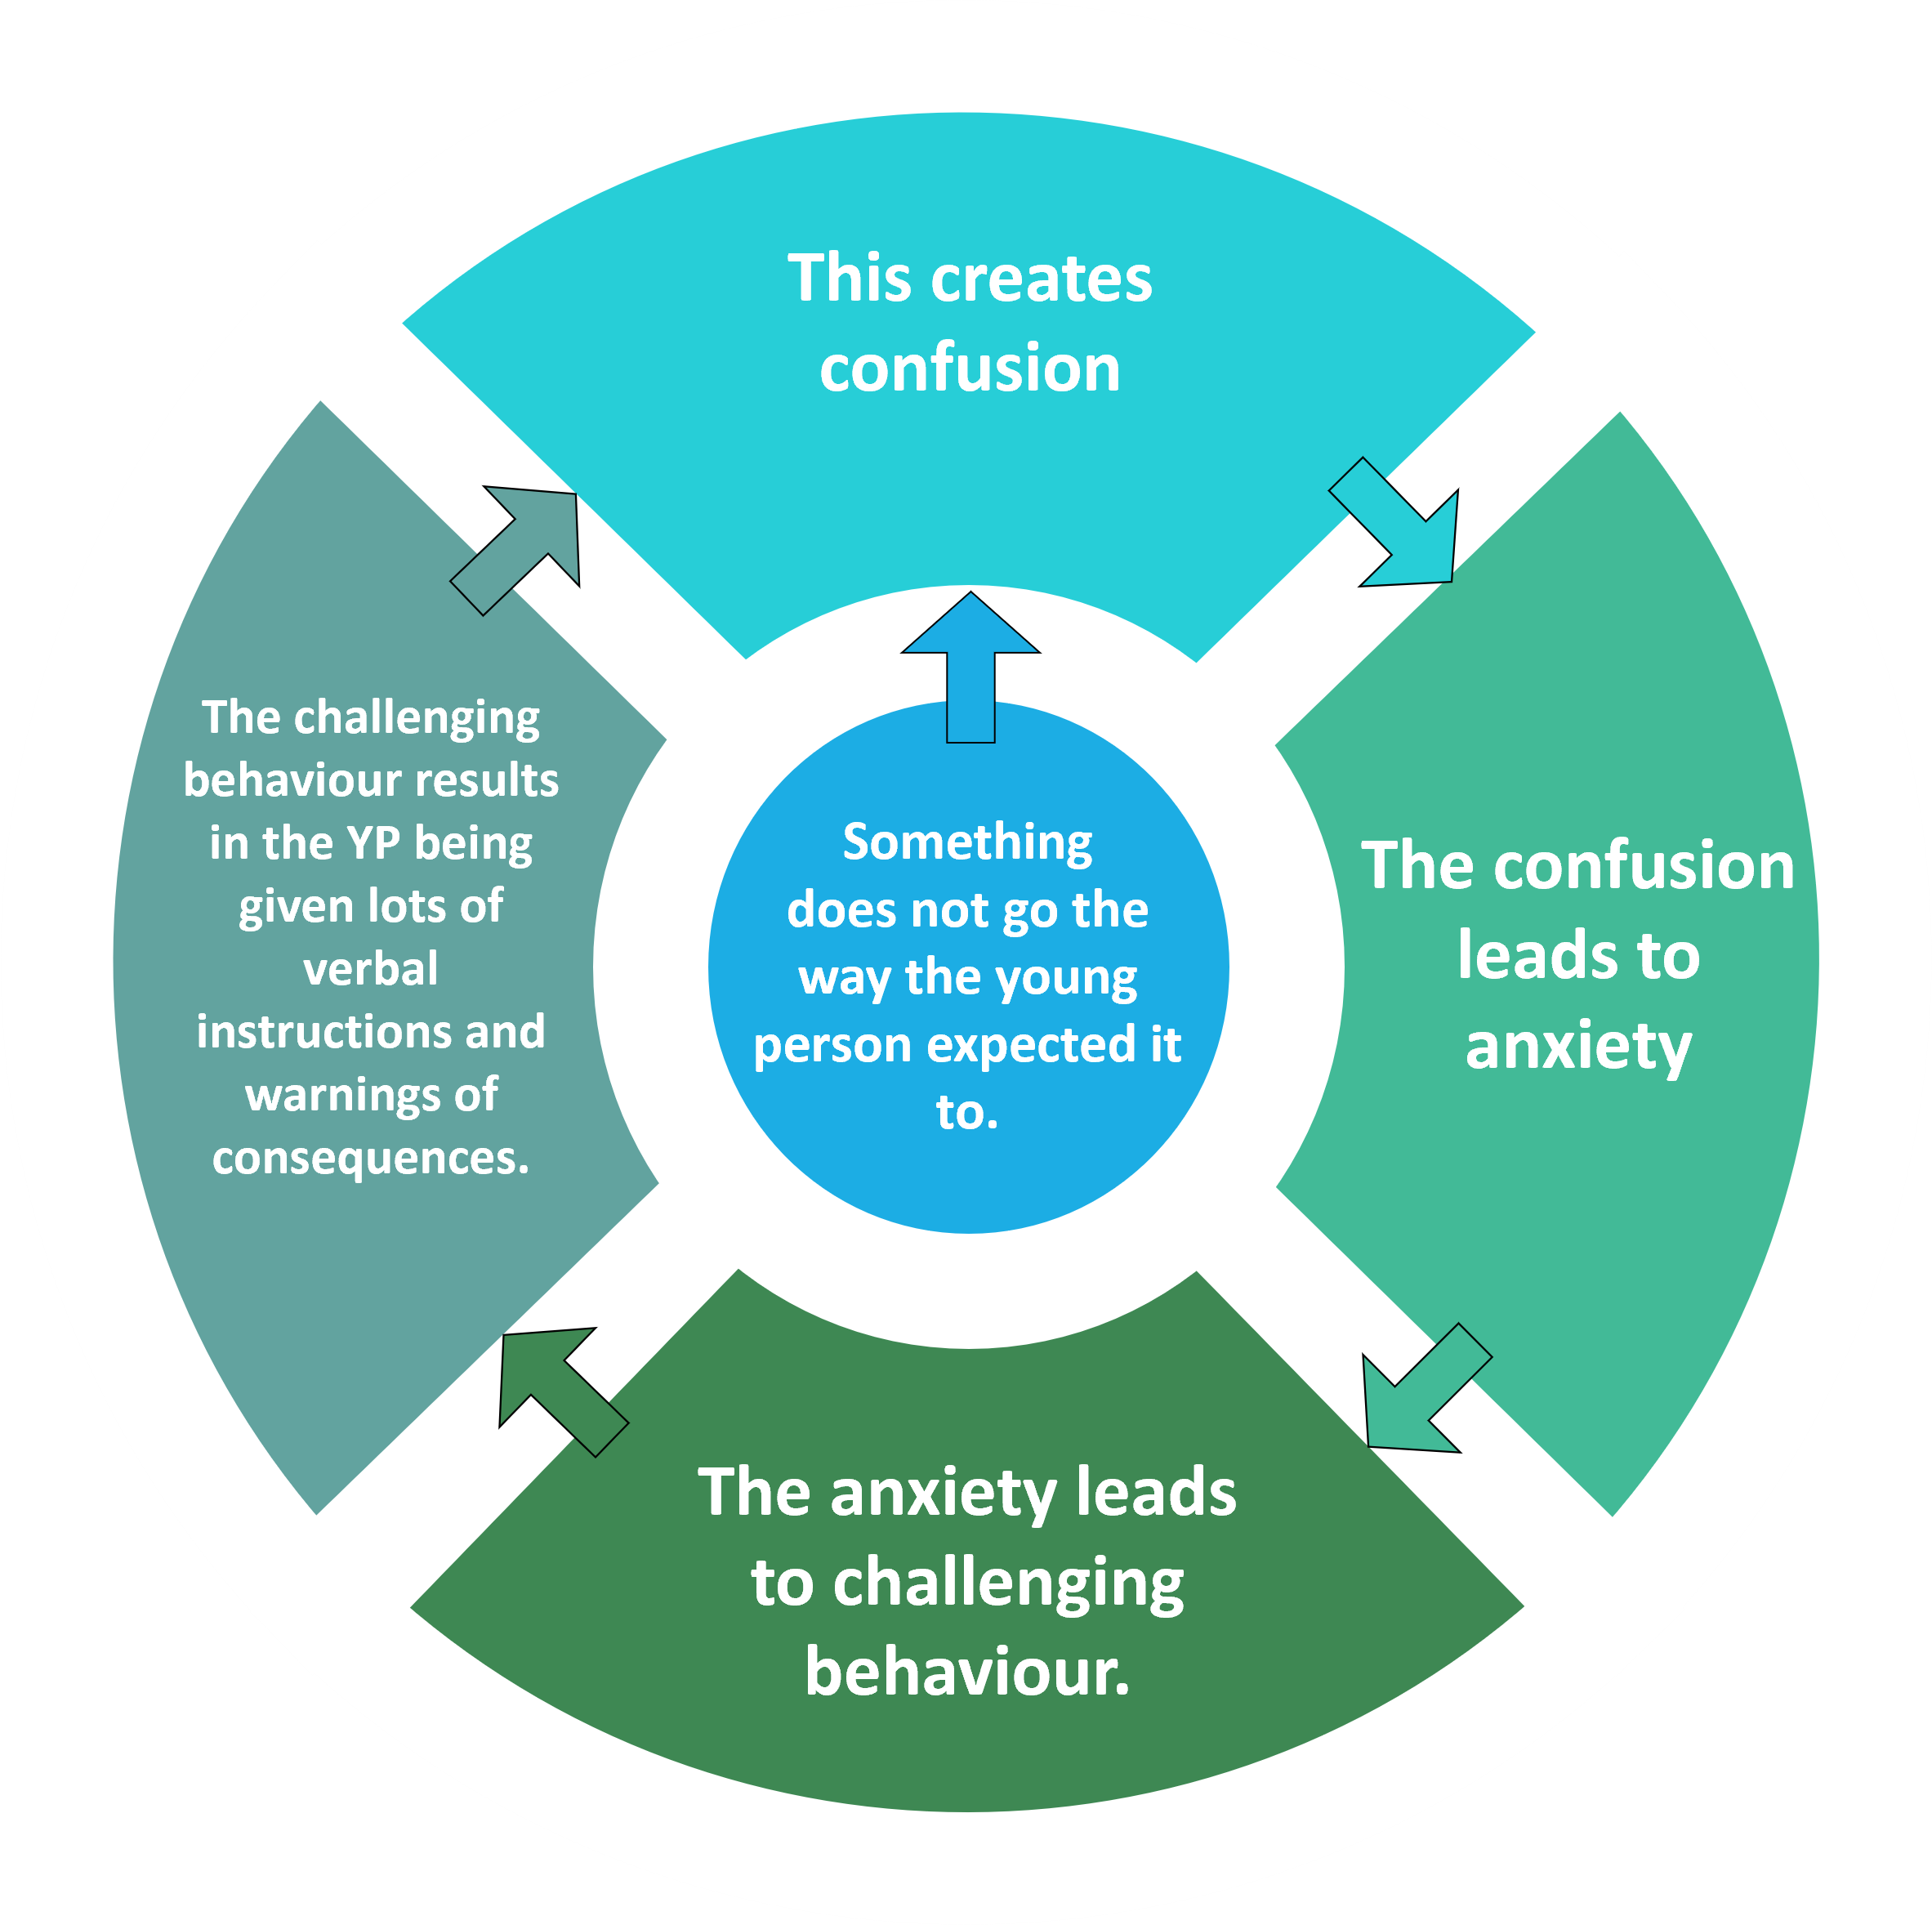
Escalating Anxiety-Behaviour Cycle
This creates confusion
Sometimes a young person's mood and behaviour rapidly worsens.
Within minutes they can go from being relatively calm to being extremely upset or disruptive.
It is important to remember that such behaviour is unintentional and very often we play a role in its escalation.
The challenging behaviour results in the YP being given lots of verbal instructions and warnings of consequences.
Something
does not go the way the young person expected it to.
The confusion leads to anxiety
The anxiety leads to challenging behaviour.
Notes:
Sarah

Slide 34
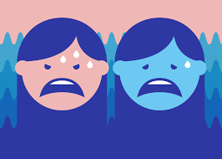
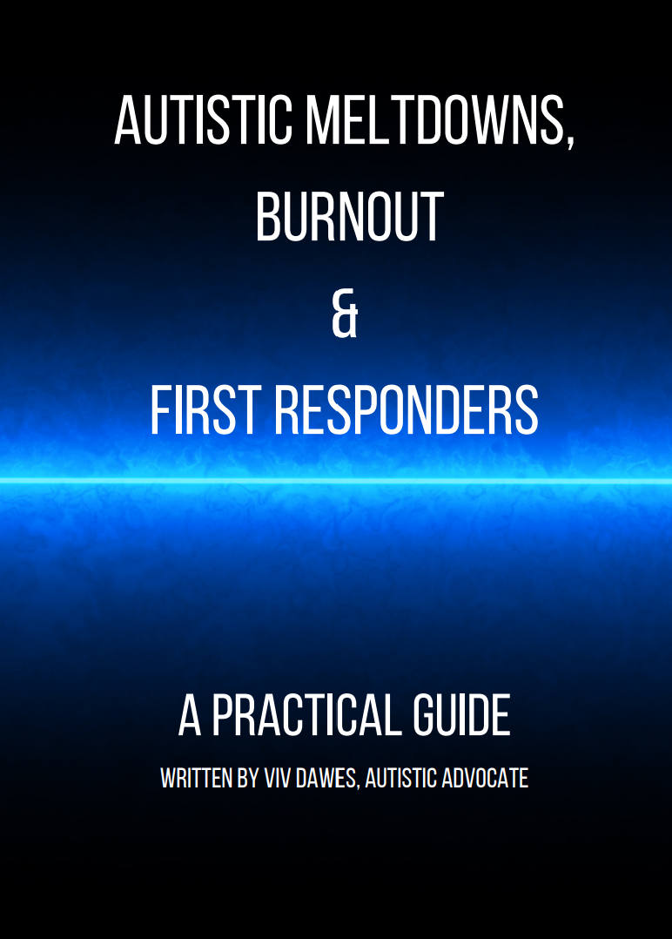
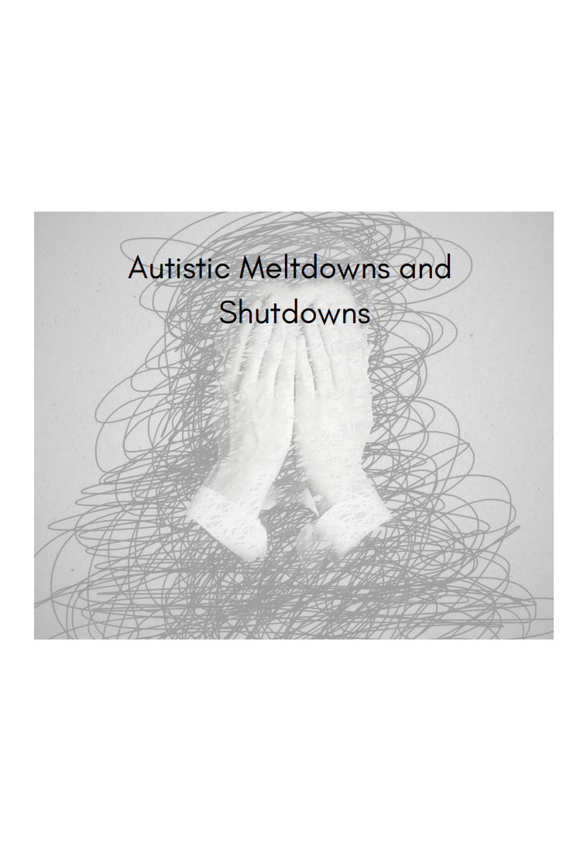
Meltdowns & Shutdowns.
When everything becomes too much for an autistic person, they can go into meltdown or shutdown.
These are very intense and exhausting experiences.
A meltdown happens when someone becomes completely overwhelmed by their current situation and temporarily loses behavioural control.
A shutdown down happens when the autistic person is in 'freeze' mode. The person is very stressed, but
has no energy and may seem very low in mood and withdrawn. It is
common for an autistic person in shutdown to not be able to talk.
Autistic Meltdowns Autistic Burnout and First Responders (careknowledge.com)
Notes:
Sarah

Slide 35
Meltdowns & Shutdowns.
This loss of control can be verbal (e.g. shouting, screaming, crying) and physical (e.g. kicking, lashing out, biting) or both.
Meltdowns in children are often mistaken for temper tantrums and parents and their autistic children often experience hurtful comments and judgmental stares from less understanding members of the public.
A shutdown appears less intense to the outside world but can be equally debilitating.
Shutdowns are also a response to being overwhelmed but may appear more passive - e.g. an autistic person going quiet or 'switching off’.
Notes:
Meg

Slide 36
It is important to remember that even young people who are quite verbal can indicate anxiety through nonverbal behaviours.
Verbal behaviours may also indicate anxiety.
This may include:
Asking more questions than usual;
Speaking at a faster pace;
Speaking at a louder volume;
Greater focus on areas of interest to help the young person feel calm.
Notes:
Meg

Slide 37
Physical Signs Of Anxiety
The mind and body are connected in many ways.
When the mind gets anxious about something, the body will react.
This is part of our fight, flight and freeze response and happens whenever we encounter something that makes us fearful or anxious.
Physical signs of anxiety
Shaking or trembling
Symptoms of long-term stress
Tension headaches
Possible mood symptoms
Can feel overwhelmed about minor things
Sweating
Muscle tension
Looking stiff and tight
Pacing restlessness or jumpiness
Feelings of nausea
Appears flushed
Extremely still or frozen
Eyes wide open
Complains of dizziness
Heart racing
Migraines
Nausea or stomach upset
Diarrhoea
Neck or back pain
Fatigue and low energy
Elevated blood pressure
Frequent colds and infections
Constipation
Clenched jaw or teeth grinding
Ringing in the ears
Says no more often
Becomes impatient
Appears angry
Less willing to follow rules
May startle easily
Notes:
Sarah

Slide 38
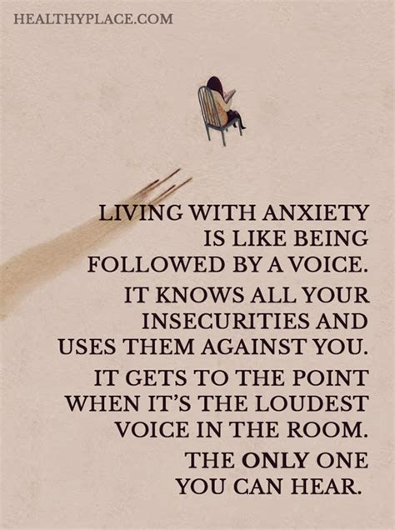
Importance of Acceptance.
Anxiety is personal and affects each of us differently.
The situations we fear, that cause anxiety is very person specific.
The level of anxiety / situation a person is responding to should never be judged.
EVERYONE has the right to feel how they feel.
One person’s anxiety should not be more acceptable than others.
Notes:
Meg

Slide 39
Causes of Anxiety
Notes:
Sarah

Slide 40
Possible causes of Anxiety:
SENSORY SENSITIVITIES
SOCIAL CHALLENGES
COMMUNICATION BARRIERS
TASK FRUSTRATION
RIGIDITY
In his book C, Lynch (2019) identified 5 main reasons (prime suspects) that increase an autistic young people’s anxiety:
Notes:
Sarah

Slide 41
Rigidity – Intolerance to Uncertainty
Autistic young people often show signs of being uncertain about change.
They process the world by details rather than context. When one detail has changed the situation is different and they now need to become comfortable with the new situation.
Autistic people have an intolerance to uncertainty and when things change or don't go the way that they were supposed to or are expected to young people can become highly anxious.
Notes:
Meg

Slide 42
Rigidity – Intolerance to Uncertainty
Changes in the details can lead to confusion and fear.
Young people may experience a meltdown or shutdown.
Autistic people often have difficulty making transitions from one activity / place to another due to the number of changes involved.
This may explain why autistic young people like having routines and keeping things the same. Consistency helps to prevent confusion and anxiety.
The anxiety can be severe and result in challenging behaviour.
Notes:
Sarah

Slide 43
Is the anxiety due to a change in routine?
Does the anxiety seem to happen when things don't go according to plan?
Does the anxiety happen when the young person is asked to stop an activity without advance notice?
Does the anxiety happen when there is a major break in the schedule or routines?
Is the anxiety higher when the child believes that rules have been broken?
Is the anxiety higher when you try to divert from their intense interests?
Rigidity – How to spot a Young Person is Struggling.
Questions to Consider...
Is the anxiety due to a change in routine?
Does the anxiety seem to happen when things don't go according to plan?
Does the anxiety happen when the young person is asked to stop an activity without advance notice?
Does the anxiety happen when there is a major break in the schedule or routines?
Is the anxiety higher when the child believes that rules have been broken?
Is the anxiety higher when you try to divert from their intense interests?
Difficulty adjusting to change
Fixed routines
Difficulty adjusting to transitions
Inflexibility
Restricted and Intense Interests
Notes:
Meg

Slide 44
Is the anxiety due to a change in routine?
Does the anxiety seem to happen when things don't go according to plan?
Does the anxiety happen when the young person is asked to stop an activity without advance notice?
Does the anxiety happen when there is a major break in the schedule or routines?
Is the anxiety higher when the child believes that rules have been broken?
Is the anxiety higher when you try to divert from their intense interests?
Rigidity – Strategies To Support Young People
Use relaxation techniques to reduce and manage symptoms of anxiety.
Try to prevent too many changes occurring in a short space of time.
Offer gentle and genuine praise to the young person when change is handled well.
Prepare the young person for upcoming changes. Provide calm reminders if transitions are about to happen.
Include manageable / positive changes in the schedule and encourage the young person to embrace these surprises**
Use visual aids and naturally occurring events to support the understanding of time. (egg timers, when you have read this chapter, completed this game on the x box)
Having structure to the day and organised environments can support with transitions and change. (specific areas in the class, timetables, resources ready)
Notes:
Sarah

Slide 45
Sensory Sensitivities
Autistic children sometimes have difficulties with regulating sensory information.
Some sensations don't get filtered or processed by the brain effectively.
Because of this, sensations that wouldn't bother most children may seem extremely harsh or even painful to an autistic child.
Children with sensory sensitivities have no choice in how sensations are processed.
Notes:
Meg

Slide 46
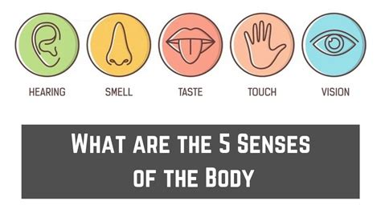
Sensory Sensitivities
Throughout the day we experience countless sensations related to the five senses: sight, sound, smell, taste and touch.
Our brain can filter out sensations that are not relevant to the current situation and help us to focus on the task in hand.
Autistic children often have difficulty with this filtering mechanism and can be acutely aware of each individual sensation.
They can often experience sensations in an intense way.
People do not choose how they process sensory input. What may barely register for those without autism may be experienced as very harsh and intrusive for autistic children.
Notes:
Sarah

Slide 47
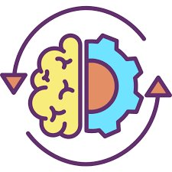
Sensory Sensitivities continued…
Children may get anxious when there is a lot of stimulation going on in general for examples at parties, assemblies or movie theatres.
Sensitivities can occur with specific types of sensory inputs or a child can be sensitive to stimulation in general.
This is not only highly distracting but can cause distress and anxiety.
This anxiety can become high very quickly and can unintentionally lead to challenging behaviour as the child struggles to cope.
Children may become overwhelmed if they have a busy schedule with a number of stimulating activities occurring.
Problems can also occur if young people are under stimulated. If there is a lack of activity available or if the YP does not understand the activity.
Notes:
Meg

Slide 48
Sensory Sensitivities – The Sensory Comfort Zone
Everyone has a range of sensory input that we can tolerate and function well in.
This is our “sensory comfort zone”
Neurotypical Child
UNDER-STIMULATED | SENSORY COMFORT ZONE Comfortable in the situation, functioning well and can tolerate slight variations. | OVERSTIMULATED
Even when over or under stimulated a child who is not autistic is often able to take steps to quickly get back into their comfort zone.
Notes:
Meg

Slide 49
For an autistic child, the sensory comfort zone tends to be quite narrow.
Overstimulation can easily occur.
Difficulties with attention and organisation can make it difficult for the child to start or stick to activities and can quickly lead to under-stimulation.
Autistic Child
UNDER-STIMULATED | SENSORY COMFORT ZONE | OVERSTIMULATED
When an autistic child is out of their sensory comfort zone, they can become quickly distressed and this can make it even more difficult to take steps to get back on track.
Notes:
Sarah

Slide 50
Sensory Sensitivities – How to spot them.
Difficulty with loud sounds
(fire alarms, school bells or the roar of a crowd.)
Difficulty with particular sounds (squeak of markers, someone eating crisps)
Sensitivities to the taste, smell and texture of food which can lead to food refusal.
Sensitivity to smell can lead to challenging behaviour and impact on social lives and public behaviour.
Sensitivity to touch can lead to being sensitive to the feel of certain types of clothing / towels.
Autistic YP can also be highly sensitive to being touched or bumped into unexpectedly by others.
Under –responsive to touch can also lead to YP trying to stimulate their sense of touch through firm bear hugs, chewing on inedible items.
YP can be hyper or hypo sensitive to sight. ( light levels, specific types of lighting)
Many autistic YP experience difficulty making eye contact with others.
Autistic YP can be sensitive to the systems responsible for movement, balance and Body position.
Notes:
Meg

Slide 51
Sensory Sensitivities – How to spot them.
Self –Stimulatory behaviours increase
YP may try to escape / avoid the situation
Behaviour can become challenging as they struggle to cope
Distress can be visible (covered ears, nose)
Questions to Consider...
Does the anxiety happen in places that are known to be noisy?
Are there particular noises that the child has problems with?
Is the anxiety higher in bright places or in certain kinds of lighting?
Does the anxiety happen when the young person is around food?
Is anxiety higher in crowded places like hallways, the playground or the dining hall?
Is the anxiety higher when they have to wear certain kinds of clothing?
Notes:
Sarah

Slide 52
Sensory Sensitivities – Preventative Strategies To Support Young People
Prevent or minimize exposure to sensory overload.
Help the Young Person to anticipate situations where they will encounter sensory challenges.
Discreetly use (to prevent YP being singled out) sensory resources like ear plugs, chewable items, weighted blankets*.
Allow YP leave class early to move to next classes before the rush.
Carefully consider where the YP is sitting in classrooms, halls.
Use of natural light whenever possible can minimize harsh visual sensations.
* The use of some speciality sensory resources need to be overseen by professional occupational therapist.
Notes:
Meg

Slide 53
Strategies To Get Back Into the Sensory Comfort Zone
Autistic Child
UNDER-STIMULATED | SENSORY COMFORT ZONE | OVERSTIMULATED
Avoid Over Scheduling / Over Stimulating
Consider the number of activities scheduled in a short space of time. (A week)
Avoid Under-Scheduling
If there is not enough activity in a YP’s life.
Environmental Control
If you suspect an activity is overstimulating, take steps to make it more tolerable.
When planning activities think about the levels of stimulation involved:
Noise / light levels,
Number of people involved,
Physical energy required,
Number of Transitions involved in the activities
Number of unexpected things.
YP Motivation to take part.
If they cannot access the planned activities.
This leads to challenging behaviour.
There are no strict rules for this as it depends on the YP.
Ensure YP take part in a number of engaging activities each day with one or two “bigger activities” per week.
Go to events when they will be less crowded.
Leave lessons early to reduce busy corridors.
Consider sensory friendly events.
Strategic Breaks
Plan breaks during busy activities.
Schedule the breaks ahead of time and ensure the YP is aware of them in advance.
Alternate exciting activities with calmer ones.
Encourage Self-Regulation
Work With the Young Person.
Work with the YP to identify the signs they are feeling over or under stimulated.
Agree steps / options the YP can use to get back on track.
Teach YP how to self-regulate.
Review the options regularly to remind the young person of their coping strategies.
Notes:
Sarah

Slide 54
Social Challenges
Children with autism often have problems with socialising, it is often considered to be one of the hallmark “symptoms”.
Many struggle to understand the rules that apply to social situations.
Young people may know that they're doing something that is not quite right socially, but they aren't sure of what it is.
This can cause increased frustration and anxiety.
Additionally, other young people may not respond well to the social errors that young people with autism can make, and this too can cause anxiety.
Notes:
Sarah

Slide 55
Social Challenges
Children may experience negative, unpleasant or confusing social experience.
Young people may stop socialising as a way of coping. Avoiding social situations and activities can lead to feeling isolated and increased anxiety.
As the number of these experiences increase, the autistic young person may become increasingly fearful of future social interactions.
Young people may feel frustrated because when social interactions don’t go well and they do not understand why, they cannot learn from their experiences which leads to further feelings of fear and frustration.
To try and improve social skills and support making friends, Young people may be put into more social situations that are overwhelming which can also create increased stress and anxiety.
Notes:
Meg

Slide 56
Social Challenges – How to spot them.
Self –Stimulatory behaviours increase.
YP may try to avoid social situations.
Behaviour can become challenging as they struggle to cope, understand or express themselves.
Difficulty working in groups
YP may become withdrawn or zone out during interactions.
Difficulties with peers – not following rules, not playing the games they wish to play,
Other Peers report YP making seemingly blunt, offensive comments.
YP may seek out pastoral support during break and lunch times and may appear isolated.
YP may struggle during drama, PE, tasks requiring social presentations.
Questions to Consider...
Is the anxiety higher in group situations?
Is anxiety higher before or during a social activity?
Does the child seek escape from social situations?
Does a child often prefer to play alone?
Is anxiety very high when the young person is meeting someone new?
Notes:
Sarah

Slide 57
Social Challenges – Strategies To Support Young People
The following strategies are designed to reduce the anxiety associated with social interactions:
PRACTISE, PRACTISE, PRACTISE – Young people will develop confidence if they practise using social skills in practice sessions. Sessions should use role modelling specific skills and supporting the young person to understand why skills are important – we make eye contact to keep another person’s attention.
Begin with social interactions / activities that are structured (playing a game with definitive rules) as the young person becomes more comfortable you can begin to gradually work towards developing skills in less structured settings (Playground where pupils are doing many activities).
Consider the number of people in the social situation. Generally young people with autism feel more comfortable in smaller group situations. It may be best to focus on interactions involving one or two others initially.
Approach social challenges gradually, help the young person to develop their confidence in small steps, over time.
Notes:
Meg

Slide 58
Social Challenges – Strategies To Support Young People
Use activities the young person is familiar with. Confidence will be higher if young people are interacting while doing an activity they are familiar with and enjoy. This may including beginning with interactions that incorporate the young person’s interests.
Support young people in real-life situations. Young people will need time and support to apply developing skills and this will require involving everyone who is involved in the young person’s daily life to be mindful of their growing confidence and to reinforce positive social skills.
Notes:
Meg

Slide 59
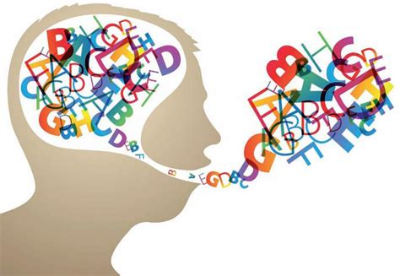
Communication Barriers
Many autistic children struggle with speech and language.
Problems with communicating can be frustrating and anxiety provoking.
Children who have core language skills may still have difficulty with understanding more subtle or complex forms of language.
Speech and language difficulties may also make it difficult for a young person to express when they are distressed or be verbally comforted.
What is autism
Notes:
Sarah

Slide 60
Communication Barriers
Difficulties with processing, understanding and using language can lead to confusion and frustration. The young person can struggle to understand what is being asked but also struggles to explain how they feel and the knowledge they have.
If a young person struggles to get the right words out, the listener can become confused or impatient which can further increase frustration and anxiety, especially if the young person is asked to repeat themselves.
Increased anxiety or distress levels can make speech difficulties worse.
The older pupils get, the more they are required to rely on their understanding of language and this results in increased frustration and anxiety.
When young people struggle to understand what other people are trying to say it can be challenging to support or comfort a child when they are distressed. When we try to comfort with lots of words this can overwhelm children who are already anxious.
Notes:
Meg

Slide 61
Communication Barriers– How to spot them.
Questions to Consider...
Is the anxiety higher when a young person is required to process a lot of language?
Is the anxiety higher during group discussion?
Does the young person struggle engaging in conversation?
Is the young person anxious when they struggle to get their point of view across?
Is anxiety higher when the young person is interacting with people who may not understand their speech?
YP struggles with vocabulary or finding the right word.
YP finds it difficult to process and use language.
Often uses short, simplifies sentences.
YP can become frustrated / anxious when asked to explain an answer or knowledge.
YP may appear to tune out when others are speaking as it is difficult to process and understand
Taking things literally and not understanding abstract concepts.
Needing extra time to process information or answer questions.
Repeating what others say to them (this is called echolalia).
Needing extra time to process information or answer questions.
Notes:
Sarah

Slide 62
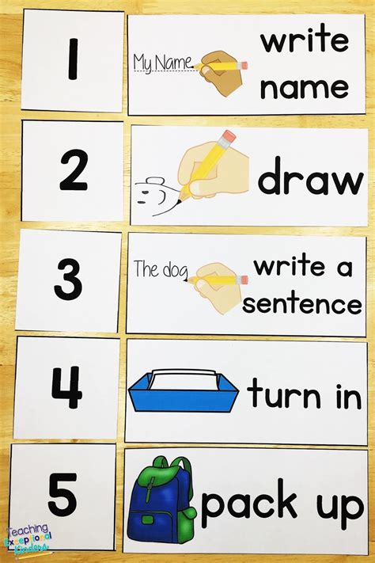
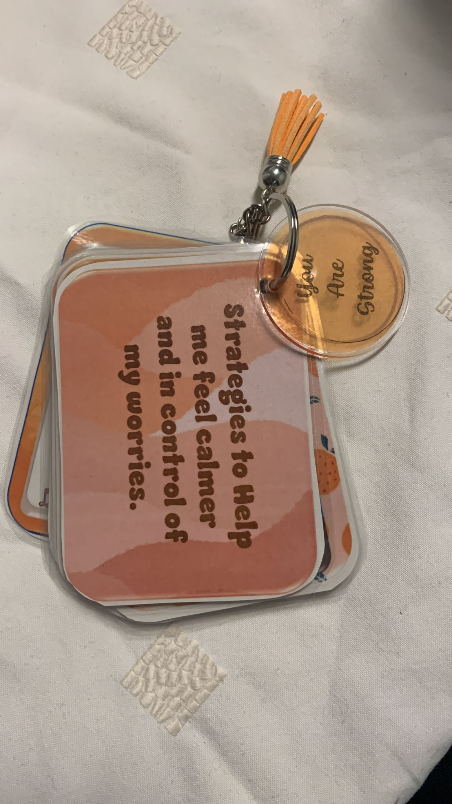
Communication Barriers– Strategies to Support Young People.
The following strategies are designed to reduce the anxiety associated with communication barriers:
Use Visual Supports. Autistic young people tend to be visual learners and will find it easier to understand information when it is visually represented using photographs, drawings, diagrams, symbols or physical demonstrations.
Visual supports can be used to:
provide understanding of what will be happening during the day / routine,
provide reminders of tasks or chores,
explain rules and guidelines for behaviours,
remind young people of consequences for behaviour,
Explain instructions and break larger tasks down into simple steps,
To support a child with expressing feelings,
To remind a child of available coping strategies,
Help prepare a young person to get used to a new situation. (Medical appointments, meeting new professionals)
Provide visual prompts for the passing of time (egg timers etc)
Notes:
Meg

Slide 63
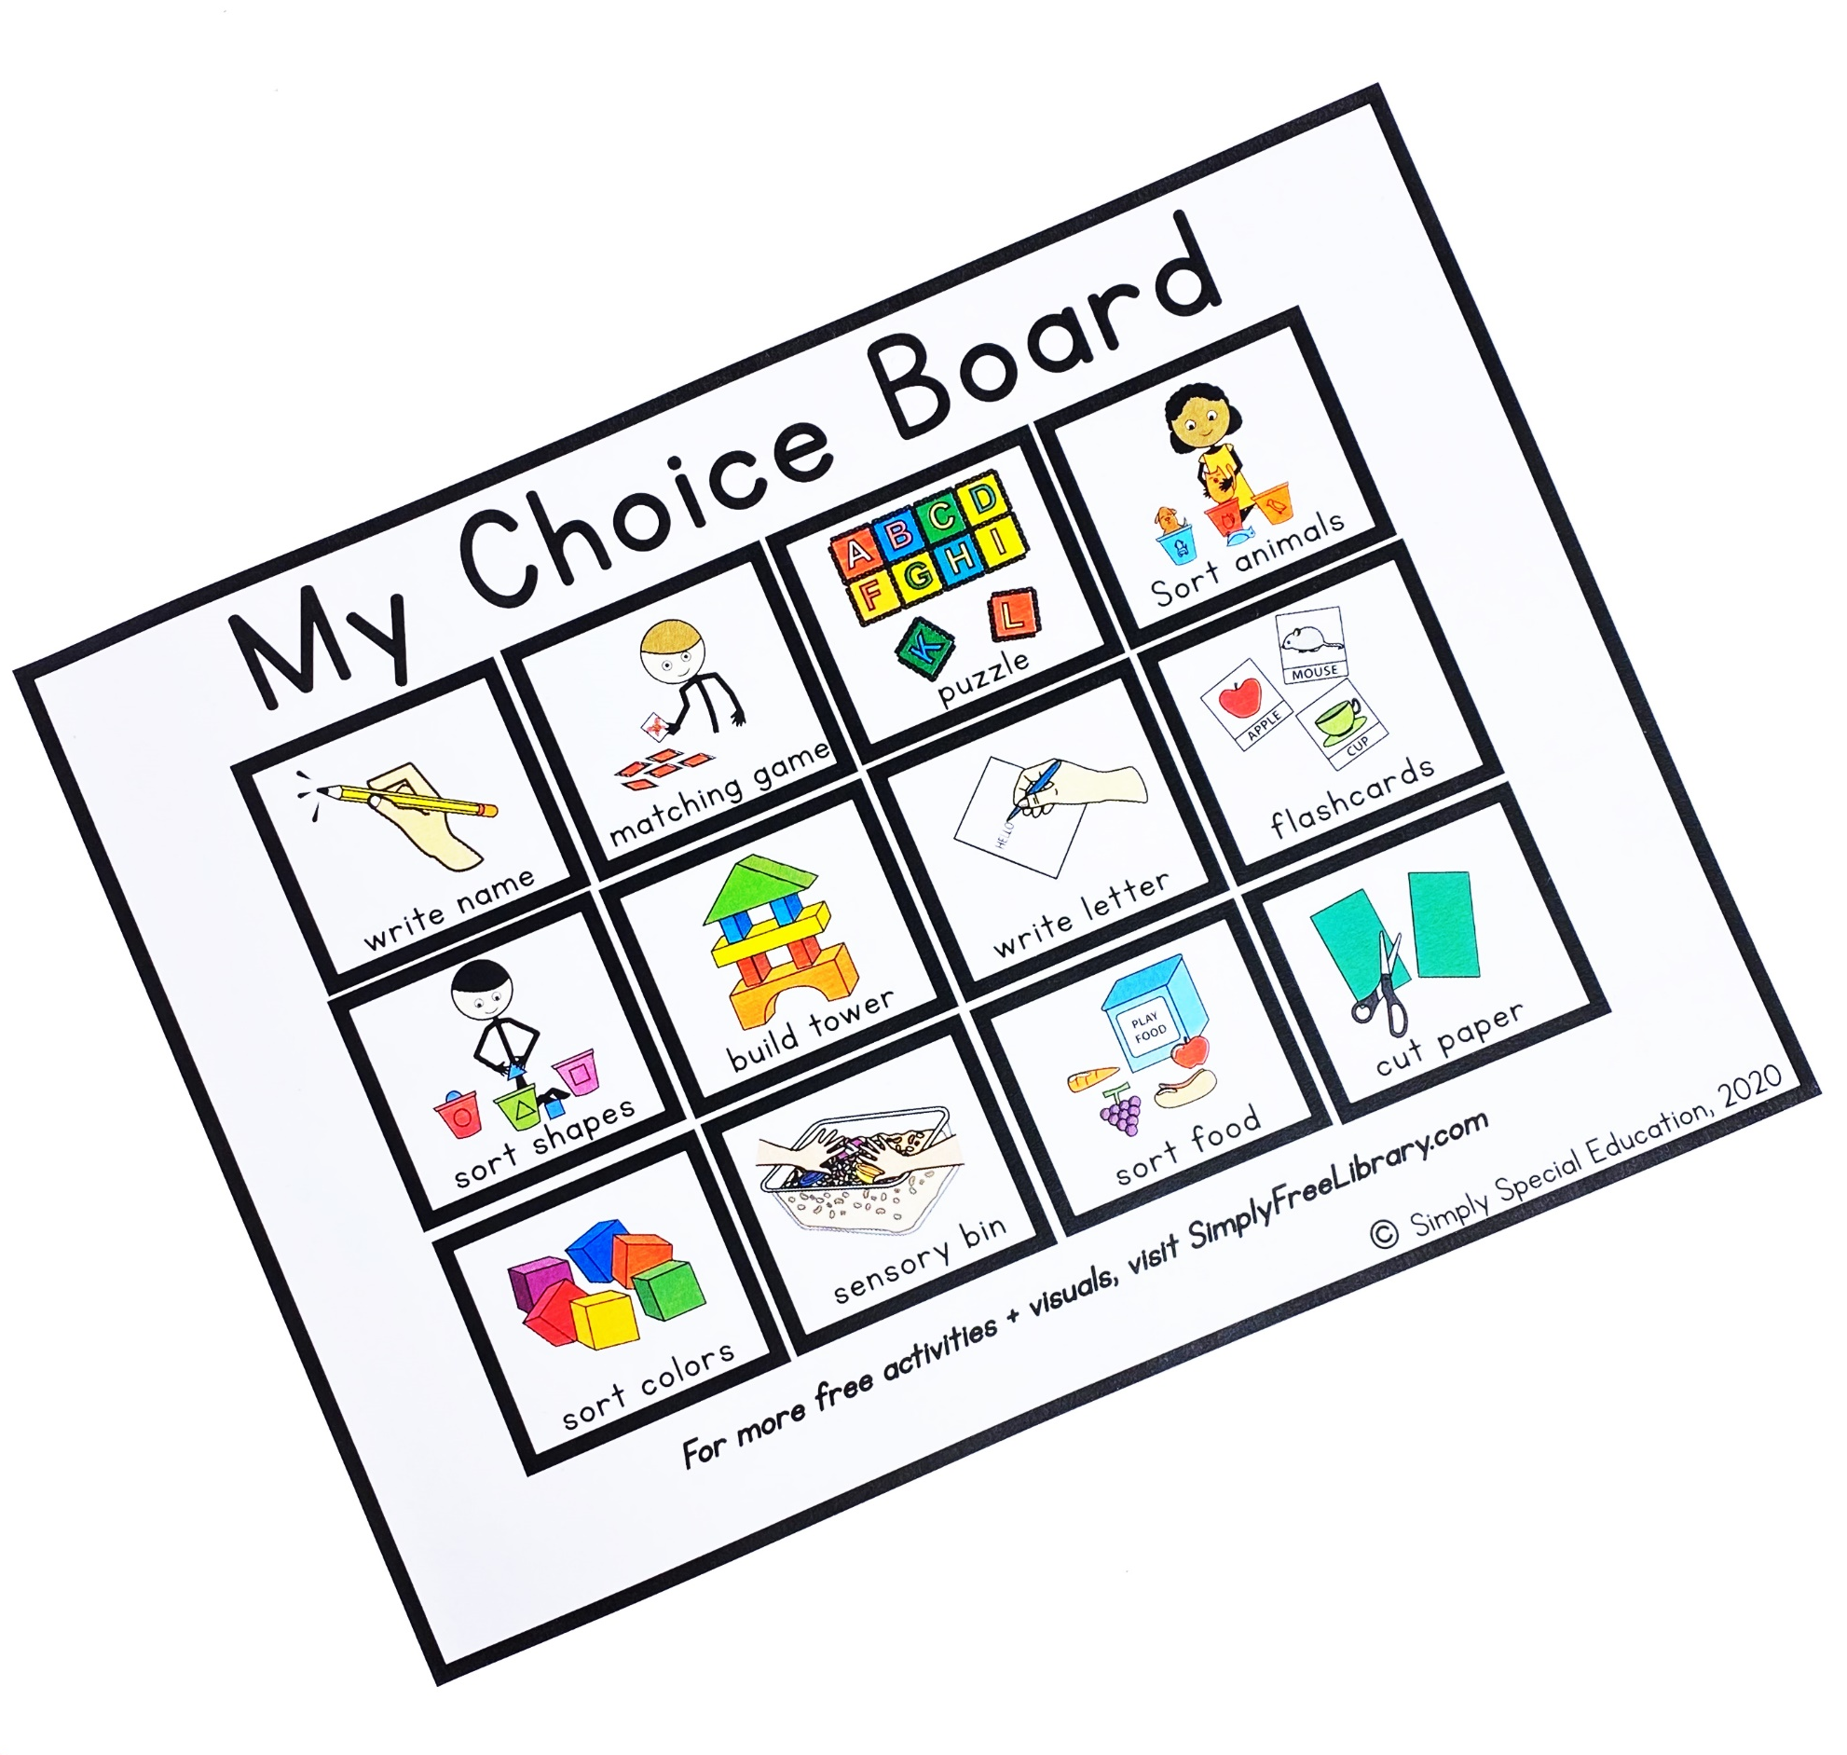
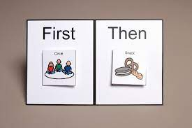
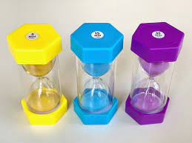
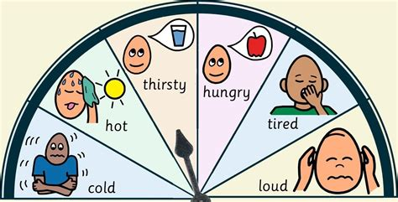
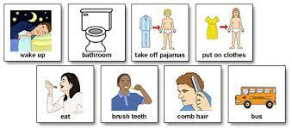
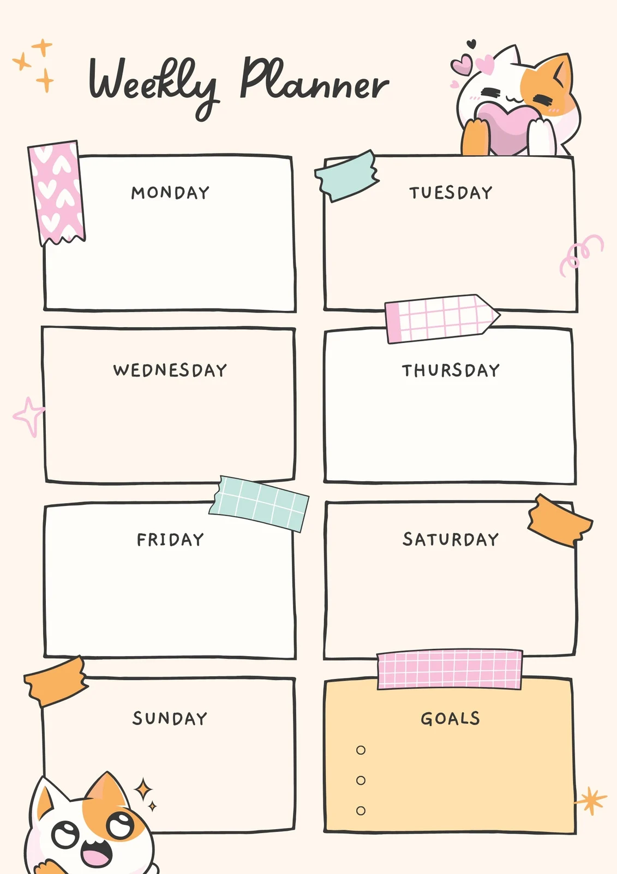
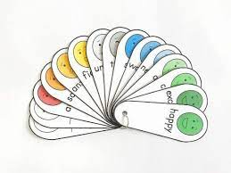
Communication Barriers– Strategies to Support Young People.
Notes:
Sarah

Slide 64
Communication Barriers – Strategies To Support Young People
Deliver information at a manageable pace – share one instruction, piece of information at a time.
Ensure you have the young person’s attention (make eye contact, address them by name, minimise distractions) and ask the child to repeat an instruction to check understanding.
Social narratives/social stories, patient journey and comic strips help understanding situations and what is to be expected.
Try not to ask too many questions / use lots of words / jargon.
Give a 6-10 second processing time.
Notes:
Meg

Slide 65
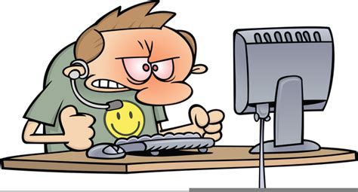
Task Frustration
Autistic children have many talents – both academically and personally.
Sometimes, young people struggle in particular areas of school and daily life and the young person can quickly become frustrated, anxious and overwhelmed by tasks.
Task frustration can happen across a range of situations including whilst playing, getting dressed, doing an art and crafts project, socialising or completing schoolwork.
Notes:
Sarah

Slide 66
Task Frustration
Children may struggle with both fine or gross motor skills. Affecting ability to perform in PE class, participate in a sport, use scissors, tying shoelaces or writing.
Children may struggle with organizing their time well.
Young people may spend a lot of time studying but focus on the wrong topic.
Young people recall facts about a subject confidently but struggles to organise thoughts to write an essay about it.
Autistic young people will read fluently and accurately but can struggle understanding what they have read.
Often, when video gaming young people can become quickly frustrated if there is a glitch, the game doesn’t go the way they were expecting or it does not save properly.
Notes:
Sarah

Slide 67
Task Frustration – How to spot them.
Questions to Consider...
Is the anxiety higher at school than at home?
Is the anxiety higher during homework completion?
Is the anxiety higher during fine-motor tasks? (cutting with scissors, tying shoelaces or writing)
Is the anxiety higher during gross-motor activities? (Doing sports, physical activity)
Is there frustration / anxiety around writing or reading?
Is anxiety higher during a particular subject or during a particular kind of task?
YP struggles with concentrating or organizing their time well.
YP finds it difficult to complete fine-motor skill tasks like tying shoelaces, cutting things out , writing and riding a bike.
YP feels Frustration with tasks like homework and this often leads to avoidance of tasks
YP can become frustrated / anxious when making mistakes / errors.
YP may find it difficult to complete gross-motor tasks like catching a ball, running and playing sports.
Notes:
Meg

Slide 68
Task Frustration – Strategies to Support Young People.
The following strategies are designed to reduce the anxiety associated with task frustration:
Seek support from school to discuss concerns about learning.
Ensure young people know who, when and how to ask for help in different situations. Think about when they may struggle and who can help.
Support children to develop time management skills by planning out when homework is due and when they will complete it.
Plan the time they will spend on a task, using a visual timer or clock and follow tasks with a relaxing, enjoyable activity.
Consider the timing of Tasks – time of day, after a snack, earlier in the week, avoiding last minute.
Notes:
Sarah

Slide 69
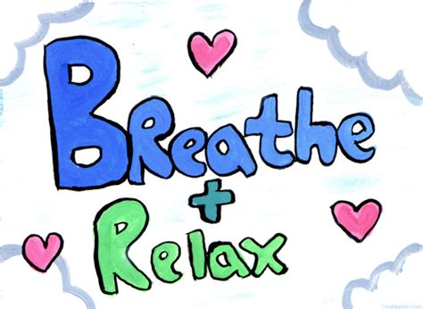
Task Frustration – Strategies to Support Young People.
Encourage time to relax. It is important to take a break from expectations to perform. This could include playing outside, reading, playing sport, games, spending time with a family pet or just relaxing.
Support young people with organisation by encouraging important items to be kept in the same place.
Use labels, visual checklists to support routines and organisation.
Notes:
Sarah

Slide 70
Additional
Strategies to Support Autistic Young People to Manage their Anxiety
Notes:
Meg

Slide 71
Encourage young people to use coping strategies to manage the symptoms of anxiety.
Breathing, distraction and relaxation techniques.
Notes:
Meg

Slide 72
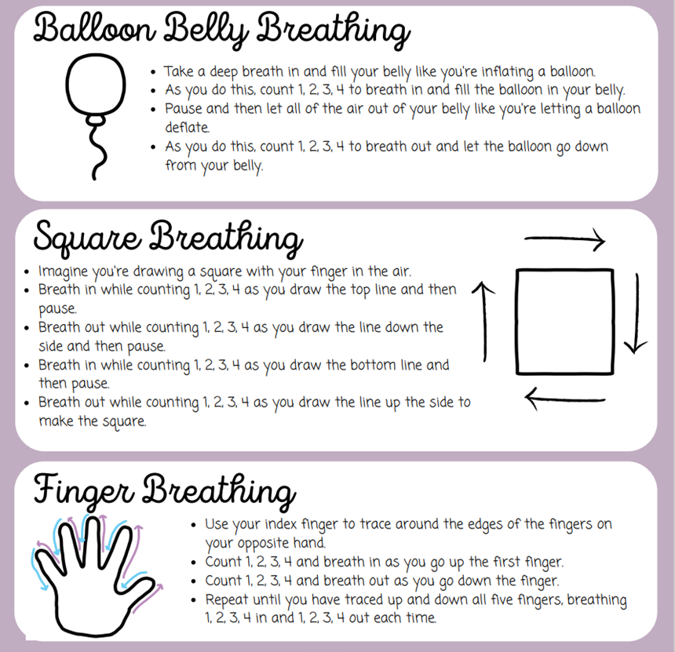
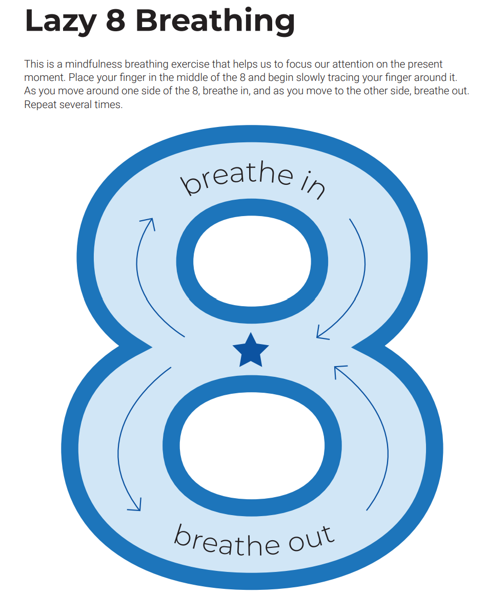
Is the anxiety due to a change in routine?
Does the anxiety seem to happen when things don't go according to plan?
Does the anxiety happen when the young person is asked to stop an activity without advance notice?
Does the anxiety happen when there is a major break in the schedule or routines?
Is the anxiety higher when the child believes that rules have been broken?
Is the anxiety higher when you try to divert from their intense interests?
Breathing Techniques.
Notes:
Sarah

Slide 73
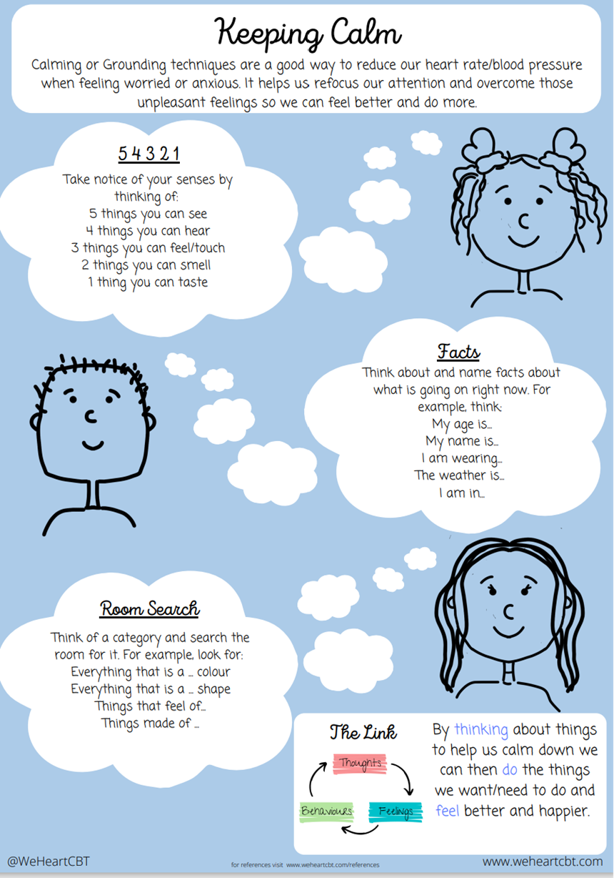
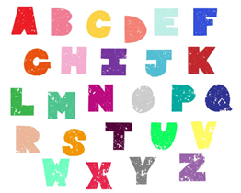
Is the anxiety due to a change in routine?
Does the anxiety seem to happen when things don't go according to plan?
Does the anxiety happen when the young person is asked to stop an activity without advance notice?
Does the anxiety happen when there is a major break in the schedule or routines?
Is the anxiety higher when the child believes that rules have been broken?
Is the anxiety higher when you try to divert from their intense interests?
Distraction Techniques.
The A-Z Game
Pick a topic! Animals, food, countries, films, music etc. Start with the letter A and work your way through to the letter Z.
Notes:
Meg

Slide 74
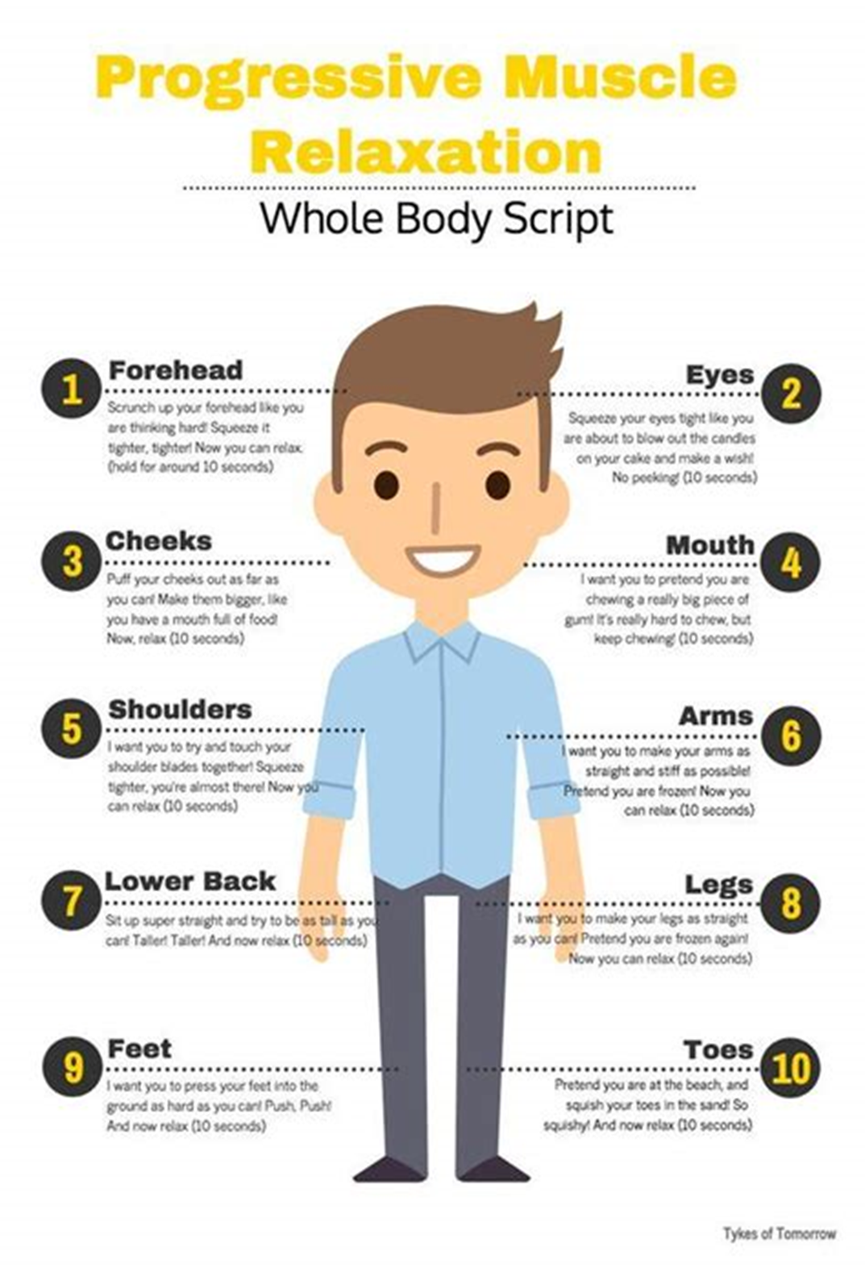
Relaxation Techniques.
Meditation/mindfulness
Progressive muscle relaxation
Stretching or yoga
Colouring/drawing/painting
Journaling
Managing Anxious Thoughts And Stress With Mindfulness (youtube.com)
Notes:
Sarah

Slide 75
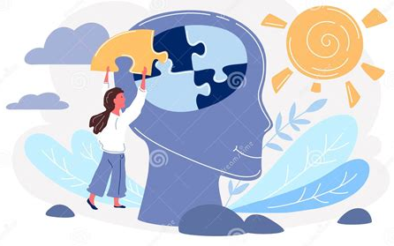
Is the anxiety due to a change in routine?
Does the anxiety seem to happen when things don't go according to plan?
Does the anxiety happen when the young person is asked to stop an activity without advance notice?
Does the anxiety happen when there is a major break in the schedule or routines?
Is the anxiety higher when the child believes that rules have been broken?
Is the anxiety higher when you try to divert from their intense interests?
Psychoeducation
This provides young people and families with education and understanding about anxiety or other common mental health difficulties.
Sometimes understanding what happens and why is the first step in helping to manage our difficulties.
Notes:
Sarah

Slide 76
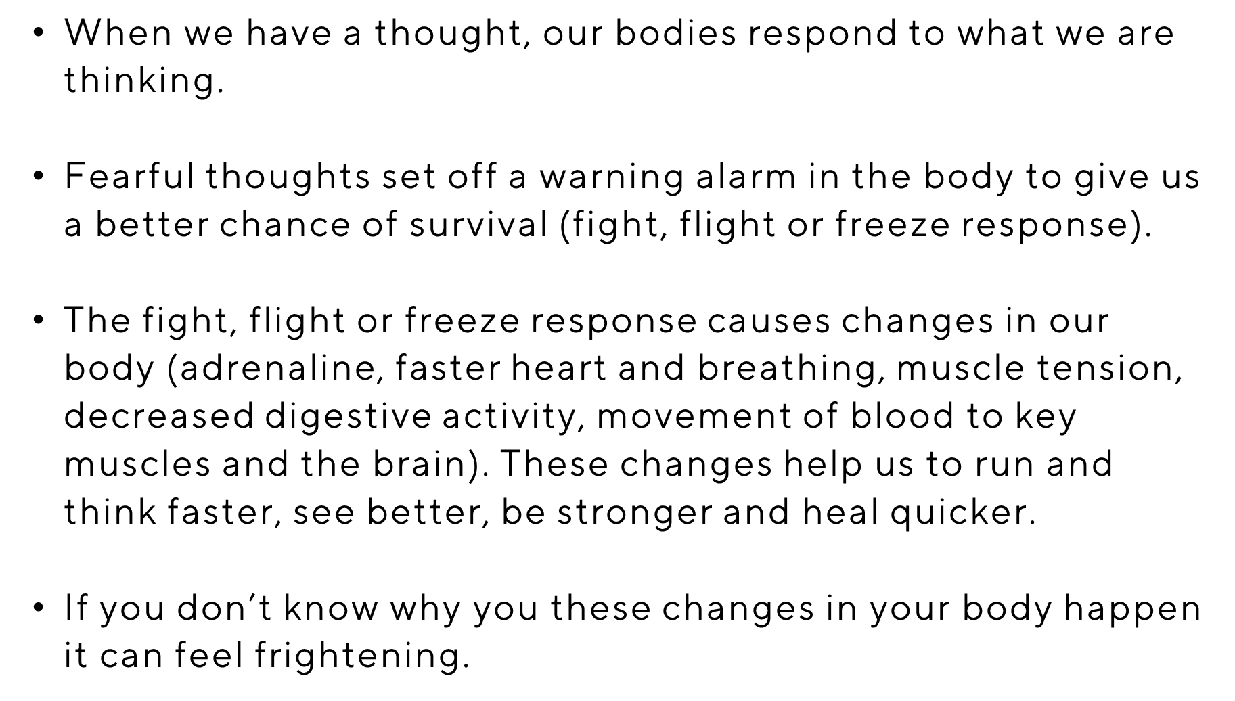
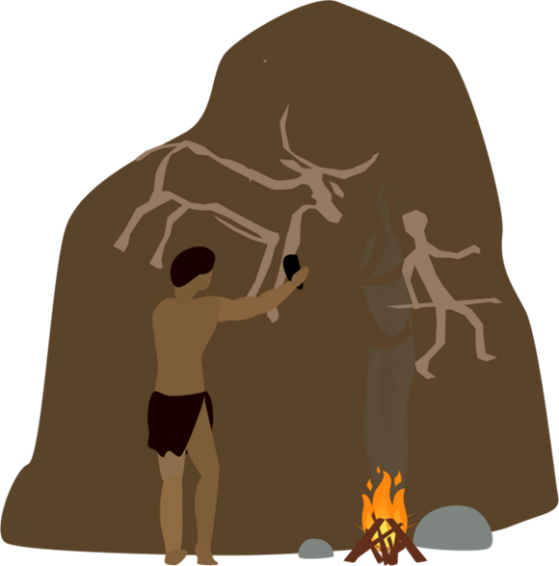
Is the anxiety due to a change in routine?
Does the anxiety seem to happen when things don't go according to plan?
Does the anxiety happen when the young person is asked to stop an activity without advance notice?
Does the anxiety happen when there is a major break in the schedule or routines?
Is the anxiety higher when the child believes that rules have been broken?
Is the anxiety higher when you try to divert from their intense interests?
Our body's response to anxiety
Notes:
Meg

Slide 77
Is the anxiety due to a change in routine?
Does the anxiety seem to happen when things don't go according to plan?
Does the anxiety happen when the young person is asked to stop an activity without advance notice?
Does the anxiety happen when there is a major break in the schedule or routines?
Is the anxiety higher when the child believes that rules have been broken?
Is the anxiety higher when you try to divert from their intense interests?
The Fight, Flight & Freeze Response
We need anxiety.
It is a normal alarm system that everyone has.
The emotions we feel come and go but it is not dangerous.
FREEZE
FIGHT
FLIGHT
Notes:
Sarah

Slide 78
Is the anxiety due to a change in routine?
Does the anxiety seem to happen when things don't go according to plan?
Does the anxiety happen when the young person is asked to stop an activity without advance notice?
Does the anxiety happen when there is a major break in the schedule or routines?
Is the anxiety higher when the child believes that rules have been broken?
Is the anxiety higher when you try to divert from their intense interests?
The Amygdala Hijack
Notes:
Meg

Slide 79
Is the anxiety due to a change in routine?
Does the anxiety seem to happen when things don't go according to plan?
Does the anxiety happen when the young person is asked to stop an activity without advance notice?
Does the anxiety happen when there is a major break in the schedule or routines?
Is the anxiety higher when the child believes that rules have been broken?
Is the anxiety higher when you try to divert from their intense interests?
Brain Development
Our brains are not fully developed until we are between 22 - 25 years old.
It is normal during adolescence for there to be lower reasoned/rational thinking, more impulsiveness and a tendency to respond emotionally.
In addition, taking another person's perspective into account can be difficult.
Notes:
Sarah

Slide 80
Is the anxiety due to a change in routine?
Does the anxiety seem to happen when things don't go according to plan?
Does the anxiety happen when the young person is asked to stop an activity without advance notice?
Does the anxiety happen when there is a major break in the schedule or routines?
Is the anxiety higher when the child believes that rules have been broken?
Is the anxiety higher when you try to divert from their intense interests?
Support and Information Available
Notes:
Meg

Slide 81
Role of MHST in offering support
To deliver evidence-based interventions for mild-to-moderate mental health issues.
To support schools to develop their whole school approach to mental health.
Provide signposting and advice and liaise with external specialist services to help children and young people to get the right support.
Worry management and graded exposure.
Coping strategies.
Adjusting session content and times.
Training for staff.
Workshops for parents.
Psychoeducation workshops.
Signposting to GP and additional services in the community.
Notes:
Meg

Slide 82
Signposting
Watch the Anxiety Webinar for Teens: https://www.youtube.com/watch?v=gkqTXCB3P-A
National Autistic Society – The National Autistic Society is the leading charity in the UK for autistic people and their families. Provides support, guidance, advice, campaigning, and services to help create a society that works for autistic people: https://www.autism.org.uk/
Wigan Autism Pathway and Service - https://www.wigan.gov.uk/Resident/Education/Educational-support/Autism.aspx
Tel: 0300 707 1446
Email: wwl-tr.neurodevelopmentpathway@nhs.net
Wigan Family Hubs - https://directory.wigan.gov.uk/kb5/wigan/fsd/localoffer.page?localofferchannel=0
Embrace - User-led charity dedicated to supporting disabled people and their families. They have a range of projects in Wigan and Leigh that aim to enhance the lives of the people they support.
https://www.embracewiganandleigh.org.uk/about-us/
Tel: 01942 233323
Email: info@embracewiganandleigh.org.uk
Spectrum Gaming - An autistic-led UK based charity that supports autistic young people. Offers online and face to face services, training and advocacy: https://www.spectrumgaming.net/about-us
Wigan Parent Carer Forum - Collective voice of parents/carers of children and young people age 0-25 in Wigan Borough with Special Educational Needs and/or Disabilities (SEND): https://www.wiganpcf.org.uk/
Notes:
Sarah

Slide 83
Urgent or emergency support
If you have urgent concerns about your child's mental health, but it is not an immediate or life-threatening risk, we advise contacting: Wigan CAMHS duty team on 01942 764473 (9am - 5pm) or call NHS 111.
If it is an emergency and you feel your child cannot keep themselves safe, if they have harmed themselves or are making serious threats/plans to harm themselves or end their life, we advise calling 999 and/or visiting your nearest A&E to get immediate help.
Out of hours – Wigan Mental Health Urgent Response Team: 0800 051 3253 Parents and young people can contact the 24/7 mental health crisis line for people of all ages in Wigan.
Notes:
Meg

Slide 84
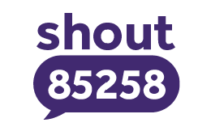
Useful Websites
YoungMinds | Mental Health Charity For Children And Young People | YoungMinds
www.kooth.com
Kooth is a free online counselling and emotional wellbeing support service providing young people aged 11-25 years with a safe and secure means of accessing support from a professional team of qualified counsellors.
YoungMinds are a mental health charity for children, young people and their parents, making sure all young people can get the mental health support they need.
Free, 24/7 mental health text support in the UK | Shout 85258 (giveusashout.org)
https://www.childline.org.uk/about/about-childline/
Shout is a 24/7 text service, free on all major mobile networks in the UK, for anyone in crisis. It’s a place to go if you’re struggling to cope and you need immediate help. At the heart of the service is a team of volunteers who take people from crisis to calm every single day.
Childline is here to help anyone under 19 in the UK with any issue they’re going through.
You can talk about anything. Whether it’s something big or small, our trained counsellors are here to support you.
Childline is free, confidential and available any time, day or night. You can talk to us:
Notes:
Sarah

Slide 85
Support Available for Parents:
Think Wellbeing – offers free NHS therapy for people registered with a Wigan GP with common mental health problems like anxiety or low mood. It is a self-referral service. Visit www.gmmh.nhs.uk/think-wellbeing
Qwell – access free, safe and anonymous mental wellbeing support for adults. Access online messaging, general information, personal development tools or book a drop-in session as and when you need it. Visit www.qwell.io
Young Minds Parent Helpline – offers support and advice to parents/carers who are supporting a young person with a mental health problem. Call 0808 802 5544 (9:30-4pm during the week). Also a Webchat service, access through www.youngminds.org.uk/parent/parent-helpline-and-webchat/
This May Help – access free NHS advice and practical ways to support your child’s mental health.
Visit Home | ThisMayHelp
Notes:
Meg

Slide 86
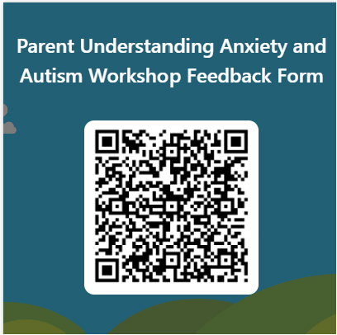
Your Feedback is Important to us.
Notes:
Meg

Slide 87
Thank you for listening.
Do you have Any questions?
Notes:
Sarah

