Slide 1
Year 10 Guidance Evening
Thursday 10th October 2024

Slide 2
In the classroom
Information will be given about:
Linear exam system (meaning behind the numbers)
Target setting process 2024/2025
Understanding your child’s data
Progress and ATL data and dates
How you can help your child

Slide 3
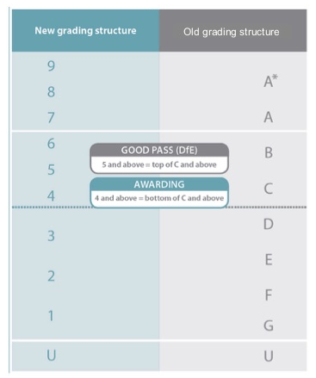
Important Changes – A Reminder:
Coursework has been removed from a number of GCSE subjects
GCSEs are graded from 9 to 1 (instead of A*-G)
The numbers awarded loosely correspond with previous grades

Slide 4
Year 10 – National Expectations
Fischer Family Trust (FFT)
Significant changes have taken place nationally in relation to GCSE grade boundaries over recent years

Slide 5
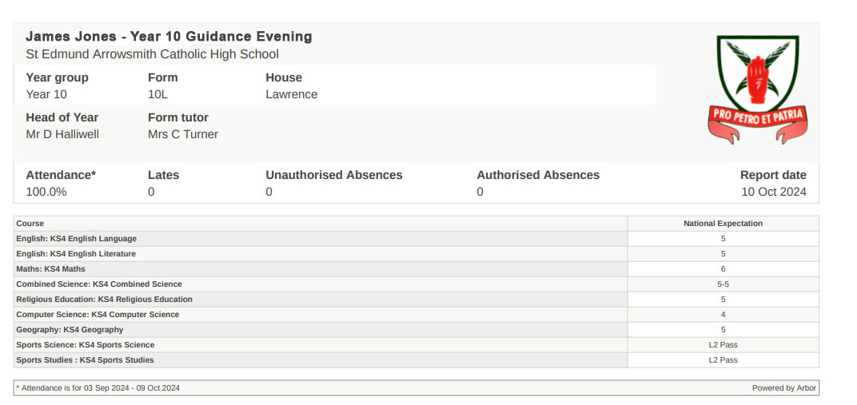

Slide 6
Year 10 ‘Targets’
Fischer Family Trust (FFT)
Significant changes have taken place nationally in relation to GCSE grade boundaries over recent years
For student targets this year, we will adopt a two-step process
1. ‘National Expectation Grade’ to be shared with student and parents at the start of their GCSE studies.
2. Students will be continually assessed throughout the first term of their GCSEs by their class teachers. Their ‘National Expectation Grade’ will be reviewed after February half term and a ‘Target Grade’ will be issued. Target grades will not fall below National Expectation therefore, grades may go up, but they will not come down.

Slide 8
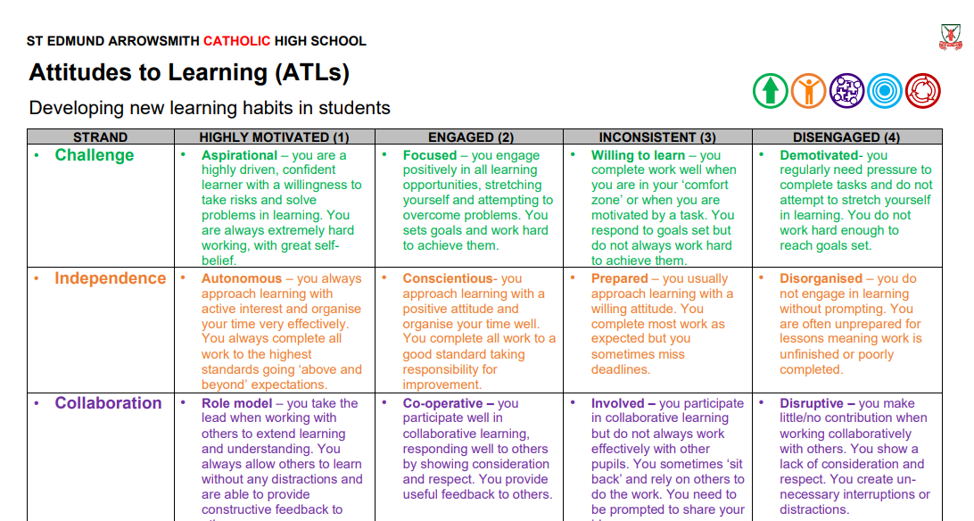
Attitudes to Learning

Slide 9
Attitudes to Learning
1. Highly Motivated
Aspirational, Autonomous, Role model, Persistent, Proactive
2. Engaged
Focused, Conscientious, Co-operative, Hardworking, Reflective
3. Inconsistent
Willing, Prepared, Involved, Hesitant, Reliant
4. Disengaged
Demotivated, Disorganised, Disruptive, Resistant

Slide 10
How can you help your child?
Talk to your child about their work and use Arbor to monitor homework
01
Provide a quiet study area away from ‘temptation’ - Consider confiscating their phones for a couple of hours each evening
02
Help them organise books and files: they will be needed at practice test and exam times
03
Encourage a routine – no homework means time for revision
04
Encourage pupils to access revision materials
05
Remind them that every test is an important test
06

Slide 11
How can you help your child?
Talk to your child about their work and use Arbor to monitor homework
Provide a quiet study area away from ‘temptation’ - Consider confiscating their phones for a couple of hours each evening
Help them organise books and files: they will be needed at practice test and exam times
Encourage a routine – no homework means time for revision
Encourage pupils to access revision materials
Remind them that every test is an important test

Slide 12
Tracking your child’s progress
National Expectation Grades issued at Year 10 Guidance Evening
AtL judgements emailed home in the final week of each half term
Target Grades issued after February half term and communicated with students and parents.
Pupil progress measured against the above grades at two key points during Year 10:
Year 10 Mock Examinations
End of Year 10 Examinations
Y10 Mock Examinations – 28th November – 6th December 2024
Y10 Parents’ Evening - Thursday 16th January 2025
End of Year 10 Examinations – 2nd June – 20th June 2025
Y10 End of Year Review – 8th July 2025
Please check Arbor on a regular basis for live reports of your child’s performance

Slide 13
Thank You
YOUR SUPPORT MAKES A HUGE DIFFERENCE!!!

