Slide 1
Year 10 Careers Education and Guidance
Preparing for education, employment or training after St Edmund Arrowsmith

Slide 2
Comprehensive Careers Education Programme
Includes a variety of engaging and meaningful activities, such as:
Pastoral Curriculum Lessons: Careers education is integrated into the wider Personal Development curriculum for Years 7 to 11.
Assemblies and Careers Workshops: Inspiring talks and interactive sessions led by careers advisers, employers and teachers.
Careers Learning in Lessons: Subject teachers link curriculum content to career pathways and opportunities.
Employer Visits: Opportunities to meet and interact with employers on-site.
Workplace Experience: Real-world placements to build employability skills.
One-to-One Guidance: Personalised career advice for every student in KS4.

Slide 3
Why Careers Education Matters in Year 10
Helps pupils make informed post-16 choices
Introduces a wide range of pathways: college, sixth form, apprenticeships, training and employment
Develops essential skills: communication, teamwork, problem-solving, and self-reflection
Provides meaningful encounters with employers, colleges, and universities
Helps pupils understand their strengths, interests, and career aspirations
Builds confidence and knowledge to plan effectively for future education and career decisions

Slide 4
Careers Programme in Year 10
Offers pupils a wide range of opportunities to explore future pathways and prepare for life after school.
Activities include careers fairs with colleges, employers, training providers, and apprenticeships, pastoral sessions on decision-making and career planning, and the development of personal statements and CVs.
Pupils gain insights into college and university life through taster days and visits to institutions like Wigan and Leigh College, St John Rigby College, and Russell Group universities.
The Workplace Experience allows students to visit local employers, understand the skills and qualities valued in the workplace, and explore potential careers.
The programme helps pupils make informed choices about GCSEs, post-16 options, and future career pathways while building essential skills and confidence

Slide 5
Key Activities in Year 10
Pastoral Curriculum:
My Career Journey
What type of Career is best for me?
Wellbeing in the Workplace
What is a CV?
What is a Personal Statement?
Step-by-Step guide for writing your CV and Personal Statement
Introduction to Pathways, Post 16 (Careers Lessons):
Pupils will explore the different pathways available after school and learn how their choices can shape their future.
College Taster Days:
St John Rigby, Winstanley, Wigan & Leigh College
University Open Day:
Leeds University
Workplace Experience:
Students will arrange a visit to a local workplace, completing a Workplace Experience booklet and engaging with employers to learn about the environment and roles.

Slide 6
Linking Learning to Careers
School Careers Week – 23rd March 2026
Aims:
Inspiration – Encourage pupils to think ambitiously about their future possibilities.
Relevance – Show how school subjects and skills link to real-world careers.
Engagement – Provide opportunities to hear from employers, further education providers, and role models.
Reflection – Give pupils time to consider their interests, strengths, and possible future goals.

Slide 7
Supporting Pupils at Home
Discuss future aspirations and career ideas.
Encourage exploration of interests and skills.
Seek opportunities for volunteering
Support preparation for interviews and applications.
Keep open communication about post-16 options.

Slide 8
Preparing for the Future
Knowledge of Careers and Opportunities
Exploration of career sectors: Pupils gain insights into different industries, roles, and future trends.
Understanding qualifications: They learn how GCSEs, A-levels, vocational courses, and apprenticeships link to different career paths.
Labour market awareness: Awareness of growing sectors, local job opportunities, and required skills prepares pupils to make informed decisions
Post-16 Planning
Option choices: Guidance on selecting subjects that align with career aspirations and strengths.
Pathways awareness: Understanding the pros and cons of sixth form, college, apprenticeships, and employment.
Career progression: Early exposure to higher education and vocational routes helps pupils plan for the future.

Slide 9
Parental Involvement
Engage in meaningful discussions at home about your children’s strengths, interests, and ambitions, complementing the concepts explored in our Careers Education curriculum.
Conversations are instrumental in helping students make informed and confident decisions about their future pathways.
Opportunities for parents to support careers events or share experiences:
Event | Date | Time
Years 9-11 Careers Fair | Thursday 12th September | 8:30am – 4:15pm
Year 11 Mock Interview Day | Thursday 7th November | 8:30am – 2:00pm
Year 9 STEM and Wider Careers Networking Event | Thursday 9th January | 8:30am-10:00am
Year 7 Meet the Professional (Careers lessons) | March - April | Various lesson times
Year 8 Raising Aspirations Presentations (Careers lessons) | May - June | 8:30am – 8:55am online
Year 8 Broadening Horizons (Careers lessons) | June - July | Various lesson times
Year 10 Workplace Experience | October -June | *Can you offer a placement?

Slide 10
Next Steps
Careers interviews with advisers (individual one-to-one appointments).
Research post-16 options: sixth form, college courses, apprenticeships.
Engage in work experience and employer encounters.
Continue building skills and reflecting on strengths/interests.

Slide 11

Workplace Experience
Between now and the summer term, students have a task to visit a workplace:
It can be a family member, friend or neighbour
Somewhere you might like to work
A possible part time job in the future
Opportunity to seek/arrange some volunteering
*Students must attend with a Parent/Carer. THEY MUST NOT ATTEND ALONE!
*They must NOT attend in school time.

Slide 12
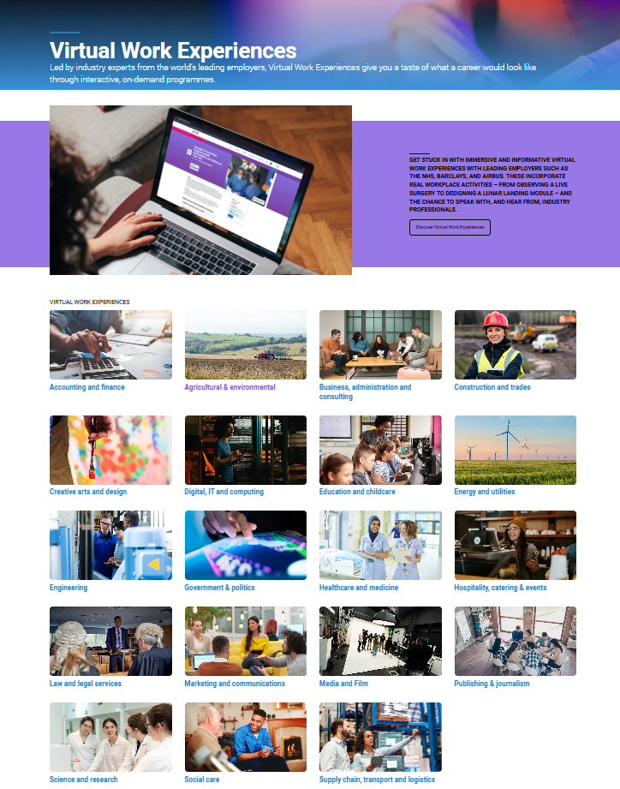

Virtual Work Experience can be accessed by scanning the QR code.

Slide 13
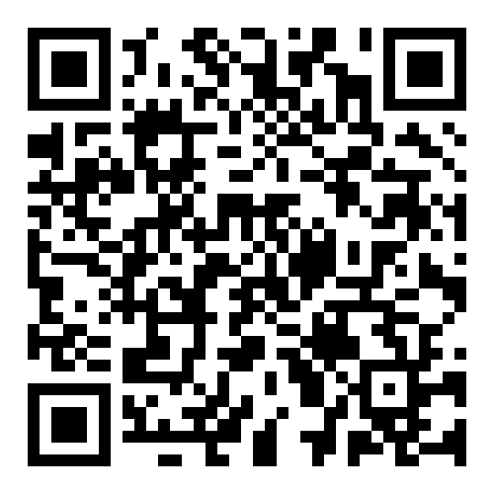
Who can I speak to regarding careers, education & guidance?
You can contact the Careers Team via email or phone if you would like further support regarding Careers, Information and Guidance for your child.
Mrs Claire O’Shaughnessy - Curriculum, Events and Educational Visits Coordinator
coshaugnessy@Arrowsmith.wigan.sch.uk
Mrs Paul – Careers & Work Experience Lead rpaul@arrowsmith.wigan.sch.uk
Mrs Rosie Morris – Careers Advisor rmorris@arrowsmith.wigan.sch.uk
Ms Lisa Hutchinson – Careers Advisor lhutchinson@arrowsmith.wigan.sch.uk
School website - Careers

