Slide 1
Year 10 Guidance Evening
Thursday 10th October 2024

Slide 2
What does the journey ahead look like?
Date | Event
Nov 28th – Dec 6th | Y10 Mock Examination Week
Jan 7th – Jan 24th | Y10 Shadow Prefects
Jan 16th | Y10 Parents Evening (and mock results released to parents)
After Feb Half Term | Formal process of prefect selection begins
May 2nd | Final Deadline for Senior Prefect applications
June 2nd – June 20th | End of Year 10 Examinations
July 2nd | End of Year Review Day

Slide 4
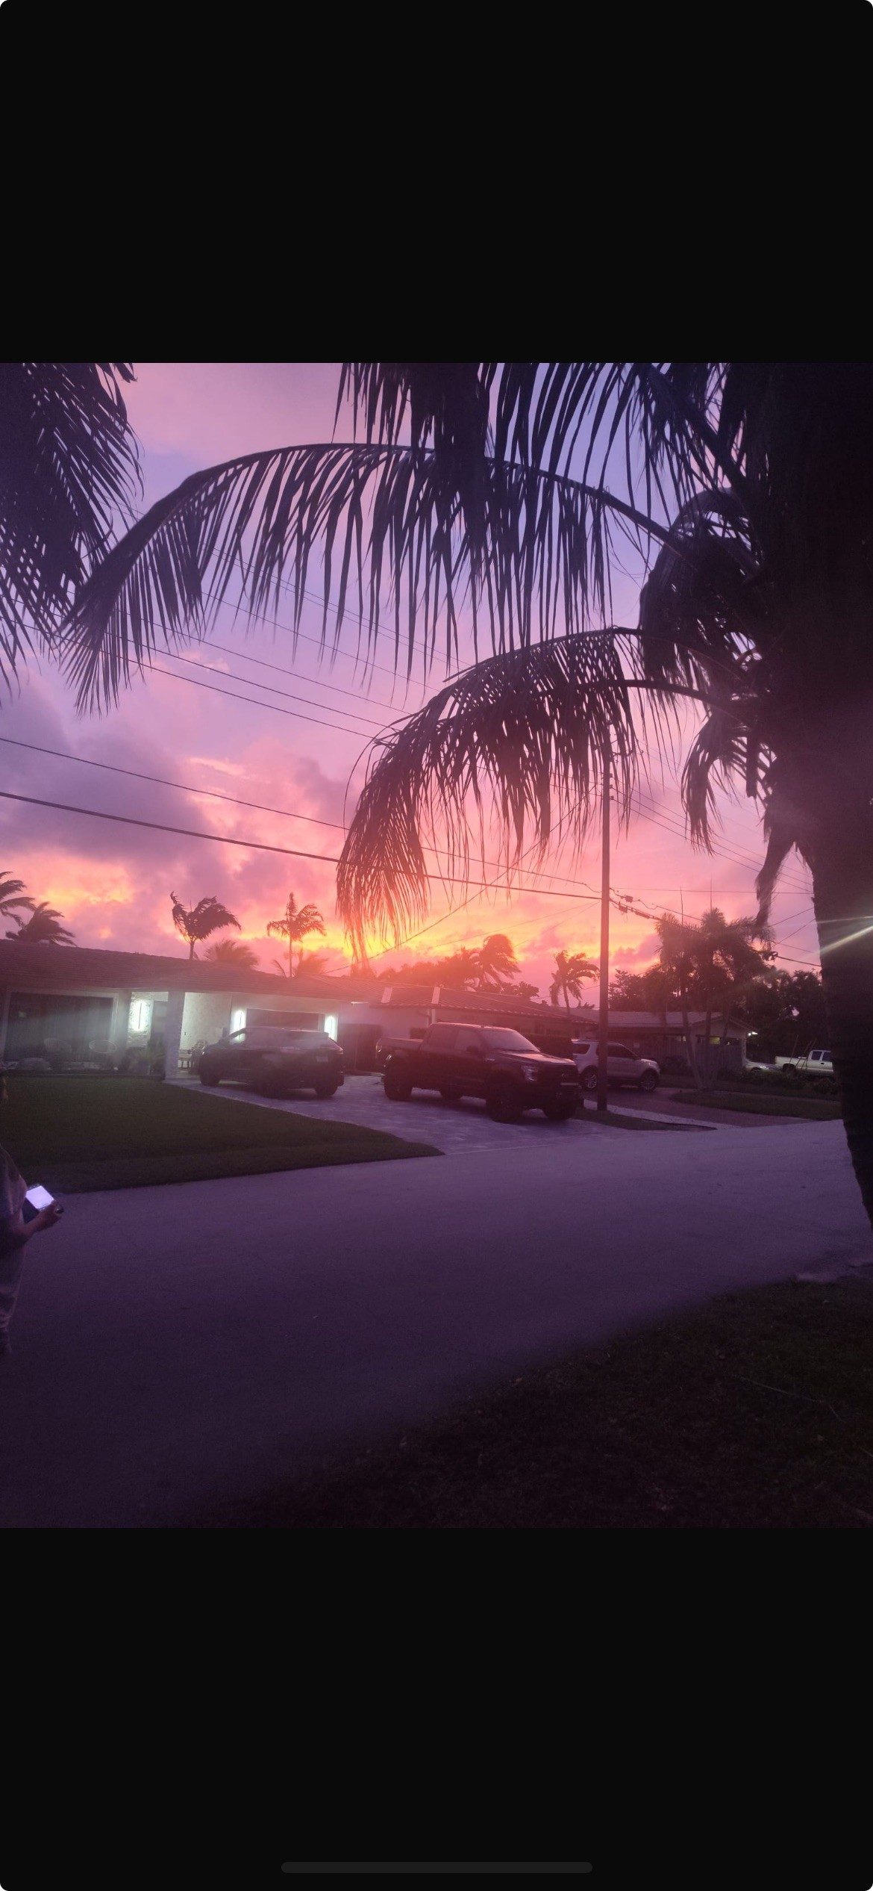

Slide 5
Independent study
Attendance
Assessments

Slide 6
Happy
Are able to control the career choices they follow.
Try their best in all aspects of life.
Decent members of society.

Slide 7
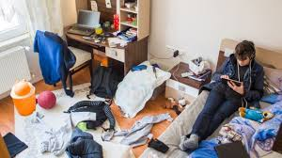
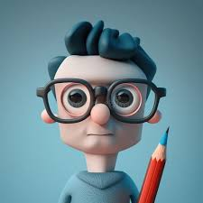
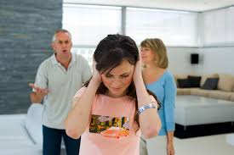

Slide 8
PREPARATION
Goal
Environment
Attitude

Slide 9
They need to learn how to be independent learners

Slide 10
Homework/Home learning
At least 60 mins per night

Slide 11
1. Communication – all homework should now be communicated via Arbor but we also insist homework is recorded by pupils in their planner.
Pupils can only do their best.

Slide 12
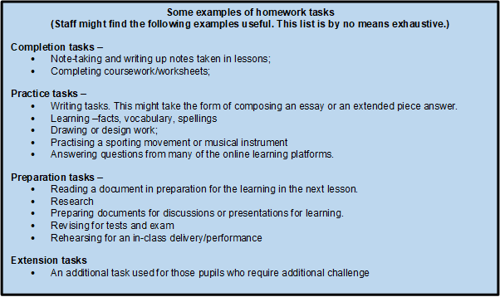

Slide 13
Home learning
Organising notes.
Revision cards/flash cards
Mind-maps
Past papers
Study groups
Quizzes

Slide 14
Attendance

Slide 16
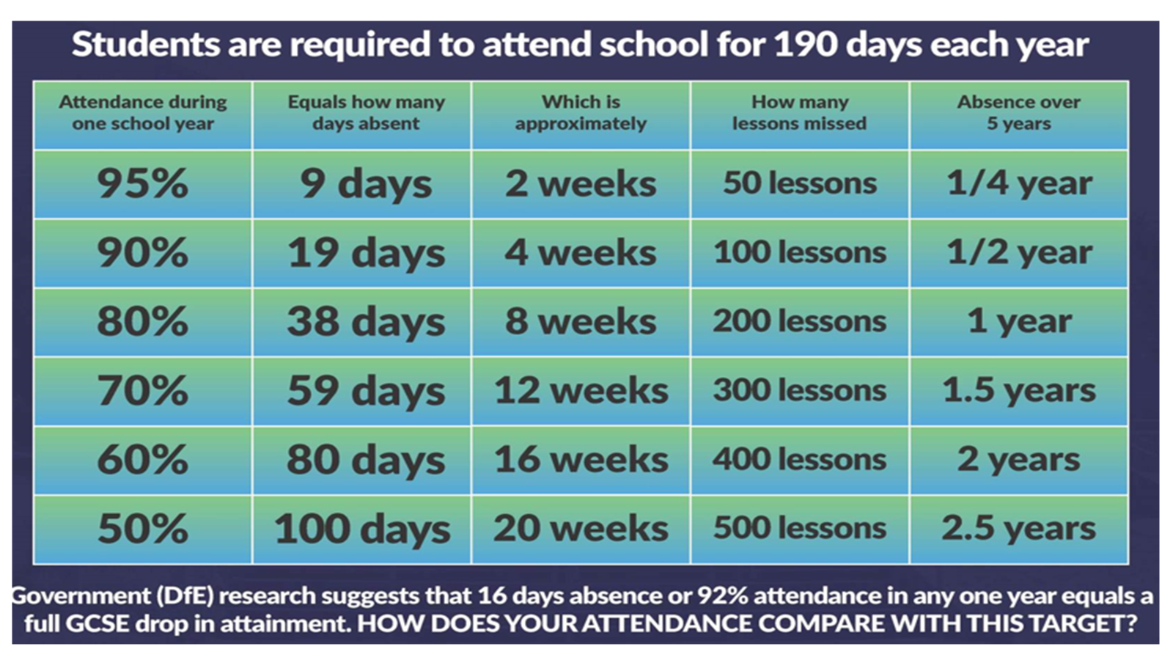

Slide 19
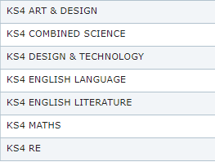
Candidate 2 – attendance – 76.6% 53 days 350 lessons
Actual grade Target grade

Slide 20
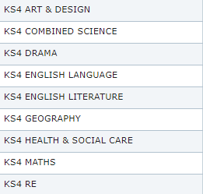
Candidate – attendance 92.5% 14 days 300 lessons
Actual grade Target grade

Slide 21
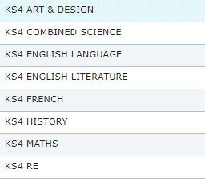
Candidate – 100%
Actual Target

Slide 22
Assessment
1st assessment - 28th Nov – 6th December
2nd assessment - 2nd June – 20th June
Pupils can only do their best.

Slide 23
Pupils can only do their best.

Slide 24
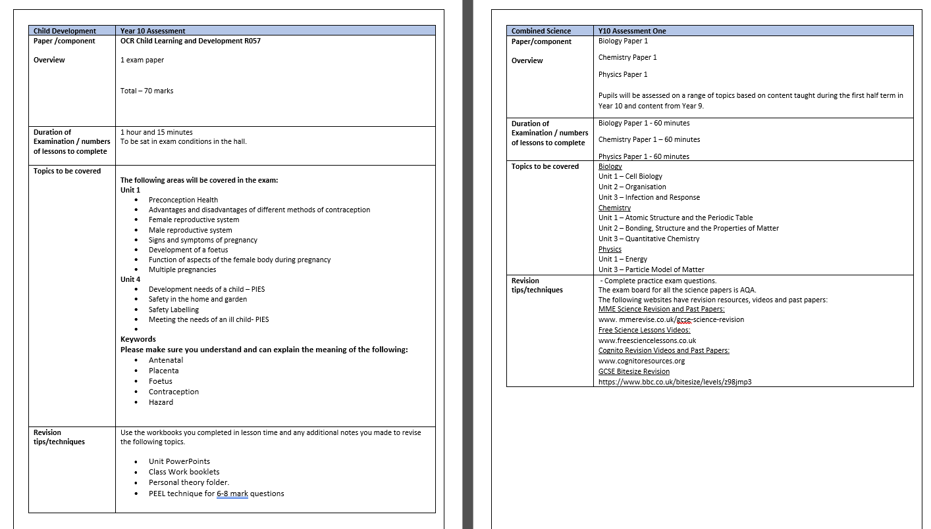
Pupils can only do their best.

Slide 25
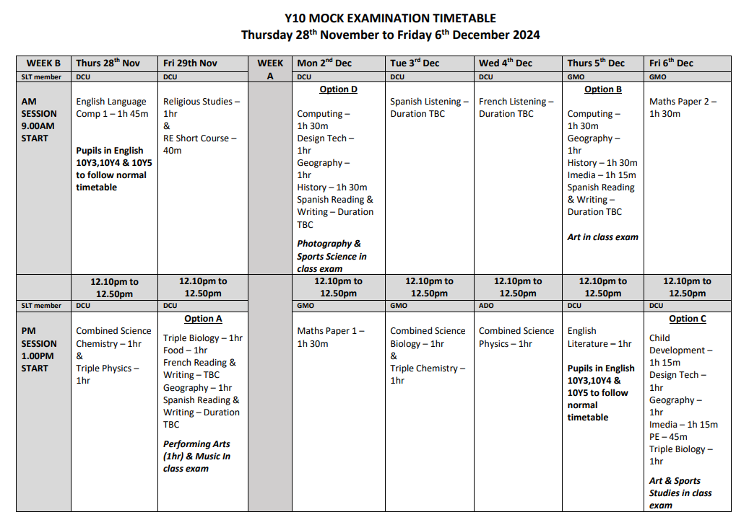

Slide 26
How can we help prepare our young people?
Motivate
Motivate
Communication
Pupils can only do their best.

Slide 27
“When I was five years old, my mother told me that happiness was the key to life.
When I went to school they asked me what I wanted to be when I grew up.
I said “happy”.
They told me I didn’t understand the assignment and I told them they didn’t understand life.”
John Lennon

Slide 28
Happy
Are able to control the career choices they follow.
Try their best in all aspects of life.
Decent members of society.

Slide 29
Pupils can only do their best.

Slide 30
In the classroom
MFL 1 | Mr M Dumican
English 6 | Ms A Morgan
RE 1 | Mrs G Morris
English 8 | Mr D Cullen
RE 5 | Mrs A Doolan
English 5 | Miss C Brophy
RE 3 | Mrs S Cole
English 7 | Mrs K Westwell
MFL 2 | Mrs C McGoldrick

Slide 31
Year 10 Guidance Evening
Thursday 10th October 2024

