Slide 1
Year 7 Careers Education and Guidance
Starting the Journey

Slide 2
Comprehensive Careers Education Programme
Includes a variety of engaging and meaningful activities, such as:
Pastoral Curriculum Lessons: Careers education is integrated into the wider Personal Development curriculum for Years 7 to 11.
Assemblies and Careers Workshops: Inspiring talks and interactive sessions led by careers advisers, employers and teachers.
Careers Learning in Lessons: Subject teachers link curriculum content to career pathways and opportunities.
Employer Visits: Opportunities to meet and interact with employers on-site.
Workplace Experience: Real-world placements to build employability skills.
One-to-One Guidance: Personalised career advice for every student in KS4.

Slide 3
Why Careers Education Matters in Year 7
It helps pupils start to think early about their future
Raises awareness of the wide range of jobs and pathways available
Builds confidence, communication and teamwork skills
Begins to show how subjects link to real-world careers
Starting early also helps pupils to recognise their strengths and interests, laying the foundations for informed choices at key transition points later in school

Slide 4
Careers Programme in Year 7
Dedicated Careers Lesson and Pastoral Curriculum Sessions during form time
Focus on dream jobs, different careers
Key skills and qualities employers value
Students recognise, develop and assess these skills for themselves

Slide 5
Key Activities in Year 7
Pastoral Curriculum:
Who am I?
Exploring Possibilities - dream jobs
What is a career?
What is an entrepreneur?
What is a work-life balance?
Meet the Professional (Careers Lessons):
Pupils will take part in an interactive session led by Careers Advisers and local employers, where they will create and use Yes/No questions to identify visitors’ jobs. The activity will also highlight the key skills and qualities employers value, helping students to recognise, develop and assess these skills for themselves.
Future Skills Questionnaire:
Identifies pupils’ strengths, interests, and personal skills
Focuses on skills like teamwork, problem-solving, and communication
Encourages self-reflection on abilities and learning
Links skills and interests to subjects and potential careers
Provides a starting point for tailored guidance and future goal-setting

Slide 6
Linking Learning to Careers
School Careers Week – 23rd March 2026
Aims:
Inspiration – Encourage pupils to think ambitiously about their future possibilities.
Relevance – Show how school subjects and skills link to real-world careers.
Engagement – Provide opportunities to hear from employers, further education providers, and role models.
Reflection – Give pupils time to consider their interests, strengths, and possible future goals.

Slide 7
Supporting Students’ Development
Introducing pupils to a broad range of job roles and pathways.
Help them explore their interests and strengths. Interactive activities, employer encounters, and skills-focused lessons build confidence, teamwork, and communication.
Link curriculum subjects to future careers so pupils can see the relevance of their learning

Slide 8
Preparing for the Future
Recognise strengths and interests so they can start thinking about which subjects and activities suit them best.
Understand the skills employers value (like teamwork, problem-solving and communication) so they can begin developing them early.
See the relevance of school subjects to real careers, which motivates them to engage more in their learning.
Explore different job roles and pathways before making important choices in Year 9, giving them time to reflect.
Build confidence in talking to adults and employers, an essential skill for interviews and future opportunities.

Slide 9
Parental Involvement
Engage in meaningful discussions at home about your children’s strengths, interests, and ambitions, complementing the concepts explored in our Careers Education curriculum.
Conversations are instrumental in helping students make informed and confident decisions about their future pathways.
Opportunities for parents to support careers events or share experiences:
Event | Date | Time
Years 9-11 Careers Fair | Thursday 12th September | 8:30am – 4:15pm
Year 11 Mock Interview Day | Thursday 7th November | 8:30am – 2:00pm
Year 9 STEM and Wider Careers Networking Event | Thursday 9th January | 8:30am-10:00am
Year 7 Meet the Professional (Careers lessons) | March - April | Various lesson times
Year 8 Raising Aspirations Presentations (Careers lessons) | May - June | 8:30am – 8:55am online
Year 8 Broadening Horizons (Careers lessons) | June - July | Various lesson times
Year 10 Workplace Experience | October -June | *Can you offer a placement?

Slide 10
Summary & Next Steps
Continue careers lessons and employer encounters throughout school.
Encourage pupils to explore their interests, hobbies and opportunities for volunteering (building their CV early on).
Support them in thinking about how their learning links to future pathways.
Provide opportunities for reflection and goal-setting to prepare for subject choices in Year 9.

Slide 11
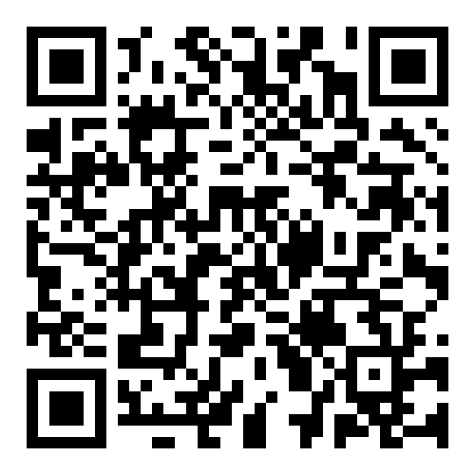
Who can I speak to regarding careers, education & guidance?
You can contact the Careers Team via email or phone if you would like further support regarding Careers, Information and Guidance for your child.
Mrs Claire O’Shaughnessy - Curriculum, Events and Educational Visits Coordinator
coshaugnessy@Arrowsmith.wigan.sch.uk
Mrs Paul – Careers & Work Experience Lead rpaul@arrowsmith.wigan.sch.uk
Mrs Rosie Morris – Careers Advisor rmorris@arrowsmith.wigan.sch.uk
Ms Lisa Hutchinson – Careers Advisor lhutchinson@arrowsmith.wigan.sch.uk
School website - Careers

