Slide 1
Year 8 Careers Education and Guidance
Preparing students for future choices

Slide 2
Comprehensive Careers Education Programme
Includes a variety of engaging and meaningful activities, such as:
Pastoral Curriculum Lessons: Careers education is integrated into the wider Personal Development curriculum for Years 7 to 11.
Assemblies and Careers Workshops: Inspiring talks and interactive sessions led by careers advisers, employers and teachers.
Careers Learning in Lessons: Subject teachers link curriculum content to career pathways and opportunities.
Employer Visits: Opportunities to meet and interact with employers on-site.
Workplace Experience: Real-world placements to build employability skills.
One-to-One Guidance: Personalised career advice for every student in KS4.

Slide 3
Why Careers Education Matters in Year 8
Builds awareness of different career pathways early
Connects learning in school with real-world opportunities
Encourages aspiration, motivation, and engagement

Slide 4
Careers Programme in Year 8
Dedicated Careers Lesson
Pastoral Curriculum Sessions during form time
Focus on self-awareness: skills, strengths, interests
Career exploration: industries, roles, Labour Market Information
Links to Year 9 GCSE options preparation

Slide 5
Key Activities in Year 8
Pastoral Curriculum:
What are my interests?
Challenges and Rewards
Creating the Life You Want
What does success mean to me?
Careers and Climate
Raising Aspirations Presentations. Exploring a Career in:
Medicine
Cyber Security
Architecture
Government & Politics
Broadening Horizons (Careers Lessons):
Pupils start to explore a broad range of careers and pathways beyond school. Through a classroom-based workshop, they learn how skills, study and training can influence salaries and opportunities,

Slide 6
Linking Learning to Careers
School Careers Week – 23rd March 2026
Aims:
Inspiration – Encourage pupils to think ambitiously about their future possibilities.
Relevance – Show how school subjects and skills link to real-world careers.
Engagement – Provide opportunities to hear from employers, further education providers, and role models.
Reflection – Give pupils time to consider their interests, strengths, and possible future goals.

Slide 7
Supporting Students’ Development
Builds employability skills (teamwork, communication, problem-solving)
Increases confidence in planning for the future
Helps students raise aspirations

Slide 8
Preparing for the Future
Year 8 lays foundations for Year 9 option choices
Smooth transition into GCSE pathways
Early awareness reduces stress and helps informed decision-making

Slide 9
Parental Involvement
Engage in meaningful discussions at home about your children’s strengths, interests, and ambitions, complementing the concepts explored in our Careers Education curriculum.
Conversations are instrumental in helping students make informed and confident decisions about their future pathways.
Opportunities for parents to support careers events or share experiences:
Event | Date | Time
Years 9-11 Careers Fair | Thursday 12th September | 8:30am – 4:15pm
Year 11 Mock Interview Day | Thursday 7th November | 8:30am – 2:00pm
Year 9 STEM and Wider Careers Networking Event | Thursday 9th January | 8:30am-10:00am
Year 7 Meet the Professional (Careers lessons) | March - April | Various lesson times
Year 8 Raising Aspirations Presentations (Careers lessons) | May - June | 8:30am – 8:55am online
Year 8 Broadening Horizons (Careers lessons) | June - July | Various lesson times
Year 10 Workplace Experience | October -June | *Can you offer a placement?

Slide 10
Summary & Next Steps
Year 9 GCSE Options
Apply knowledge of careers pathways to make informed subject choices.
Consider how option subjects link to future career routes.
Further Careers Education in Year 9
Deeper exploration of pathways (A-Levels, T-Levels, Apprenticeships, Vocational courses).
More encounters with employers, colleges, and training providers.
Personal Development
Continued self-reflection on skills, strengths, and interests.
Building confidence in making decisions about the future.
Preparation for Key Stage 4
Begin thinking about long-term career goals and how GCSE choices support them.
Increased emphasis on employability skills and workplace awareness.

Slide 11
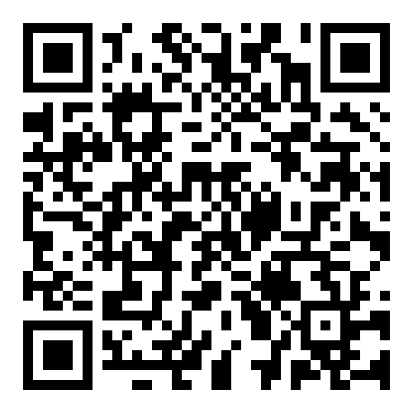
Who can I speak to regarding careers, education & guidance?
You can contact the Careers Team via email or phone if you would like further support regarding Careers, Information and Guidance for your child.
Mrs Claire O’Shaughnessy - Curriculum, Events and Educational Visits Coordinator
coshaugnessy@Arrowsmith.wigan.sch.uk
Mrs Paul – Careers & Work Experience Lead
rpaul@arrowsmith.wigan.sch.uk
Mrs Rosie Morris – Careers Advisor
rmorris@arrowsmith.wigan.sch.uk
Ms Lisa Hutchinson – Careers Advisor
lhutchinson@arrowsmith.wigan.sch.uk
School website - Careers

