Slide 1
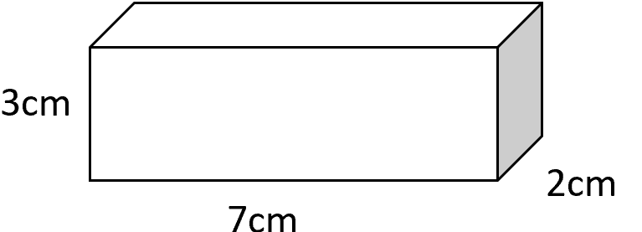
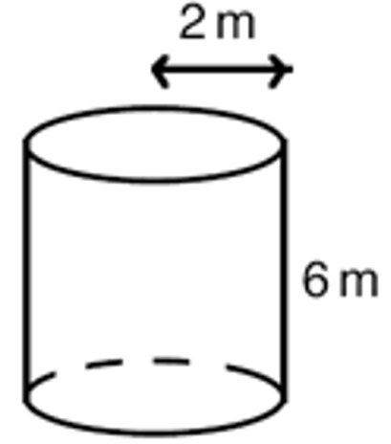
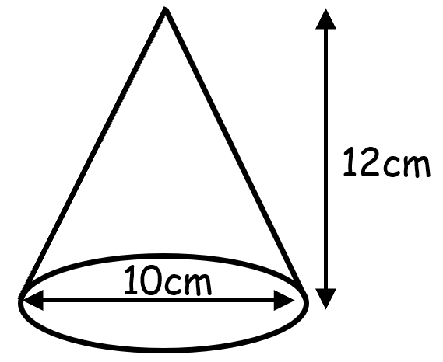
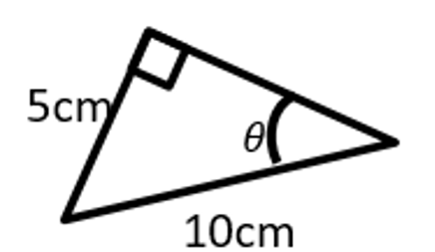
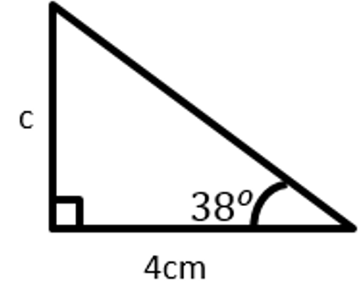
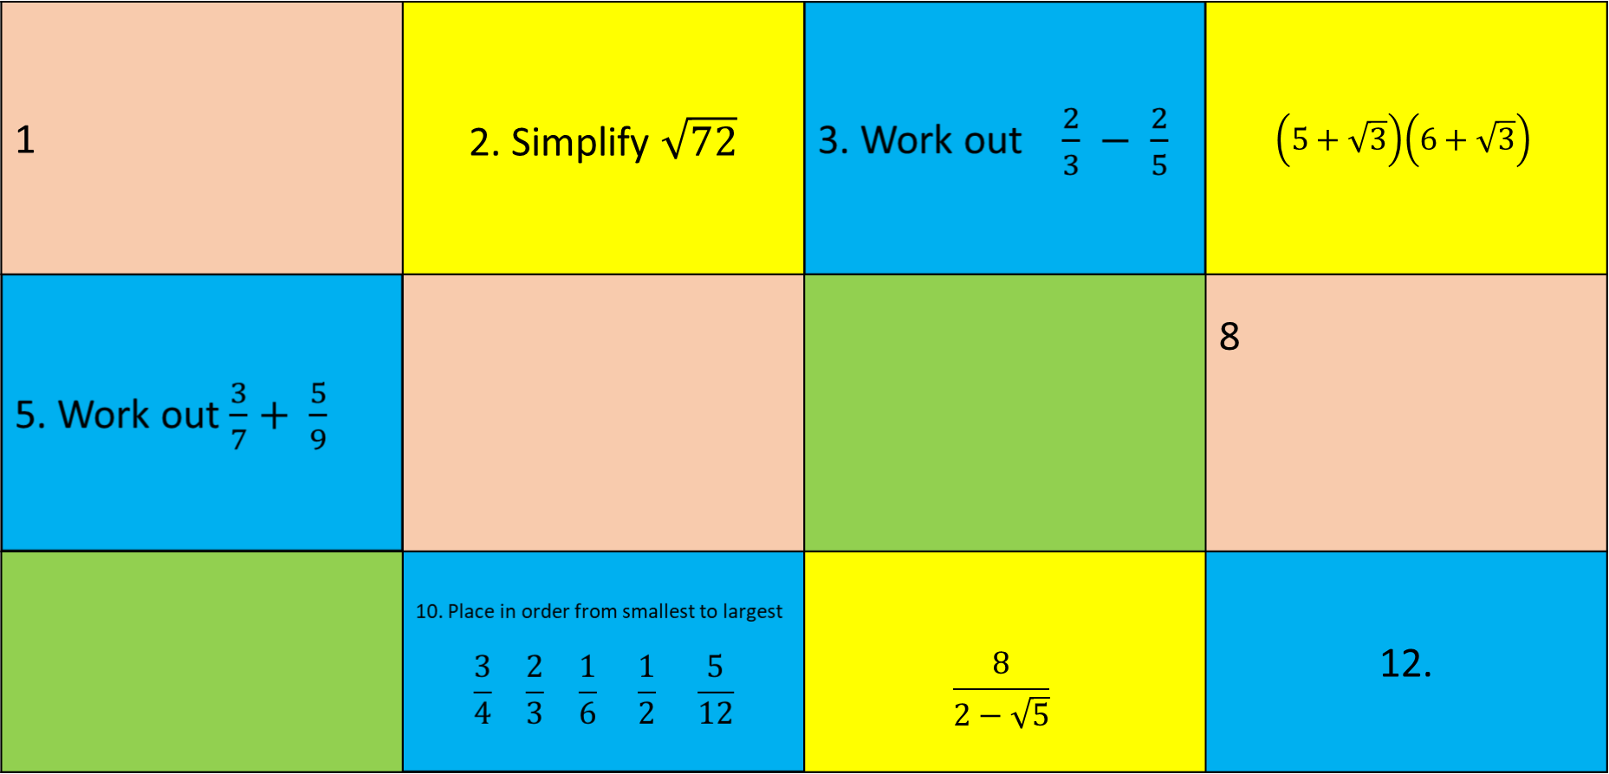
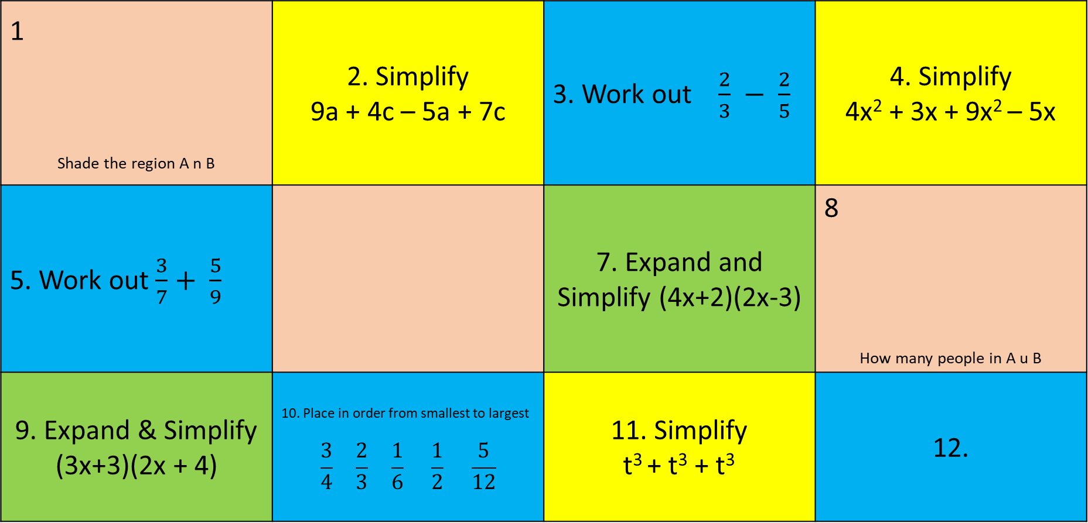

Knowledge Retrieval Quiz
4. Expand and Simplify
1 | 2. Simplify $\sqrt{72}$ |  | $$\left(5+\sqrt{3}\right)\left(6+\sqrt{3}\right)$$
 |  |  | 8
 |  | $$\frac{8}{2−\sqrt{5}}$$ | 12.
3. Work out in standard form
$$(8.1×{10}^{−15})×(3×{10}^{3})$$
Find Surface area
6 Find Volume of Cone
5. Work out
(2a⁶)⁷
7) Find the angle
Find Surface Area
9) Find
the
side
10. Evaluate
${27}^{−\frac{4}{3}}$
12) Find the exact value of
Cos 60
11) Rationalise
This topic 1 point | Last topic 2 point | Previous topic 3 points | Wayyy back! 4 points

Slide 2
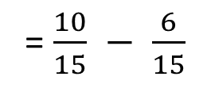
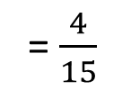
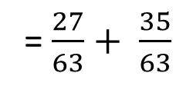
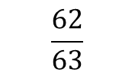




30 + 5 $\sqrt{3}+6\sqrt{3}+\sqrt{9}$
1 2x(21+6+21) = 96cm² | 2 | 3 | 4
5 | 6 | 7 | 8
9 | 10 | 11
3) 8.1 x 3 = 24.3
$\sqrt{72}= \sqrt{36 x 2}$= 6$\sqrt{2}$
10 ⁻¹⁵ x 10³ = 10⁻¹²
= 30 + 11 $\sqrt{3}+3$
= 24.3 X 10⁻¹²
= 2.43 X 10⁻¹³
= 33$+11\sqrt{3}$
sin ο = $\frac{5}{10}$
= 2$x π x 2$² +
6 x 2 x $π$ x 2
5. 128a⁴²
= $\frac{1}{3} x π x 5$² x 12
=
ο = 30⁰
= 8$π+24π$
= 314.2 cm³
= 32$π$ = 100.5cm²
10.
12
Cos 60
= $\frac{1}{2}$
Tan 38 = $\frac{c}{4}$
27⁻$\frac{4}{3}$
$\frac{16+8 √ 5}{−1}$
= 1/ $(\sqrt[3]{27}$)⁴
= - 16 – 8 $√ 5$
4 x tan 38 = 3.1 cm
= 1/$(3$)⁴
= 1/ 81
This topic 1 point | Last topic 2 points | Previous topic 3 points | Wayyy back 4 points

