Slide 1
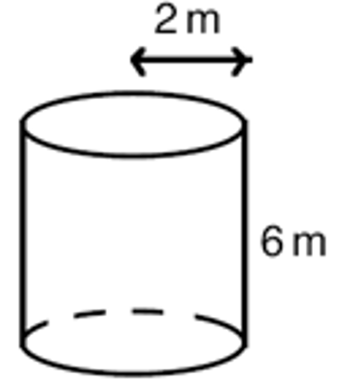
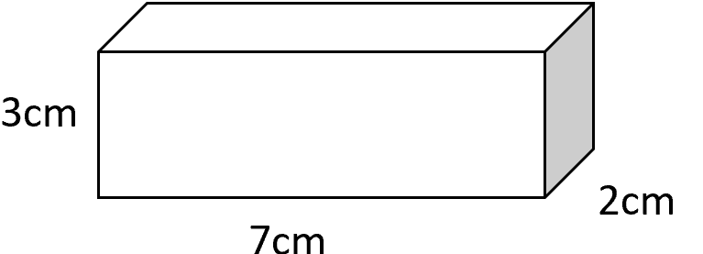
Knowledge Retrieval Quiz
4. Find the value of x
1 | 2.
 |  |  | 8
 |  |  | 12.
3. Work out in standard form
$$(8.1×{10}^{−15})×(3×{10}^{3})$$
6
7) Find the length of side x
5. Work out
(2a⁶)⁷
Find the volume
9) Find the
side
10. Evaluate
${27}^{−\frac{4}{3}}$
11)
12) Find the surface area
This topic 1 point | Last topic 2 point | Previous topic 3 points | Way back! 4 points

Slide 2
1 5 x 3.5 x 2.3 = 40.25 | 2 | 3 | 4
5 | 6 | 7 | 8
9 =2.81cm | 10 | 11
3) 8.1 x 3 = 24.3
= 180 – 73 = 107
Because co-interior angles are equal
$$540 −75 −38 −252−40$$
= 135
10 ⁻¹⁵ x 10³ = 10⁻¹²
= 24.3 X 10⁻¹²
= 2.43 X 10⁻¹³
=base x height/2
= 3.32 cm
= 2$x π x 2$² +
6 x 2 x $π$ x 2
5. 128a⁴²
=(5 x 7.1 x 8.2)/2
=
= 8$π+24π$
= 145.55 cm³
= 32$π$ = 100.5cm²
10.
12
= (3 x 7 x 2)
+ (7 x 2 x 2)
+ (3 x 2 x 2)
= 82cm^2
27⁻$\frac{4}{3}$
=$£510.60$
= 1/ $(\sqrt[3]{27}$)⁴
= 1/$(3$)⁴
= 1/ 81
This topic 1 point | Last topic 2 points | Previous topic 3 points | Wayyy back 4 points

