Slide 1
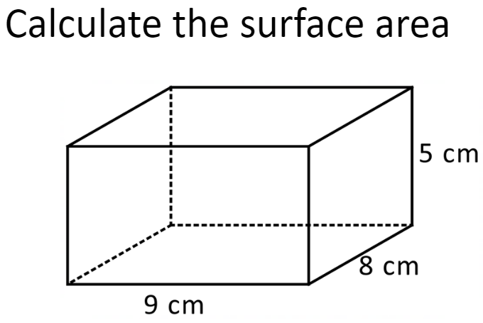
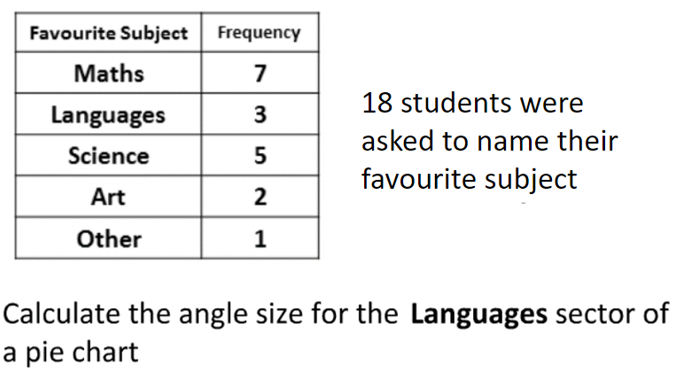
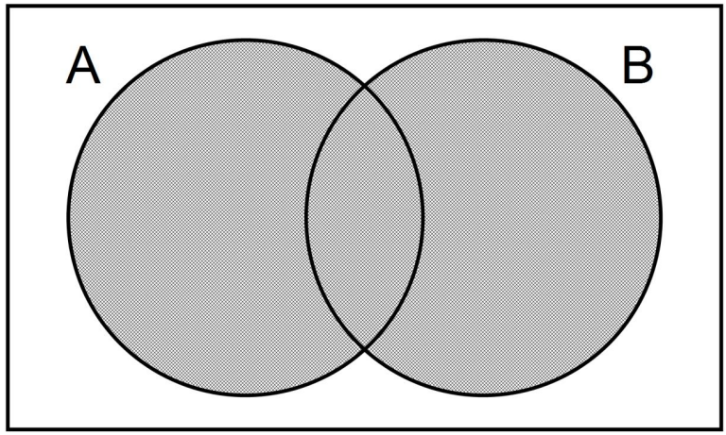
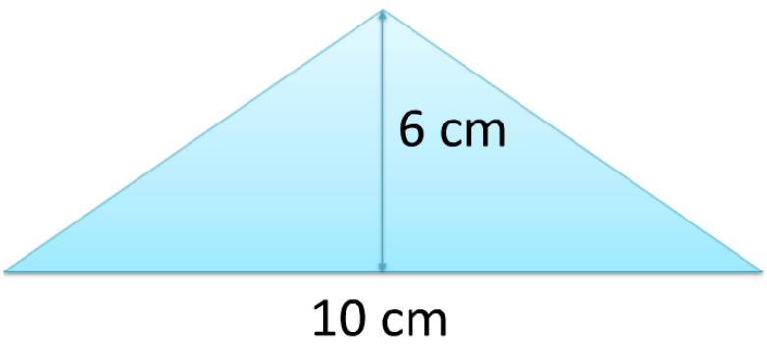
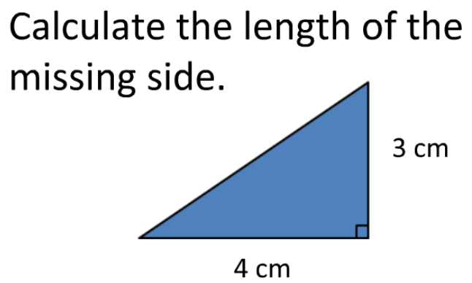
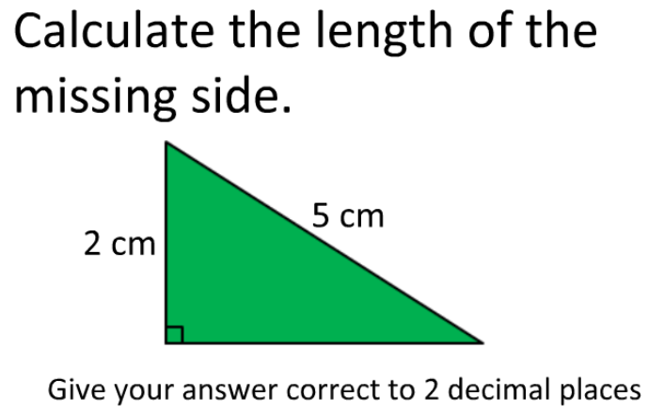
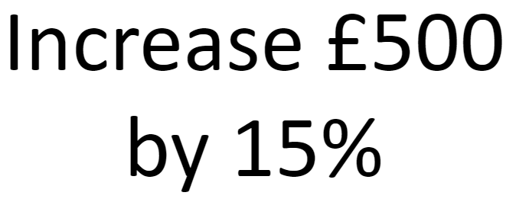
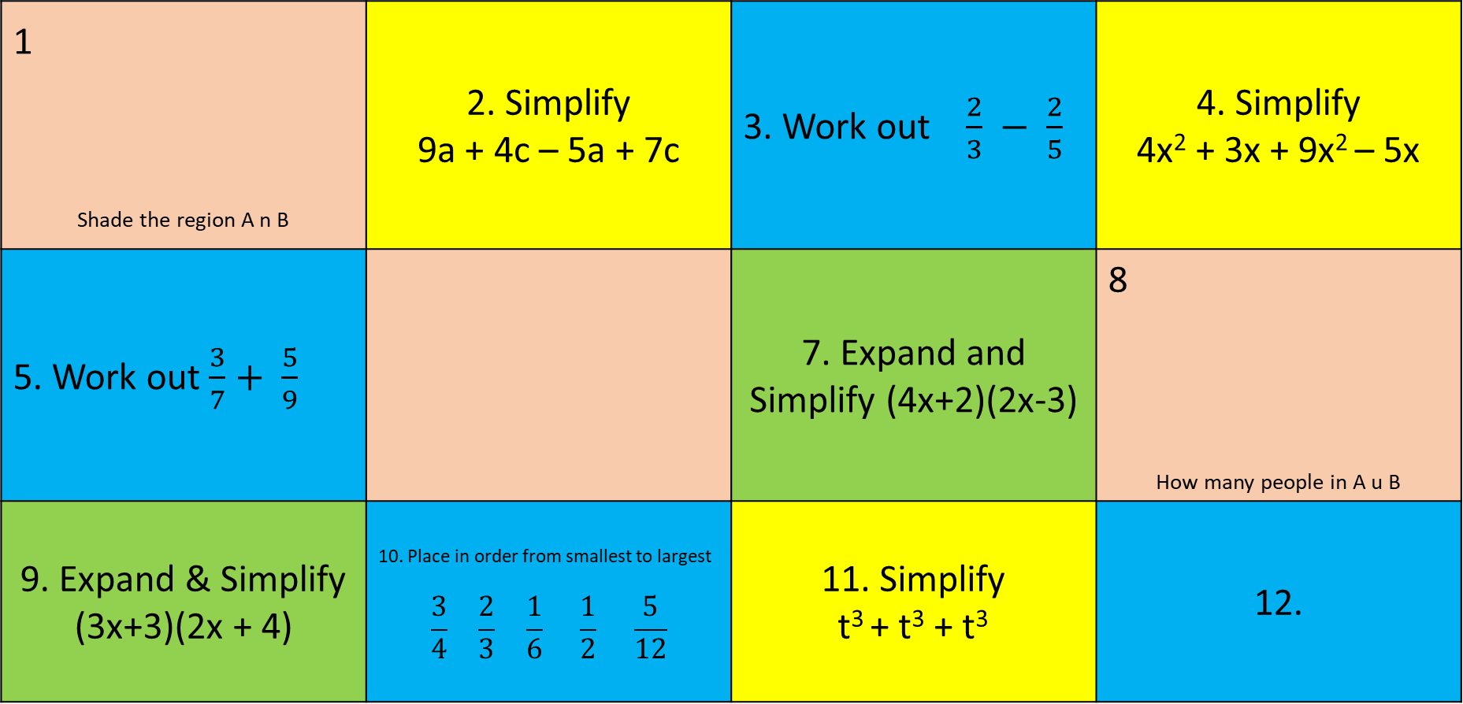
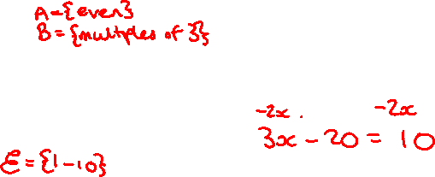
Knowledge Retrieval Quiz
1.
2.
4.
 |  |  | 12.
3.
5.
6.
7.
8.
9.
10.
11.
12.
This topic 1 point | Last topic 2 point | Previous topic 3 points | Wayyy back! 4 points

Slide 2
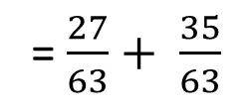
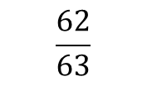
$\frac{3}{18}×360=60$
1 X = 3 | 2 | 3 | 4
5 | 6 | 7 | 8
9 | 10 | 11
$$314{cm}^{2}$$
= 5.52 X 10⁵
5.
A u B
$$30{cm}^{2}$$
=
£400
X = 10
10.
12
4.58cm
5cm
$£575$
4n + 5
This topic 1 point | Last topic 2 points | Previous topic 3 points | Wayyy back 4 points

