Slide 1
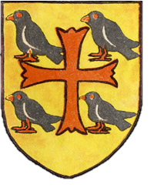
Saint Edmund of Abingdon
St. Edmund (1174-1240) Peacemaker, Father of the Poor, Patron of sick Children

Slide 2
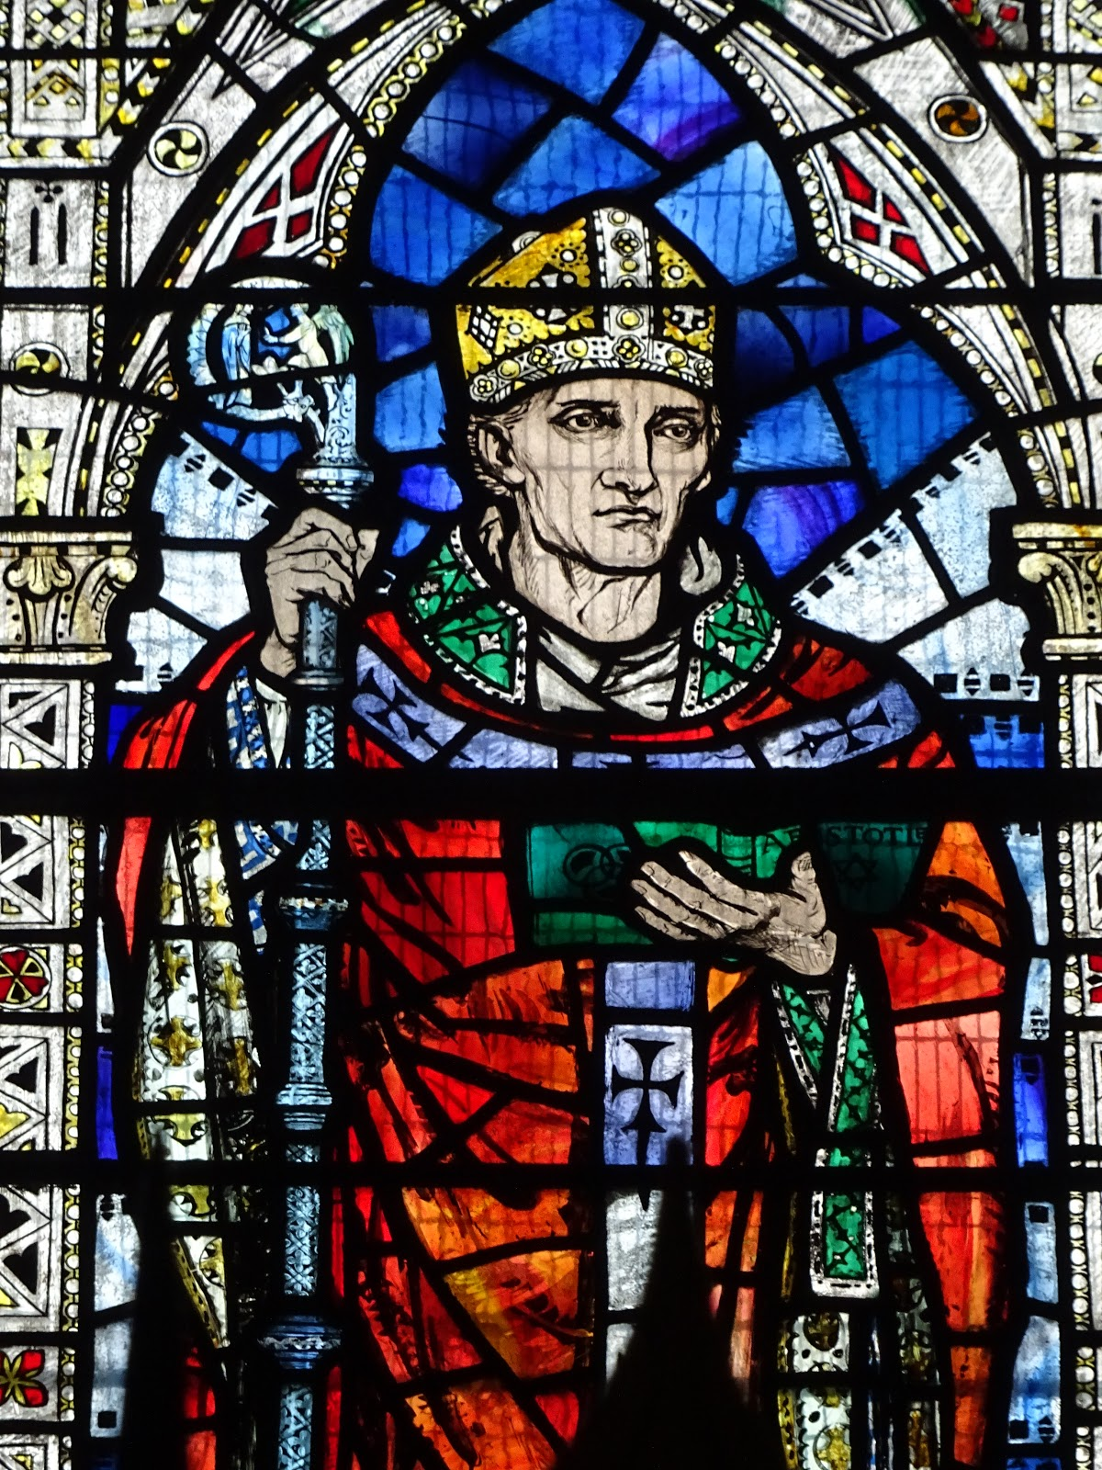
Who is he?
St. Edmund of Canterbury is remembered in England, France and America for his faithful life loving God.
In France, where he is buried, St. Edmund is known as the patron saint of sick children.

Slide 3
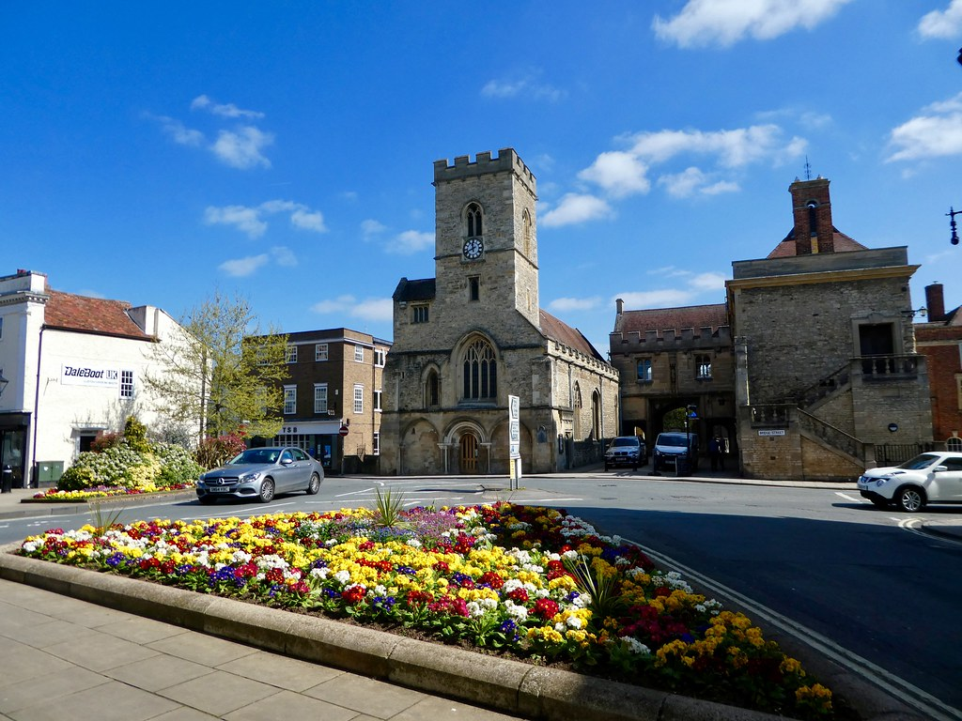
Where was he from?
In England, where he was born, St. Edmund is known as a peacemaker. Edmund’s life began in Abingdon, a small village close to Oxford.

Slide 4
Why was he special?
As a young man, he became a noted professor of maths and geometry at Oxford University. In mid-career, he was inspired by a dream to leave teaching and enter the priesthood.
After becoming a priest, Edmund left Oxford for a country parish near Salisbury.
There he gave away his possessions to feed the poor and care for the sick. The Pope, learning of Edmund’s self-sacrificing spirit, named him Archbishop of Canterbury.

Slide 5
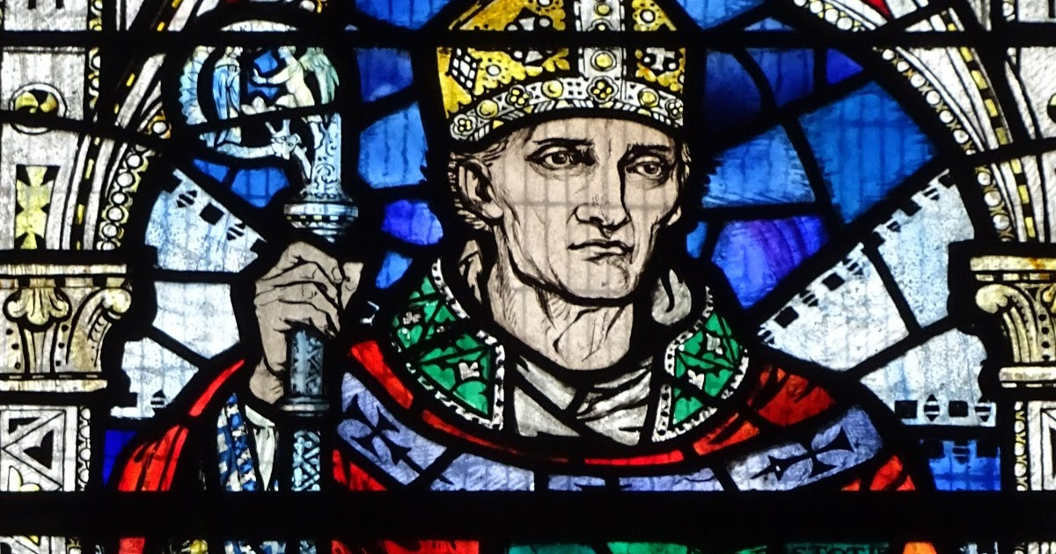
What happened to him?
While journeying to Rome, Edmund fell sick and died in Pontigny, France. He was buried there at the Abbey and many miracles took place at his tomb. Within six years, the Pope declared him a saint. Six centuries later, the Society of St. Edmund was founded at Pontigny.

