Slide 1



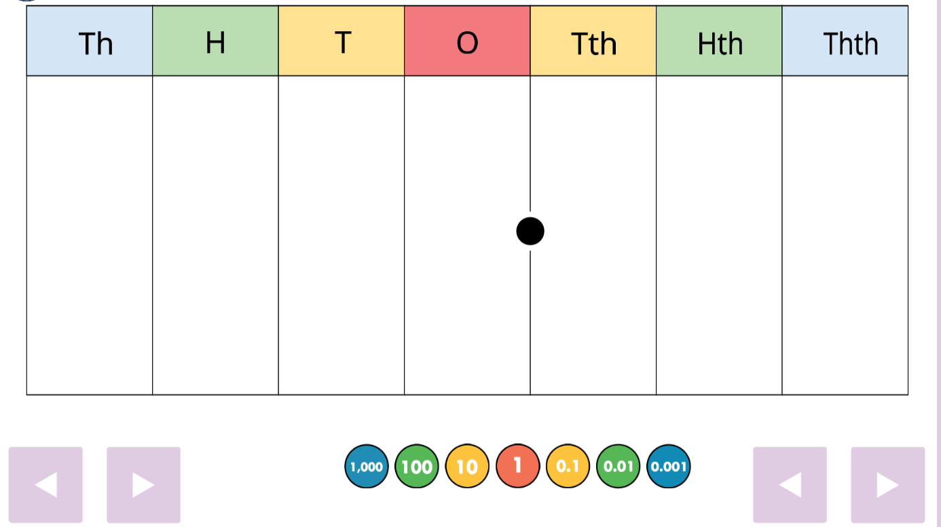
Maths at Stilton C of E Primary Academy
Planning is informed primarily by the use of Can Do Maths
Curriculum Objectives
Long Term plans in line with Can Do Maths and National Framework
Medium Term plans in line with Can Do Maths which specify key objectives
Short term plans developed by class teacher and evident through weekly L.O. slips
Developing fluency
Times Tables Rock Stars
Flashback 4
Purple Mash
Maths.co.uk
Concrete Resources
Numicon
Deans
Fraction Walls
Base 10
Measuring equipment
Place Value frames
Multilink
Place Value counters
2D/3D Shapes
CPD Opportunities
Whole staff book looks
Classroom learning walks by SLT
Classroom learning walks by Subject Leader
Staff meeting and ½ termly briefings
Pupil Voice
Subject Leader network meetings
Challenge and support provided by:
Pre-teaching
Use of additional adults
Additional challenge questions
Targeted questioning
Planned intervention groups
Working walls
Vocabulary on display
L.O. visible during lesson
Resources
Curriculum Strengths
Resources are available and accessible for all, so children are becoming familiar with Can Do Maths wording and diagrams.
Learning walks will demonstrate impact of Can Do Maths.
Quantity of independent work increasing and children taking pride in presentation.
L.O. slips are now uniform across the school and make daily and weekly objectives clear.
Children can reflect and self-assess using purple-polishing pens.
Books marked in line with school policy.
Termly book looks allow successes to be shared and ensure consistent expectations.
Pictorial Resources
Part-Part Whole
Bar Model
Arrays
IWB resources
Place value counters

Slide 2

Maths at Stilton C of E Primary Academy
Assessment
Instant Formative Assessment
In-class marking
Self-marking
Verbal feedback
Written feedback
Formative Assessment
Flashback 4
Termly Headstart Assessments (Number & Place Value)
Homework
Times Table Rock Stars
Summative Assessment
End of Key Stage Assessments (Y6)
Year 4 Multiplication Tables Test
Year 5 Mock SATS
Complete Maths Diagnostics
Impact of Assessment
Changes to short-term planning, including groupings and scaffolding
Changes to timetables
Intervention groups
APDR targets updated
Gap analysis completed by Subject Leader
Identifying trends across the school
Whole-school focus on a particular topic
Curriculum Successes
Secure knowledge of place value across school.
Book-looks show progression through the units and consistency in topic delivery.
Medium Term plans updated termly which are monitored by subject leader.
Gap analysis reinforced learning of key areas.
SMSC Development
Spiritual - Pupils develop a curiosity and an ability to question the way in which the world works
Moral – Pupils given opportunities to use their maths skills in real life contexts, applying and exploring the skills required in solving various problems.
Social - Pupils are always encouraged to explain concepts to each other and support each other in their learning.
Cultural – Pupils develop an awareness of both the history of maths as well as the realisation that many topics we still learn today have travelled across the world and are used internationally.
Areas for Development
How do we revisit topics to ensure overlearning?
How do we extend the pupils’ learning through challenge?
What does ‘Dive Deeper’ look like for our pupils?
How do we involve all stakeholders in celebrating Maths?

