Slide 1

















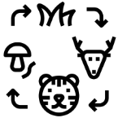


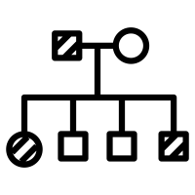






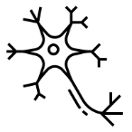





































St Joseph’s Catholic Academy
Science: Biology Learning Journey
Biological
Molecules
Organisms exchange substances with their environment
Energy transfers in & between organisms
Genetics, populations, evolution & ecosystems
A level
Cells
Genetic information, variation & relationships between organisms
Organisms respond to changes in their internal & external environments
University
www.ucas.com
OR
The control of gene expression
Apprenticeships
www.futureme.ac.uk
GCSE Preparation & revision
B9: Ecosystems & Material Cycles
B8: Exchange & Transport in Animals
Biology Required Practicals
1 | Microscopy (AT1,7)
2 | Bacterial Growth (Triple) (AT1,3,4,8)
3 | Osmosis (AT 1,3,5)
4 | Food Tests (AT 2,8)
5 | Enzymes (AT1,2,5,8)
6 | Photosynthesis (AT1,2,3,4,5)
7 | Reaction Times (AT1,3,4)
8 | Seedling Growth (Triple) (AT1,3,4,7)
9 | Populations (AT1,3,4,6,8)
10 | Decay (Triple) (AT 1,3,4,5)
B5: Health & Disease
B6: Plant Structure & Function
B7: Homeostasis
B,F,G,N,O,P
B4: Natural Selection & Genetic Modification
B3: Genetics
Key Stage 4
B2: Cells and Control
B1: Key Concepts in Biology
Year 9
Breathing & respiration
Plants & their reproduction
Food and Nutrition
Unicellular organisms
Year 8
Sexual reproduction in animals
Cells, Organs & Systems
Year 7
Muscles & bones
Ecosystems
Read like a Biologist
The Brain | I contain multitudes
The origin of species | The immortal life of Henrietta Lacks
Remarkable Creatures | The Gene: an Intimate history
 | Dark Lady of DNA
 | Predators: The whole Tooth and Claw Story
 | Gene Machine
 | Cuckoo: Cheating by ccc Nature
 | Life on Earth
 | Sapiens: A brief history of humankind
Biology Careers
Pharmacologist | Doctor or nurse
Research Scientist | Paramedic
Nutritionist | Forensic Scientist
Ecologist | Zoologist
Marine biologist | Vet
Biochemist | Engineer
Physiotherapist | Farmer
Curriculum Links
 | Maths |  | MFL
 | English |  | IT
 | P.E/ Sport |  | RE
 | Geography |  | Careers
 | Art |  | PHSE/ Citizenship
 | DT/ Engineering |  | Chemistry
 | Music |  | Physics
 | History |  | Enterprise
Key Concepts in Biology
 | B1: Cells and cellular processes
 | B2: Biological systems for life
 | B3: Organisms and their interactions with the environment

