Slide 1








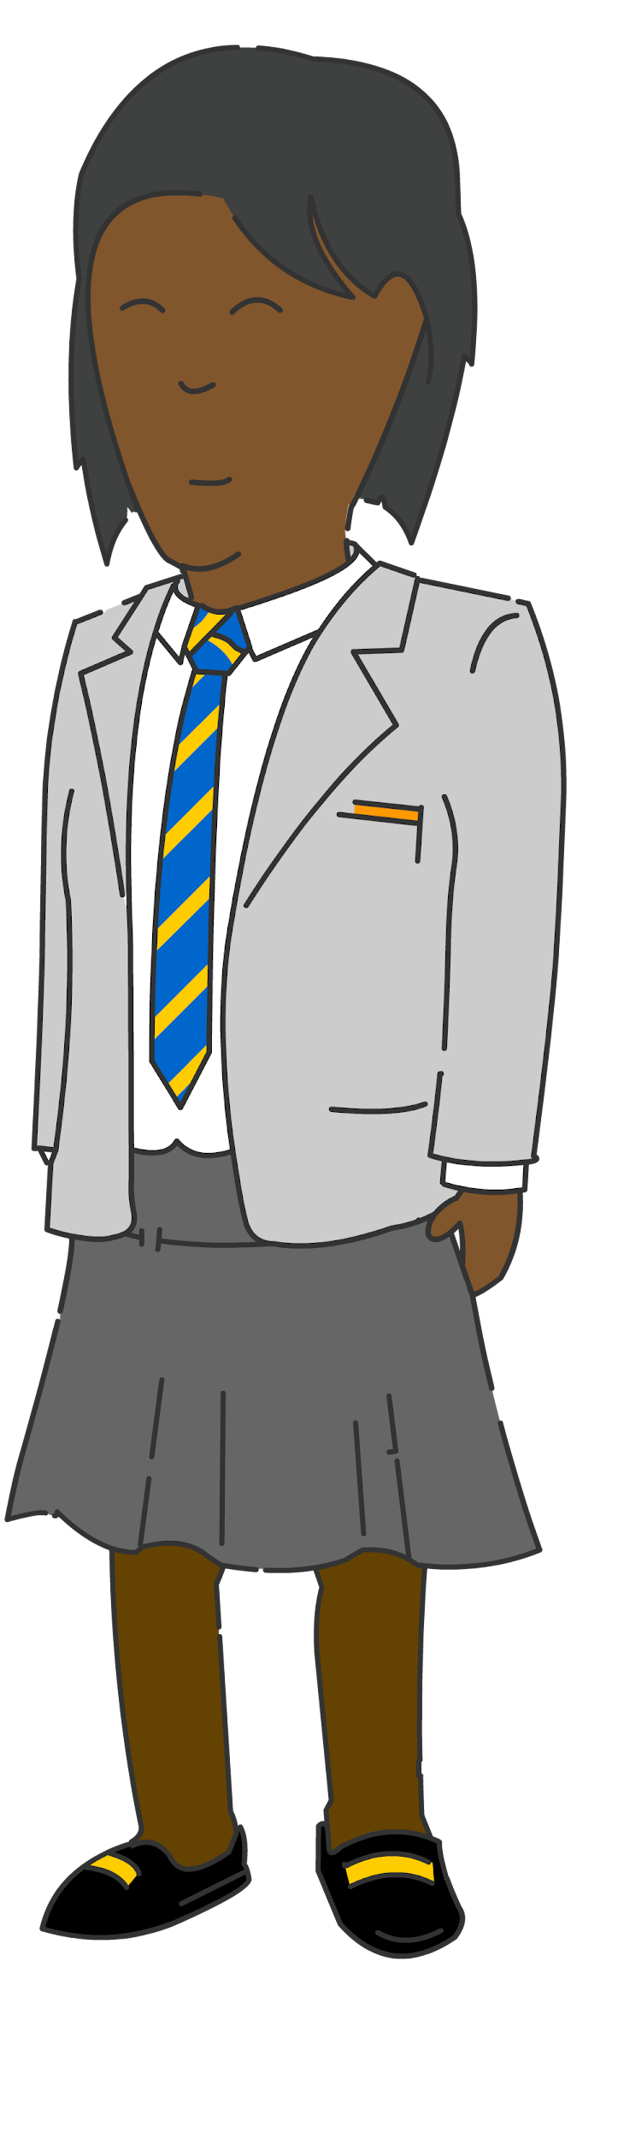


Our KS3 Learning Journey
Core PE
Striking and fielding
Athletics
Health related fitness
In Year 9 I can:
-Explain the main teaching points of the skills, techniques and tactics.
-Analyse and evaluate performance and justify recommendations to improve
-Apply the rules, tactics or strategies with creativity in order to perform successfully
-Lead and design an activity independently, across a range of sports.
-Demonstrate high levels of motivation and commitment in PE and School Sport
-Demonstrate a positive attitude towards others and communicate effectively
-Demonstrate a level of fluency in a wide range of skills and sports
-Select and apply the correct skill with fluency to perform successfully.
-Demonstrate high levels of fitness to perform very effectively.
Rugby
Table Tennis
Basketball
In Year 8 I can:
-Explain the main teaching points of the skills, techniques and tactics.
-Evaluate performance and justify recommendations to improve
-Apply the rules, tactics or strategies in order to perform successfully
-Lead a skills practice independently, across a range of sports.
-Demonstrate high levels of resilience in PE and School Sport
-Demonstrate a positive attitude towards others and communicate effectively
-Demonstrate a level of precision in a wide range of skills and sports
-Select and apply the correct skill with precision to perform successfully.
-Demonstrate high levels of fitness to perform effectively.
Volleyball
Year
9
Netball
Football
Trampolining
Fluency
Striking and fielding
Athletics
Basketball
Precision
Health related fitness
Football
Year
8
OAA
Dance
Netball
Rugby
In Year 7 I can:
-Explain the main teaching points of the skills, techniques and tactics.
-Evaluate performance and give recommendations to improve
-Apply the rules, tactics or strategies in a game successfully
-Lead a warm up independently, across a range of sports.
-Demonstrate a positive attitude towards others and communicate effectively.
-Demonstrate a consistent level of control in my sporting skills
-Select and apply the correct skill with control to perform successfully.
-Demonstrate good levels of fitness to perform effectively.
Striking and fielding
Athletics
Year
7
Netball
Rugby
Table Tennis
Gymnastics
Dance
Baseline testing
Control

Slide 2
Our KS4 Learning Journey
Core PE
Leadership:
Sports Hall Athletics / Boccia / Table tennis
Participation:
Fitness / Trampolining / Table Tennis / Badminton
Physical Challenge:
Resistance / Rowing / Strength & Conditioning / Interval & Fartlek
Change 4 Life:
Orienteering / Trampolining / Power Walking / Exercise 2 Music
Pathway Options
Boys performance:
Handball / Football / Basketball / Fitness
Year
11
Plan and lead a sports session / physical activity
Girls performance:
Table Tennis / Rugby / Basketball / Netball
Using leadership skills and behaviours in other environments
Sports Leadership
Pathway
Reflecting on leadership skills
Leadership skills and behaviours
Rugby
Striking and fielding
Football
Athletics
Basketball
Table Tennis
Netball
Volleyball
Year
10
Health related fitness
Trampolining

