Slide 1
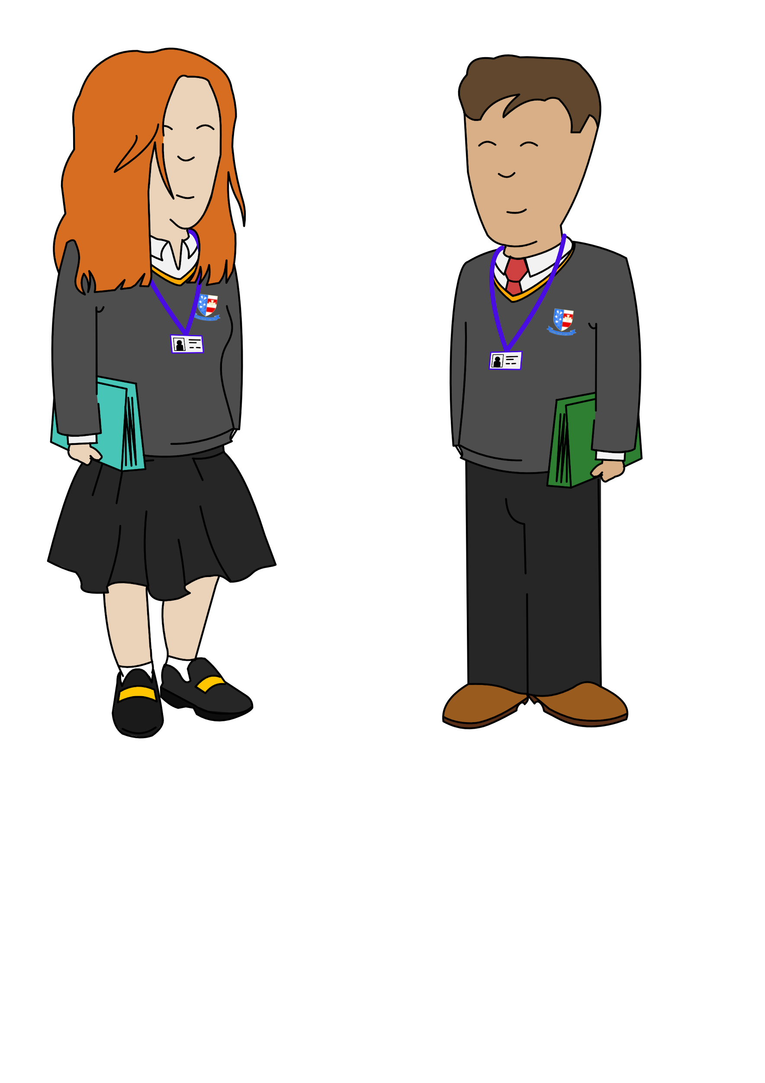










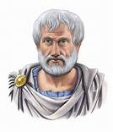




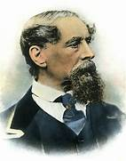

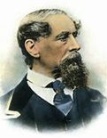







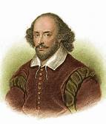
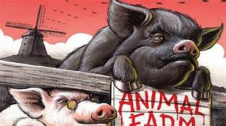

/
LANG CHANGE & DIVERSITY
LANGUAGE
NEA
LITERATURE
NEA
University
Apprenticeship
Work
FINAL REVISION
LANG & POWER
EXTERNAL A
LEVEL EXAMS
Our English
learning journey
THE MURDER OF
ROGER ACKROYD
DEATH OF A SALESMAN
CRIME & TRAGEDY
POETRY
LIT NEA CRITICAL ANTHOLOGY
LANG NEA ORIGINAL
WRITING
CHILD LANG DEVELOPMENT
INTRO TO
CRIME
GENRE
ATONEMENT
INTRO TO SOCIOLINGUISTICS
Year
13
TESS OF THE
D’URBERVILLES
KING LEAR
PAPER 2 SECTION A
PAPER 2 RHETORIC
& SPOKEN LANGUAGE
& ORACY
FINAL
REVISION
MACBETH
Year
12
PAPER 1
SECTION A
INTRO TO
TRAGEDY
GENRE
Year
11
EXTERNAL
GCSE EXAMS
THE MODERN NOVEL: LORD OF THE FLIES
GREAT EXPECTATIONS
AN INSPECTOR
CALLS
A CHRISTMAS CAROL
WAR & THE POWER OF PROTEST
VICTORIAN TRUE CRIME
POWER &
CONFLICT
POETRY
Year
9
Year
10
PAPER 1 SECTION B-CREATIVE WRITING
MODERN NOVEL: ANIMAL FARM
CULTURE & IDENTITY
SHAKESPEARE’S TRAGEDY- ROMEO & JULIET
SHAKESPEARE’S COMEDY: A MIDSUMMER NIGHT’S DREAM
CHARACTER & VOICE
Year
8
WELCOME TO ENGLISH!
Year
7
GOTHIC GENRE

