Slide 1

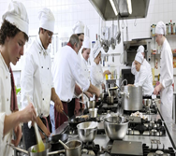

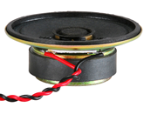
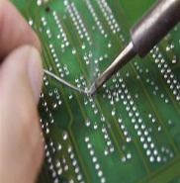
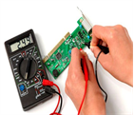
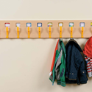
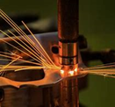

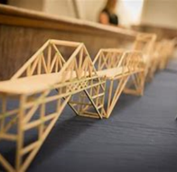
Learning Journey 7-9 Design Technology
Primary Threshold Concepts
Design – Make – Evaluate - Technical Knowledge
EYFS: Fruit Salad and Junk Modelling
KS1: Smoothies, Sandwiches, Moving Pictures, Patchwork
KS2: Fruit Crumble, Pasta,
Branding, Shoes, Pretzels, Curry, Fairground rides, phone cases.
Y7 Technology
Safe Food Preparation and Design
Create and respond to a Design Brief for Pizza and Pasta products.
Develop a specification for a pizza.
Understand the function of ingredients.
Understand how to cook chicken safely.
Create and respond to a Design Brief for a Jitterbug product.
Use and understand the vacuum former, laser cutter and soldering iron tools.
Analysis and Evaluation
Practical evaluation and testing.
3rd Party feedback.
Making
Using appropriate ingredients, tools and equipment safely.
Pizza Product.
Pasta Product.
Oaty Biscuits Products.
Mexican Chicken Product.
An Electronic Jitterbug Product
Careers Links
Year 7: Catering/Electronics in industry, Decision making, industrial processes, problem solving, research.
Year 8: Design in industry, creative thinking, planning
Year 9: Engineering in industry, machining, tolerances, quality control and management, accuracy.
Y8 Technology
Commercial Products,
Materials and Design
Create and respond to a Design Brief for a clock and a key fob.
Develop a specification for a clock.
Understand materials, tools and processes.
Use and understand the pillar drill, disk sander and fret saw machines.
Analysis and Evaluation
Practical evaluation and testing.
3rd Party feedback.
Practical
Using appropriate tools and equipment safely.
Timber Clock.
Aluminium Key Fob.
Y9 Technology
Commercial Products, Materials and Design
Create and respond to a Design Brief for a mobile phone holder and a timber puzzle.
Understand materials, tools and processes. CAD/CAM
Use and understand the laser cutter, strip heater, pillar drill and disk sander machines.
Analysis and Evaluation
Practical evaluation and testing.
3rd Party feedback.
Practical
Using appropriate tools and equipment safely.
Mobile Phone Holder.
Timber Puzzle.
Read like a designer…
Year 7: Gino's Italian Express​ Gino D'Acampo​
Year 8: ​​How to Fail at Almost Everything and Still Win Big Scott Adams
Year 9: Success Through Failure: The Paradox of Design Henry Petroski​
To KS4 – GCSE Product Design and BTEC Engineering…
Extra-curricular and enrichment
Opportunities to enter design competitions.
Opportunities to attend Cookery and CAD club.

