Slide 1

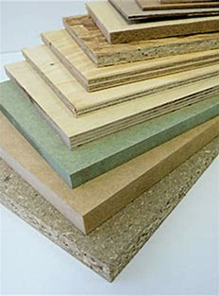
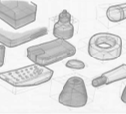
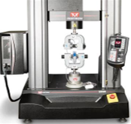

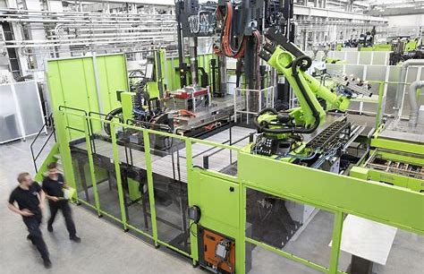

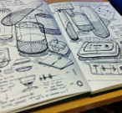


Learning Journey
10-11
Design Technology
Read like a designer…
Year 10: The New Science of
Strong Materials –
or Why You Don't Fall Through the Floor
J.E. Gordon
Where Futures End
Parker Peevyhouse
Year 11: Success Through
Failure:
The Paradox of Design
Henry Petroski
Ready Player One Ernest Cline
Careers Links
Year 10: problem-solving, critical thinking, creative solutions, using systems and technology, communicating, working collaboratively, negotiating, influencing.
Year 11: self-management, adaptability, resilience, self-monitoring and development, active research, analytical and problem-solving skills
Core Technical Principles
New and emerging technologies.
Energy generation and storage.
Developments in new materials.
Systems approach to designing.
Mechanical devices.
Materials and their working properties.
Specialist Technical Principles
Selection of material or components.
Forces and stresses.
Ecological and social footprint.
Sources and origins.
Using and working with materials.
Stock forms, types and sizes.
Scales of production.
Specialist techniques and processes.
Surface treatments and finishes.
Extra-curricular and enrichment
Opportunities to enter design competitions.
Opportunities to visit national engineering and design events and examples of local industry.
Revision
Core Technical Principles
Specialist Technical Principles
Designing and Making Principles
Designing and Making Principles
Basic sketching techniques.
Investigation, primary and secondary data.
The work of others. Design strategies.
Communication of design ideas.
Prototype development.
Selection of materials and components.
Tolerances.
Material management.
Specialist tools and equipment.
Specialist techniques and processes.
Project NEA
Using a brief to create a design portfolio.
Evaluate and develop the design to the point of manufacture.
Use a range of processes to create a final product.
Examinations
Paper 1
• Section A: Core Technical Principles
• Section B: Specialist Technical Principles
• Section C: Designing and Making Principles
To A level and beyond…..

