Slide 1





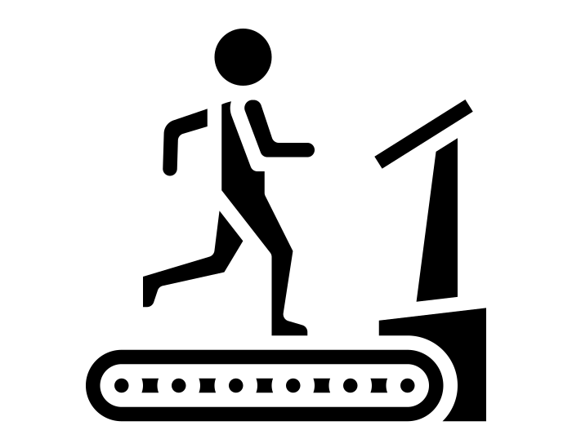

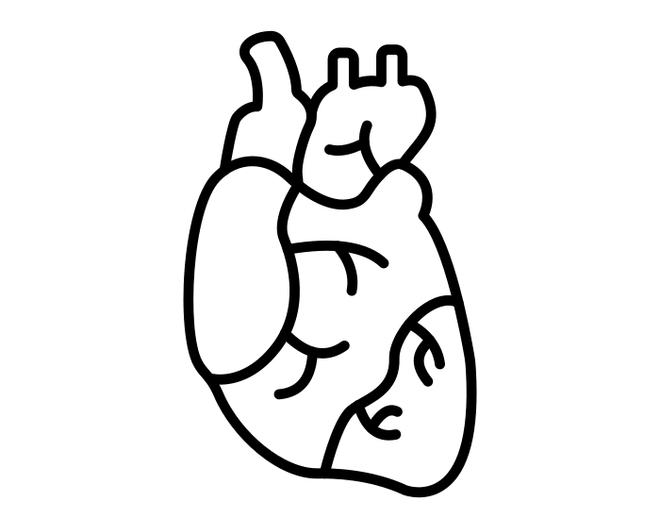

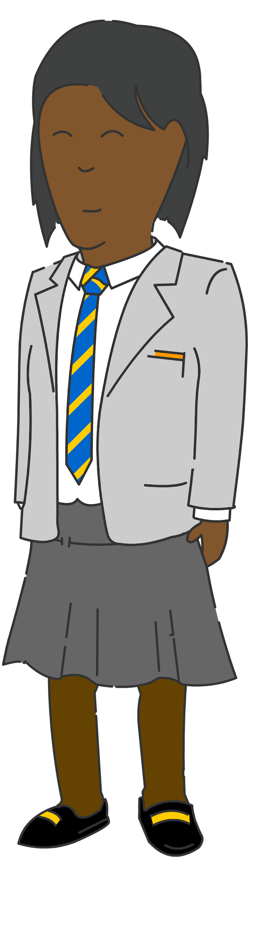



Our BTEC Sport learning journey
BTEC Sport Level 3
Review and action planning
Job application and interview process
Effectiveness and impact of leadership on a sport and exercise activity
Leadership and psychological factors
Practical skills required for different leadership styles
Leading a sport activity
Psychological factors that could impact on leadership
Expectations of leadership
Personal skills audit for potential careers
Planning personal development towards a career in the sports industry
Maintaining a personal portfolio/record of achievement and experience
Sources of CPD
Careers and jobs in the sports industry and training
Scope and provision of the sports industry
Unit 3
Year
13
Importance and effective use of skills, qualities and characteristics when leading
Skills, qualities, characteristics and application
Different leadership roles
Unit 4
Examine training methods for different components of fitness
Understand training programme design
The effects of exercise and sports performance on the energy systems
Understand programme related nutritional needs
The effects of exercise and sports performance on the respiratory system
The effects of sport and exercise performance on the cardiovascular system
The effects of exercise and sports performance on the muscular system
The effects of exercise and sports performance on the skeletal system
Unit 1
Year
12
Understand the screening processes for training programming
Examine lifestyle factors and their effect on health and well-being
Unit 2

