Slide 1
Using IT equipment in school
What IT equipment might we use in school?
What do we need to think about when using IT equipment?

Slide 2
Filtering In school, we have an internet filter. An internet filter is like a special tool that helps keep you safe when you're online. It blocks websites or things that might not be nice or appropriate, to help you stay safe on the internet.

Slide 3
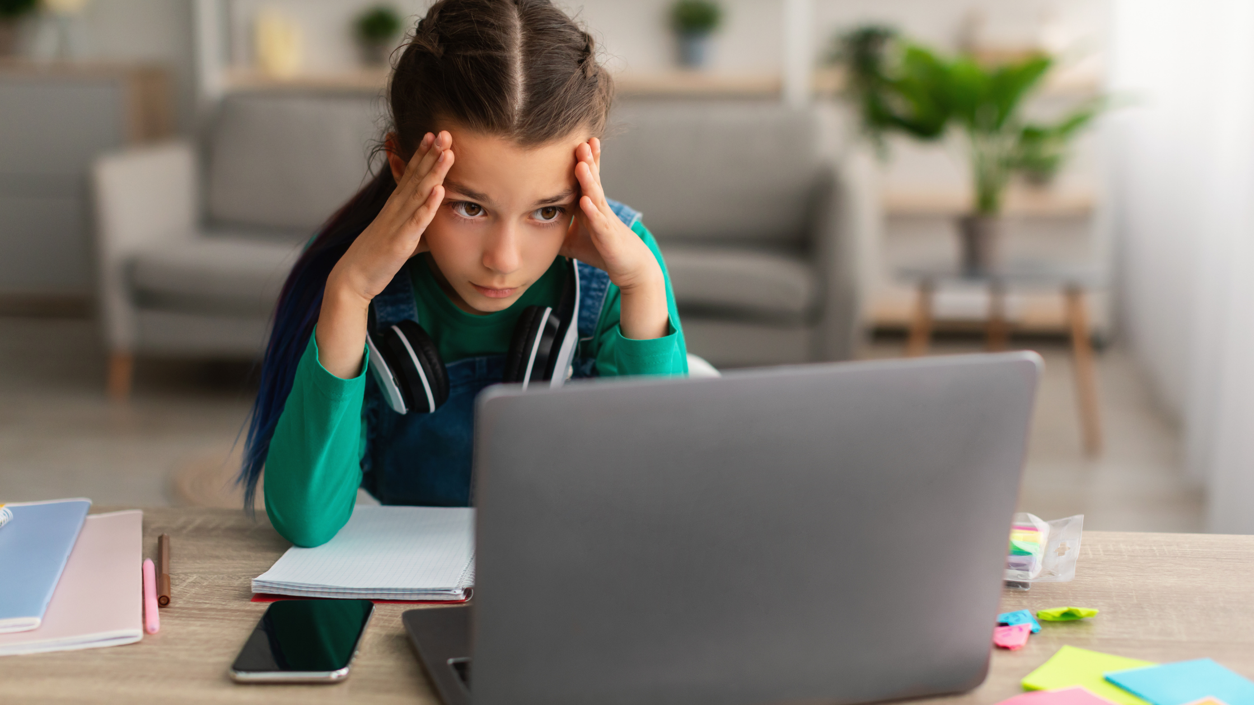
Even though we have an internet filter, some websites might still contain things which we don’t feel comfortable about or which are not appropriate.
Have you ever seen anything online which you didn’t think was appropriate or made you feel uncomfortable?

Slide 4
If you are on a website which your teacher has not told you to go on, this could –
Disrupt the lesson
Cause another child to get upset
Cause you to feel uncomfortable
You can’t decide what might make someone else in your class feel uncomfortable, but you can decide to only go on websites that your teacher asks you to go on.

Slide 5
YouTube is an example of a website you should not go on unless a teacher tells you to. Why might this be? Who puts videos on YouTube? How easy or hard is it for our school to control what videos might appear on YouTube?

Slide 6
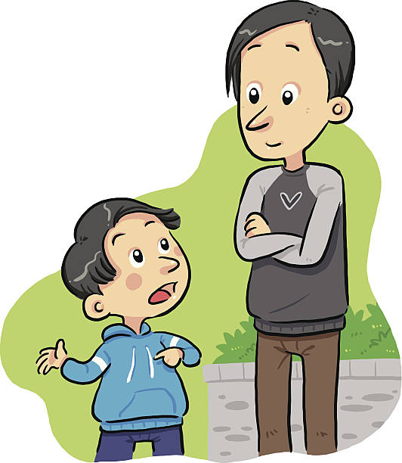
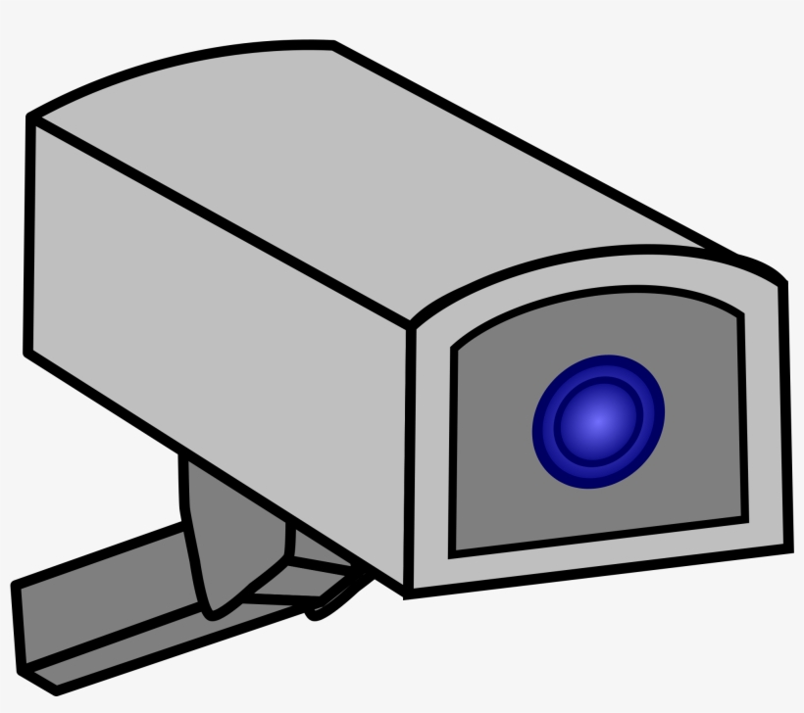
If you do find something online which you think might not be appropriate, you should tell your teacher immediately. If you don’t this could mean that it becomes a bigger problem later on. Every website you access in school is recorded on our school system, like a camera watching your screen – this means the school knows what has been seen even after you have switched the laptop off.

Slide 7
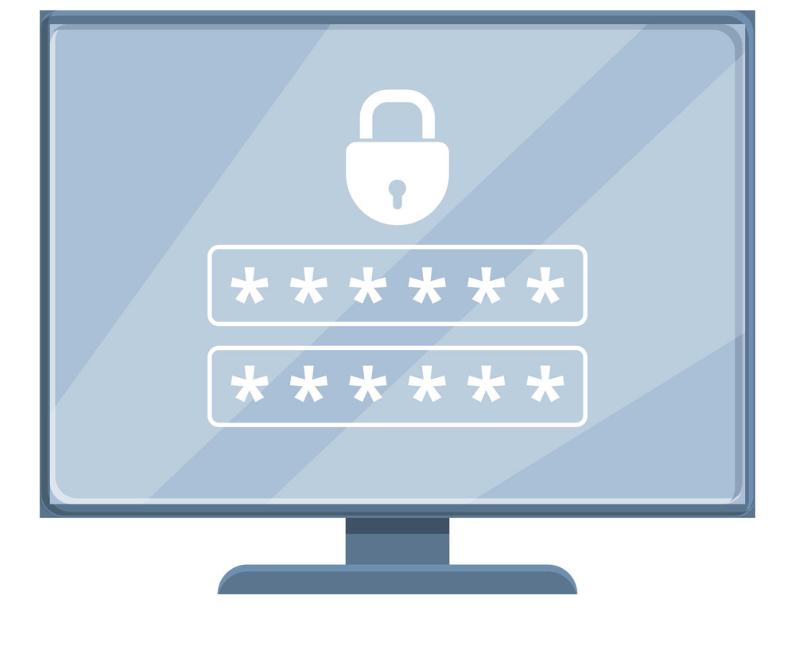
Passwords What could happen if someone else knows your password?

Slide 8
Your password for the school network is like a secret code just for you. Sharing it with others can make it easier for someone to access your personal information or pretend to be you, which can cause problems. It's important to keep your password a secret so that only you can use it to log in and keep your school things safe.

Slide 9
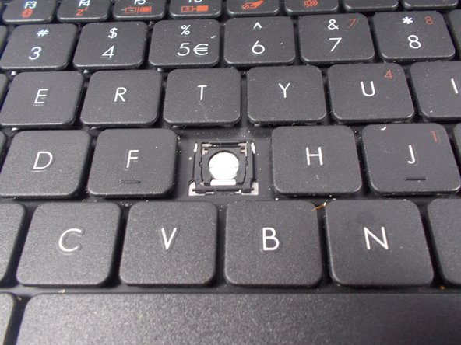
What can happen if we don’t look after IT equipment?

Slide 10
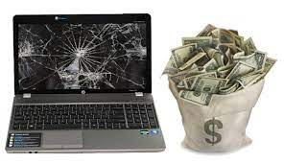
If laptops are not looked after, they can become damaged and eventually break so they can’t be used again.
If this happens, the school cannot pay for a replacement so you won’t be using laptops in your lessons anymore. They are expensive!
If you have caused a laptop to break by damaging it or not looking after it correctly, your parents may be asked to pay for a replacement.

Slide 11
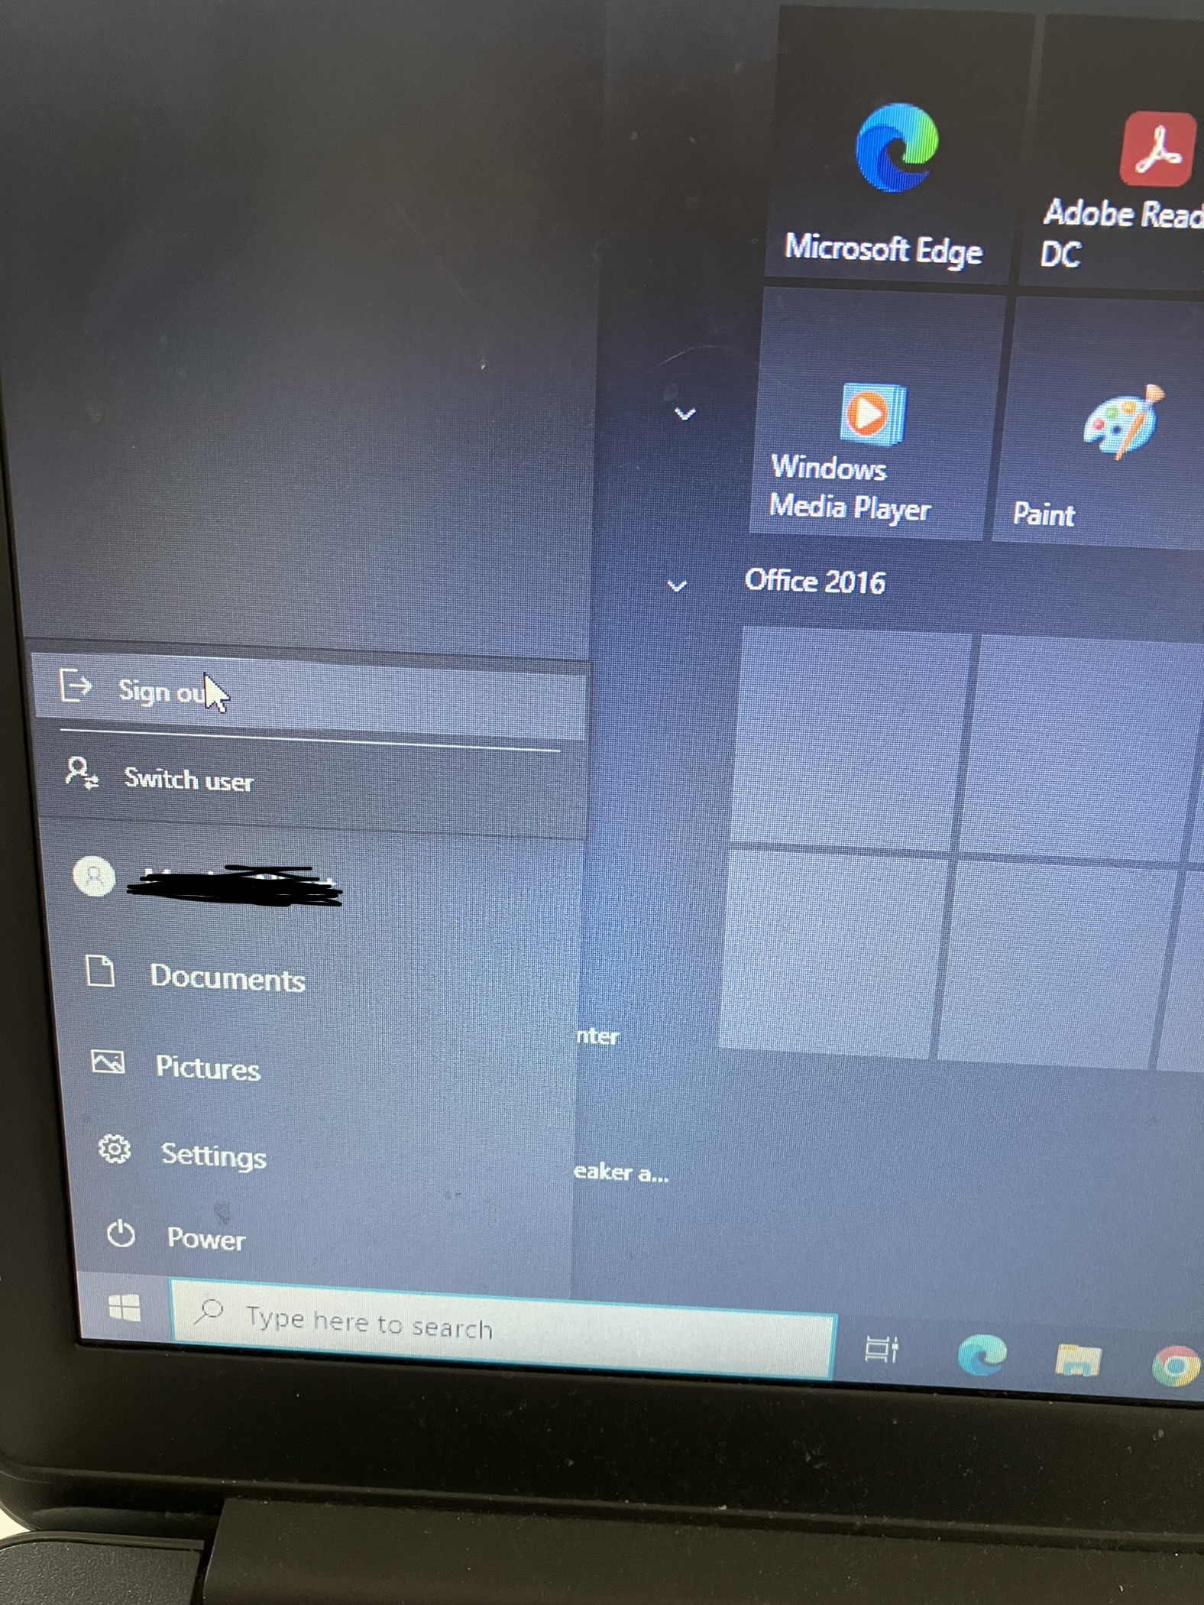
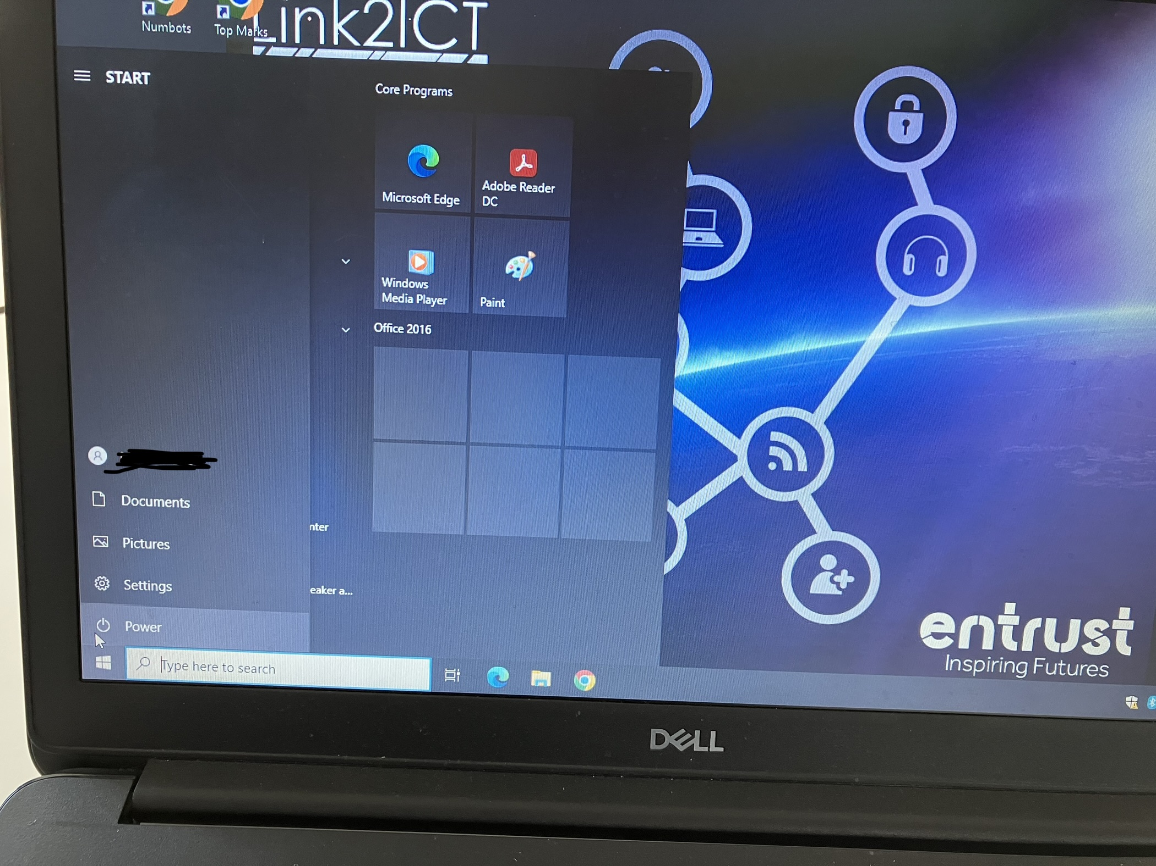
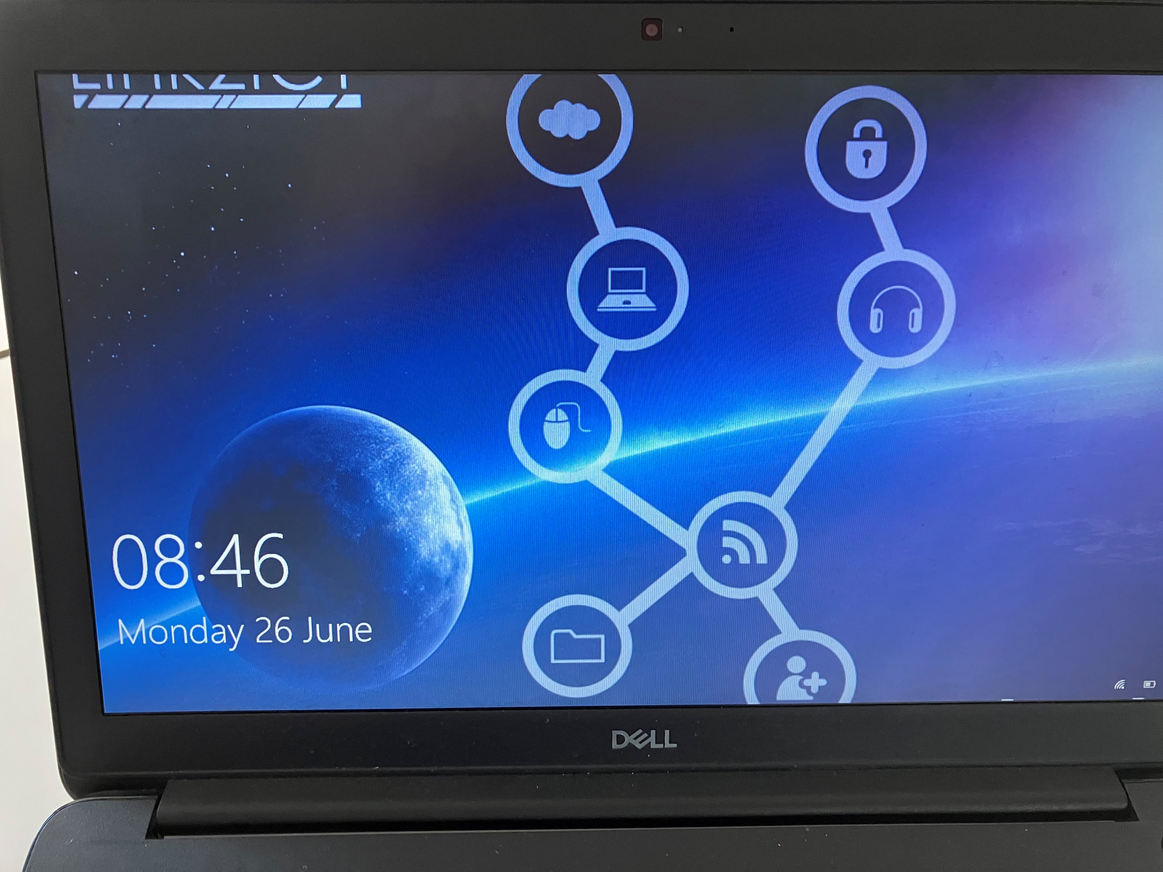
Switching things off properly. If equipment is not switched off correctly this can mean it stops working. When using a laptop, follow these steps to close it down.
You should then see a screen like this
Click on the windows icon in the bottom left. Click ‘Power’.
Click ‘Shut down’
OR if this doesn’t appear,
sign out of the laptop first
To sign out of the laptop, click on
Your username (which is blanked out in this picture) and click
‘sign out’

Slide 12
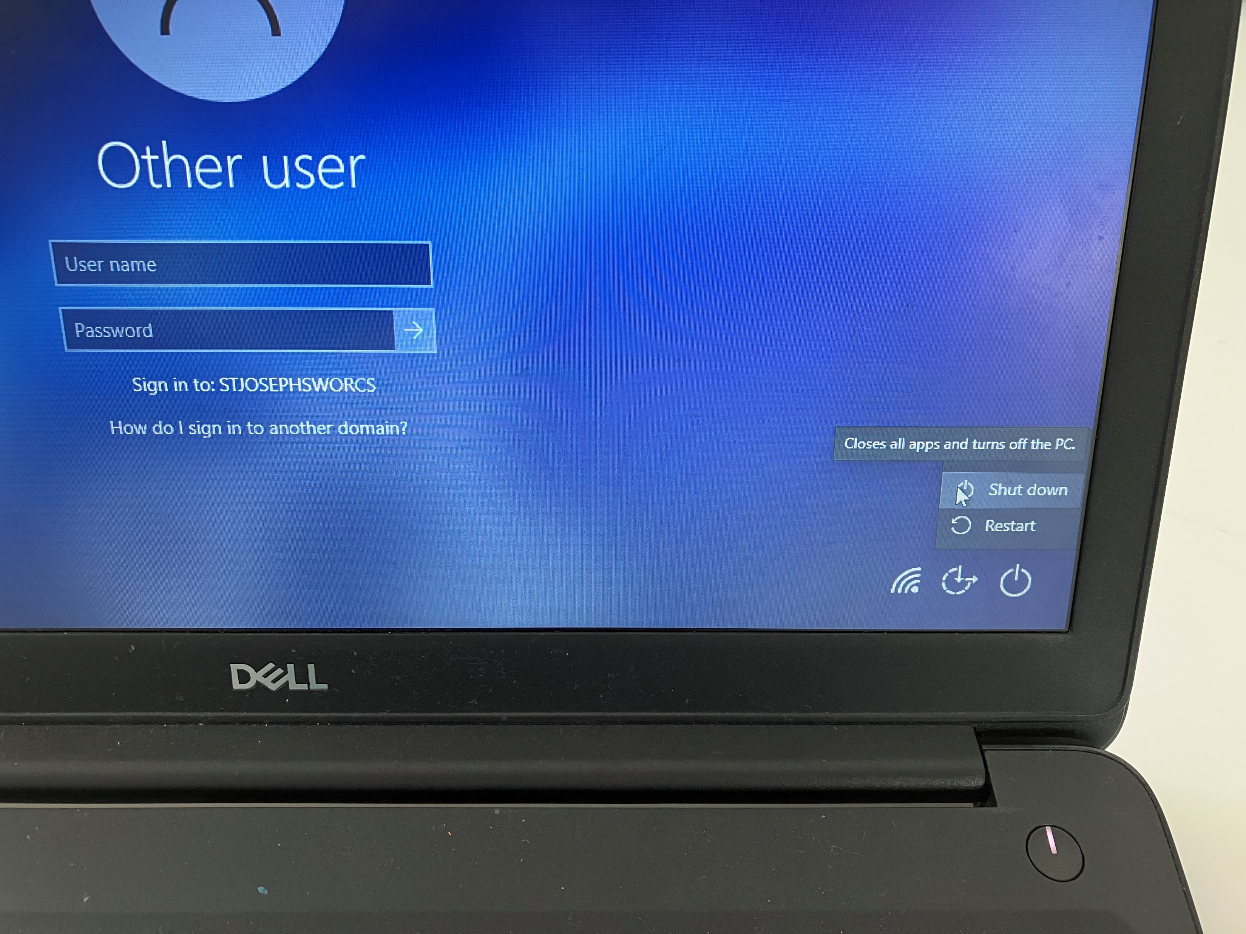
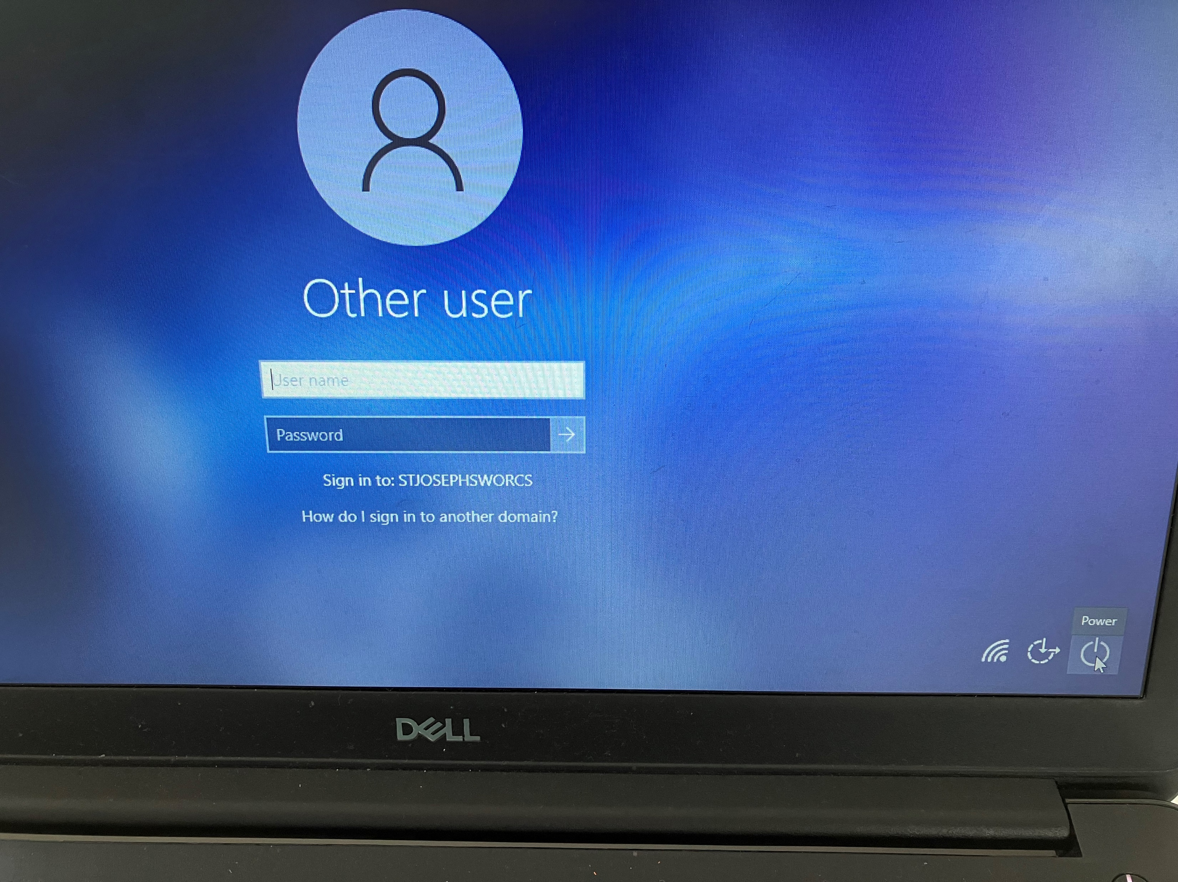
Click on the screen and go
down to ‘power’ in the bottom
left
Click on ‘power’ and then click
‘shut down’.
Wait a few seconds and the screen should go blank.
When the screen goes blank, if you have a light on the power button or anywhere on the laptop, wait for it to go off before closing the laptop.

Slide 13
How should we use IT equipment carefully so we don’t damage it?

Slide 14
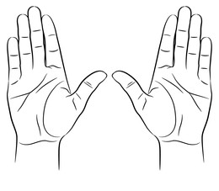
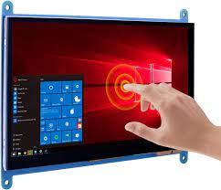
Be gentle and careful when using IT equipment. Don’t run with it or drop/slam it. Use 2 hands.
Keep food and drinks away from the equipment. Spilling something on it can cause serious harm.
Always use clean hands when using the equipment. Dirt and sticky fingers can make it dirty or hard to use.
Avoid touching the screen with sharp objects or writing on it with anything other than your finger if it's a touch screen.
If you're not sure how to use or handle the equipment, ask an adult for help. They can show you the right way to use it without causing any harm.

