Slide 1
Welcome to Mrs McDonagh’s
Maths Mansion
Play in Slide show

Slide 2
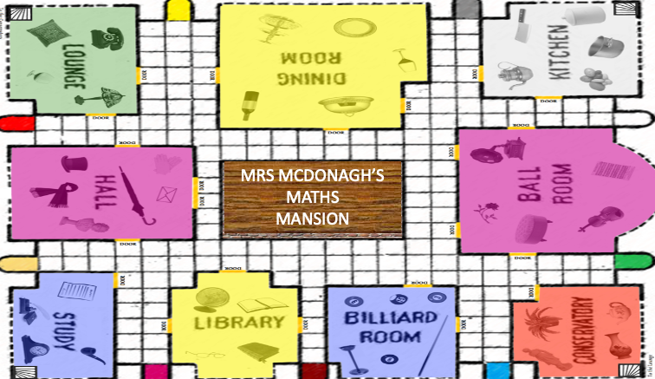
How to play:
Play game in Slide show mode
Select a room
Have a go at the question
If correct you’ll move onto the next room
If wrong you will have to go back to the map.
Answer all rooms correctly to escape..
Click here

Slide 3
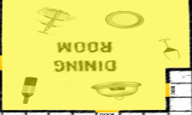
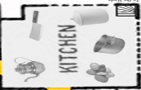
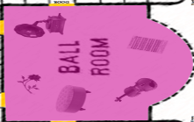
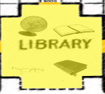
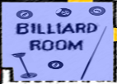
MRS MCDONAGH’S
MATHS MANSION
Select a Room

Slide 4
Go to
The
Dining Room

Slide 5
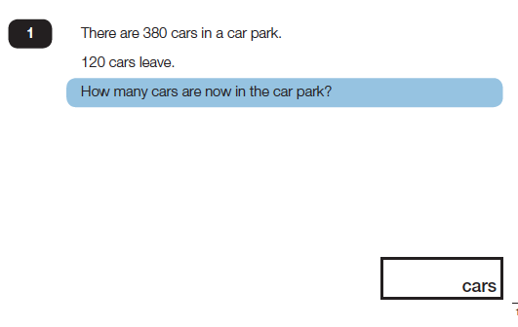
Question:
Already been here? Click on another room
Mrs McDonagh says:
”Always show your working out.”R
A) 350
B) 260
C) 500

Slide 6
Go to
The
Study

Slide 7
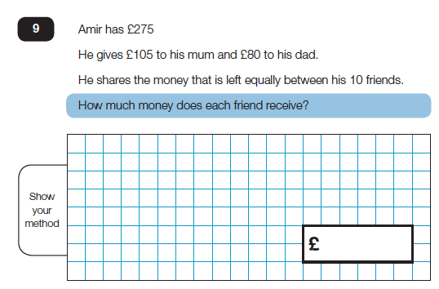
Question:
Already been here? Click on another room
Mrs McDonagh says:
”It doesn’t matter if you get the wrong answer, just keep trying.”
A) £12.00
B) £11.00
C) £9.00

Slide 8
Go to
The
Library

Slide 9
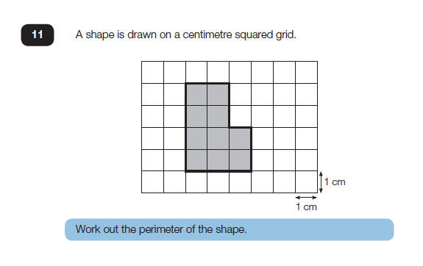
Question:
Already been here? Click on another room
Mrs McDonagh says:
”Well done, you’re a star!.”
A) 11 cm
B) 10cm
C) 14 cm

Slide 10
Go to
The
Billiard Room

Slide 11
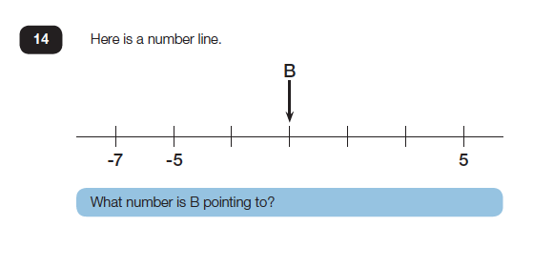
Question:
Already been here? Click on another room
Mrs McDonagh says:
”Always show your working out.”R
A) -1
B) 0
C) 1

Slide 12
Go to
The
Conservatory

Slide 13
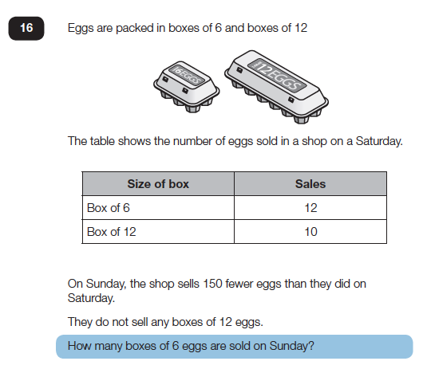
Question:
Already been here? Click on another room
Mrs McDonagh says:
”Fantastic work, it’s having a go that’s important.”
A) 7
B) 8
C) 6

Slide 14
Go to
The
Hall

Slide 15
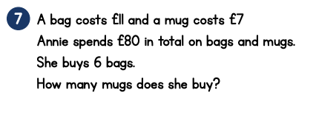
Question:
Already been here? Click on another room
Mrs McDonagh says:
” Don’t worry if you are not sure, just have a go!”
A) 3
B) 2
C) 1

Slide 16
Go to
The
Kitchen

Slide 17
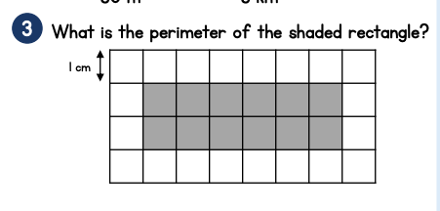
Question:
Already been here? Click on another room
Mrs McDonagh says:
”Amazing work!.”R
A) 12
B) 18
C) 16

Slide 18
Go to
The
Ball Room

Slide 19
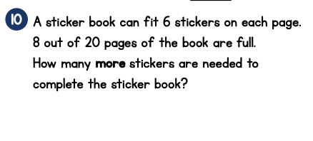
Question:
Already been here? Click on another room
Mrs McDonagh says
“Remember it’s not a mental maths test! Use jottings to help” R
A) 72
B) 96
C) 66

Slide 20
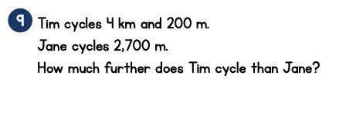
Question:
Already been here? Click on another room
Mrs McDonagh says:
”Always show your working out.”R
A) 1200 m
B) 1500 m
C) 2500m

Slide 21
Have You been to every room?
If YES- click here
If NO-
Select your next room

