Slide 1
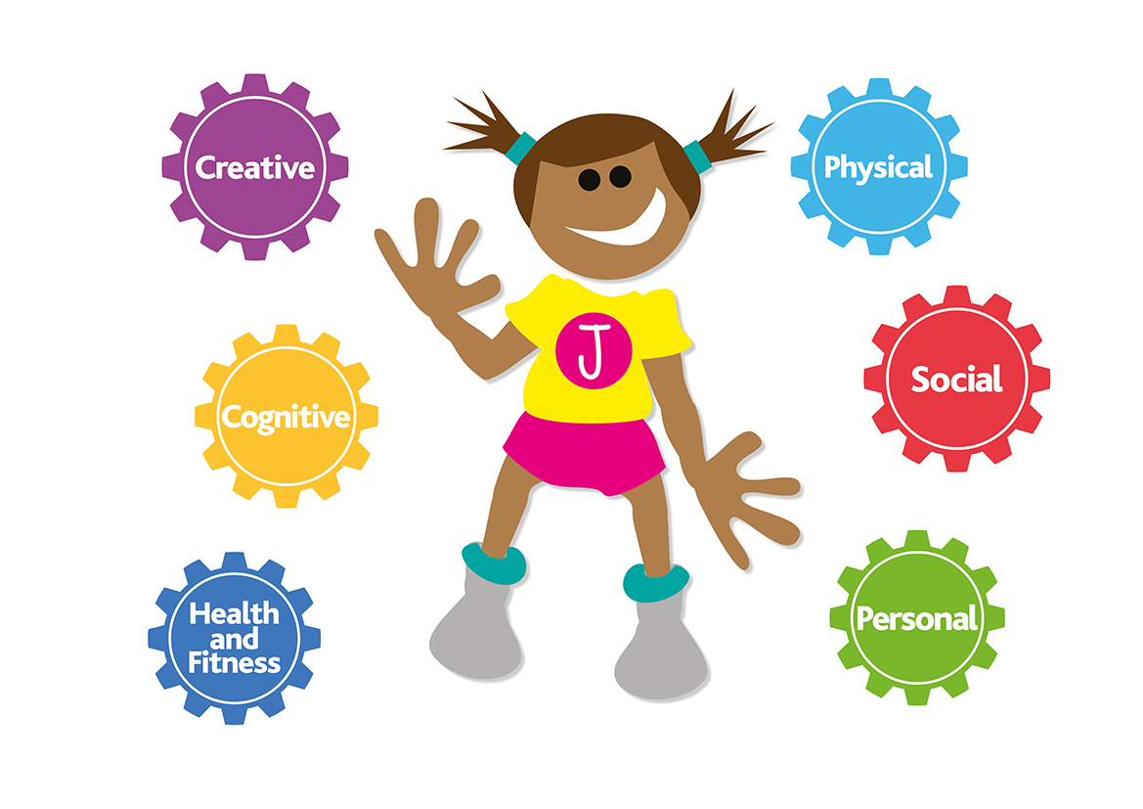
Consistency and progressive skills being taught in PE lessons across the school.
(Real PE and quality of PE teaching across the school)
Real PE Focus
Strengths
KS1 & KS2:
Children are being exposed to the various challenges and know how to challenge themselves during lessons.
Children are showing continuous improvement in Fundamentals of Movement in the three key areas: Locomotion, manipulation and stability.
Children can recall various types of movements taught during REAL PE lessons.
Children very much enjoy PE and talk positively of it.
Children can talk about what they have learnt this year and what activities they have done in Real PE. KS2 children were able to eloquently talk about the skills they have learnt in Real PE lessons (coordination, balance, foot work etc)
REAL PE system Jasmin allows for a clear progression of skills across the key stage.
EYFS have been able to adapt REAL PE to what works best for them and what units best for their curriculum.

Slide 2
Consistency and progressive skills being taught in PE lessons across the school.
(Real PE and quality of PE teaching across the school)
Real PE Focus
Future Improvements
KS1 & KS2:
Similar to last year, more work needs to be put into children being aware of what ‘cog’ they are focusing on and the main aims of that ‘cog’. E.g if the focus is ‘cognitive skills, ensure children know they are looking at explain what they are gong well and begin to share with others what they need to improve.
Children to have a greater understand as to why they are doing REAL PE and how this helps them in other sporting activities.
Ensure equipment is regularly being checked and balls are pumped up if needed.
Roll out the assessment wheel for each class teacher to complete after their unit.

Slide 3
Consistency and progressive skills being taught in PE lessons across the school.
(Real PE and quality of PE teaching across the school)
PE Focus
Strengths
KS1 & 2:
Children are being exposed to different sports during the year and a newly developed progression of skills has been developed for teachers to follow.
The recently purchased scheme Power of P.E has been embraced by teachers and is helping them with lesson structure and content. This means a consistent approach across the school in line with our progression of skills document.
Children can talk about what they have learnt this year and what activities they have done. KS2 children were able to eloquently talk about the skills they have learnt in Real PE lessons (coordination, balance, foot work etc)
AJB coach has provided CPD for every teacher in the school in a range of topics. Teachers described this as “excellent, beneficial and supportive”.
EYFS have been able to adapt the PE curriculum and create ways to ensure the new EYFS physical development skills linked to Birth to 5 is being taught in a creative, fun and systematic way.

Slide 4
Consistency and progressive skills being taught in PE lessons across the school.
(Real PE and quality of PE teaching across the school)
PE Focus
Future Improvements
KS1:
A clearer use of the skills progression document in sporting activities to ensure children's skills are being built on year on year.
Ensure equipment is checked regularly and not being used for break and lunchtimes.
Ensure new staff have been monitored and shown REAL P.E.
KS2:
Using the new skills progression document to ensure classes are teaching the correct skills needed to ensure progression throughout the key stage.
Ensure teachers are not just delivering a sport each session, they should be delivering the skills that are transferable.
Ensure everyone is teaching 2 hours of PE a week more consistently.
Ensure everyone is delivering 30 active minutes throughout their non-PE days.

Slide 5
Improve social relationships between peers and improve lunchtime behaviour in specific year groups.
Group discussion with Year 2 and 5 lunch supervisors – Talk to lunchtime staff
AJB Lunch time – Quote from lunch time supervisors – Having AJB play organised games with the children has been great. If it is their year groups turn, most children in the year group want to participate and the coaches always make it fun and enjoyable. Now having them every day has been great and provides more children with the opportunity to play the games.
Child quote on lunch times – Year 1 – “Football is so fun at lunch time. I get to score loads of goals and play with my friends. The AJB man is so funny”.

Slide 6
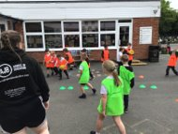
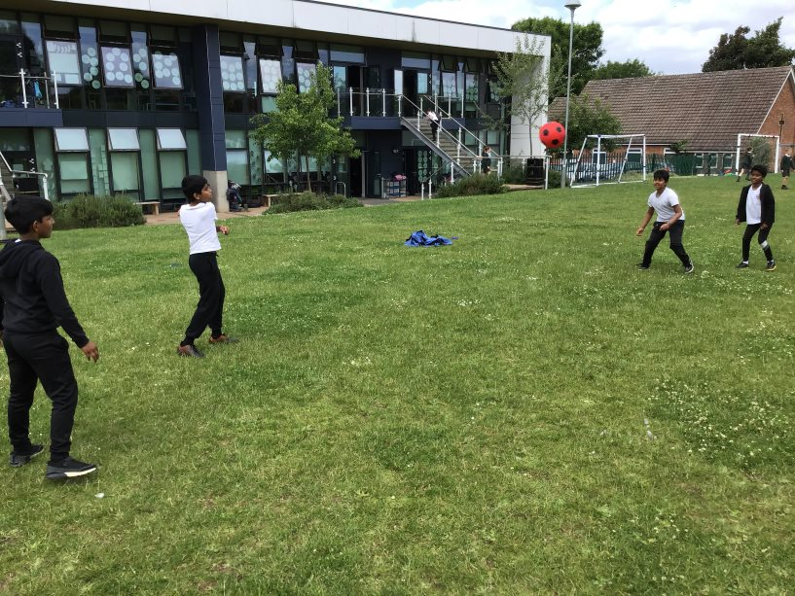
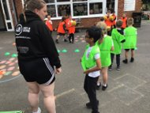
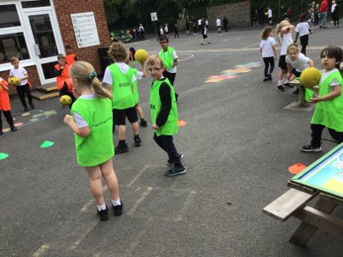
Improve social relationships between peers and improve lunchtime behaviour in specific year groups.
Active lunch times in action
AJB active lunch times KS1
AJB active lunch times KS2
Our investment in equipment has allowed children to be active during their lunch break.

Slide 7
Extra-curricular sporting opportunities
Group discussion with Year 3, 4 and 5 children who attend clubs –
There is always lots of clubs to pick from. I love it when it's time to pick new clubs each term, I get excited to see what is on offer.
I like the clubs because I can't always do clubs outside of school. There are lots to pick from.
They are good fun, we get to use equipment we don't always use in PE lessons.
Autumn 2019 (pre Covid) | Autumn 2021 | Summer 2022 | Summer 2023
20 clubs 270 places | 13 clubs 158 places | 15 clubs 216 places | Clubs 278 places
Clubs are getting back to Pre COVID numbers through the variety of offer and the uptake from the children. Places refers to the number of children that have signed up to the clubs on offer. A child might take part in more than one club per week.

Slide 8
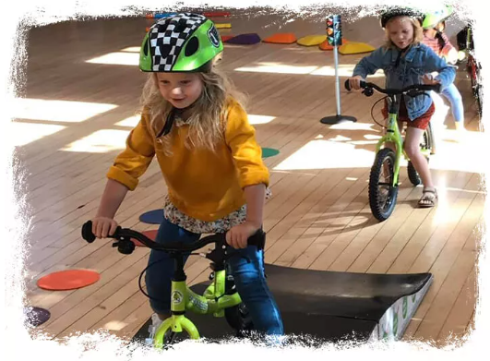
Extra-curricular sporting opportunities
Mini bikers training for EYFS staff
Staff in EYFS and Pre school were given training to deliver biking sessions with an emphasis on developing balance skills and strengthening gross and ﬁne motor skills.
Going forward we are committing to purchasing 14’ bikes so EYFS staff can deliver biking sessions for EYFS children.

Slide 9
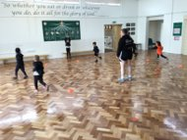
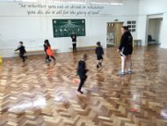
Targeted intervention to improve outcomes for children
Fundamental of movements Intervention across EYFS and KS1 - Quote from Year 1 teachers – I have seen a great increase in the children's ability to preform the basic gross motor skills activities. Chloe from AJB takes small groups and focuses on the basics with a small group at a time. I have seen a great impact on this in PE lessons and their ability to participate in team games.
I have even had to change the groups multiple times during the year due to the children improving on FMS I felt it was needed to keep changing them.
Quote from children
Its so fun when we go with Chloe. We play great games and get top hop around like bunnies a lot.
I love it when we get a ball and I get to throw it and bounce it around the hall.
ADD PICTURES

Slide 10
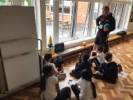
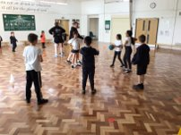
Provide children with ‘Active Minds’ intervention. This is a physically active learning educational program focused on Mental Health and Building Emotional Resilience.
Current year groups: 5, 4 and 3.
Impact of Active minds:
Children have greater knowledge of their own mental health and strategies to build their emotional resilience.
Enhances pupil confidence, resilience and education so that they have the knowledge and tools to maintain a healthy lifestyle.
Children are able to cope with challenging situations and have been equipped with strategies to support themselves when faced with obstacles.
Quote from Year 4 teacher:
Children have been able to resolve their differences in a timely way and are more accepting of others and their differences .
Quote from Year 3 Child:
I enjoy the practical games we do based on the thing we are learning about that day. Then we get to play a game at the end and have to show ways we could help eachother.

