Slide 1
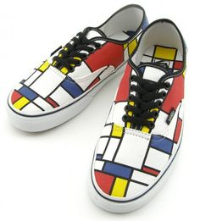
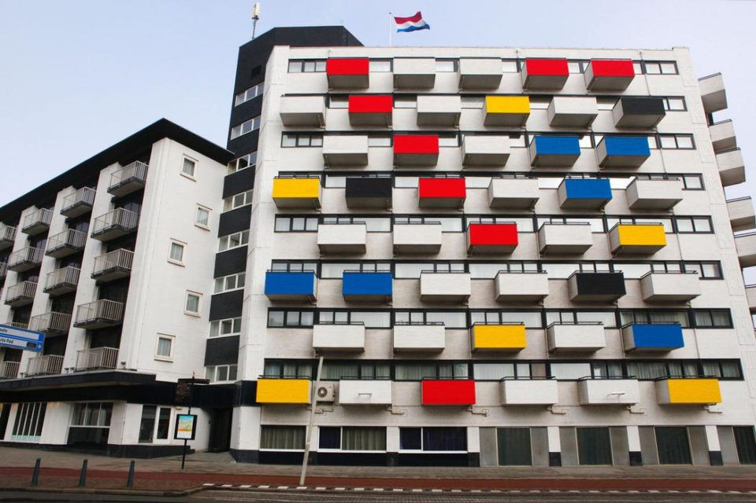
Piet Mondrian

Slide 2
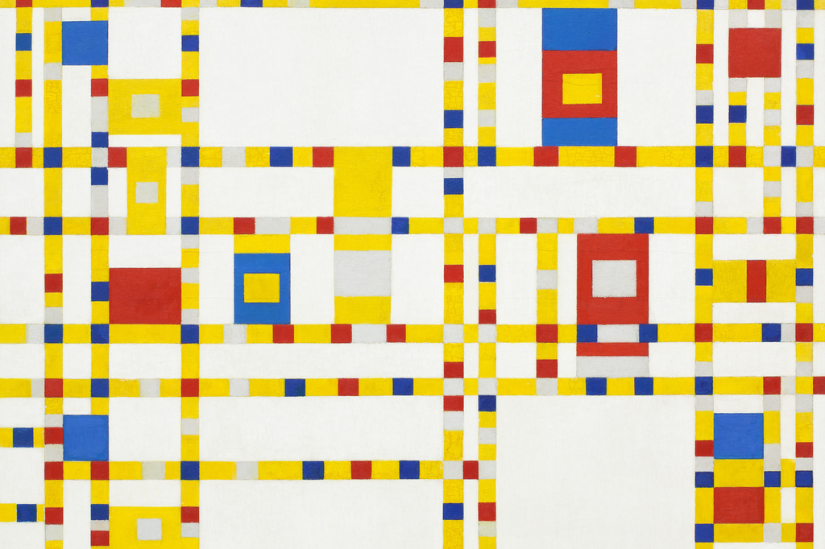
Mondrian is a Dutch Artist who is famous for his bold colourful abstract shapes. Abstract means that something is not recognisable, it doesn’t look like something we are familiar with. He uses the three primary colours Red, Yellow and Blue as well as black lines. These are two of his most famous paintings but before he made these he did paint landscapes, buildings etc but wanted to explore how shape and colour worked in a simpler way.

Slide 3
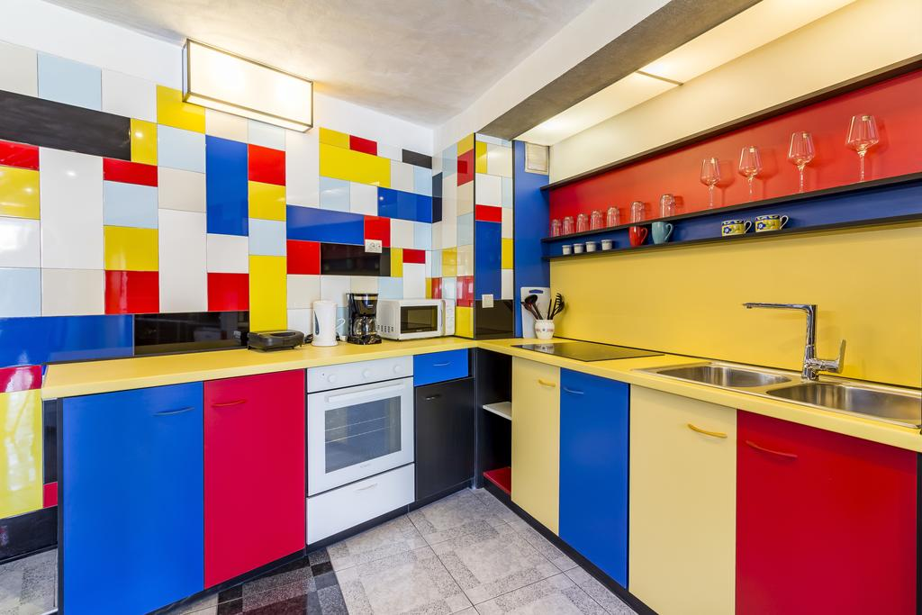
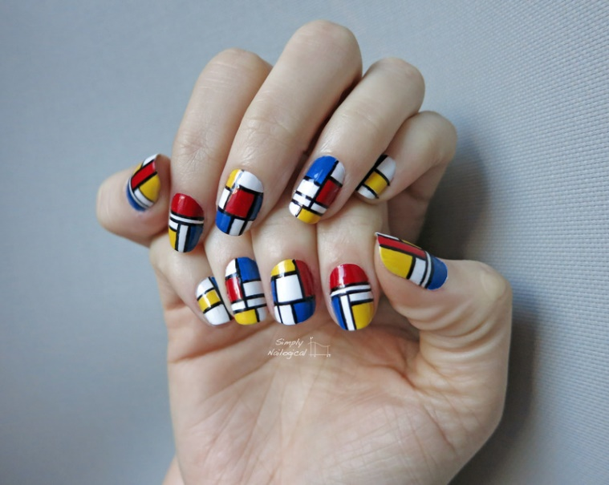
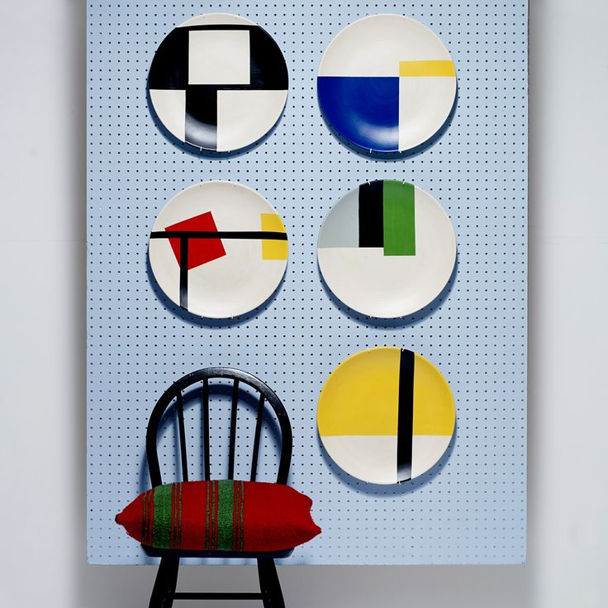
There are lots of ways in which Mondrian’s work has influenced differing designs around the home, in fashion etc.

Slide 4
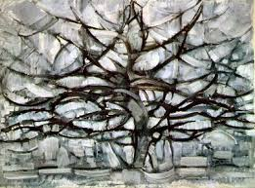
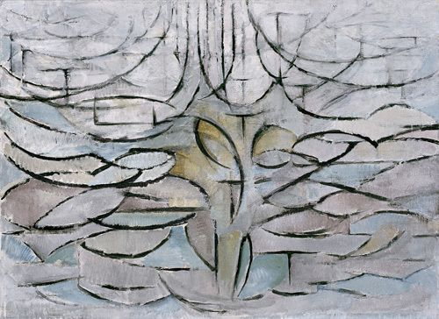
Even though Mondrian is famous for his bold Abstract colourful work he also painted buildings, landscapes, trees etc. He liked to experiment and change how familiar things looked so explored making them become ‘ABSRACT’. In the first painting of a Tree he has used very bold colours and we can see it is a tree. In the second painting we can still see the basic shape of the Tree but it is not really obvious and the last painting has become very abstract and does not look like a Tree at all. This is called ‘Absraction’.

Slide 5
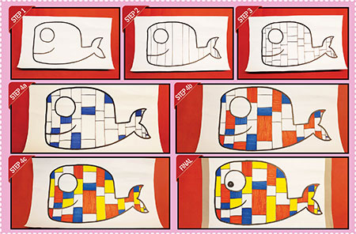
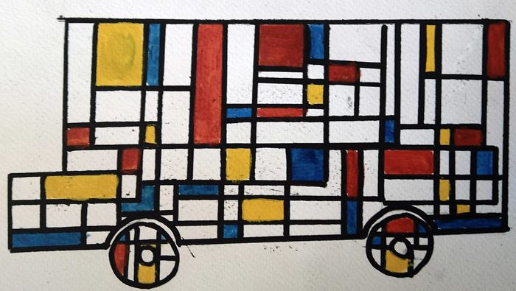
Here are some examples of drawings influenced by Mondrians. Can you draw your favourite Animal, Flower, Toy, House etc by following the steps from the Whale picture below.
Mondrian usually uses the three Primary colours but if you would like to use other colours that is fine BUT only three colours in total. Have fun and I look forward to seeing your work.

