Slide 1
Understanding Autism Group
Session 4

Slide 2
Notes:
Add names for practitioners attending

Slide 3
Group Rules
Speak in turns
Kindness
Listening to each other
Not having our phones out
Not recording or taking pictures
Not sharing things outside of the group – private and confidential
Not sharing personal information inside the group (e.g. phone number / social media)

Slide 4
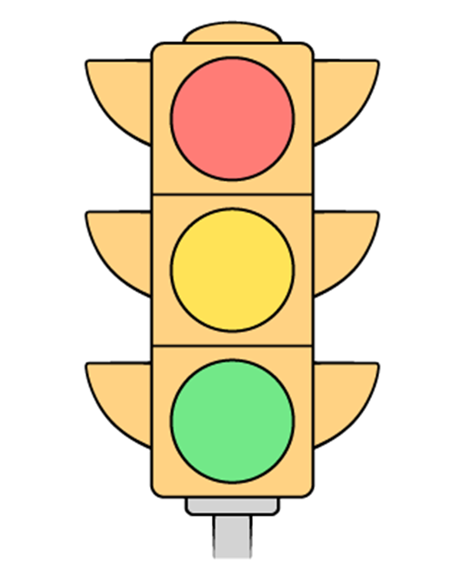
How are you doing today?
RED- I won’t take part, but I will listen as best I can. I may need extra support or a break.
AMBER- I may find it tricky to take part but I will try my best.
GREEN- I’m feeling good. I’m able to participate.

Slide 5
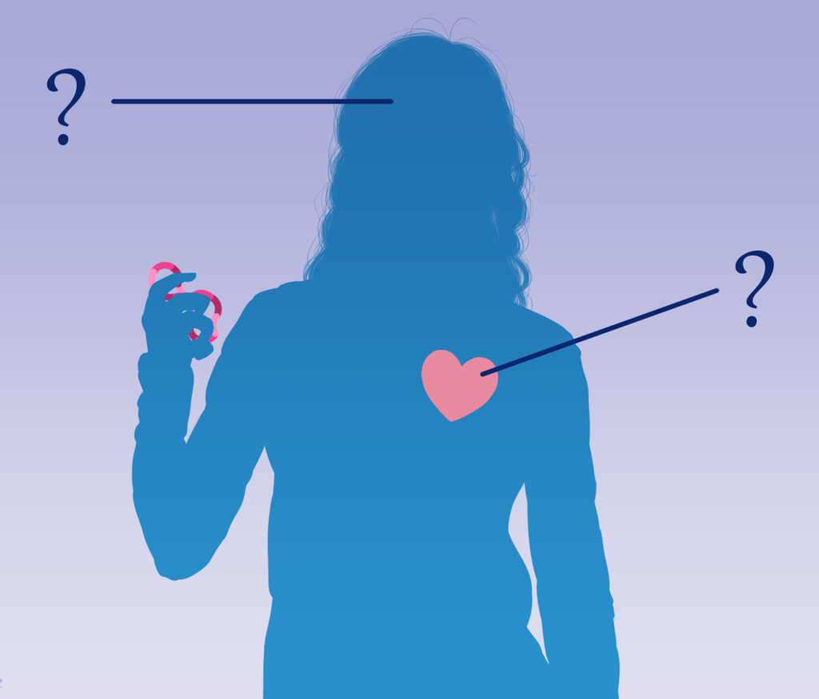
What the group will cover
Introduction to Autism
Masking
Stimming
Making friends
Senses
Back up team
Areas of interest
Anxiety
Zones of regulation
Alexithymia

Slide 6
Today’s Agenda
Game
Understanding our emotions
Why do we have emotions?
Zones of regulation
Difficult feelings
Anxiety, why we feel it and how it feels
End of session

Slide 7
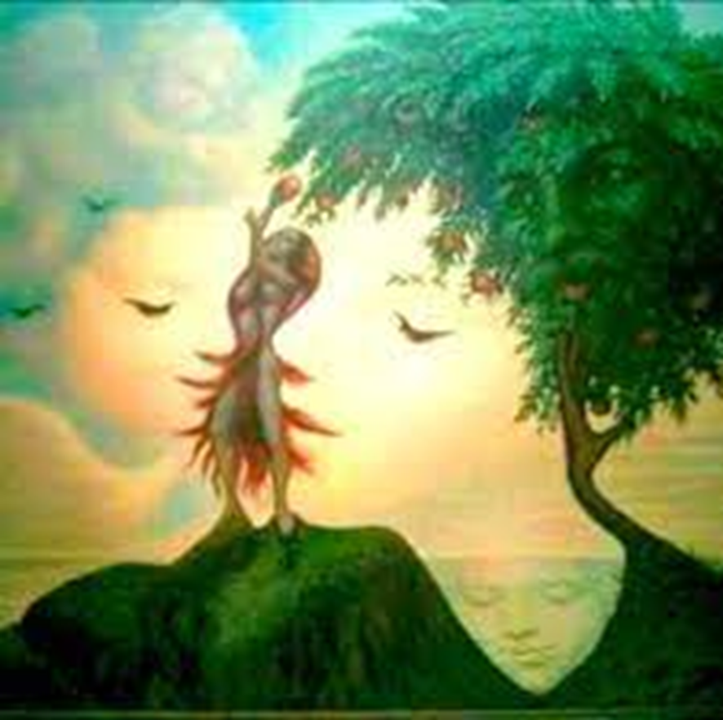
Game: How many faces can you see in the picture?
.

Slide 8
Understanding Emotions
•We can all struggle with difficult feelings at times
•It is very common to feel worried or down from time to time but sometimes it can get really hard and we might need to talk to somebody about how we are feeling
•In the group today we would like to learn some more about emotions and how they may affect you, next week we will go through some tips to manage this.
Notes:
Explain that the way in which world has been set up can make it a difficult environment for autistic people and this can bring up feelings of anxiey, stress or low mood

Slide 9
Why do we have emotions?
Emotion | Urge
Anger - | Gets us ready to attack - it activates us to attack or defend.
Fear/Anxiety - | Gets us ready to run, hide or attack - it activates us to escape danger.
Sadness - | Gets us ready to be inactive - it activates us to avoid contact.
Disgust - | Gets us ready to reject or distance ourselves - it activates us to avoid.
Notes:
The word emotion has ‘motion’ in it as our emotions get us to act and do things.
For example, back in the cave man times, if a saber tooth tiger walked into your mud hut, this would cause fear, and the action would be to run away or hide
Our emotions are there for our survival, even in todays times when we don’t have threats like saber tooth tigers

Slide 10
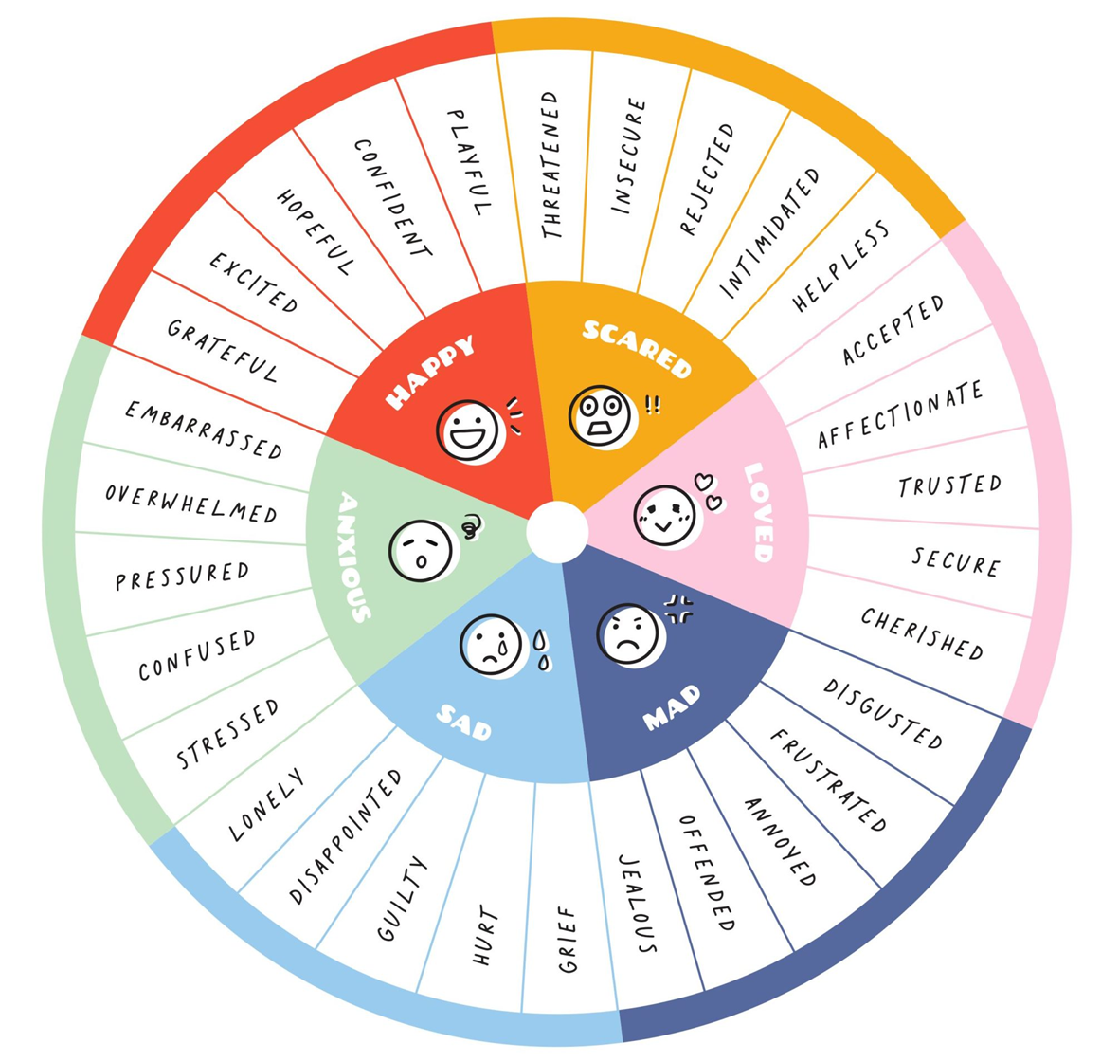
Emotion Wheel
Notes:
We can see from the colour wheel that there are lots of different names for different emotions and people can call them different things
PRINT

Slide 11
Zones of Regulation
Discuss: What are the face and body clues for each zone?
Notes:
It can be helpful to group emotions into ‘zones’. Your body will feel different in each zone.
Discuss: What are the face and body clues for each zone? - draw on whiteboard
Blue: No energy, still facial expression, moving slowly, starring
Green: Lots of energy, smiling, laughing
Yellow: Irritable, quick movements, difficulty sitting, unable to concentrate, eyes looking around, tapping legs
Red: Uncontrolled energy, tense, lots of movement, loud,

Slide 12
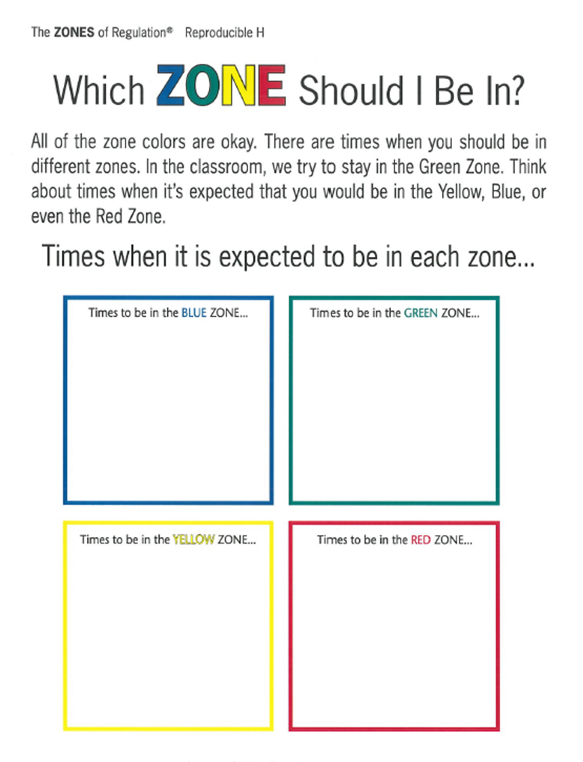
Activity: Which zone would I be in?
Notes:
All of the zone colours are ok. There are times when you will be in different zones. Think about times that you expect you would be in the Blue, Green, Yellow or Red Zone.
ACTIVITY: Add a coloured piece of paper to each 4 walls of the room for each of the zones. Facilitator reads out scenarios and group members choose where to stand stand in the room to show which zone they think they would be in during this scenario.
What zone are you in now?
You are watching your favourite TV programme.
You are in a lesson you find boring.
You are waiting to go into an important exam.
Someone pushed you in the corridor.
You just won an award for something you worked hard on.
You are in a crowded shopping centre.
You are playing with a pet.
Someone just broke something that belongs to you.
You are really hungry.
You got a test result back and you are disappointed with the result.

Slide 13
What types of feelings can be difficult to cope with?
Group Discussion
Notes:
Can occur when:
-We have difficulties making friends
-There is a sudden change
-We have to do something new
-We are somewhere that is too loud/noisy/busy

Slide 14
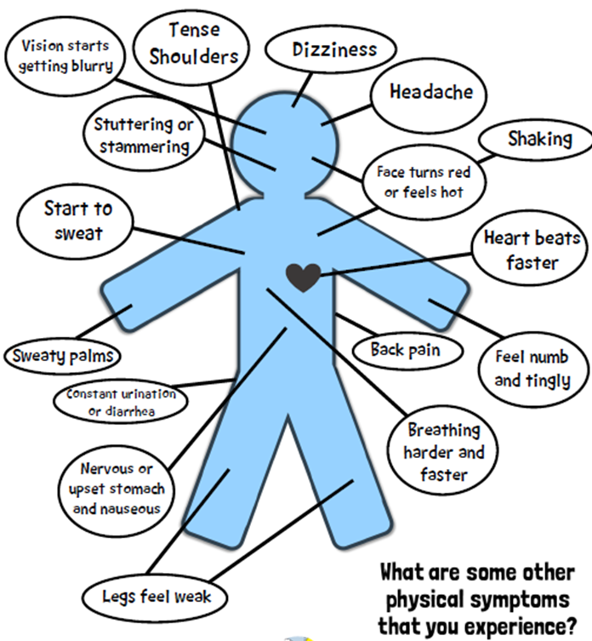
How does anxiety feel
in the body?
Notes:
Group anxiety body map exercise : Experiencing anxiety can feel scary and unpleasant, you might recognise some of these physical sensations when you are anxious.

Slide 15
Why do we experience anxiety?
(235) Fight Flight Freeze – A Guide to Anxiety for Kids - YouTube
Notes:
Discuss video
(235) Fight Flight Freeze – A Guide to Anxiety for Kids - YouTube

Slide 16
How was today?

Slide 17
Next week
Looking after our emotions
Emotion regulation strategies
Alexithymia
Spoon theory
Creating a tool box

