Slide 1
Understanding Autism Group
Session 5

Slide 2
Notes:
Add names for practitioners attending

Slide 3
Group Rules
Speak in turns
Kindness
Listening to each other
Not having our phones out
Not recording or taking pictures
Not sharing things outside of the group – private and confidential
Not sharing personal information inside the group (e.g. phone number / social media)

Slide 4
How are you doing today?
RED- I won’t take part, but I will listen as best I can. I may need extra support or a break.
AMBER- I may find it tricky to take part but I will try my best.
GREEN- I’m feeling good. I’m able to participate.

Slide 5
What the group will cover
Introduction to Autism
Masking
Stimming
Making friends
Senses
Back up team
Areas of interest
Anxiety
Zones of regulation
Alexithymia

Slide 6
Today’s Agenda
Game
Looking after our emotions
Emotion regulation strategies
Alexithymia
Spoon theory
Creating a tool box
End of session

Slide 7
Warm up game: How many animals can you see in the picture.

Slide 8
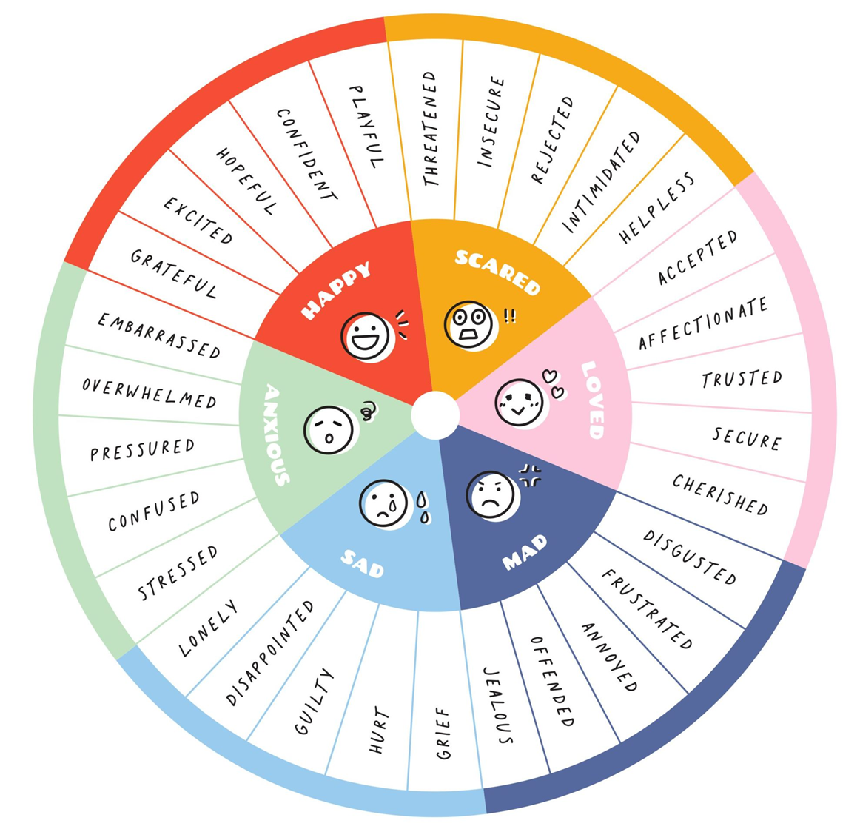
Looking after our Emotions
•Sometimes we find it hard to look after uncomfortable emotions.
•It is important that we learn to look after our emotions
•Looking after means recognising how we feel and acting in a helpful way to us and others.

Slide 9
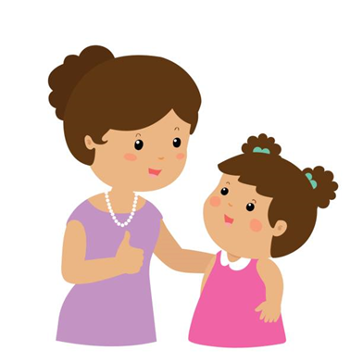
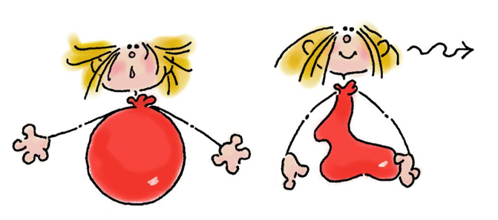
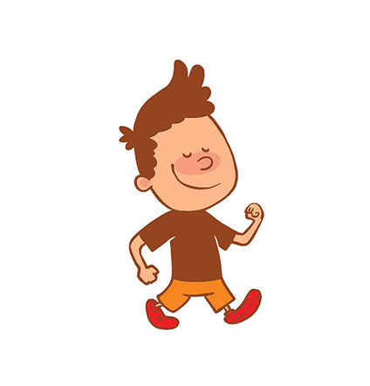
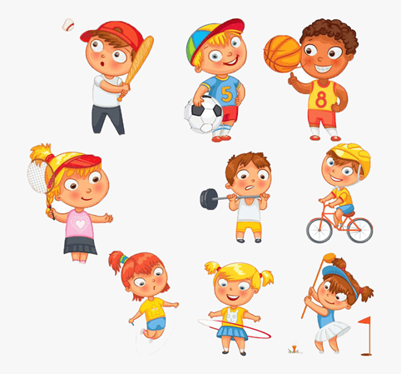
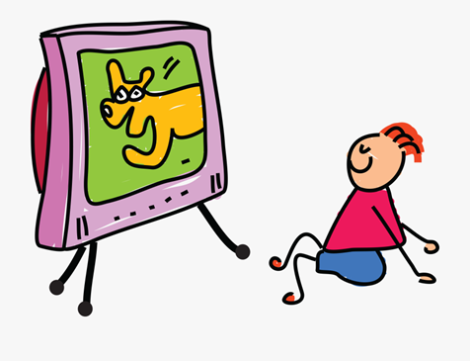
So, what can we do?
What do you already do when you feel worried, sad or angry to help you calm down or cheer yourself up?

Slide 10
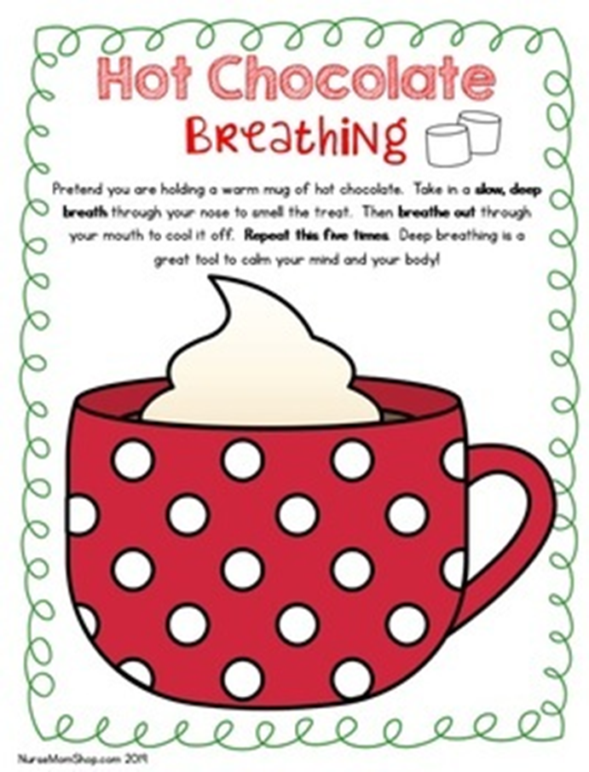
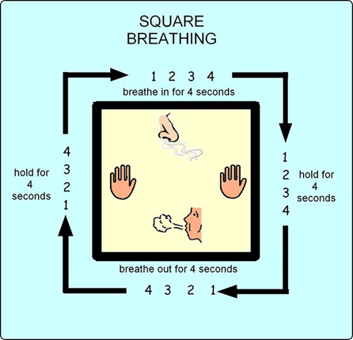
Some new things to try…
Breathing

Slide 11
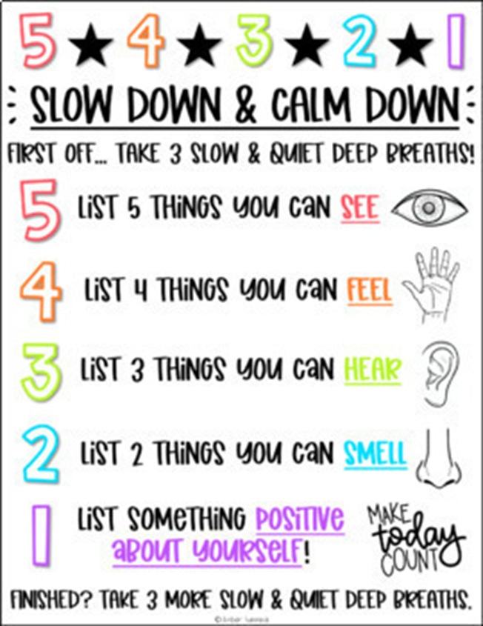
Grounding

Slide 12
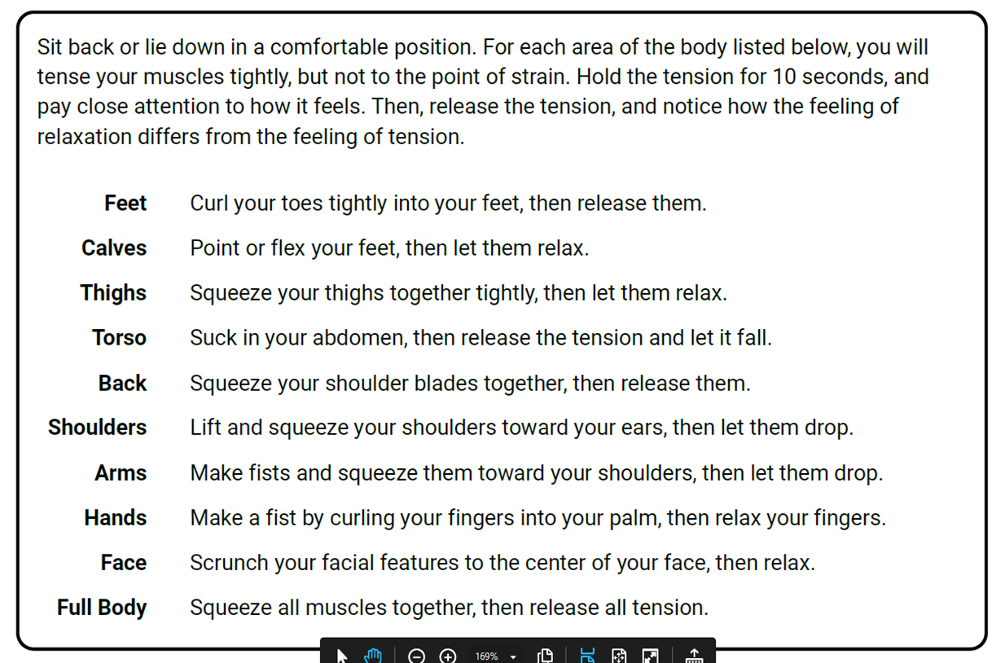
Progressive Muscle Relaxation

Slide 13
Alexithymia
Alex- e- thigh- me-a
Some people know when they are feeling a certain way. They can identify that certain feelings in their bodies indicate certain emotions. They would recognise if they had butterflies in their stomach and would understand that this meant they were feeling nervous.
Some people will struggle with this and may not always be able to identify what emotion they are feeling. This is called Alexithymia.Kinnaird, Stewart and Tchanturia (2019) found that only 4.89% of the non-autistic people in their sample had alexithymia, compared to 49.93% of autistic people. It can also be hard to interpret other people’s emotions.

Slide 14
Can you think of time where you struggled to identify your own or someone else’s emotions?

Slide 15
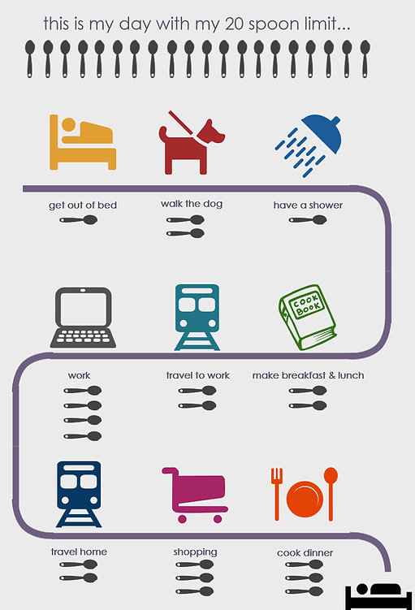
Spoon Theory
A metaphor describing the amount of physical and/or mental energy that a person has available for daily activities and tasks, and how it can become limited.

Slide 16
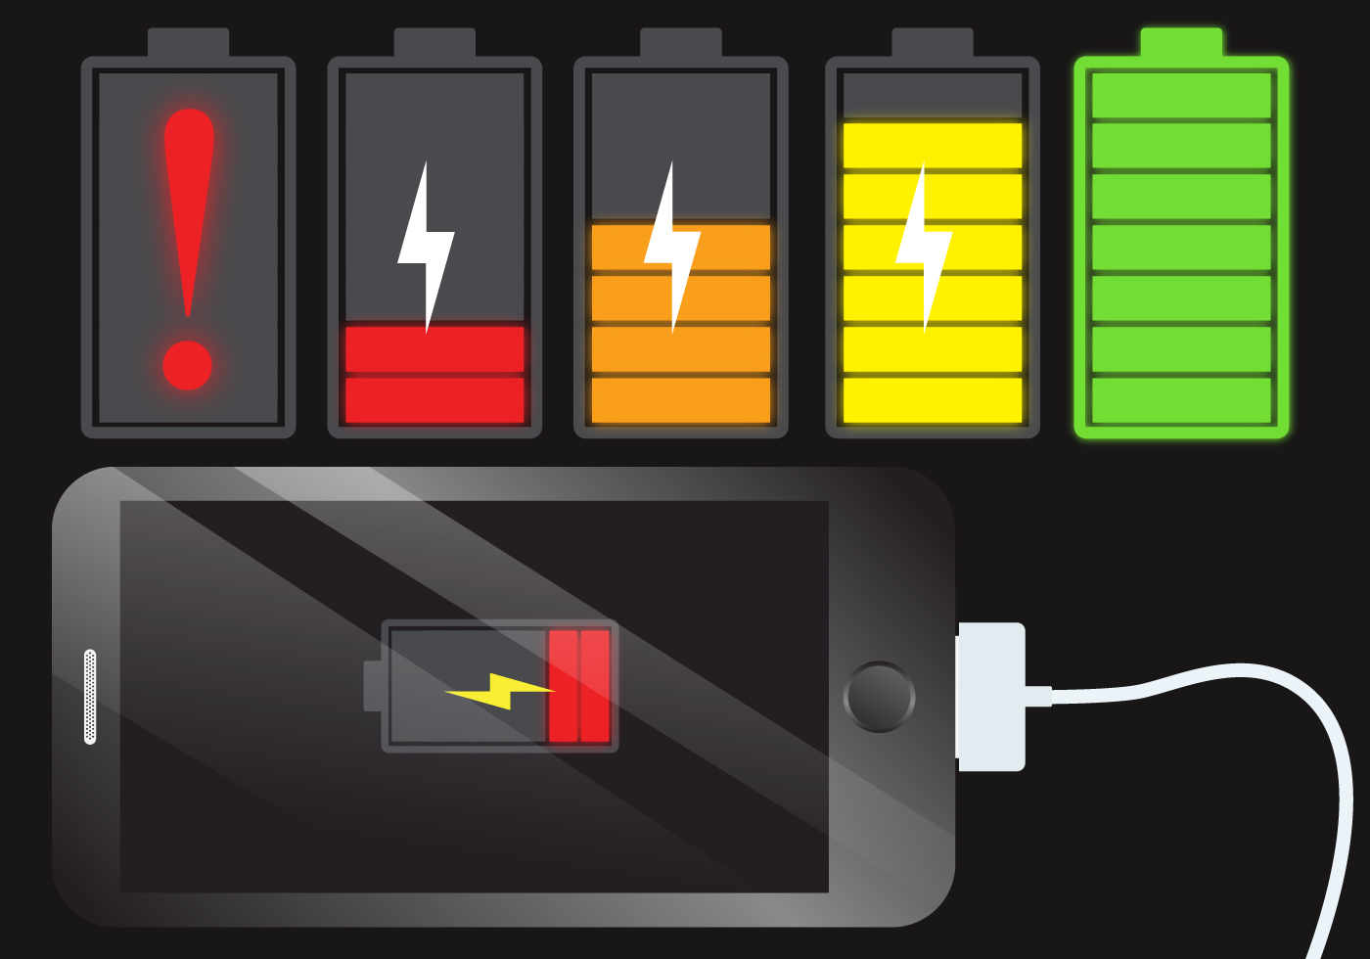
Another way to think about it…
When you use your phone or tablet for a lot of things or have a lot of apps running it can wear the battery down.
This is the same for us when we go about our days in can use our energy.
Different things may use more or less energy.

Slide 17
What drains and fills your battery?
Notes:
What drains and fills your battery

Slide 18
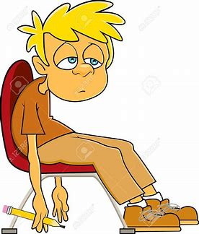
Autistic burnout
Sometimes masking, not having the right support and other stressors can can result in autistic burnout.
You may find:
Feeling exhausted for a long period of time
Finding it hard to do things e.g. finding it hard to use your skills
Finding stimuli more overwhelming (e.g sensory stimuli being more upsetting/ creating more discomfort that usual.
If you are experiencing this speak to your GP or CAMHS practitioner and let them know you may be experiencing autistic burnout.

Slide 19
Tool Box
Notes:
What can you use if you are feeling upset, angry, worried

Slide 20
How was today?

Slide 21
Next week
Final session
Recap of what we have covered in the group
Creating a round up box
Quiz

