Slide 1
Understanding Autism Group
Session 6

Slide 2
Notes:
Add names for practitioners attending

Slide 3
Group Rules
Speak in turns
Kindness
Listening to each other
Not having our phones out
Not recording or taking pictures
Not sharing things outside of the group – private and confidential
Not sharing personal information inside the group (e.g. phone number / social media)

Slide 4
How are you doing today?
RED- I won’t take part, but I will listen as best I can. I may need extra support or a break.
AMBER- I may find it tricky to take part but I will try my best.
GREEN- I’m feeling good. I’m able to participate.

Slide 5
What the group will cover
Introduction to Autism
Masking
Stimming
Making friends
Senses
Back up team
Areas of interest
Anxiety
Zones of regulation
Alexithymia

Slide 6
Today’s Agenda
Recap of what we have covered in the group
Game
End of group and sessions

Slide 7
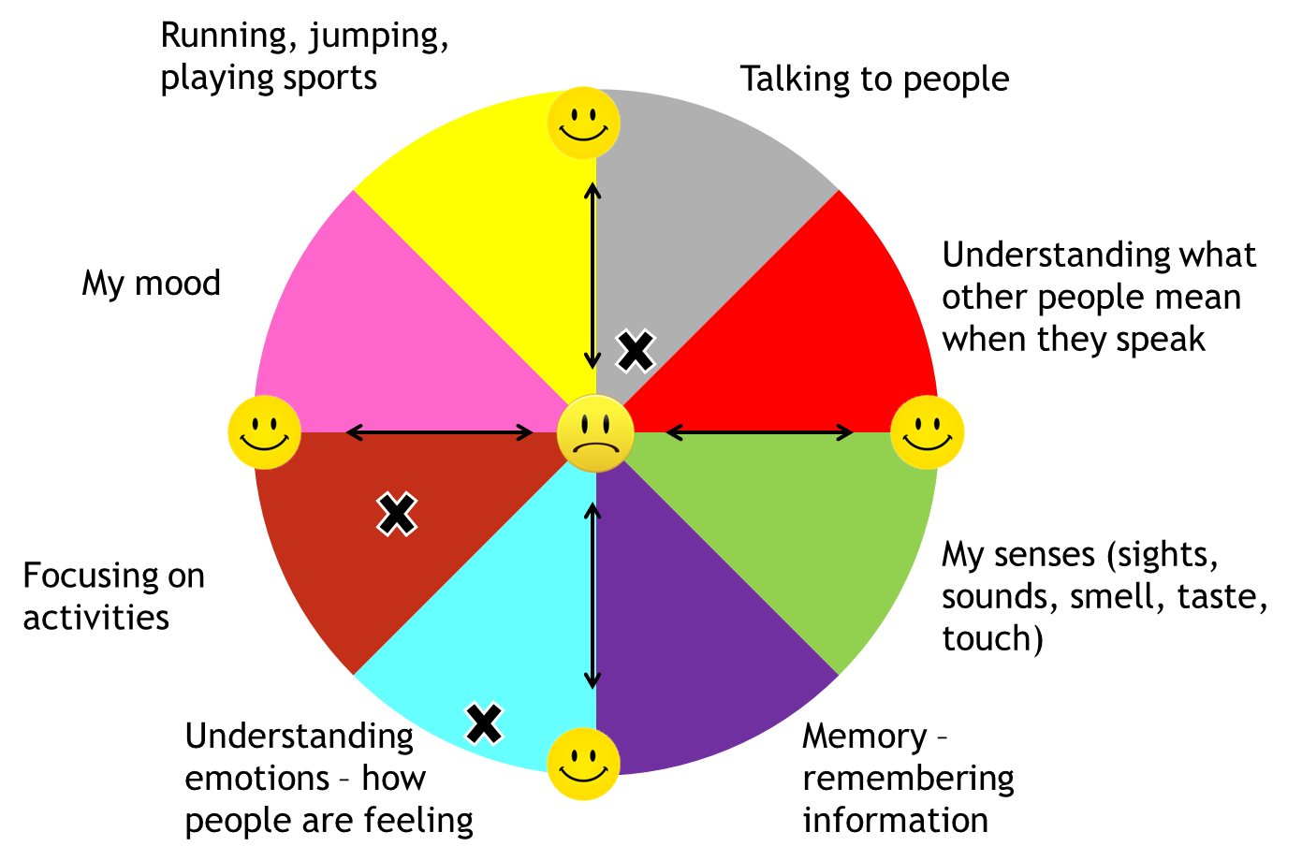
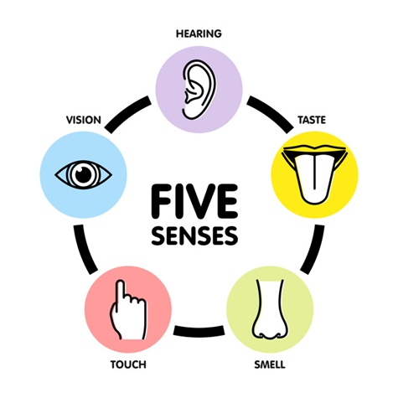
Session 1 Recap

Slide 8
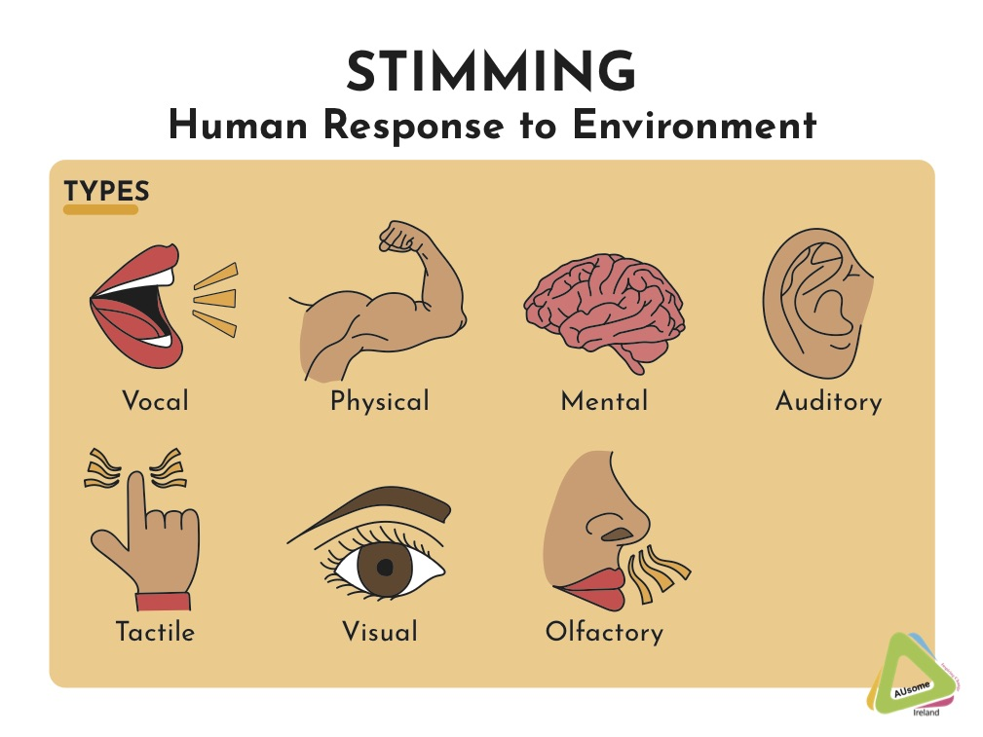
Session 2 Recap

Slide 9
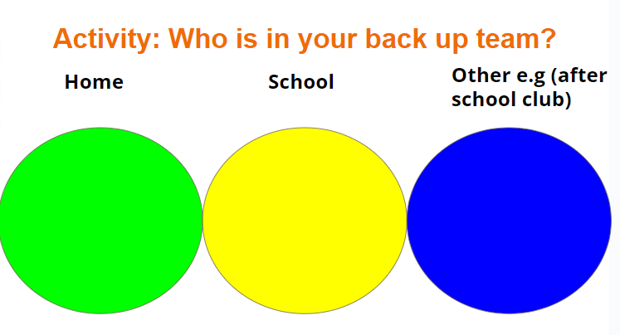
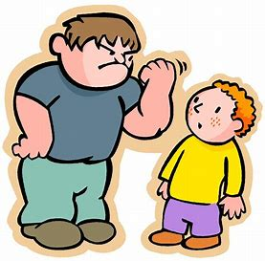
Session 3

Slide 10
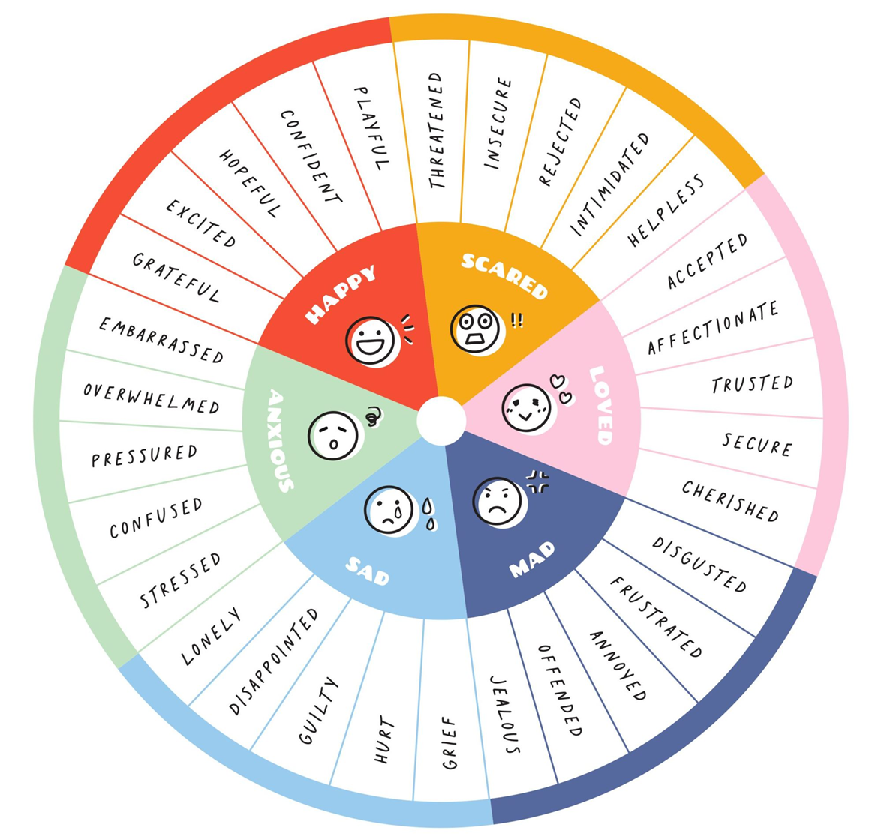
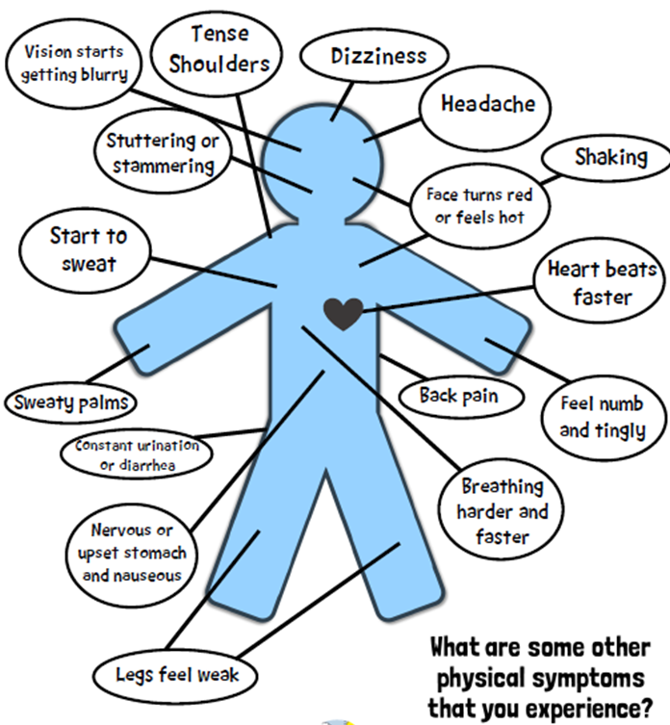
Session 4 Recap

Slide 11
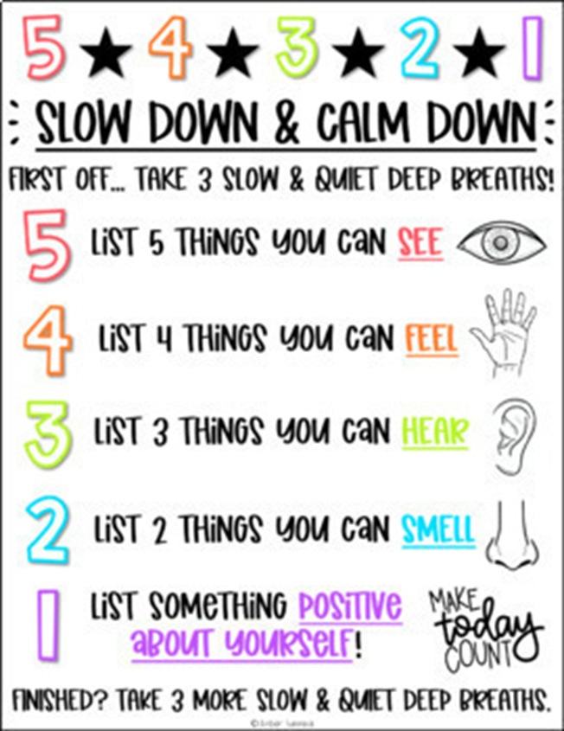
Session 5

Slide 12
Final Session Game
Notes:
Choose a game to play with YP at end, does not have to be relevant to group is for fun

Slide 13
How was today?

Slide 14
End of group!
Thank you for taking part in this group, we hope it has helped you to understand your Autism diagnosis

