Slide 1
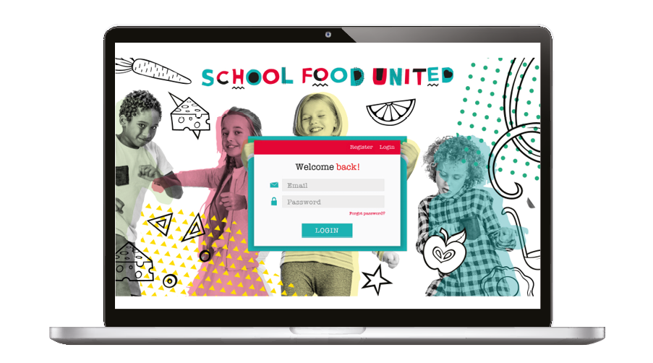
Cashless payments reduce unnecessary contact.
Schools are introducing online payments to make it easier and safer to order your child’s school meal.
A new online ordering system called School Food United is now available!
Access School Food United to
Choose what your child has for lunch
Pay in advance online to remove the need for cash.
Please note - it is important that all meals are ordered on line, including a nursery free meal / UIFSM (Reception Yr.1 & Yr.2) as no other order system is available - it only takes a few minutes to register – please read carefully and follow the instructions. ☺
Steps - how to register for the first time
Visit https://parents.schoolfoodunited.com/login & select the ‘register’ button at the top of the page. Problems logging on? Improve your browser performance by going to settings and clear your history/cache.
Complete the relevant fields (please ensure you add your child's full first /last name, - class year/ class name, phone, email & password (please check password criteria).
Don’t miss out - click ‘yes’ to opt in to receive information about special events, fun theme days, and parent invites to taster days etc.
You will then receive a confirmation email and will need to activate the link contained within it before the account will work – please check your junk folder.
Only when you have received your confirmation email can you log in using your email address and your selected password.
Add your child’s details (first name, last name, school year and class) by selecting the ‘add a child’ button. You can add passport style picture to personalize.
Repeat this process for additional children.

Slide 2
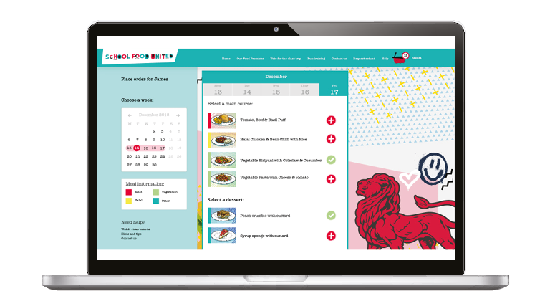
A nutritious school meal is important for children and young people to keep healthy, and improve their performance.
How to order
If logging back in, enter the email address and password you registered with.
Click ‘login’ to access your account .
Select the ‘order meals’ button.
Click on 17.05.2021 and place meals for this date onwards.
You also have the option to….
ORDER MEALS
CHANGE OR CANCEL ORDERS
VIEW & PRINT YOUR CHILD’S MEAL PLANS
ADD NEW CHILDREN TO YOUR ACCOUNT
Important information
Free school meals
This service is also available for children who eligible for free school meals. You can choose their meals by:
Logging on using your personal device, or
Speaking to the catering team at your school at the start of each term.
To check if your child is eligible for Free School Meals in England visit http://www.gov.uk/apply-free-school-meals
Allergies If your child has a special dietary need that has been declared on the ‘Special Diet Form’, you will be able to order a ‘special dietary’ meal.
The Catering Team will offer a menu that meets your child’s dietary needs.
Where to get help If you encounter any difficulties, please contact your school directly.

