Slide 1

Strathmore Wraparound Provision

Slide 2


Slide 3
Table of contents
01
Our vision
02
What’s on offer?
03
A typical session
04
Food options
05
Costs and booking
06
FAQs
Wraparound sessions available and our vision
An overview of the activities and resources available to pupils
A day in the life of a pupil at our wraparound sessions
Breakfast, lunch and after school options.
Session costs and how to book, pay and register interest
A selection of questions and answers linked to our wraparound

Slide 4

01
Our Vision

Slide 5
Our Wraparound Provision
At Strathmore we provide wraparound care for our pupils from 7.45am until 5.45pm. This includes the following options:
Breakfast club: 7:45am - 8:45am. Early drop off option of 8.15am
Nursery Lunch Club: 11:45am - 12:45pm
After school provision: 3:15pm - 5:45pm. Late collection option until 6pm.
All of our sessions are run by staff trained and employed directly by the school.
Our vision is to ensure our pupils feel welcome, safe, happy and respected in each provision on offer. Children should feel like this time is an extension to their school day and have an opportunity to socialise and continue to build relationships with pupils and staff. Our wraparound vision is closely linked to our whole school vision which can be found on our website.
In order to ensure all our attendees have access to a range of activities that suit all their needs, we spend time talking to our pupils to discuss their interests and likes on a regular basis.
In all our wraparound provisions, we follow the school’s Child Protection and Behaviour Policies which can be found on our school website.

Slide 6

02
What’s on offer?

Slide 7
Our environment set up
Let’s get…
Other options
Most of our activities will be split up under a title of ‘Let’s get….’ These will be planned over a 2 week cycle. Our aim is to have an environment that is similar to our Early Years approach, which includes key areas that remain consistent and are enhanced throughout the year. They will also have resources they can choose to use independently and follow our approach ‘Choose it, Use it, Put it away.
Our pupils have access to an amazing environment both inside and outside. The grounds include allotments, 2 large playgrounds, play equipment, field during drier periods, Forest School area, Rainforest (sensory space), dining room, hall space, library, children’s kitchen, and other classrooms if needed.

Slide 8
Let’s get…
Creative | Painting, cooking, drawing, colouring, junk modelling, clay, etc | Talking | Guided social opportunities including board games, circle times, mindfulness activities, sensory walks.
Active | A selection of structured activities included in the session such as yoga, multi skills, dance, access to Forest School area. This is in addition to full use of our outdoor spaces. | Chilling | Down time in the Rainforest room with bean bags, books, calming music, fiddle toys. This is a smaller room next to the main area.
Reading | Group visits to our school library to read independently, in small groups or story telling time. | Eco-minded | A focus on sustainability, how we can be eco-friendly and activities which improve our school grounds.
Cooking | Time to cook, learn to prepare food, plan for themed events, etc. Use produce from our allotments. | Thinking | Challenges to solve linked to curriculum areas such as Science, DT, English, Maths, etc.
Building | A range of construction activities such as hollow blocks, plus plus, lego, duplo, etc | Eating | Children will be encouraged to help themselves to food options (with adult guidance) and eat within the Restaurant like we do at lunch times.
Imaginative | Opportunity for children to explore small world, create their own worlds, use fancy dress, etc.

Slide 9
03
A typical session

Slide 10

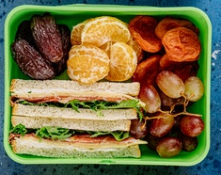
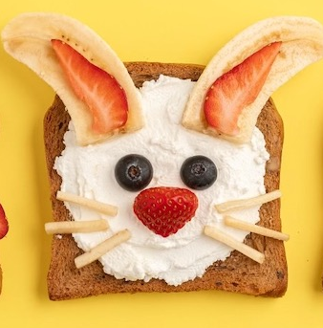
Breakfast Club
After school wraparound
Nursery Lunch Club
7:45am arrival with options for breakfast such as cereal, fruit, toast.
Early drop off option at 8.15am with no breakfast.
Activities are mapped out across the week such as colouring, small world, crafts, construction, themed weeks.
8:45am children taken to classes.
At the end of the nursery morning at 11:45am, children head to Strathmore Restaurant (dining room). They can have a hot meal, catered through HCL or bring a packed lunch.
Children head back to the nursery setting around 12:15pm and play with the resources in their provision to ensure they feel secure.
Children are collected from their classes at 3:15pm and taken to the dining room. They will have their cold option food which they help themselves to. If children go to after school clubs, they will be collected from the club at 4:15pm and have their food following this.
There are timetabled activities and also freedom to choose resources. The outside space is free to use and the hall becomes available after 4:15pm. Our sessions finish at either 5:15pm or 5:45pm. Late collection is offered until 6pm.

Slide 11
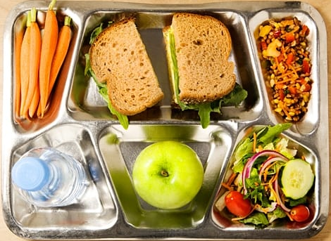
04
Food options

Slide 12
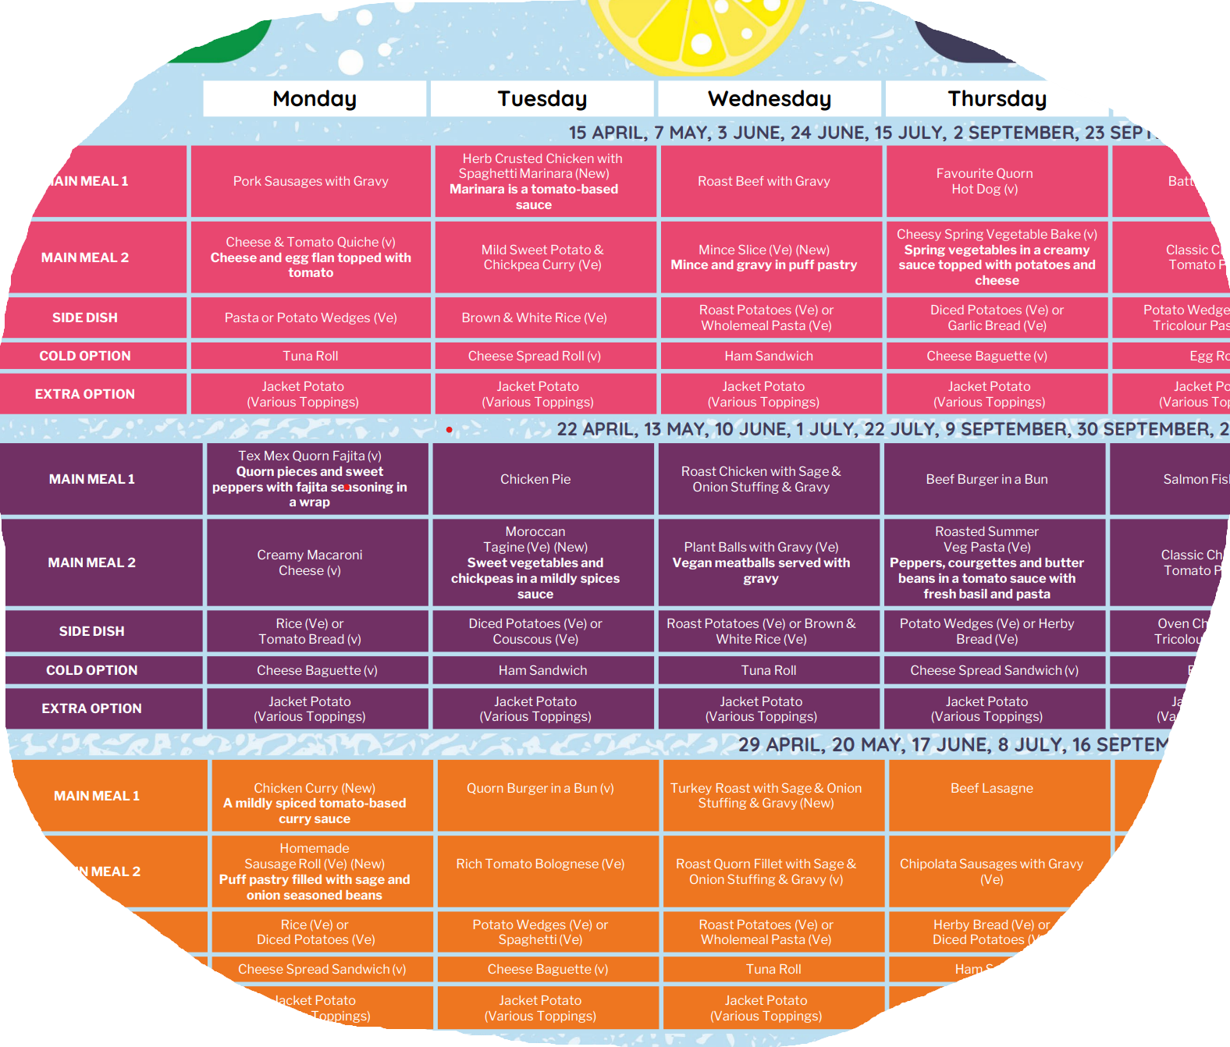
Breakfast
Nursery Lunch Club
Wraparound provision
Children have access to a variety of fruit, cereals, toast, spreads and other cold snacks. Alternative dairy options can be provided at no extra cost. Please contact the school office to discuss.
If your child chooses a hot meal option they will have a 3 week menu to choose from via HCL. Please visit their website via this link for example menu options.
The children will have access to a selection of cold foods such as wraps, sandwiches, breadsticks, meats, vegetables, fruit, dairy items, etc. The children are encouraged to access the Restaurant as a buffet style, helping themselves with guidance and support from staff. Children will eat in the restaurant before returning to activities. There will be one sitting from 4pm to 4.45pm. Please speak to the office if you have any dietary requirements.

Slide 13
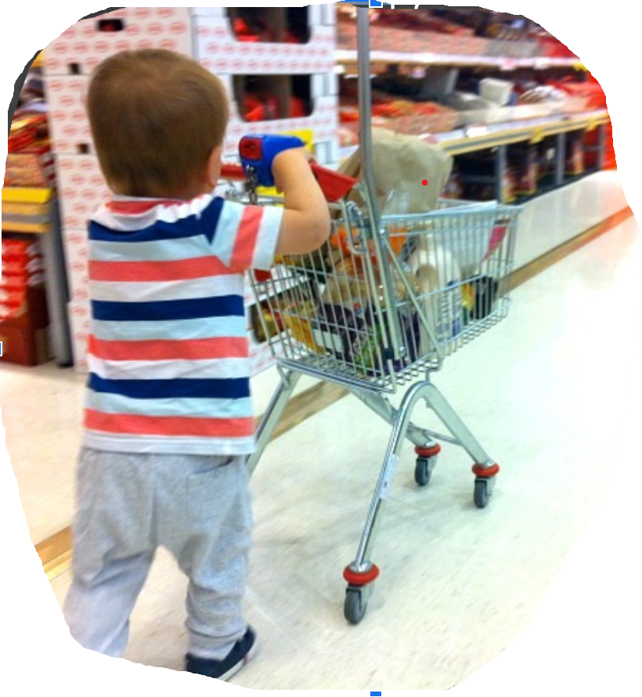
05
Costs and booking

Slide 14
Wraparound costings
Breakfast club including food | Nursery lunch club | Wraparound provision including food
£6.50 food included 7.45am – 8.45am £3.50 early drop off from 8.15am (no food) | £3.50 a session with own packed lunch Optional hot food option through HC, currently £2.61 per meal. | £12.50 a session 3.15pm - 5.15pm £15.50 a session 3.15pm – 5.45pm Additional £3 for 6pm collection

Slide 15

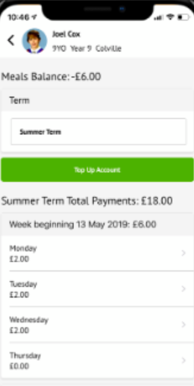
Paying via Arbor
Please note we will charge late fees of £10 per child for every additional 10 minutes.
All payments for wraparound can be made through our Arbor app.
Payments can be made a half term in advance or monthly if this is more financially viable.
If you wish to pay via Childcare vouchers please speak to the school office for more information.
Please note there is a non-refundable registration fee of £10 per child. This secures your child’s place at our wraparound provision until your child leaves Strathmore or until you no longer need it.

Slide 16

06
FAQs

Slide 17
FAQs
Will I need to rebook my child on each year?
Can I use my 30 hours to attend nursery lunch club?
Can my child attend a mixture of the after school sessions?
Do you offer any discounts?
Why do we need to pay in advance?
My child has SEND needs. Will you be able to accommodate them?
No, once your child has a place at any of our provisions, it is theirs until they leave Strathmore or you inform the office you no longer require the provision.
Yes. You can use 15 hours in the morning sessions, 5 hours for lunch provision and have 10 hours to use with another provider.
At this time, we ask for you to identify a best fit. If you need wraparound most days until 5:45pm then choose this option. For odd sessions, please speak to the main office so we can check staffing ratios.
If your child is entitled to Pupil Premium funds you can have one free session in one of our wraparound provisions a week. We do not currently offer sibling discount.
We need to ensure staffing ratios for each term and cover costs. Sessions cannot be refunded unless 48 hour notice has been given.
All children are welcome. Please speak to the office so we can discuss options, consider staffing requirements if needed and training.

