Slide 1
Welcome to Daffodils
September 2023
Teacher – Miss Pitcher
TA – Miss Griffiths

Slide 2
‘Stay and Play’ with a focus on Physical, Emotional development and Communication skills.
Ideas to support these skills at home.
Answer any questions

Slide 3
Parental Engagement
We strive to ensure that you are fully involved in your child’s Pre-School year by doing a range of things:
Open Door Policy
Famly (Class learning updates, WOW moments, In the moment impacts, Focus child)

Slide 4
In Autumn Term we have a focus on the Prime Areas
Communication & Language (C&L)
Physical Development (PD)
Personal, Social, Emotional Development (PSED)
Today we have set up the classroom to show some examples of how we support children’s PD and C&L skills. This will hopefully give you some ideas of how to further support their development at home.

Slide 5
Supporting Communication & Language
Listening – stories, rhymes, games
Speaking – adult modelling and circle times
Understanding – instructions, routines

Slide 6
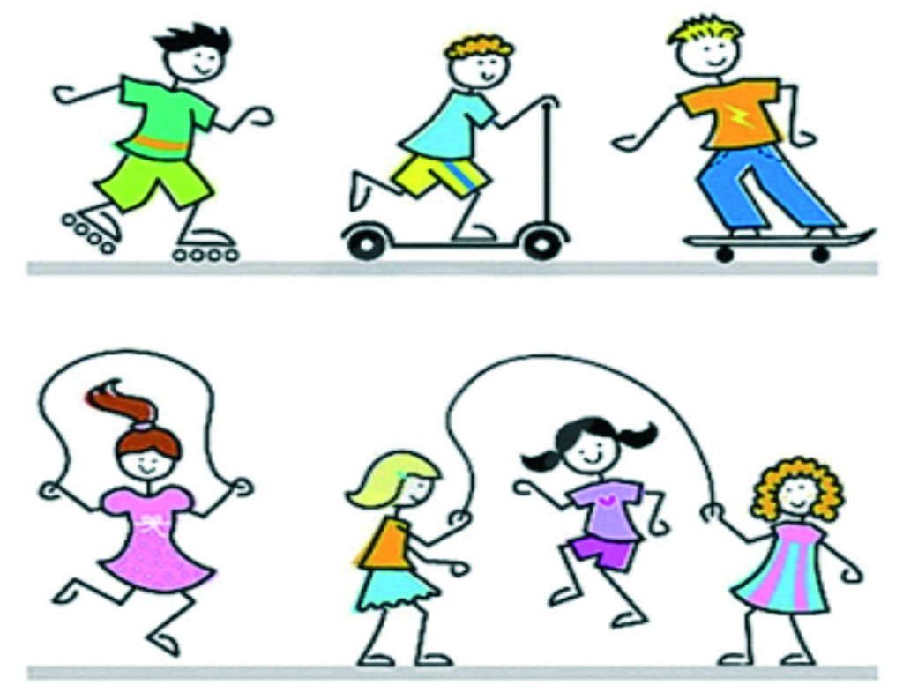
Supporting Physical Development
Gross motor – larger muscle movements (balance, climbing, riding)
Fine motor – smaller muscle movements (pencil control, threading, tweezers, playdough)
Self needs – (making healthy choices and self-care)

Slide 7
Supporting Personal, Social, Emotional Development
Self-confidence and self-awareness. (independence, celebrating diversity)
Managing feelings and behaviour. (likes/dislikes, talking about feelings, rules)
Making relationships. (sharing, making friends)

Slide 8
Any Questions?
We hope that this information has been useful.
Please do not hesitate to get in touch if you have any additional questions or comments.
Thank you for your support so far in Daffodils, we are looking forward to continuing to explore our new classroom and our Autumn 1 topic Marvellous me.
info@Streethay.set.org
http://www.streethayprimary.org.uk/
01543 396 180 or contact us on Tapestry

