Slide 1

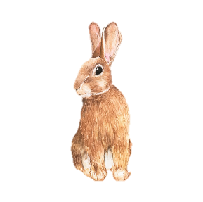
Welcome To Year 1
Team Rabbits
Miss Kirby and Mrs McGlade

Slide 2

Staff
Miss Kirby- Teacher
I support with the delivery of Phonics and Reading across the school.
Mrs McGlade- Teaching Assistant in the mornings. We are very lucky to have her helping the children settle into Year 1 life. We have the added benefit of her already knowing the children from Sunflowers!

Slide 3

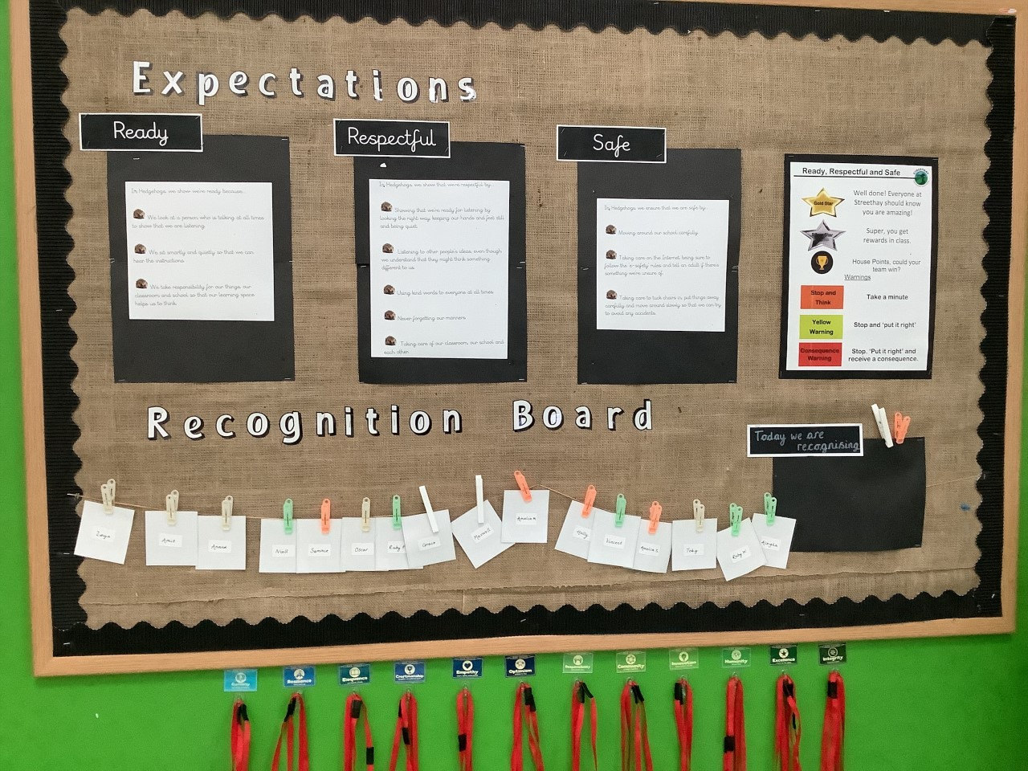
Expectations
The children came up with their own class expectations for Ready, Respectful, Safe during the first couple of days in Rabbits.

Slide 4
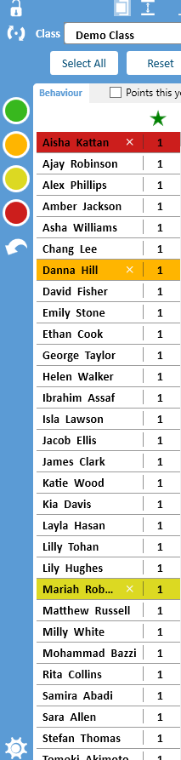
Expectations
We are introducing the rewards slowly, so the children aren’t overwhelmed.
Rewards
Recognition Board
Star of the Week*
Lanyards
Track It Lights
Green Card - House Points
Orange Warning- persistent/usually after a verbal warning.
Yellow Warning- time out of class
Red Warning- speak to parents.
Chn always have the opportunity to ‘put it right.’

Slide 5
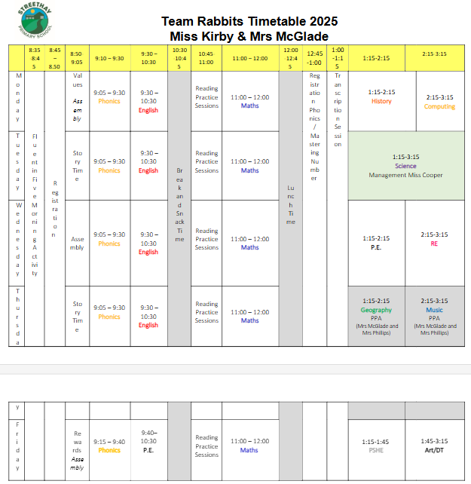
Timetable

Slide 6
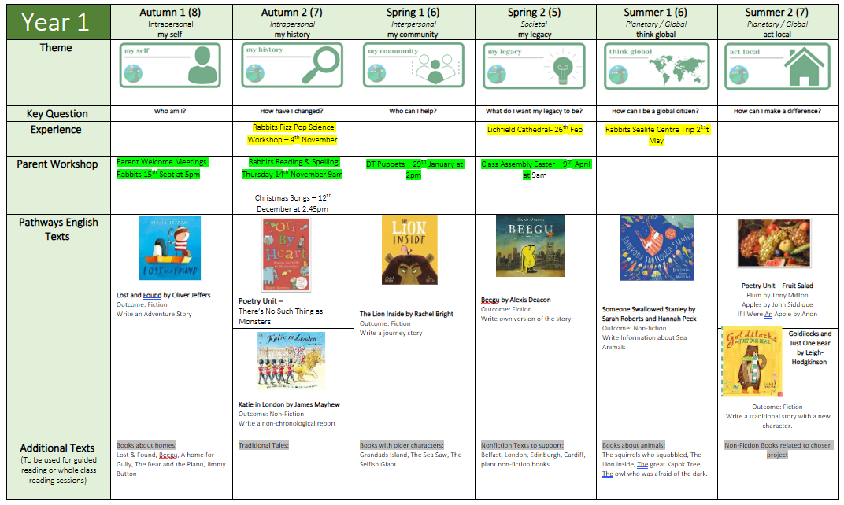
Yearly Overview

Slide 7
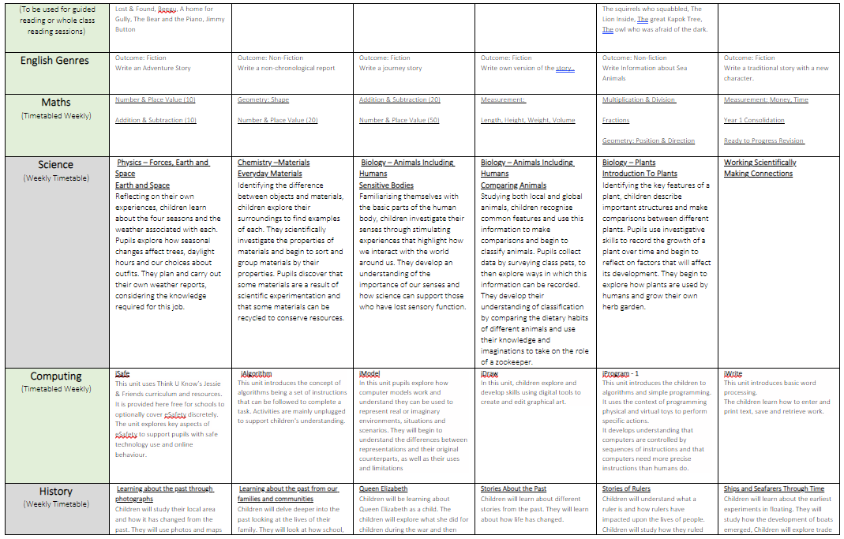

Slide 8
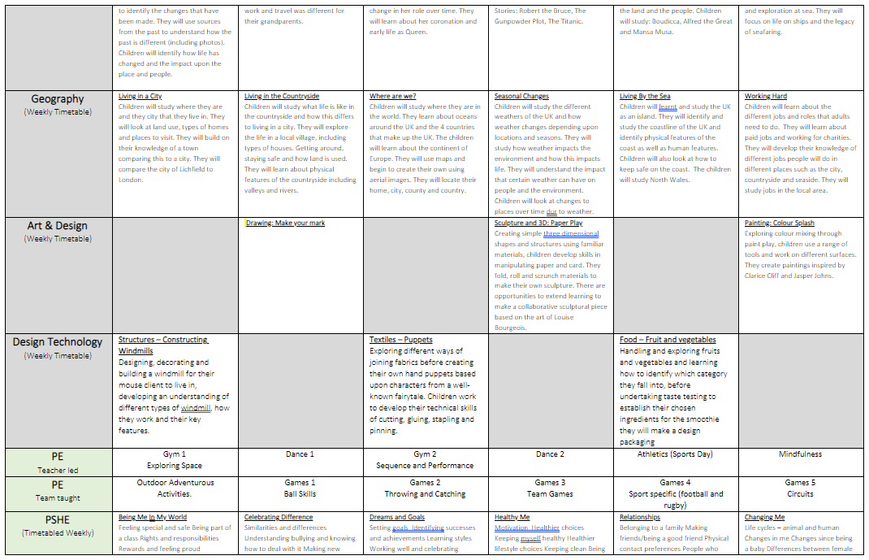

Slide 9
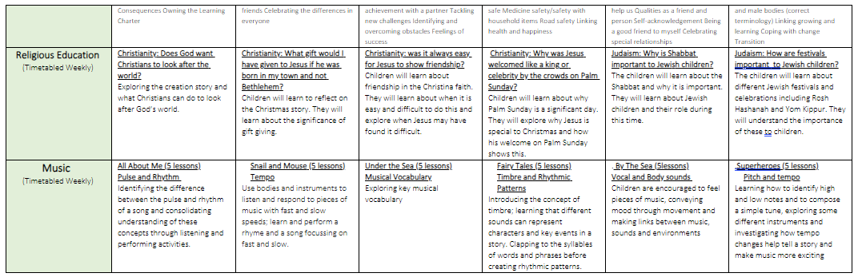

Slide 10

Home Reading
All children will be issued with a reading book, appropriate to the book band they are now reading at. We practise this in the week and it goes home on a Friday, then hopefully they will be able to read it to you fluently over the weekend.
The children then choose a library book of their choice on a Friday which goes home and is then exchanged for a new one the following Friday. If your children are enjoying sharing their library book with you, we are more than happy for you to keep it an extra few days until Friday.
Please ensure your child is reading EVERY NIGHT if you can. 5-10 minutes is perfect!
Online books- Collins E books

Slide 11
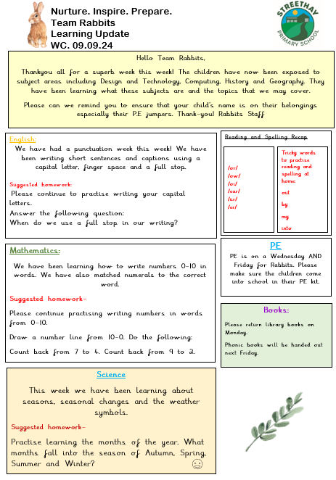
Class Newsletter
Contains suggested homework activities.
Notices or important dates or messages.
If struggling to complete homework activities –We would ALWAYS prefer quality reading time, phonics practise, 2, 5 and 10 times tables and recall of number bonds.

Slide 12
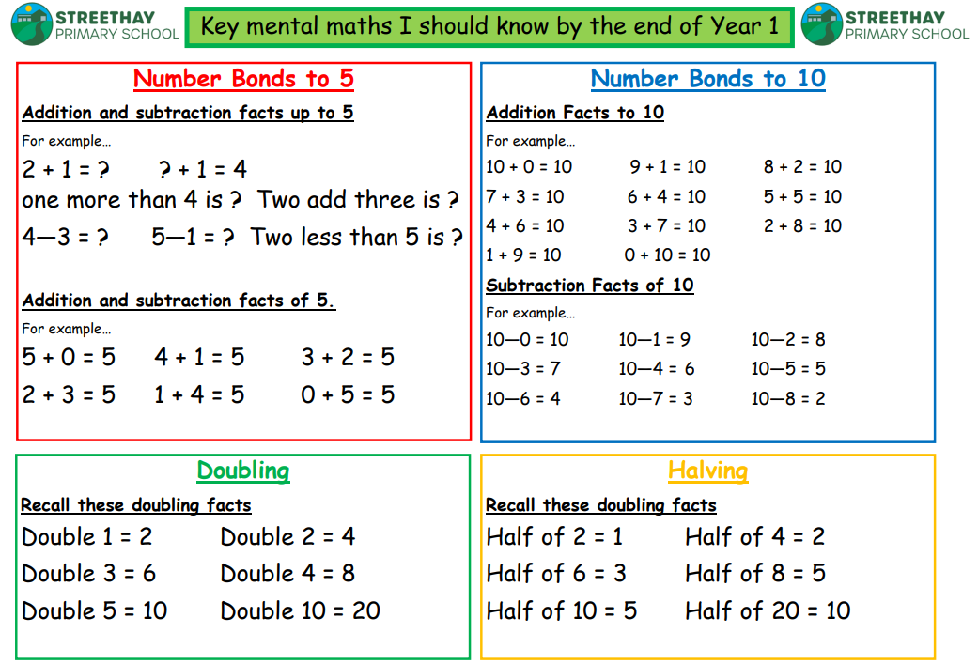
Key Recall Facts for End of Year 1

Slide 13
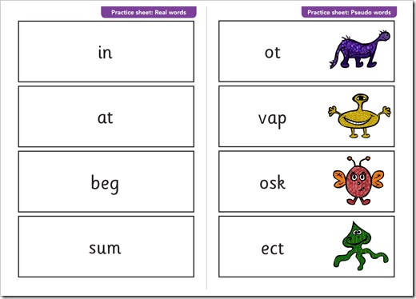
Phonics Screening
Officially named the Phonics Screening Check, the year 1 phonics test occurs in the month of June when all year 1 pupils, and some year 2 pupils, will take a test to assess their phonics abilities. The test is designed to see if pupils have learnt phonic decoding and blending skills to an appropriate standard for their age. We also do practise test papers throughout the year.

Slide 14
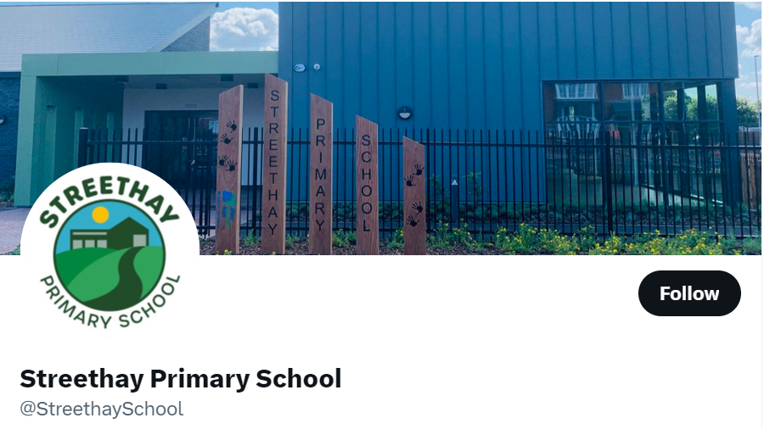
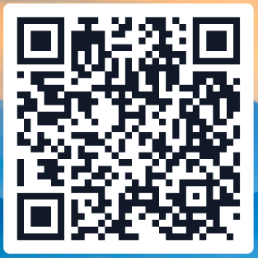
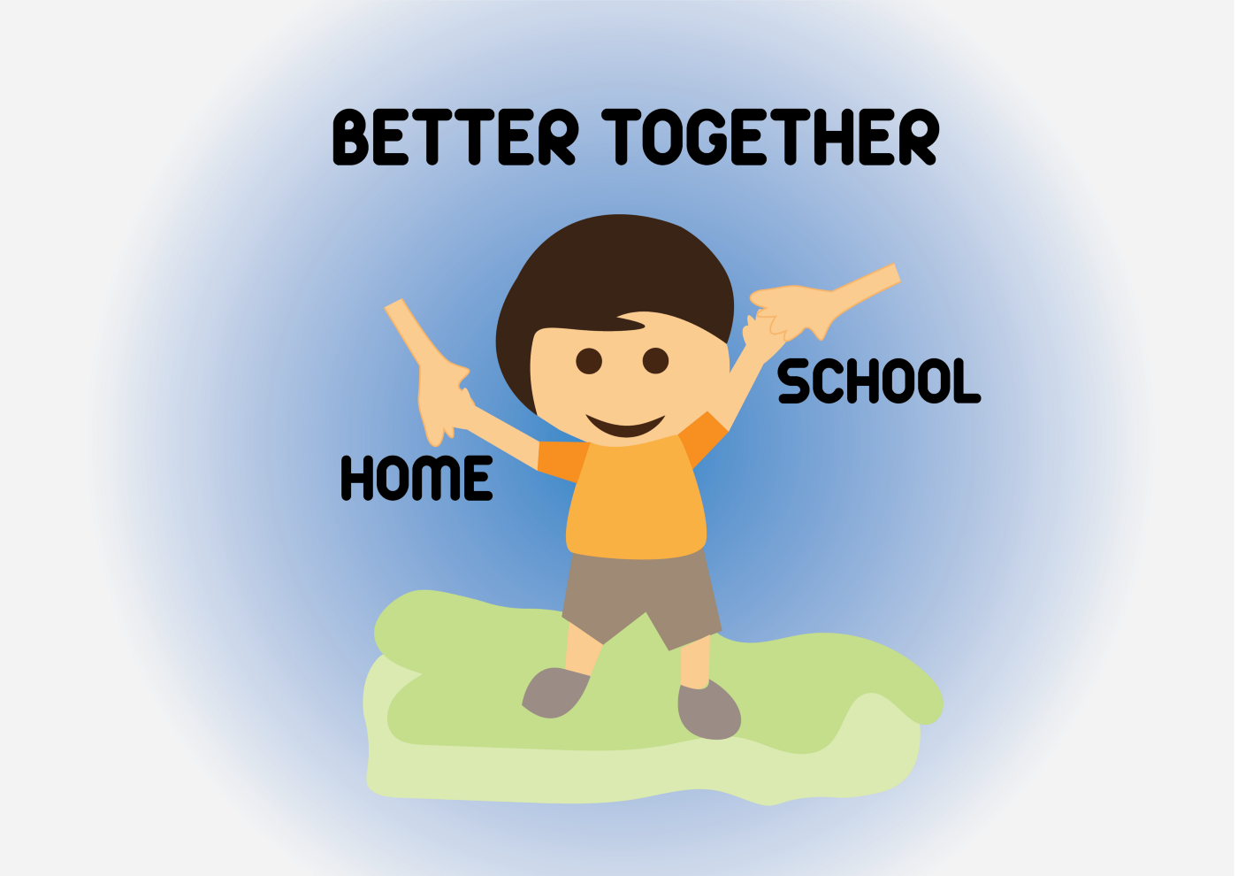
Communication
Open door policy.
Parents evenings and open nights to look at books/work.
Make an appointment to see us and discuss any worries/concerns whenever you need to.
You can always call the office to ask any questions also.
Follow us on Twitter to see photographs and updates.

