Slide 1
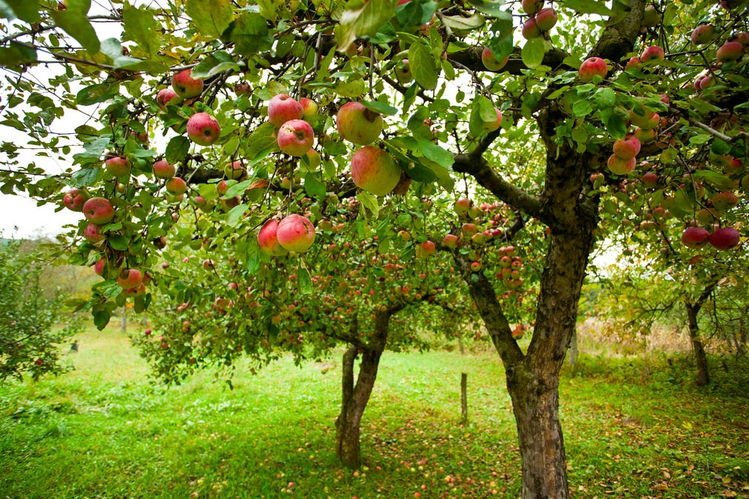
Welcome To Year 6 Team Orchard Mrs. Radford-Holliday and Mrs McGann

Slide 2
Staff
Class Teacher – Mrs. Radford-Holliday
Teaching Assistant- Mrs. McGann

Slide 3
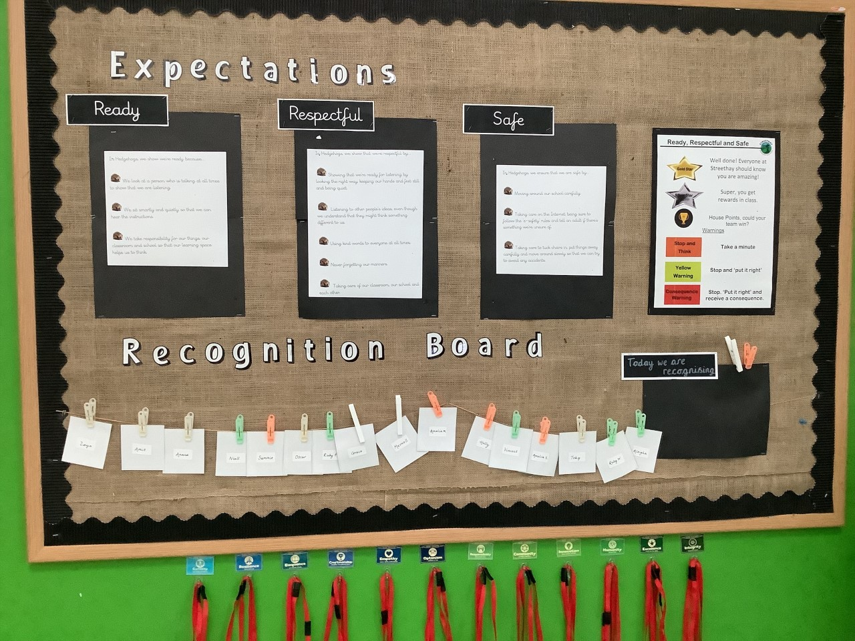
Expectations
Children came up with their own class expectations for Ready, Respectful, Safe.

Slide 4
Expectations
Rewards
Recognition Board
Gold Star of the Week
Head Teacher Award
Half Termly Super Star
House Points
Praise from teachers and peers
TrackIt
Green Card - House Points
Orange Warning
Yellow Warning
Red Warning

Slide 5
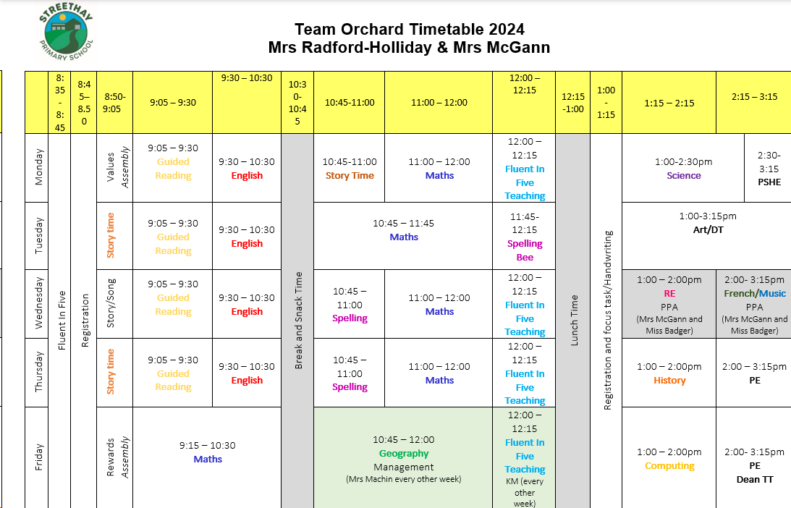
Timetable
Spelling
Fluent in Five/Maths

Slide 6
Autumn Term Overview

Slide 7
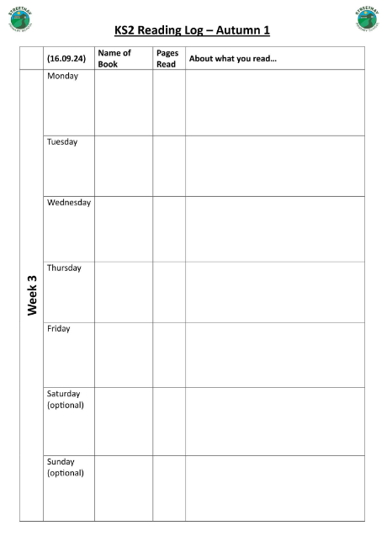
Home Reading
All children have now been issued with a reading book, and a library book.
Every time they read their book, they will record it in their reading record.
Reading records will be available to fill in on Showbie by the child or an adult.
Children are asked to read for 15 – 20 minutes every week night.
Books will need to be changed on a Monday.
Children do not need to bring their book in to change if they haven’t finished reading it.

Slide 8
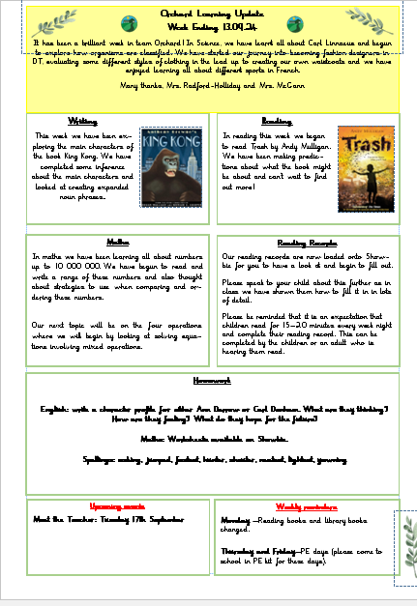
Class Newsletter
Contains suggested homework activities.
Notices or important dates or messages.
If struggling to read and complete homework activities – we ALWAYS would prefer quality reading time, spelling practise and times tables practise.
Limited paper copies available in office.

Slide 9
Maths Calculation Policy
You can find our calculation policy on the website within the curriculum area for maths.
This shows the methods we use in class to teach the four main operations.
Please look at this at your leisure and feel free to contact us should you have any questions.

Slide 10
Standard Assessment Tests – SAT’s
Please don’t worry!
Aim – to see if children are on track to meet the expected standards for their age, as set out by the government.
When: Monday 12th May – Thursday 15th May
Children take part in reading, maths and SPAG (spelling, punctuation and grammar) papers.
Reading – 1 paper
Maths – 3 papers (1 arithmetic paper, 2 reasoning papers)
SPAG – 2 papers (1 punctuation and grammar paper and 1 spelling paper)
We are completing work now to prepare them for their SAT’s and talking to them about this process and what it will look like.
Parent information evening – January to discuss in more detail.

Slide 11
Secondary School
Application needs to be completed by 31st October.
Offers for secondary school places sent out on March 1^{st.}
How do we prepare the children?
Children will have a transition ‘week’ with their new school.
Transition weeks look different for each secondary school – some may offer 1 day in school, some may offer 2 days or a whole week.
We will be completing PSHE lessons around this and spending lots of time talking to the children about hopes, fears and worries.

Slide 12
Trips and Visitors
Autumn Term
Hyatt Education: Drone Coding TBC
18th December- KS2 Christmas songs
Spring Term
Tamworth Castle KS2 Workshop – date TBC
Tuesday 14th January - Parent Workshop: SAT’s Information Evening
Summer Term
Tuesday 29th April – Parent Information Evening (residential to Plas Gwynant)
Monday 7th – Friday 11th July – Residential to Plas Gwynant
Tuesday 15th July – Year 6 Leaver’s Performance
Thursday 17th July – Year 6 Leaver’s Assembly

Slide 13
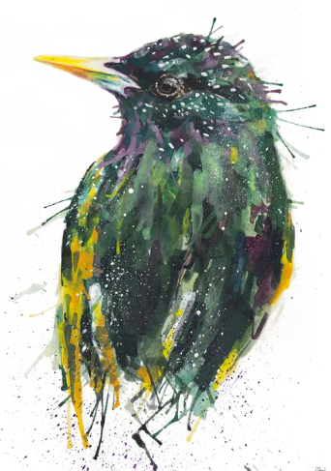
Communication
Good parental relationships /communication vital for children to succeed in school.
Open door policy.
Make an appointment to see us and discuss any worries/concerns whenever you need to.

