Slide 1

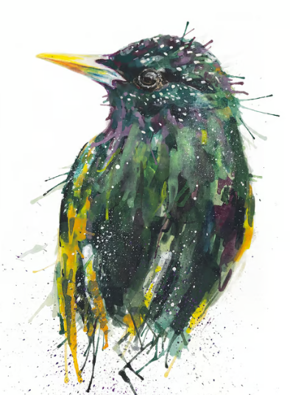
Welcome To Year 5
Team Starlings
Miss Haycox, Mrs Gill and Miss Pinkerton

Slide 2
Staff
Class Teacher – Miss Haycox
Teaching Assistant – Mrs Gill
SCITT Trainee (Autumn and Summer) – Miss Pinkerton
PE Teacher- Mr Withers (Tuesday afternoon.)
Mrs Machin on Wednesday afternoons

Slide 3
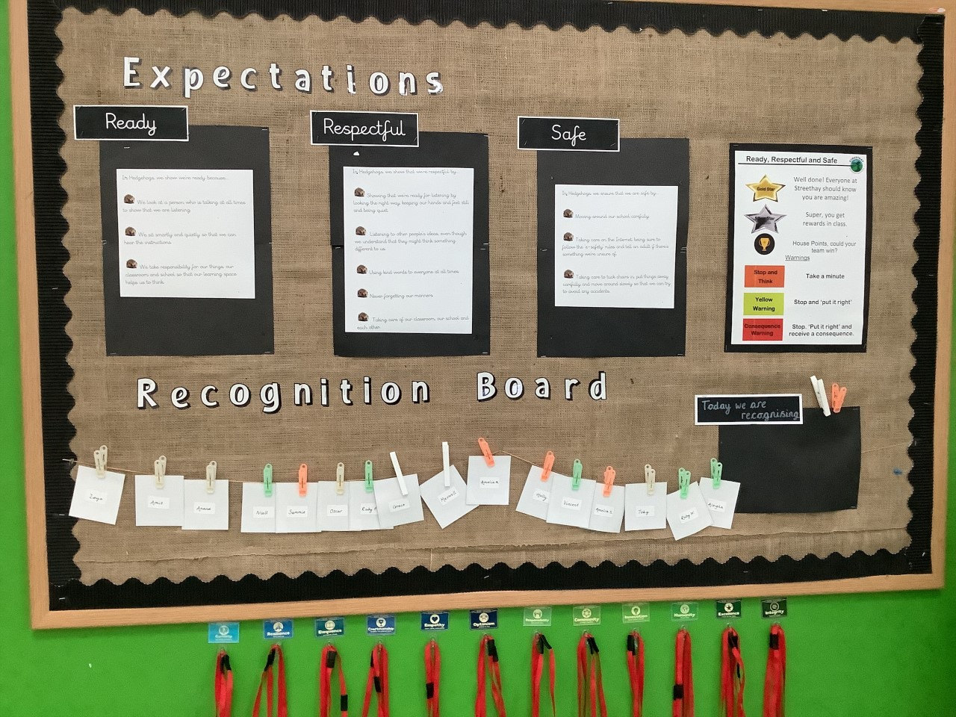
Expectations
Children came up with their own class expectations for Ready, Respectful, Safe.

Slide 4
Expectations
Rewards
Recognition Board
Gold Star of the Week
Lanyards
TrackIt
Green Card - House Points
Orange Warning
Yellow Warning
Red Warning

Slide 5
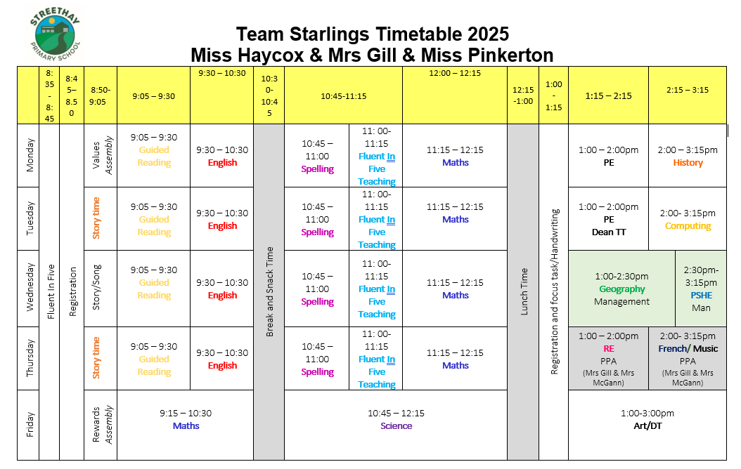
Timetable

Slide 6
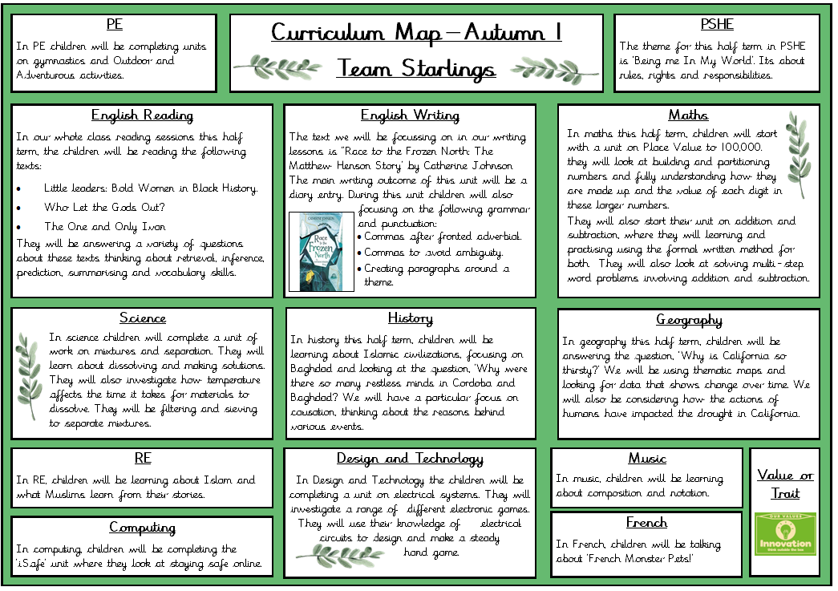
Autumn Term Overview

Slide 7
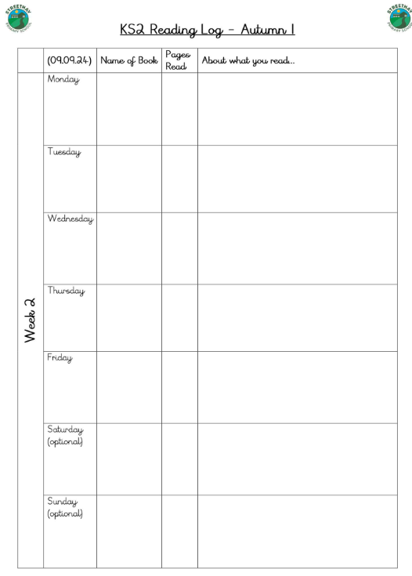
Home Reading
Home readers are now available on Showbie.
Children will need to read daily and complete their log straight into showbie.
Reading at the weekend is encouraged, but not expected.
Reading logs will be checked each morning during registration.

Slide 8
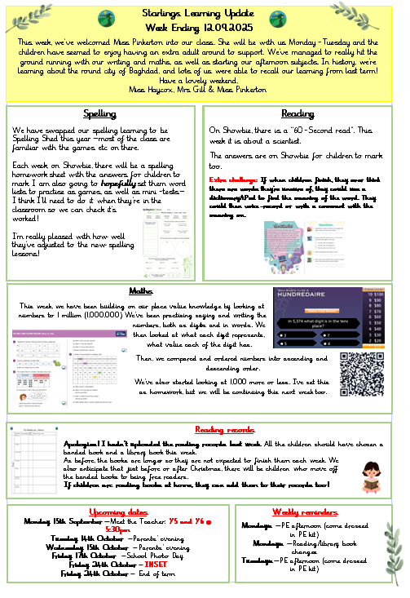
Class Newsletter
Contains homework activities, to be completed on showbie.
Notices or important dates or messages.
If struggling to read and complete homework activities – we ALWAYS would prefer quality reading time, spelling practise and times tables practise.

Slide 9
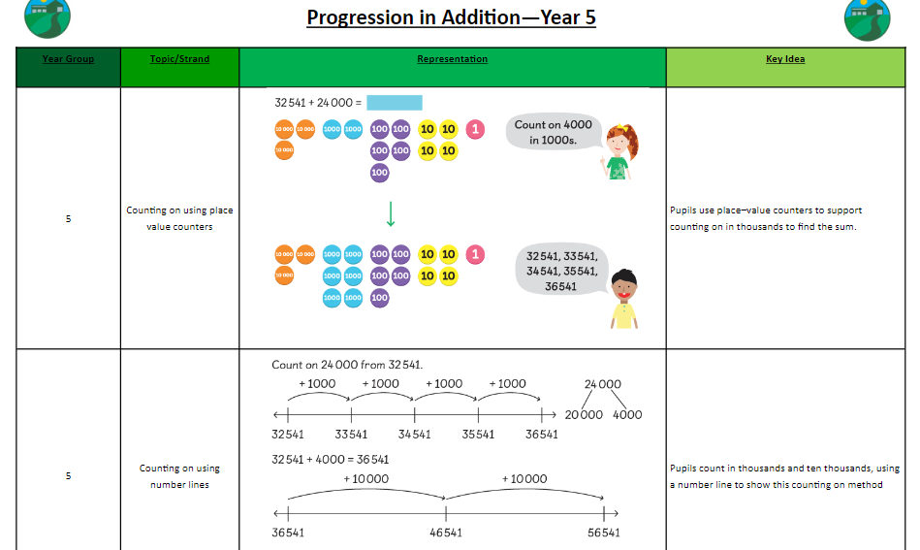
Maths Calculation Policy
You can find our calculation policy on the website within the curriculum area for maths.
This shows the methods we use in class to teach the four main operations.
Please look at this at your leisure and feel free to contact us should you have any questions.

Slide 10
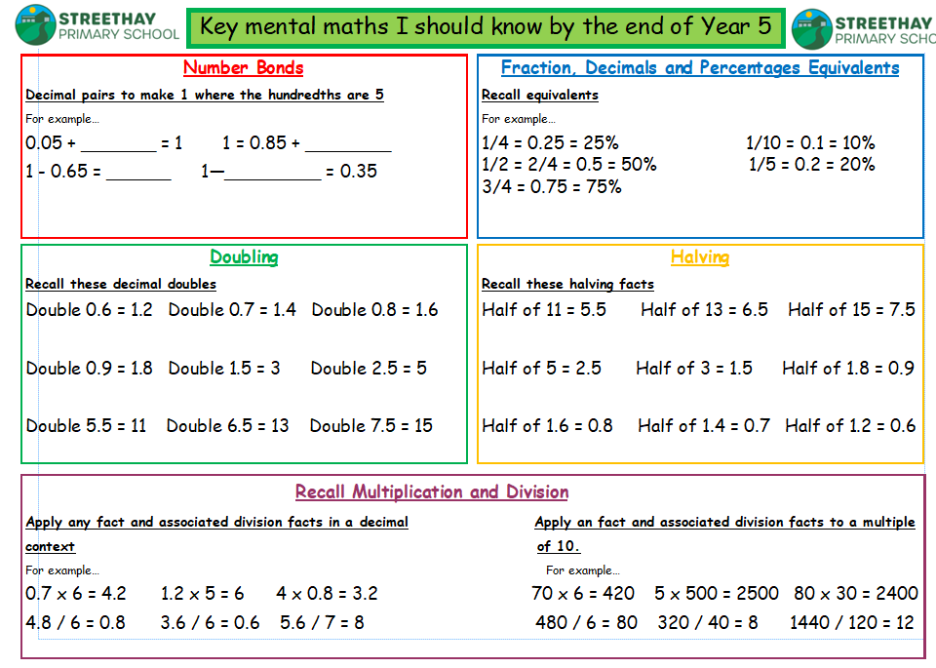
Key Recall Facts for End of Year 5

Slide 11
Trips and Visitors
Autumn Term
  Friday 14th November – Tamworth Castle
Spring Term
  Monday 12th January 2026 – Residential Meeting
  Thursday 22nd January 2026 - Leicester Space Centre (Science)
  Tuesday 27th January 2026 – Swimming Pool Workshop
  Thursday 26th March – Class Assembly
Summer Term
  Monday 1st June – Friday 19th June – Swimming Pool (Y4 and Y5)
  Wednesday 3rd June – Online Safety Parent Workshop
  Monday 29th June – Friday 3rd July - Residential

Slide 12
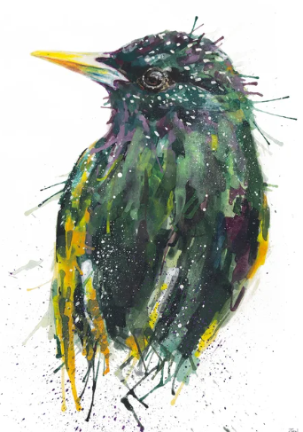
Communication
Good parental relationships /communication vital for children to succeed in school.
Open door policy.
Make an appointment to see us and discuss any worries/concerns whenever you need to.

