Slide 1



Welcome to Streethay
Team Sunflowers

Slide 2
Purpose of the session
Who are the key people in school?
What does learning look like in Sunflowers?
What do I need to do before September?
How can I prepare my child?
What Wraparound Care is available?

Slide 3
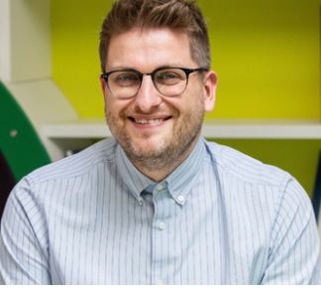
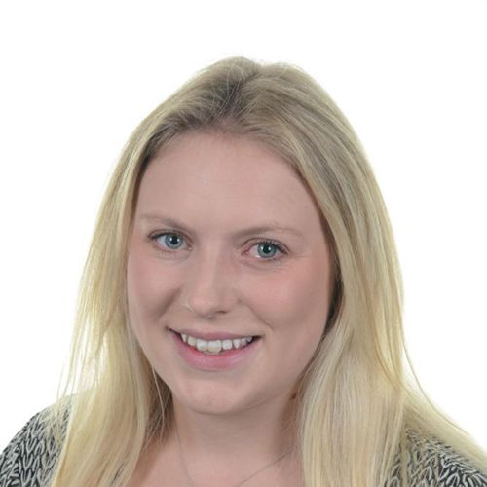
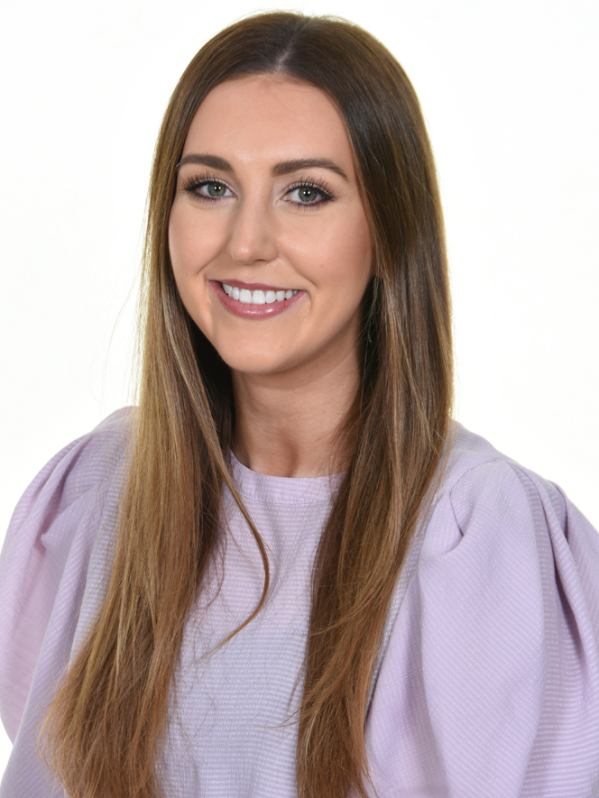
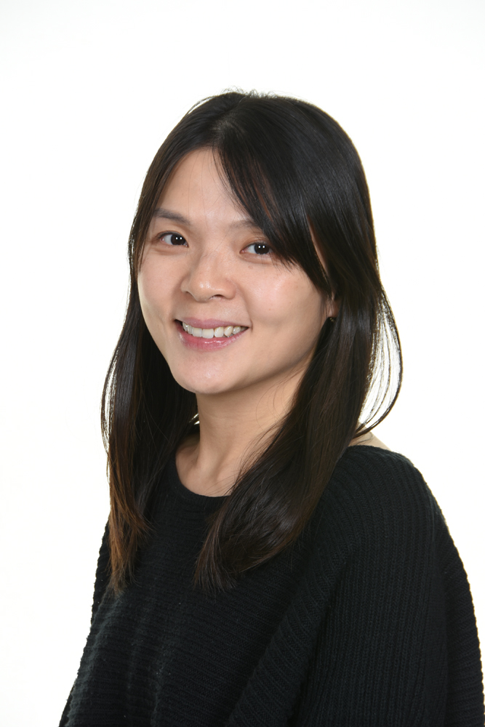
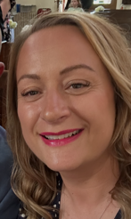
Meet the Team
Mr Taylor – Headteacher
Mrs Price- Head of Early Years & Class Teacher
Mrs Small- Class Teacher
Mrs Yeung– Class Teaching Assistant
Mrs Hunt- Class inclusion TA
Miss Bonehill – Wraparound Care Supervisor and Manager
Mrs Mole – Admissions, Attendance and Business and Pupil Services

Slide 4



Essential information
Famly links have been sent out.
Arbor is our payment system, invoices are sent out via Famly for all chargeable provisions. Your account will be activated within the first week of the school term.
Tax Free childcare/childcare vouchers can be used to pay for private provision.
The office is open from 8am-4pm daily.

Slide 5


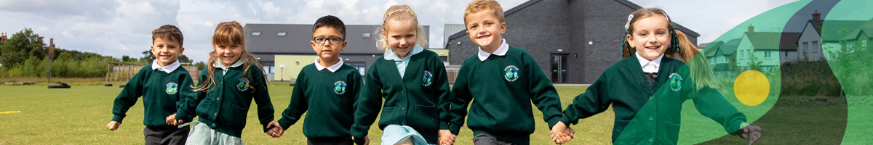
Uniform
At Streethay we have high expectations and believe that maintaining a smart uniform and appearance can contribute to the development of a respectful and purposeful learning atmosphere.
Our uniform supplier is Uniform Plus.
You can order via the internet or in a store. - https://www.uniformsplus.co.uk/category/school-uniforms/
Local Supermarkets may also supply suitable and affordable items.
Overview of uniform:
- Green jumper
- White polo shirt
- Grey trousers/skirt/pinafore dress
- Black smart shoes
- Additionally, children may choose to wear a green check summer dress in the warmer months

Slide 6
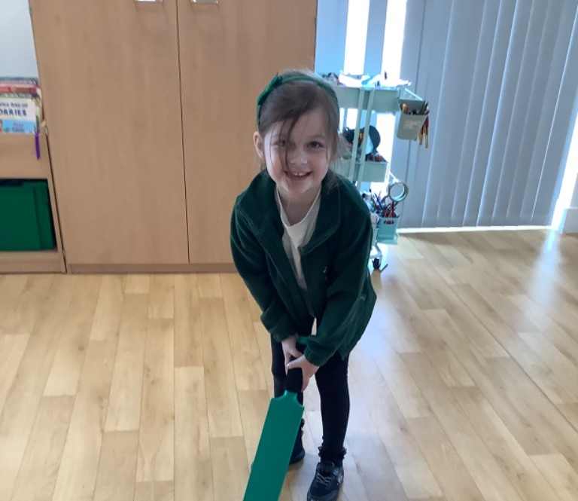
PE Kit
Your child will have P.E.
P.E. Kit overview:
No branded sportswear.
White t-shirt
Black shorts, joggers or leggings
Green Hoodie
Trainers suitable for sports
Coat
Please ensure all your child’s uniform is clearly labelled.

Slide 7
Reporting an absence
If a child is absent from school, we ask parents to:
Contact the school office by 9:30am on the first morning of absence.
Reply promptly to any requests or enquiry concerning an absence.
Holidays and absences…
In Sunflowers children should attend every session during term time. We expect holidays to be booked during school holidays and not during term time.
If your child has a medical appointment or you need to request exceptional leave, please complete a ‘Leave Request Form’ found in the office area.
At Streethay we aim to achieve 97% Attendance.
Attendance below this target is monitored.
Streethay work closely with Staffordshire County Council.

Slide 8
Billing and Booking Lunches
An invoice will be generated on Famly for provision, and payments are to be made on Arbor.
Please book lunches via Arbor. Reception Class get free school meals. Please note that the system will allow you to book these for the entire half term, but at least 24 hours in advance.

Slide 9
Wraparound Care
Wraparound Care Pricing - Before and After School
Breakfast Club 7:30am to 8:35am - £6 (Breakfast included)
Afterschool Club 3:15pm to 6pm - £12 (Light meal included)
A month notice for changes –reduce sessions.
Payments
Fees are invoiced on our Famly app and payment is made via Arbor. Payments are made in advanced of your booking and due 28th of each month.
Late payments incur a fee of £15.
Your first invoice will be sent on the second week of school for both September and October, payment will be due by 28/9/26

Slide 10

JC Academy – Holiday Club
JC run our holiday clubs.
They will ask for an expression of interest for October, Easter and Summer Holiday club.
If there is sufficient interest there may be a possibilty of future holiday clubs for under 4's

Slide 11
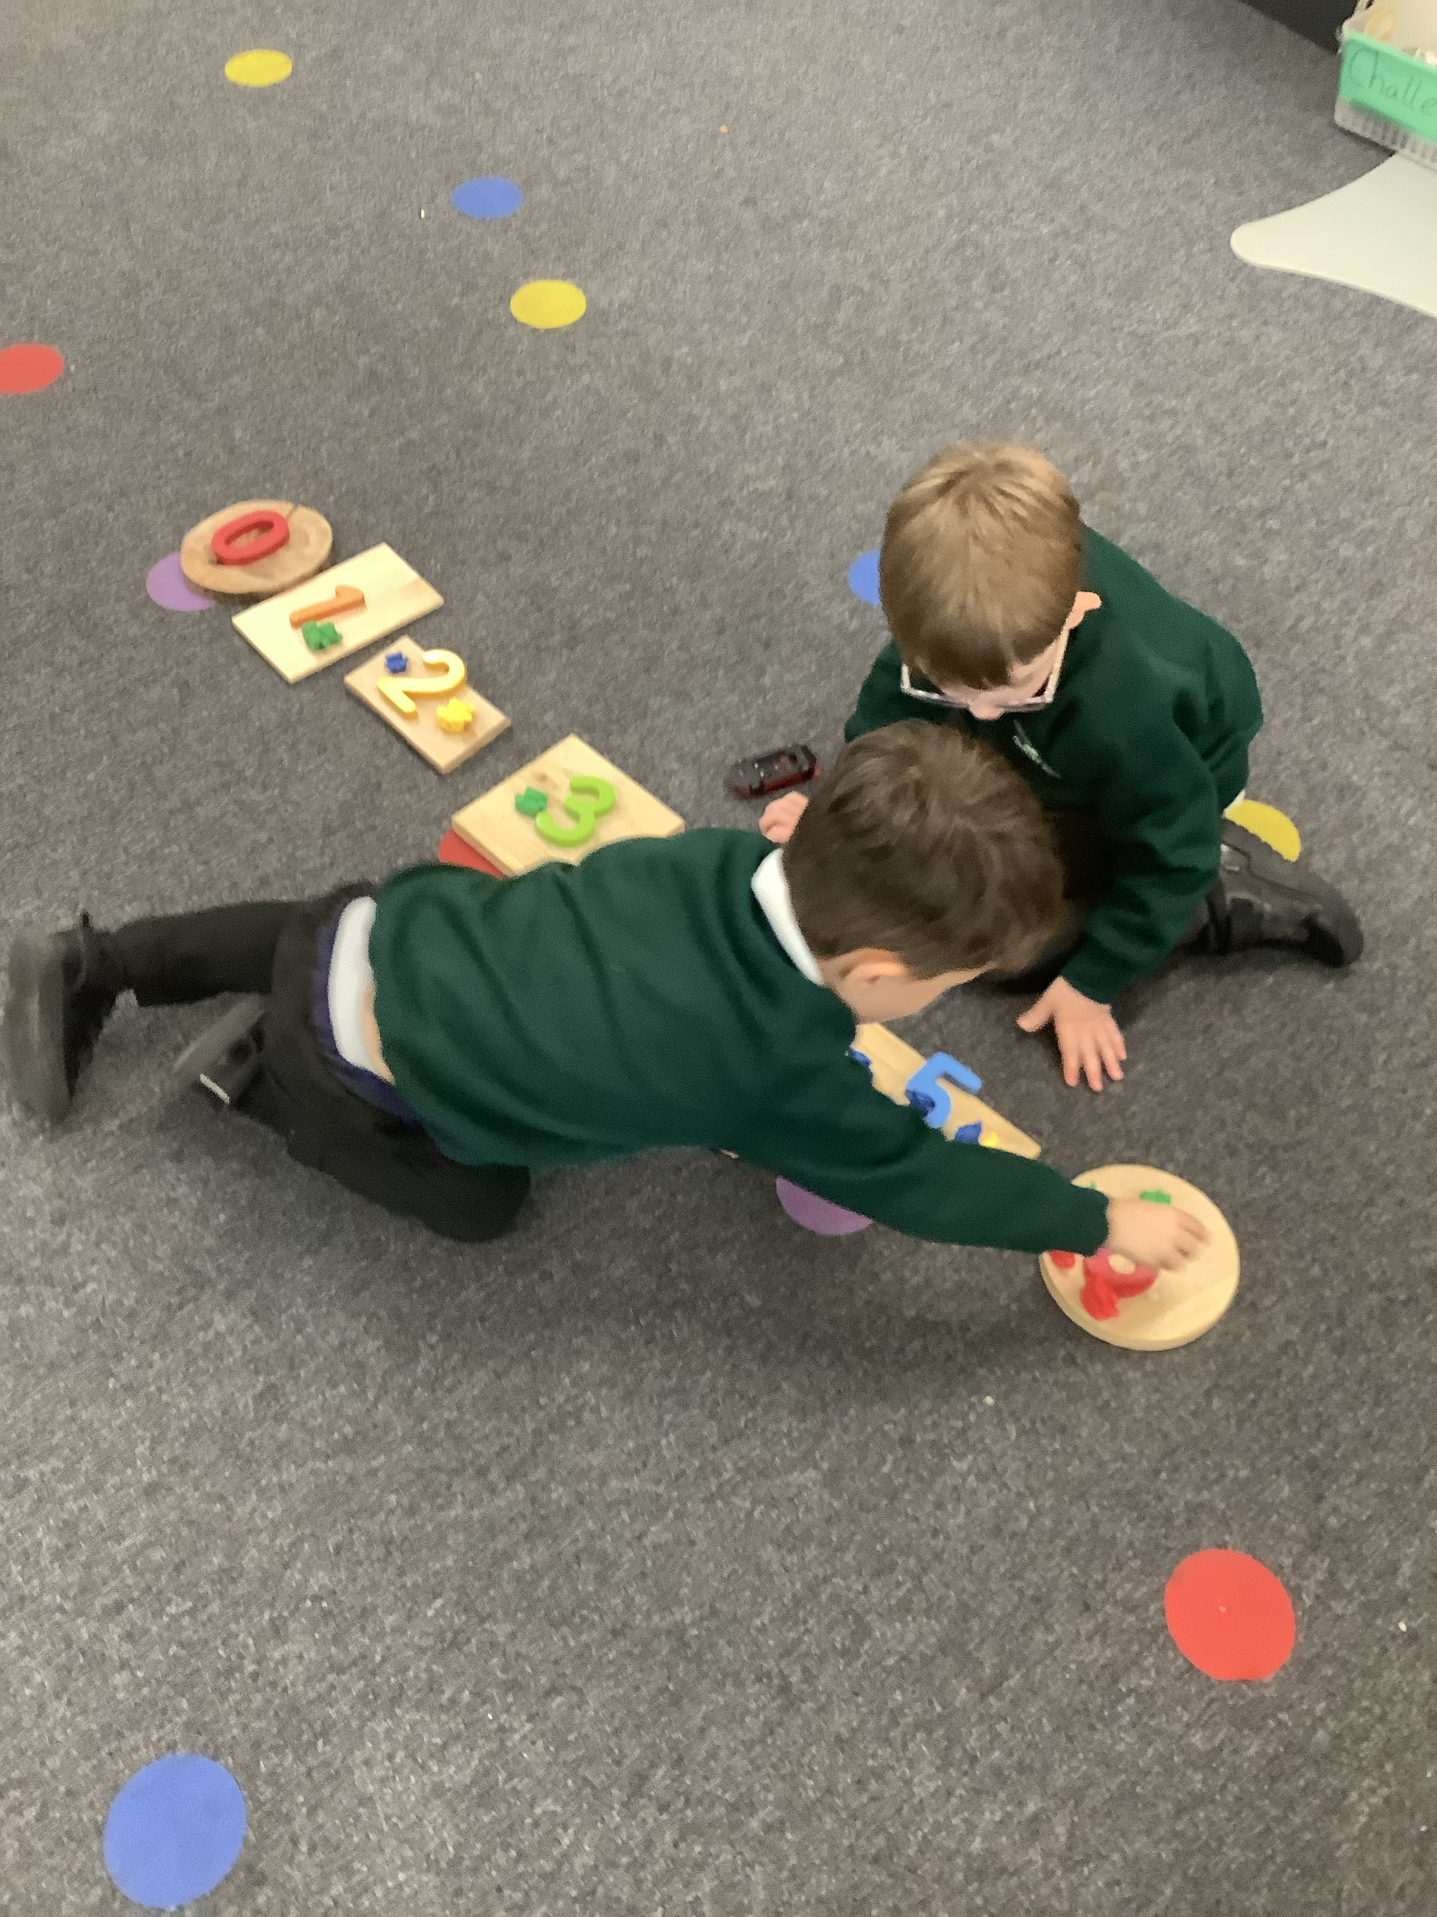
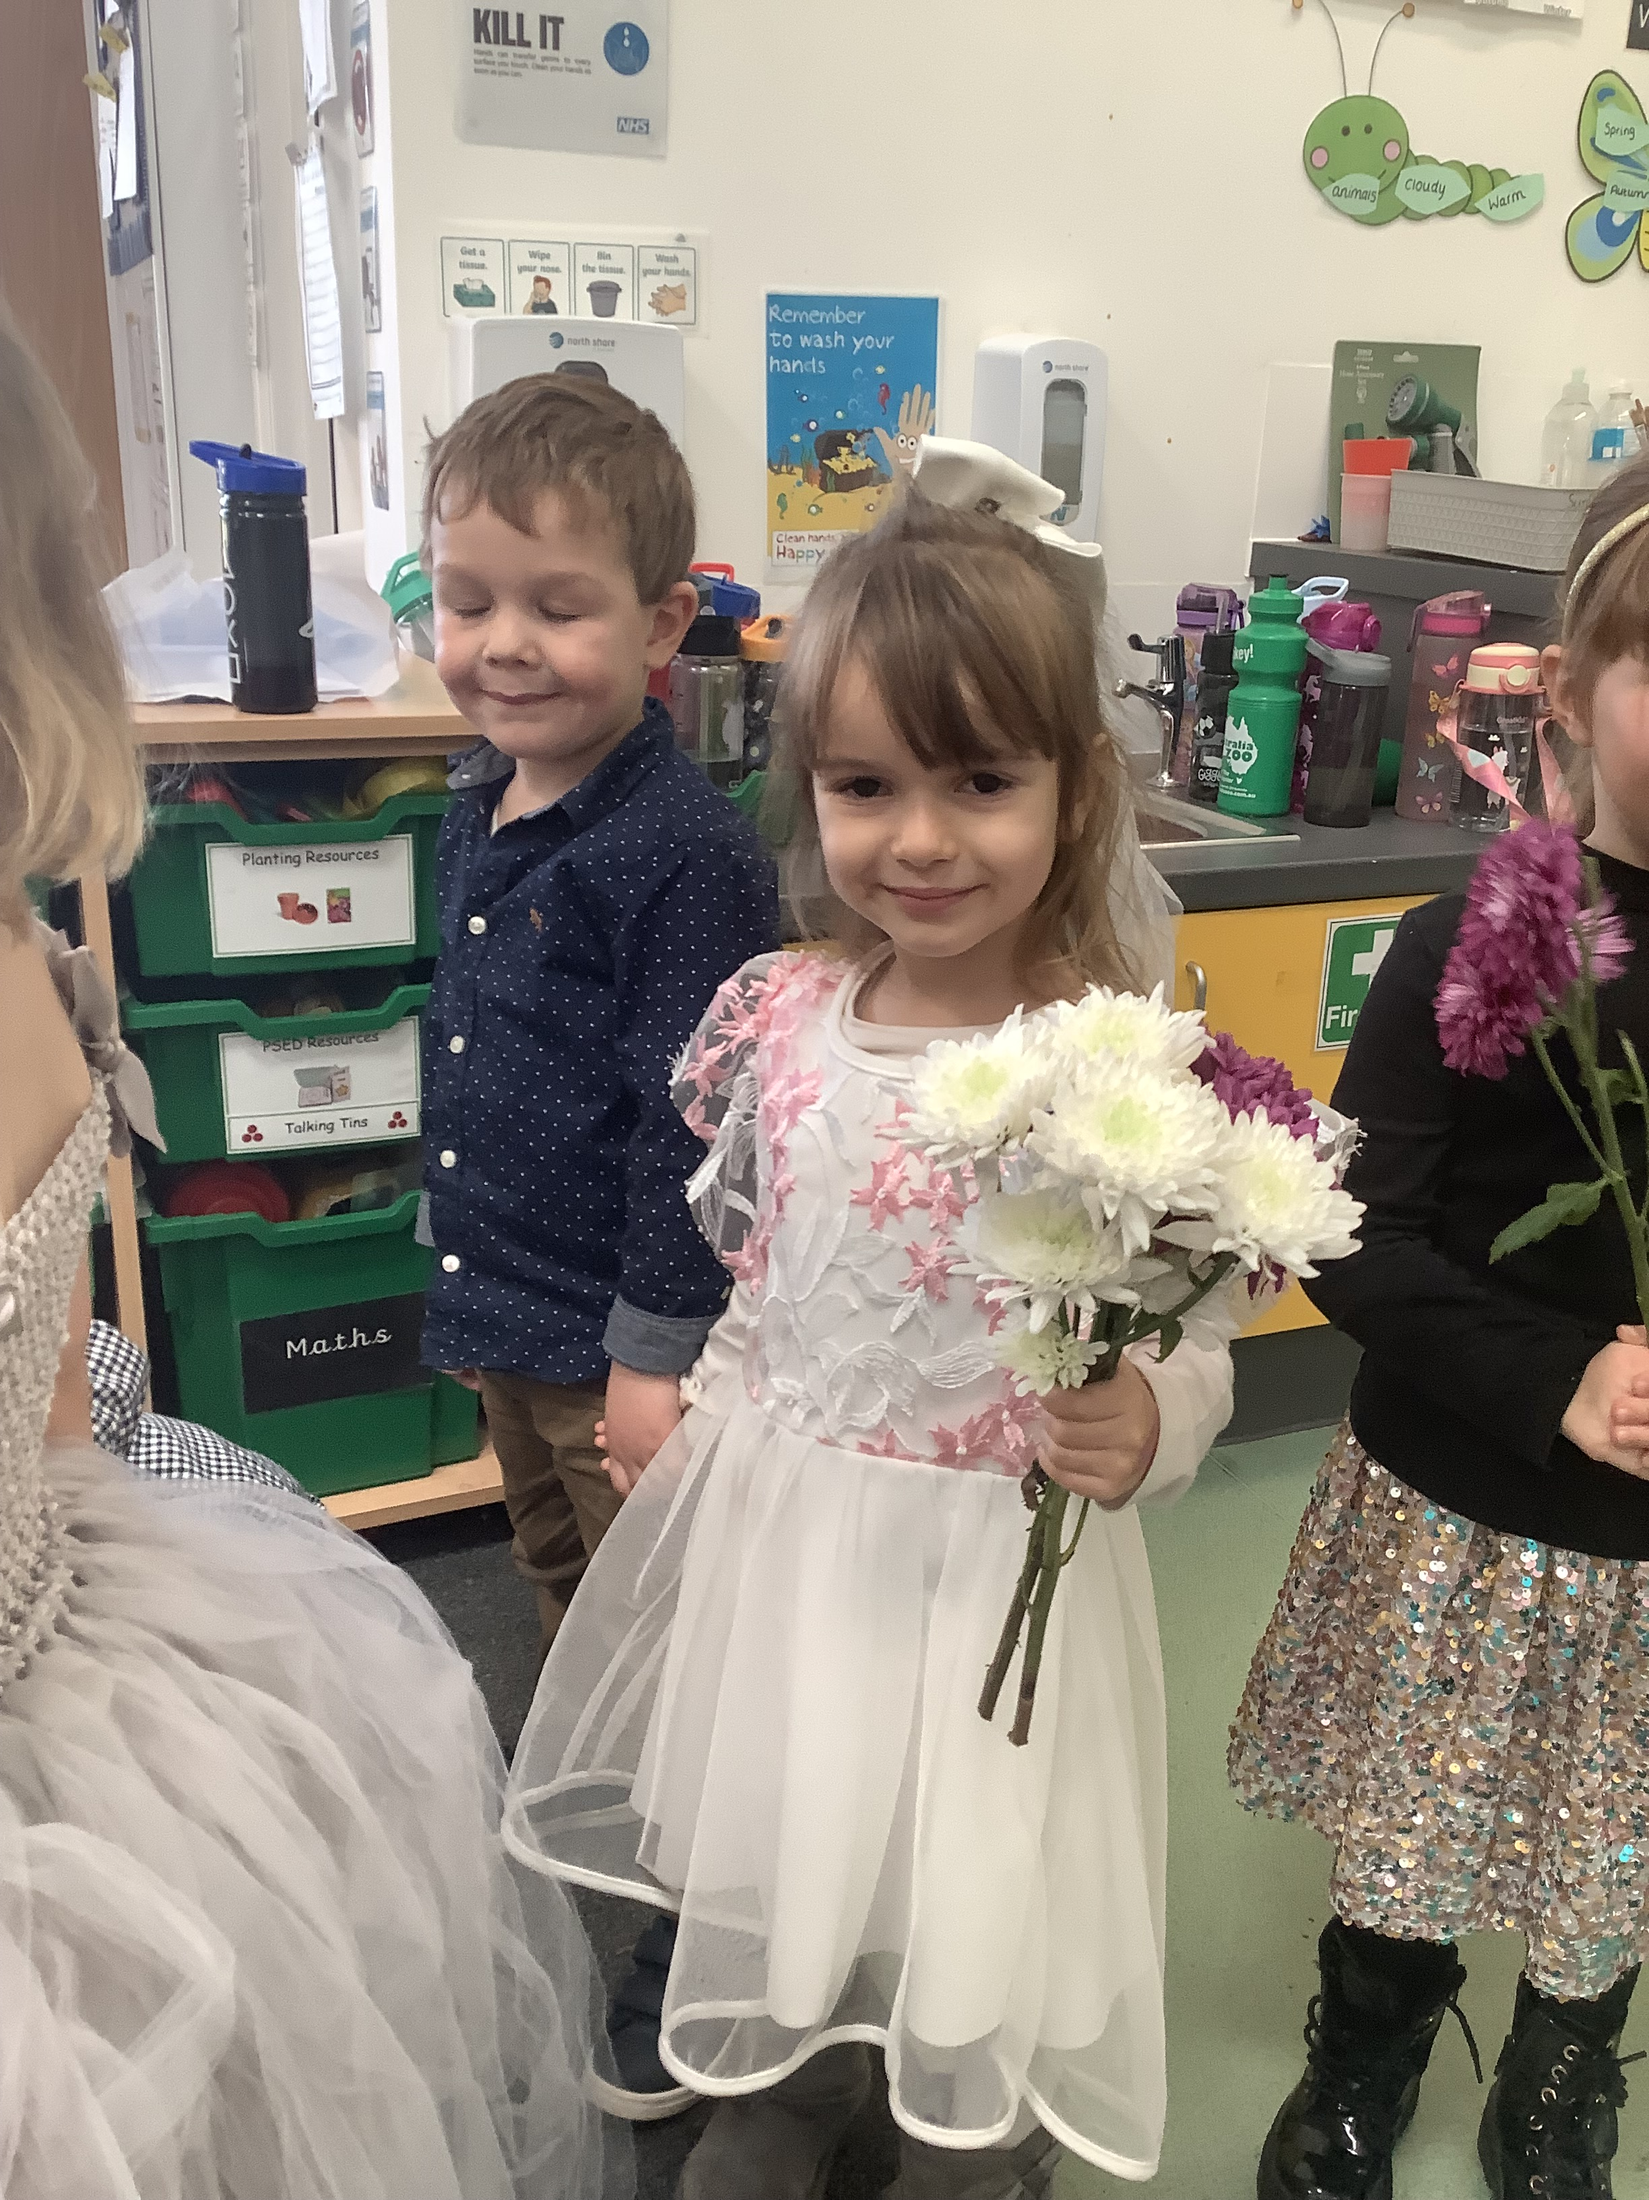
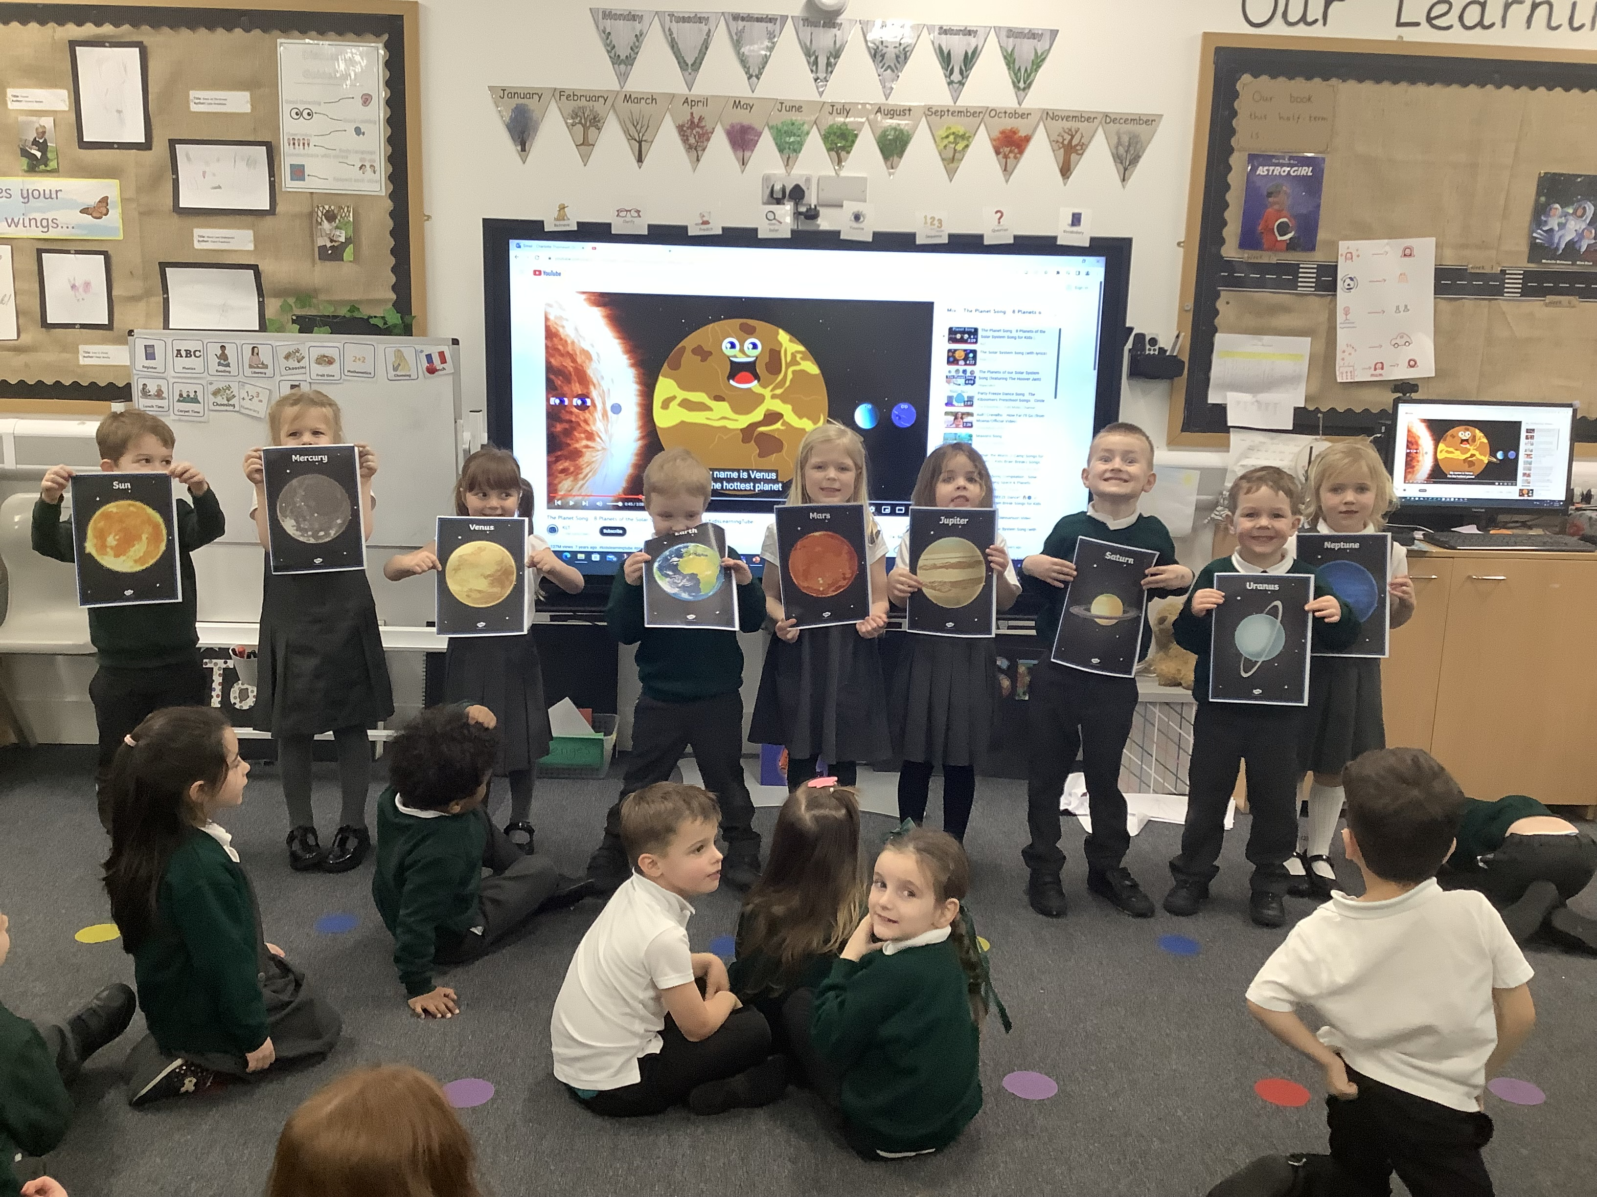

Famly App – Learning Journey
Observations
Instant messaging between – 8am and 4pm.
Interactive news feed with updates from the classroom.
Consent for your children will be required.
Notes:
The Reception baseline assessment is a short assessment which is sent to department for education to track the progress of the children from entering school to the end of school in year 6.
We use famly as our main assessment platform where we record observations of your child when they are our focus child for the week. We focus on all 7 areas of learning and observe children during ‘in the moment impacts’ where we have modelled or intervened with their learning or during a ‘wow’ moment where they have achieved an outcome independently. We have created our own curriculum which is underpinned by the non statutory framework ‘Development matters’ Creating our own Streethay expectations for the children to achieve throughout the year.

Slide 12
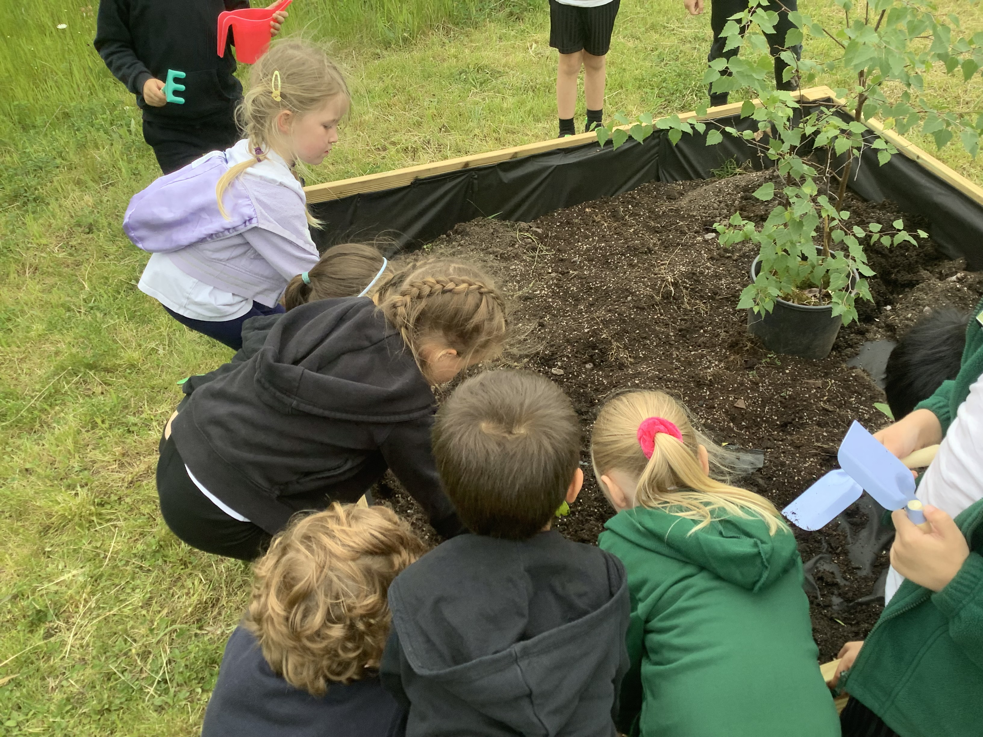
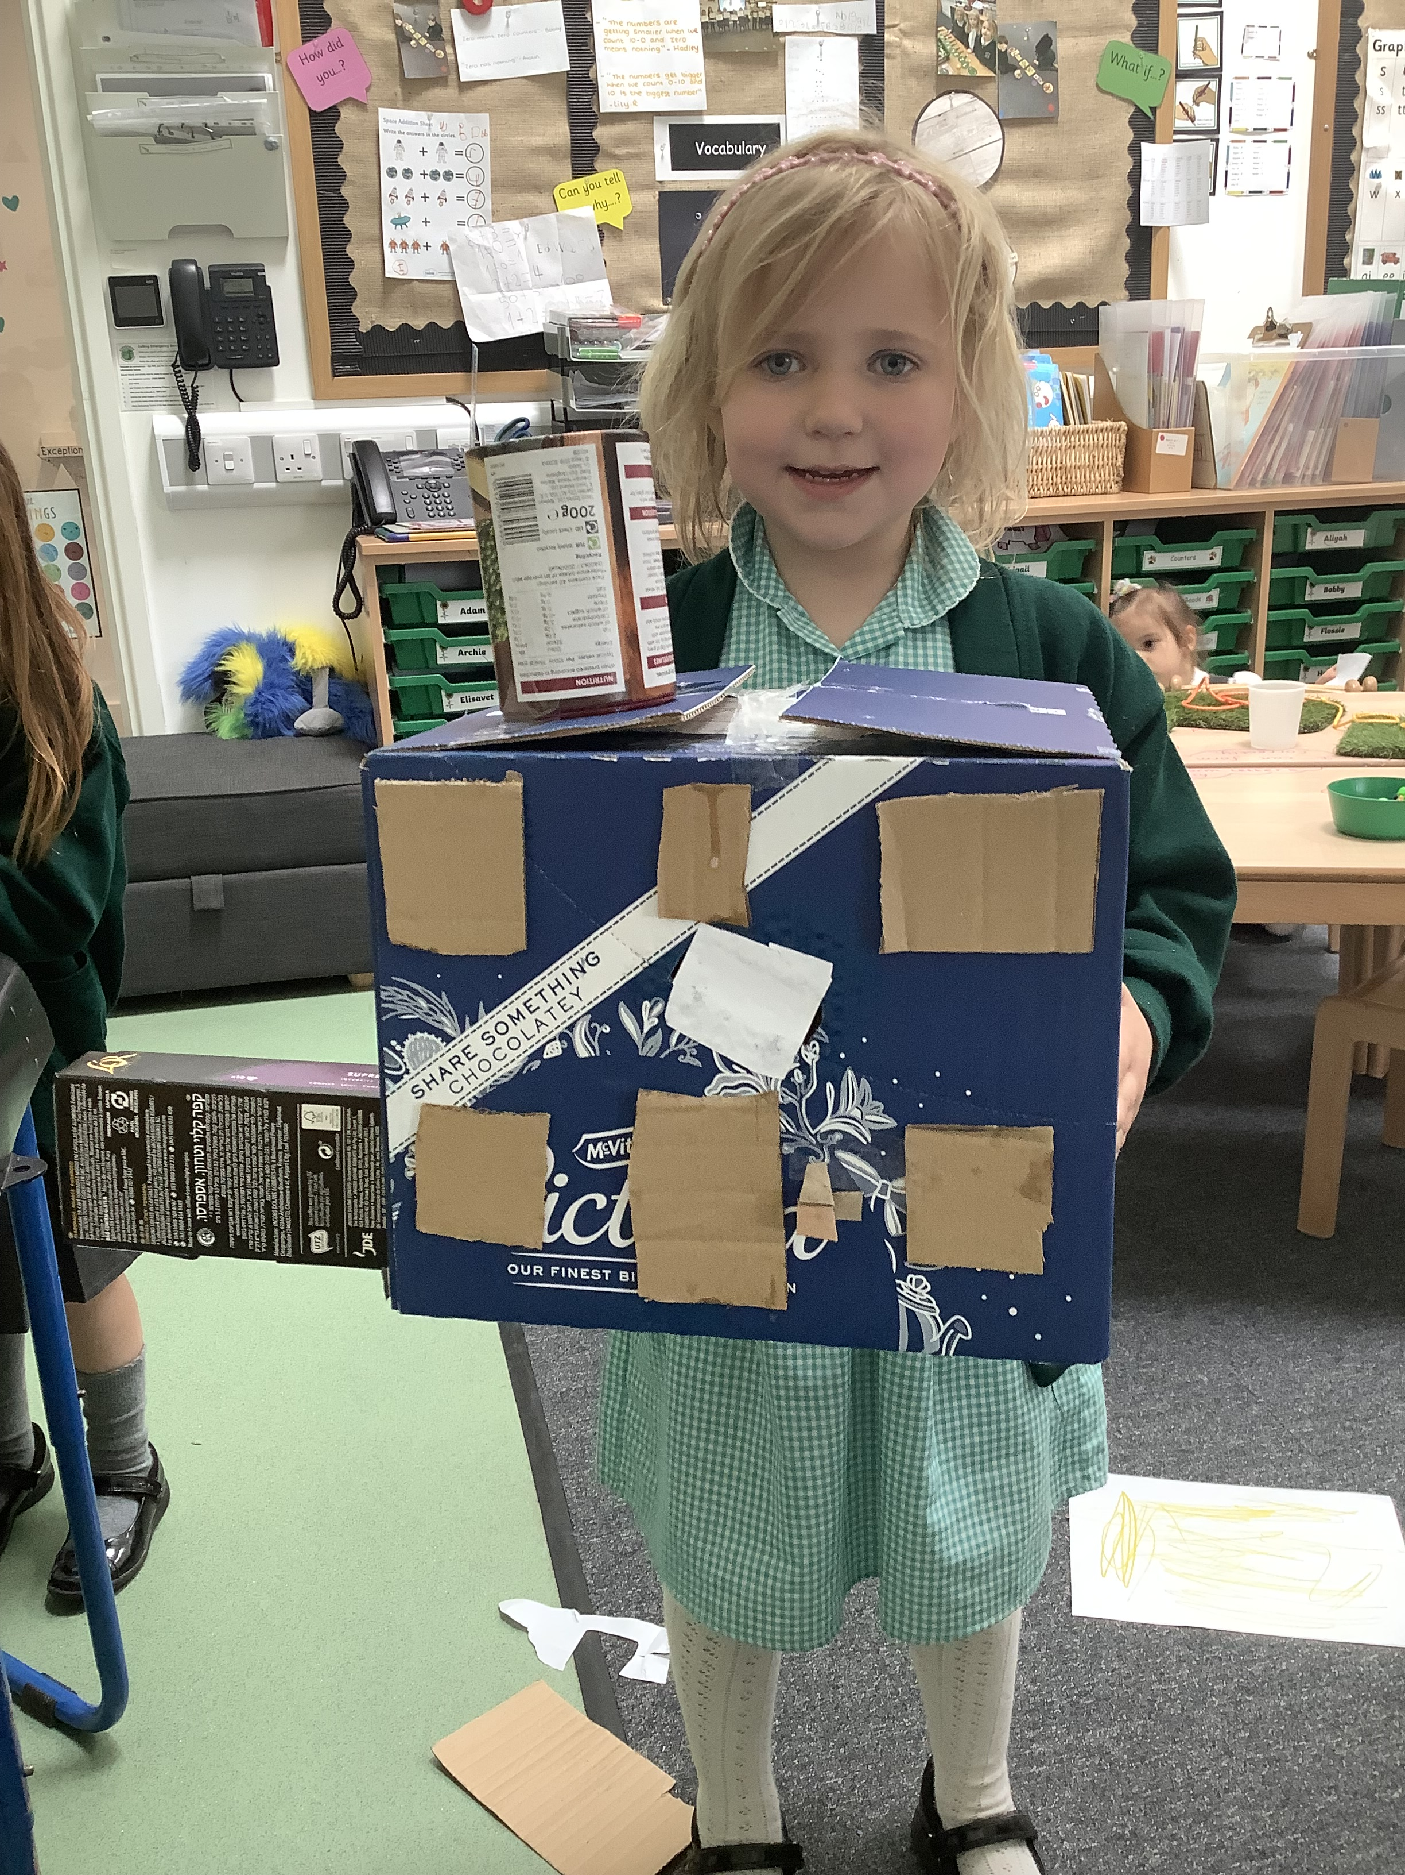
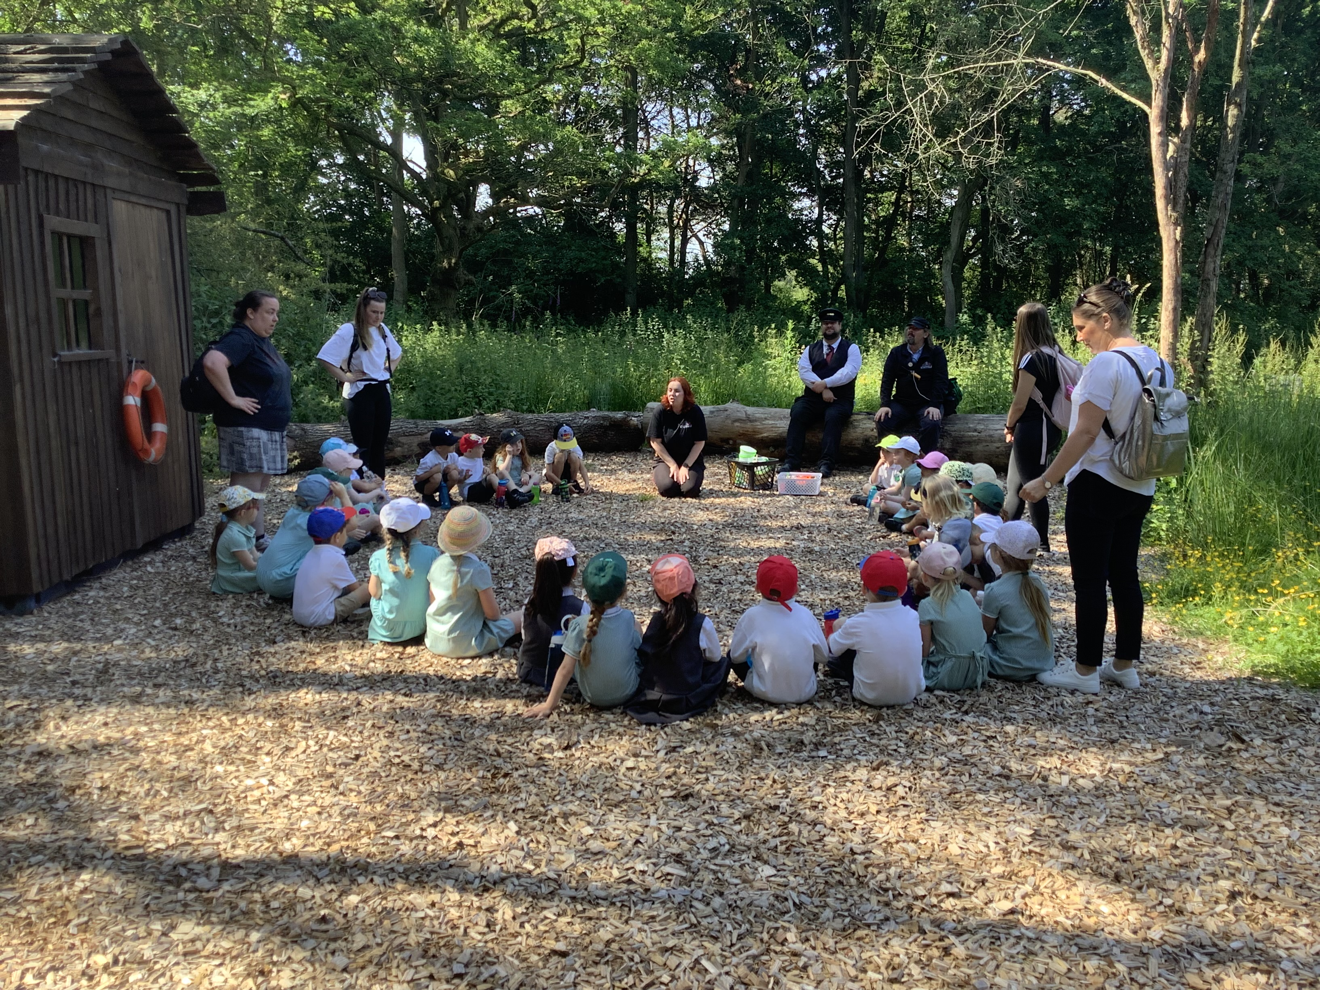
Curriculum Themes
Autumn 1 | Autumn 2 | Spring 1 | Spring 2 | Summer 1 | Summer 2
Marvelous Me! | My local Area | Once Upon a Time | Out of This World | In the Garden | Journeys
Notes:
We are passionate about giving our children the best possible start to their learning journey. We follow aspects of a Reggio Emilia approach in the EYFS, using natural materials and resources to engage and spark thinking within our learners. This environment enables all learners to become engrossed within their play and supports development.
Our Streethay curriculum has been designed to enable children to succeed. We support all learners and create opportunities to maximise opportunities for children to thrive, by challenging more able children with cross-curricular links and learning experiences. We also recognise the importance to support our SEND children with our bespoke approach to enable them to achieve the best of their abilities.

Slide 13
Curriculum Trips and Workshops
Autumn 1 Marvellous me | Autumn 2 My local area | Spring 1 Once upon a time | Spring 2 Out of this world | Summer 1 In the garden | Summer 2 Journey
Parent Workshop – Phonics. All about me posters (Parents to bring in) | Christmas Play Local walk exploring houses. Trip – The adventure Farm. | Parent Workshop – Maths. | Space Dress up day. Little Town | Spring Art Exhibition. | Teddy Bears Picnic Sports Day Transition Trip – Statfold Country Park
Notes:
At Streethay we have many enrichments to deepen children’s knowledge and skills. We are currently working hard to map out our enrichments for next year.
As the Forest School Lead my favourite enrichment for the children is forest school. It allows the children to explore their natural environment and create a safe space for them to experience risk and challenge.

Slide 14
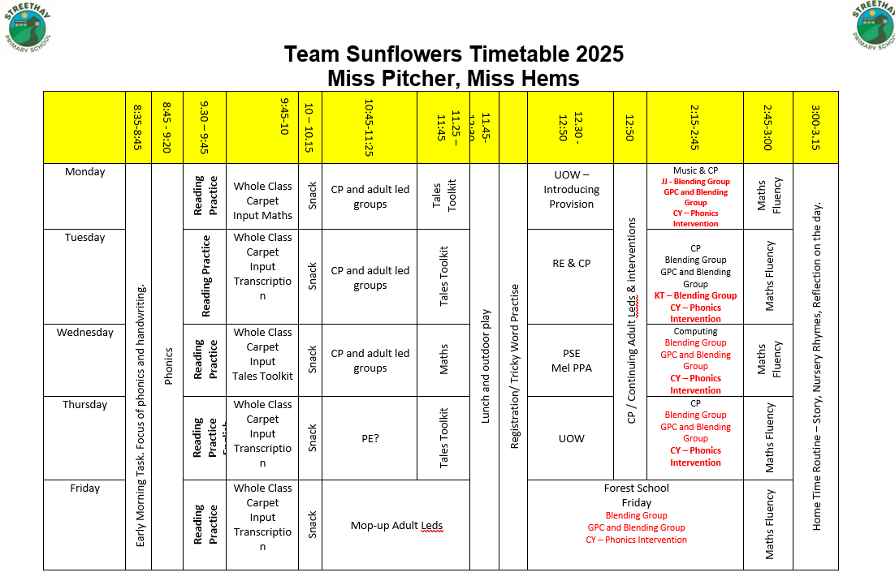
Timetable and Day to Day
Notes:
This is a guide to a day in sunflowers. We follow a routine throughout the year to support the children. We ensure children have a range of activities and that they are all stimulating and engaging for the children.

Slide 15
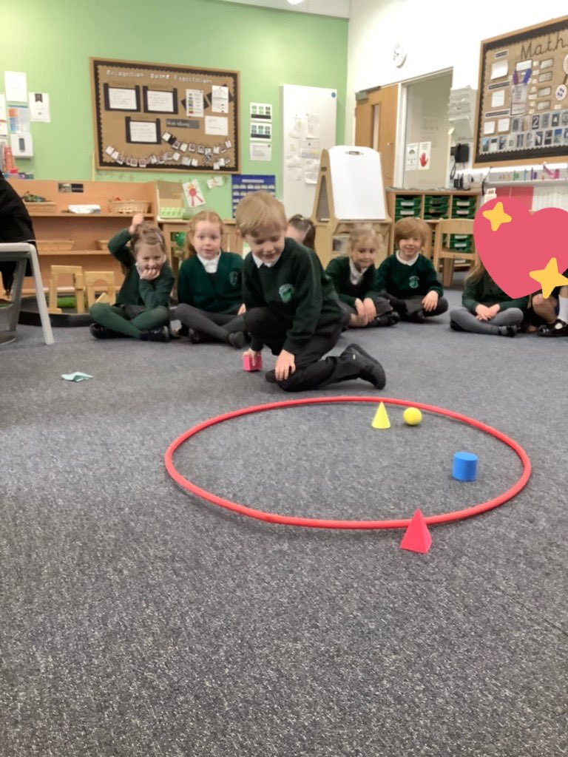
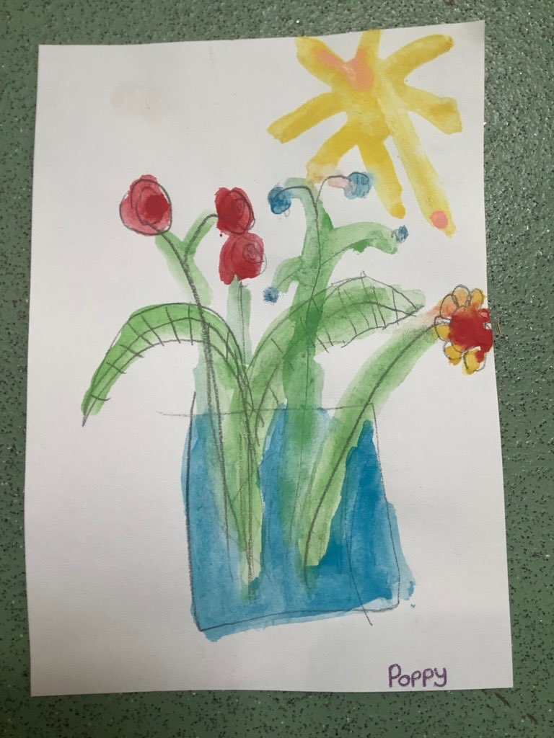
Areas of Learning and Characteristics of Effective Learning (CofEL)
Prime Areas
Personal, Social, Emotional Development | Communication and Language | Physical Development
Relationships. Manging emotions. Positive sense of self. Growing confidence. | Spoken Language. Back and forth interaction for language and cognitive development. | Gross and Fine Motor. Healthy Bodies. Oral Hygiene.
Specific Areas
Literacy | Mathematics | Understanding the World | Expressive Arts and Design
Reading. Writing. | Mastery Maths. Numbers. Shape Space and Measure | World. Community. | Being Imaginative. Creativity.
CofEL
Playing and Exploring | Active Learning | Creating and Thinking Critically
Notes:
In the time as seen on pervious slide, we ensure we cover all areas of learning in reception. This can be through adult led, continuous provision or child initiated.
CofEL These strands underpin the children’s learning and development. We use these three stands to reflect on the different rates at which children learn and develop and adjust our practise to support all children.
Play and exploring – Investitive and explore, have a go
Active learning – Concentrate and keep on trying
Creating and thinking critically - Children develop their own ideas.
The EYFS is fundamental in ensuring solid foundations for children enabling them to be life-long learners. At Streethay, we place great emphasis on building positive and secure relationships with our children and families in order to achieve the best possible outcomes. Our children are enthusiastic, safe and well supported and challenged by our teaching staff.
PSED is crucial for children to lead healthy and happy lives, and is fundamental to their cognitive development. We strive to support all children and create nurturing environments which leads to the children developing strong, warm and supportive relationships with adults. We support children with their self regulation, feelings and those of others, to play co-operatively and manage own personal needs. This develops a positive sense of self worth, confidence and resilience. Which supports them within their development and life long skills.
C&L is the development of children’s language and underpins all 7 areas of learning. It is vital for children to have back and forth interactions and conversations. We ensure our provisions are language rich with key vocabulary, adult modelling and reading frequently to the children a range of books such as fiction, non fiction, rhymes and poems. We support children to have a voice and share ideas, answers and to ask questions.
We also have an in house S&L therapist who supports children with their speech.
PD is vital in children’s all round development. It enables them to pursue happy, healthy and active lives. Gross motor skills provide the foundations for developing healthy bodies and social and emotional well being. Fine motor skills support children with their control and precision with hand eye co-ordination, which is later linked to early literacy. Helping the children to make marks and write.
L it is crucial for children to develop a life-long love of reading. Reading consists of two dimensions: Language comprehension (When an adult talks to a child about a the world around them using books) and word reading (this is taught later but involves decoding words in order for them to read). Writing involves pre mark making skills which then develops into spelling and handwriting and articulating ideas and structuring them in speech before writing.
M this develops a strong grounding in numbers. Children should be able to count confidently, develop a deep understanding of numbers to 10, the relationship between them and the patterns within those numbers. Children will secure their mathematic vocabulary through our math mastery approach. We think it is important for children to explore numbers and have the confidence to have a go and not be afraid to make mistakes in order to develop their knowledge.
UW – This allows the children to have a sense of their physical world and community. It is allow children to experience the world around them such as visiting parks, museums and in addition explore the diversity of the whole world through books, looking at cultures, traditional, religions and countries.
EAD – This develops the children’s artistic and cultural awareness to support their imagination and creativity. It is important that children have opportunities to engage with arts allowing them to play with a variety of materials such as instruments, songs, dance, paint, playdoh and much more. It allows children to develop their understanding of self-expression and allows them to communicate through arts.

Slide 16
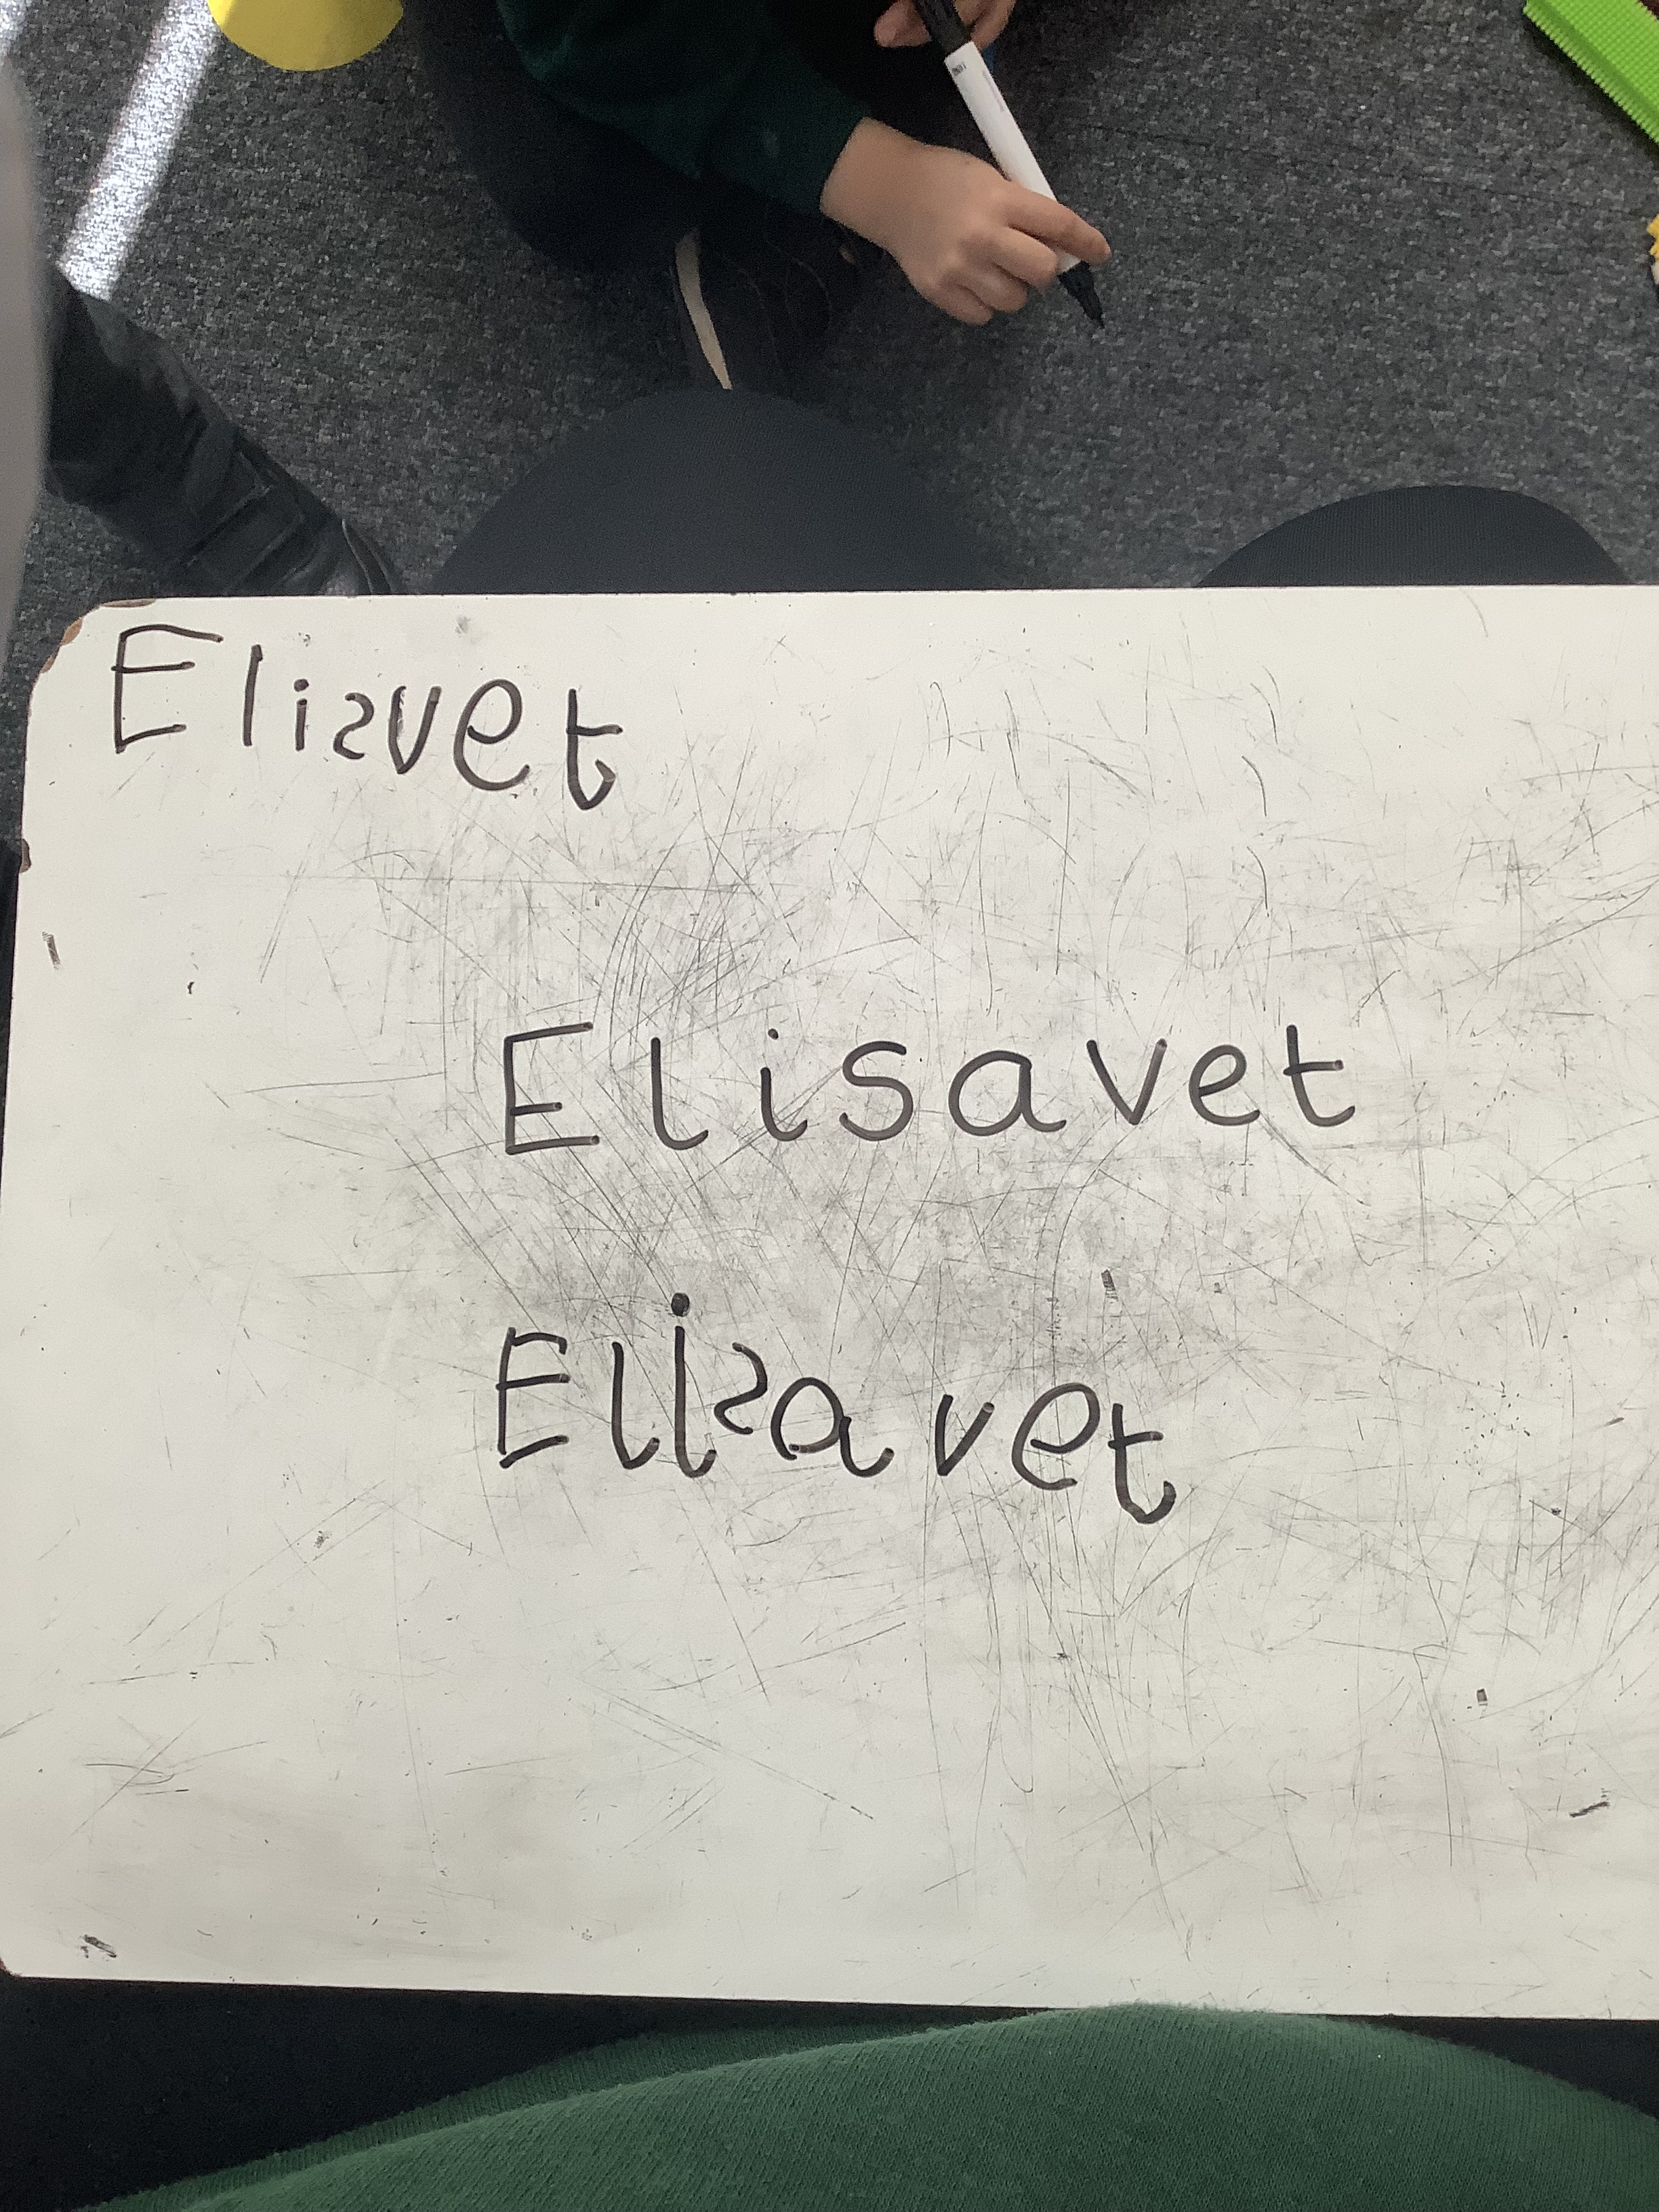

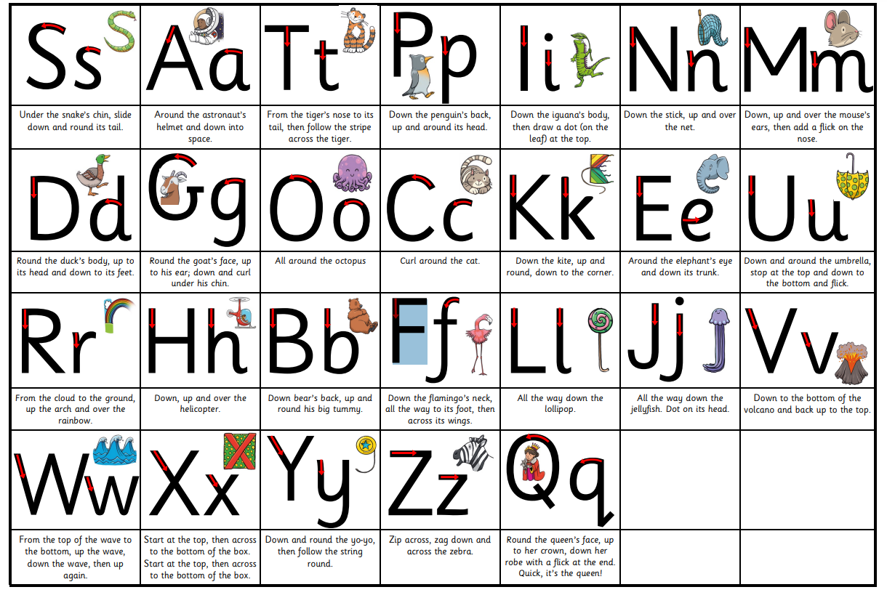
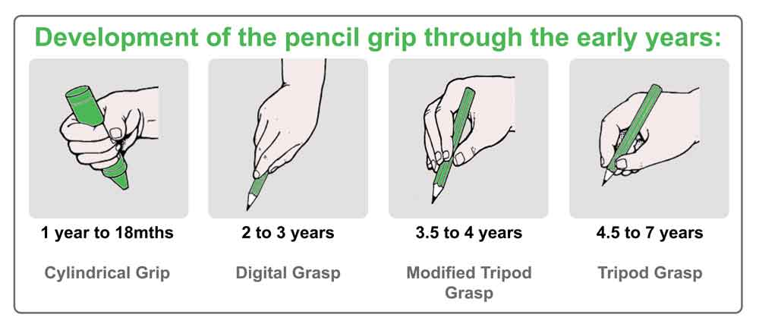
Little Wandle
We use Little Wandle Letters and Sounds Revised.
Phonics is making connections between the sounds of our spoken words and the letters that are used to write them down.
We teach children to write in print and work hard during the year to ensure your child forms letters correctly, holding their pencil with the tripod grasp.
We focus on letter formation within our handwriting and phonics and transcription sessions.
We will be holding Parent Workshops to explain phonics and transcription in more detail in September.
Notes:
We follow Little Wandle for our phonics program. We have short daily sessions and follow a teacher sequence of sounds. We focus heavily on repeated practise and revisiting sounds that have been previously taught to secure children’s knowledge and understanding. We ensure all our phonics lessons are consistent and use the same terminology and lesson structure daily.
We use the Little Wandle handwriting rhymes which will be sent out at the start of the year when we begin phonics. It is important to model correct formation of letters to the children.
We begin the year by focusing mainly on name writing and the formation of letters within their name.
The children begin the year making early mark making shapes, such as lines, circles and crosses. As we start phonics the children develop the skills to begin to write words and form letters correctly.
We encourage the children to hold their pencil with a tripod grip by says “pinch your pencil” supporting children to hold their pencil correctly.

Slide 17
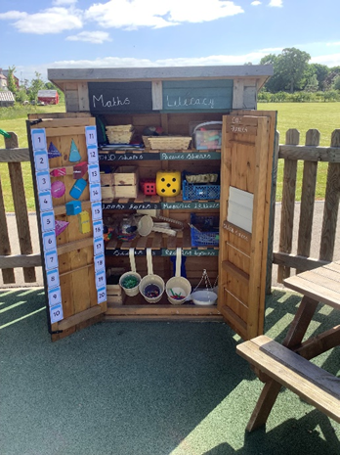
Outdoor Play
Child initiated play – Discovered by their likes and interests.
Enhanced and challenged through teacher modelling and interactions.
Reduced / printed vocab signs to support imaginations and teachers to follow children play.
Sunflowers is less structured adult lead activities (One set up per day) to support children’s ownership of learning.
Gross motor skill focused.
Loose parts play is vital outside.
Notes:
It is vital for the children to play outside and to develop their gross motor skills, team building and release energy.
In sunflowers we support the children to be their own educators outside, we nurture and guide the children and model were appropriate. Children take learning into their own hands and can explore a various of open-ended learning environments ensuring all 7 areas of learning are accessible.

Slide 18
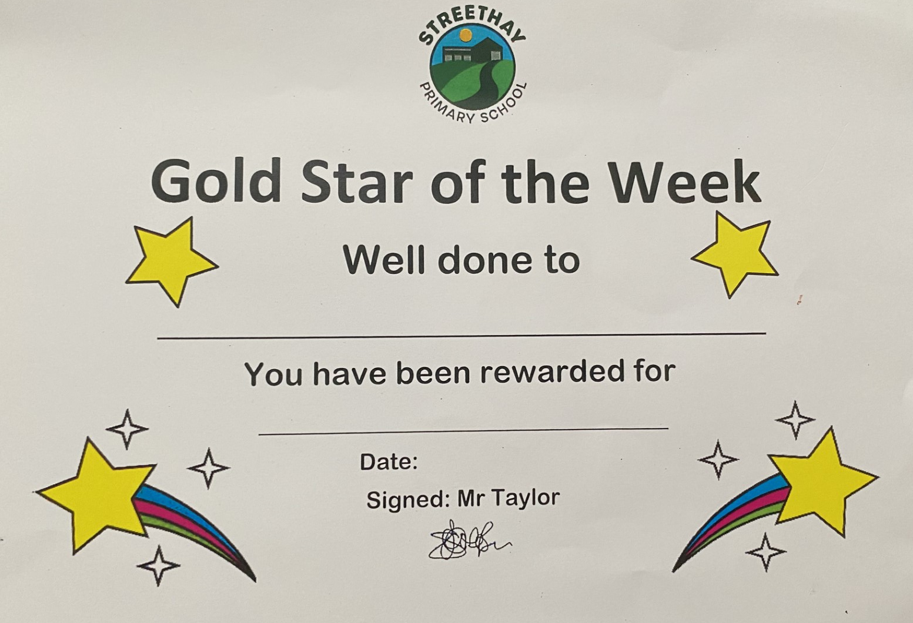
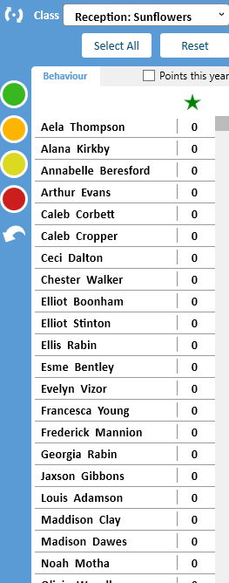


Behaviour – Track it lights
In Reception we follow the whole school behaviour policy and use Track it lights. This gives the children instant rewards -house points, and warnings which if not corrected will lead to a consequence.
We recognise that Personal, Social and Emotional development is a prime area of learning in the Early Years Foundation Stage and is fundamental to children’s development.
Following the whole school policy and adhering to the expectations of being: Ready, Respectful and Safe.’
Notes:
We have a bespoke behaviour system as we know all children are different and different streagies and approaches are individual for each child. We over all follow the “Rainbow system which is our school policy.” However, we adapt and change to meet all individual needs.
WE FOCUS ON POSTIVIE REINFORCEMENT AND COMMIUNICATION TO DISCUSS FEELINGS, NEEDS AND WANTS. We ensure children feel safe and secure to discuss their emotions.
All children’s names will start on the sun at the beginning of each day. Names will remain here for adhering to Streethay Expectations.
Rainbow
Children’s names can be put on the rainbow during the day for especially excellent behaviour and excellent work. When children move up to the rainbow, they will receive a certificate and praise their achievements.
Sun covered by cloud
Children’s names will move down onto the sun covered by the cloud when they have been given a warning. ‘Stop and think’. Children are reminded of the school rules and self-regulation is encouraged.
Grey sad cloud
Children can move down if they continue to not follow the Streethay Expectations. Children are encouraged to ‘Put it right’ and given thinking time in class or if necessary, in another class. Children have restorative conversation with a member of staff and remined of the school rules.
If children continue not to follow the Streethay rules or are aggressive physically or verbally they receive thinking time with SLT, and their behaviour is recorded on the behaviour log. Parents are contacted or spoken to at the end of the day about their child’s behaviour.
Children’s names can move up and down the system throughout the day. At the end of the day each child returns to the sun. Each day is a fresh start.

Slide 19
Transition Plan and Activities
Children's Meet The Teacher – Tuesday 7th July 9:00-10:30am
September Start Date – Thursday 3rd September
Challenge – Please post on Famly your child ‘Get Caught Reading or Singing’
Feel free to post lots of fun activities that you get up to on Famly. We can’t wait to interact.
Welcome to the Streethay Family
Notes:
We are an open door school and we encourage parents to communicate and interact with us as much as possible. If you ever need to speak to a member of staff we will always make time to discuss your child.
I have started to visit some Nursery Setting and had the pleasure speaking to current key workers and settings. I will of contacted you to discuss your child and how is best to support them in the transition into Sunflowers. I am so excited for the meet the teacher sessions and welcoming all the children into sunflowers. There will be fun and engaging activates set up for your child to explore and become familiar with their new environment.
Before the Summer holiday you will be set up onto Tapestry our learning journal where myself and Miss Wheeler will post exciting messages to welcome you to Streethay. Please over the summer holiday post pictures so we can start to develop our communication and repor with your child for when they start Sunflowers.
At the … on the table I have created welcome packs for each of you to take home. Inside you will find a transition booklet with pictures of the classroom of the main areas of the school, please show and share these with your children.

Slide 20
Any Questions?
Uniform link

