Slide 1
Sunflowers Maths Workshop
16th January 2024

Slide 2
Key Objectives
To discuss the key fundamentals of maths in EYFS.
To know the end results we are working towards for Sunflowers.
To see examples of lessons and practice in EYFS.
To develop fun and exciting activities at home.
To explore activities set up with Sunflowers.

Slide 3
Early Learning Goal – End of Sunflowers
Number
Children at the expected level of development will:
Have a deep understanding of number to 10, including the composition of each number
Subitise (recognise quantities without counting) up to five
Automatically recall (without reference to rhymes, counting or other aids) number bonds up to five (including subtraction facts) and some number bonds to 10, including double facts
Numerical patterns
Children at the expected level of development will:
Verbally count beyond 20, recognising the pattern of the counting system
Compare quantities up to 10 in different contexts, recognising when one quantity is greater than, less than or the same as the other quantity
Explore and represent patterns within numbers up to 10, including evens and odds, double facts and how quantities can be distributed equally

Slide 4
Skills Children develop in Reception
Counting
Understanding and using numbers
Calculating simple addition and subtraction problems
Describing shapes, spaces, and measure
It is important that children develop positive attitudes and interests in mathematics, look for patterns and relationships, spot connections, ‘have a go’, talk to adults and peers about what they notice and not be afraid to make mistakes.

Slide 5
Learning in the Early Years
Cardinality and counting
Comparison
Composition
Pattern
Shape and Space
Measures

Slide 6
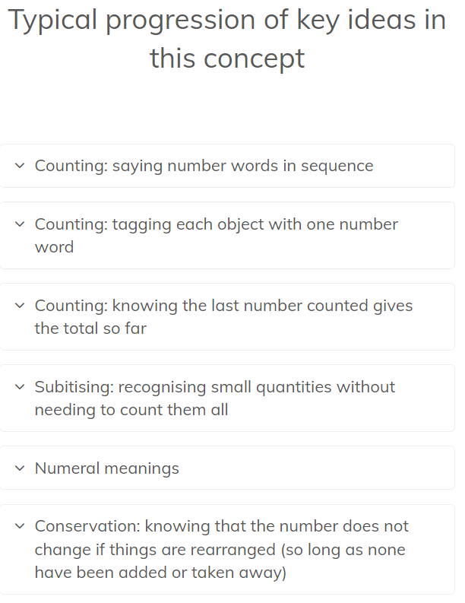
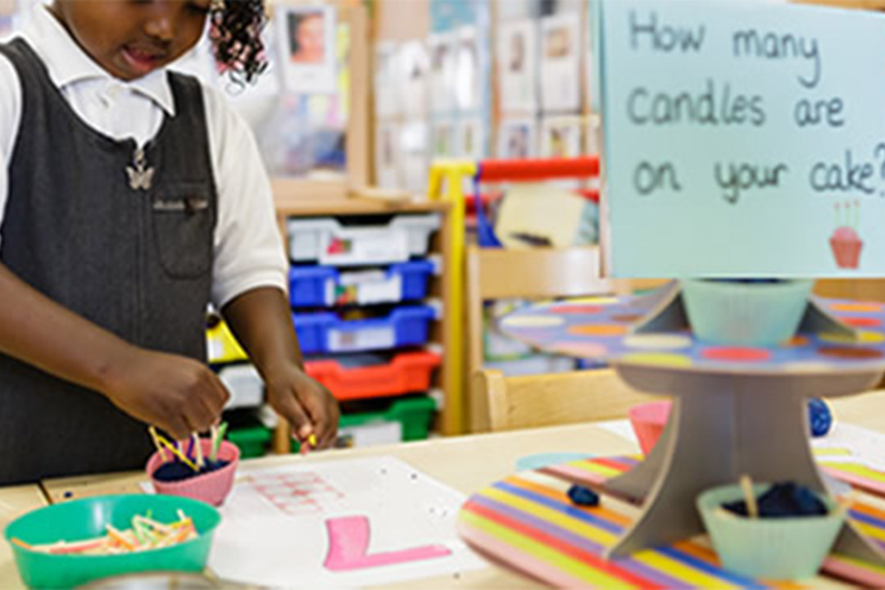
CARDINALITY AND COUNTING
Understanding that the cardinal value of a number refers to the quantity, or ‘howmanyness’ of things it represents
Counting is one way of establishing how many things are in a group, because the last number you say tells you how many there are.

Slide 7
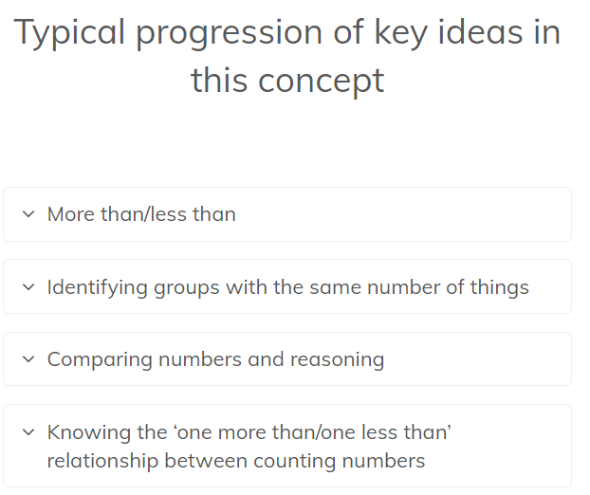
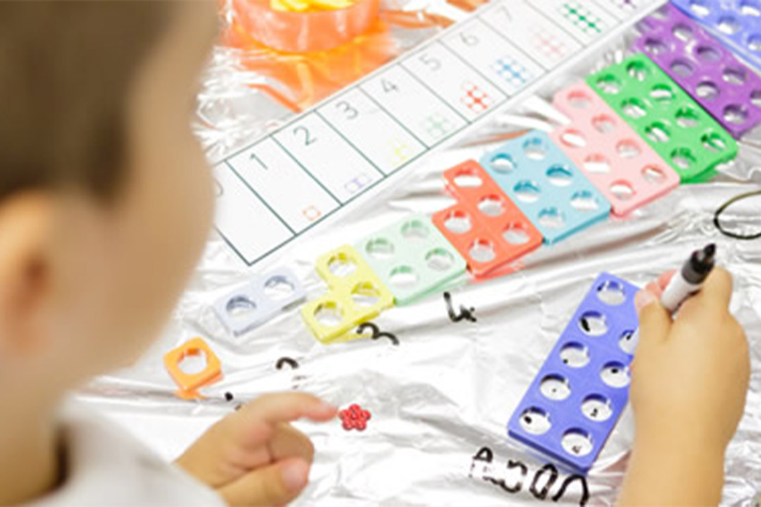
Comparison
Understanding that comparing numbers involves knowing which numbers are worth more or less than each other
Comparing numbers involves knowing which numbers are worth more or less than each other.
Notes:
This depends both on understanding cardinal values of numbers and also knowing that the later counting numbers are worth more (because the next number is always one more).
This understanding underpins the mental number line which children will develop later, which represents the relative value of numbers, i.e. how much bigger or smaller they are than each other.

Slide 8
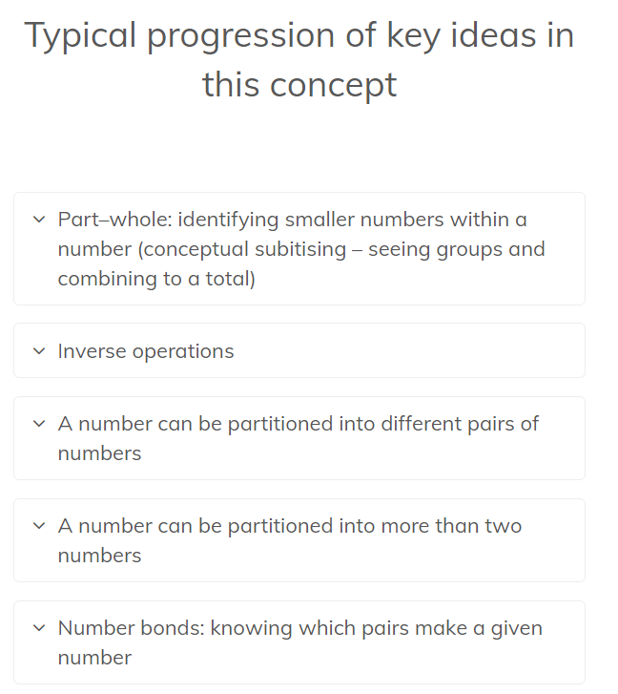
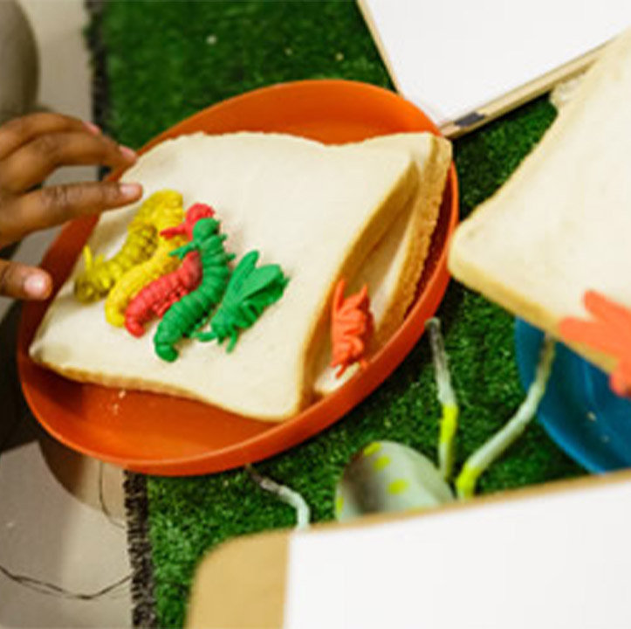
Composition
Understanding that one number can be made up from (composed from) two or more smaller numbers
Notes:
Knowing numbers are made up of two or more other smaller numbers involves ‘part–whole’ understanding. Learning to ‘see’ a whole number and its parts at the same time is a key development in children’s number understanding. Partitioning numbers into other numbers and putting them back together again underpins understanding of addition and subtraction as inverse operations.

Slide 9
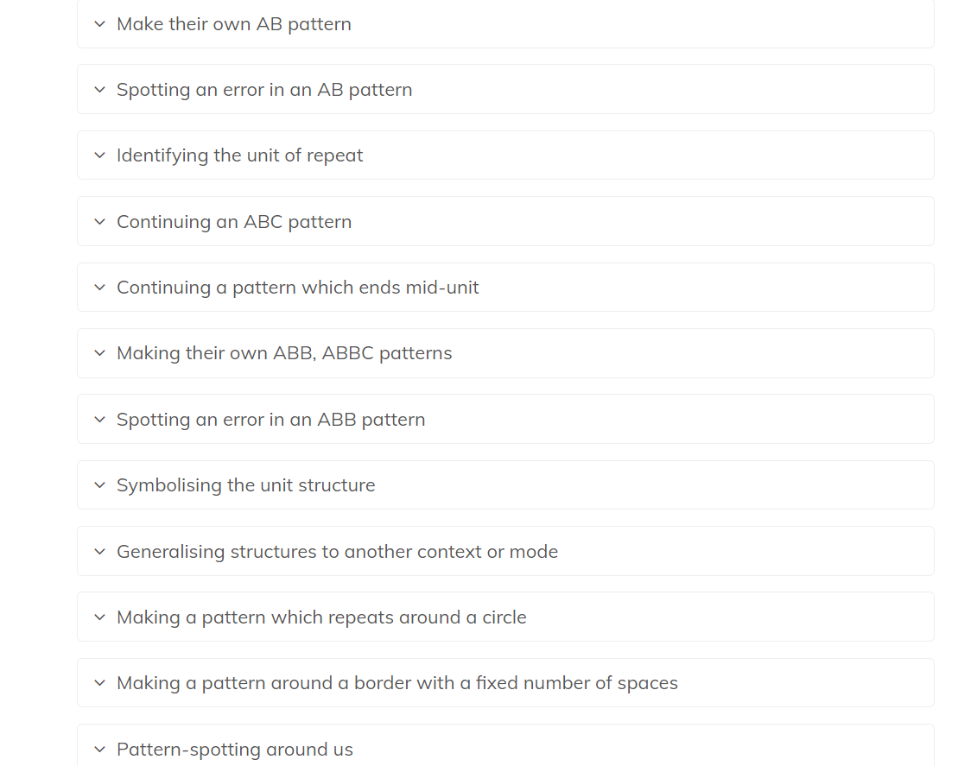
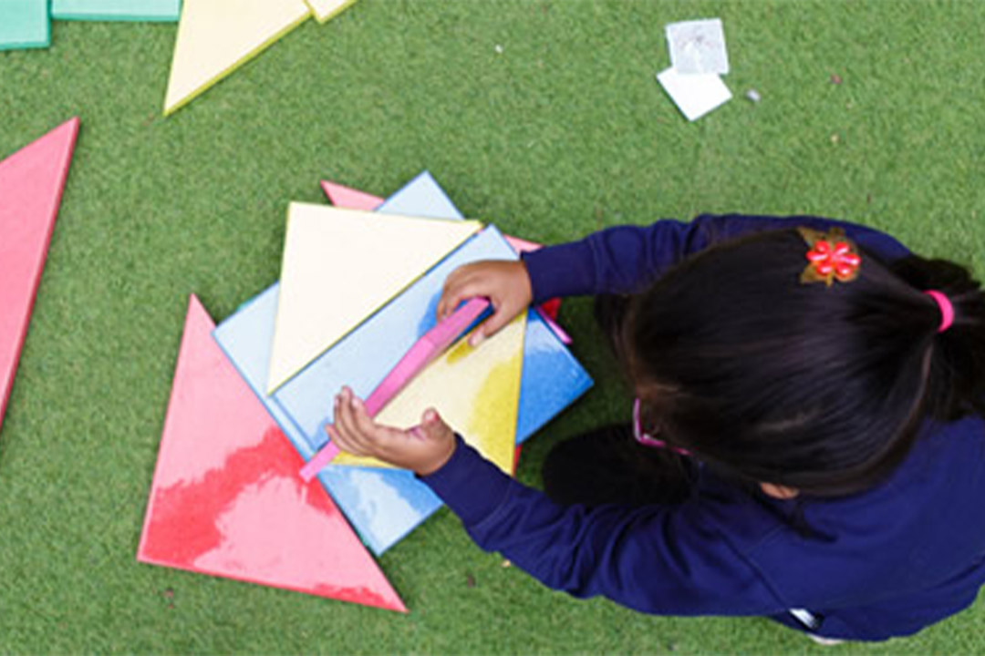
Pattern
Looking for and finding patterns helps children notice and understand mathematical relationships
Notes:
Seeking and exploring patterns is at the heart of mathematics (Schoenfeld, 1992). Developing an awareness of pattern helps young children to notice and understand mathematical relationships. Clements and Sarama (2007) identify that patterns may provide the foundations of algebraic thinking, since they provide the opportunity for young children to observe and verbalise generalisations.
The focus in this section is on repeating patterns, progressing from children copying simple alternating AB patterns to identifying different structures in the ‘unit of repeat’, such as ABB or ABBC. Patterns can be made with objects like coloured cubes, small toys, buttons and keys, and with outdoor materials like pine cones, leaves or large blocks, as well as with movements and sounds, linking with music, dance, phonics and rhymes. Children can also spot and create patterns in a range of other contexts, such as printed patterns, timetables, numbers and stories.

Slide 10
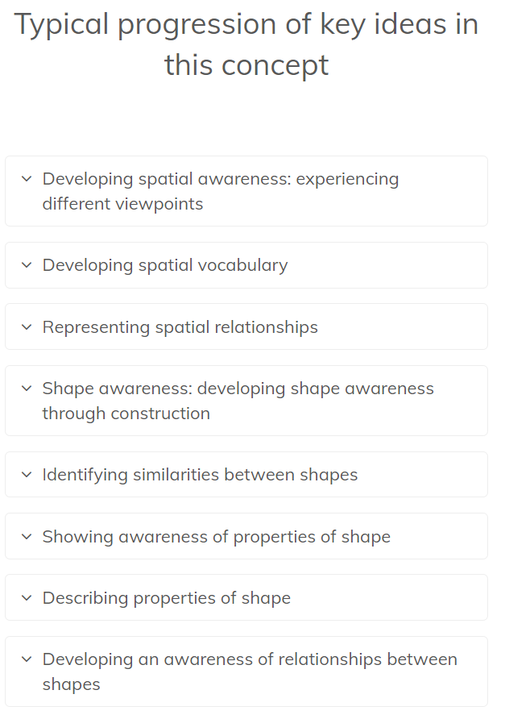
Shape and Space
Understanding what happens when shapes move, or combine with other shapes, helps develop wider mathematical thinking
Notes:
Mathematically, the areas of shape and space are about developing visualising skills and understanding relationships, such as the effects of movement and combining shapes together, rather than just knowing vocabulary. Spatial skills are important for understanding other areas of maths and children need structured experiences to ensure they develop these. Here, the focus is on actively exploring spatial relations and the properties of shapes, in order to develop mathematical thinking (rather than on shape classification, which requires prior knowledge of properties). This section is concerned with developing the two aspects of spatial awareness and shape awareness, with some progression identified within each.

Slide 11
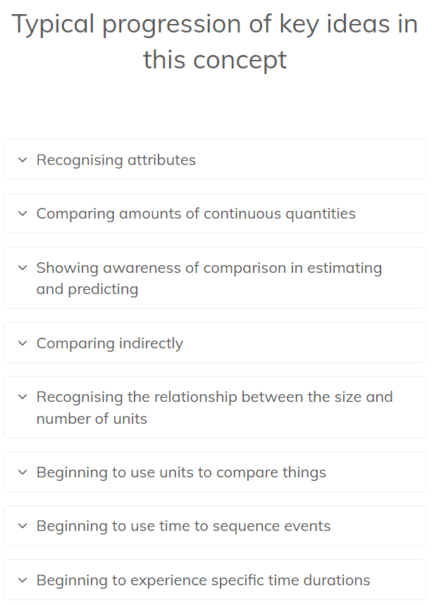
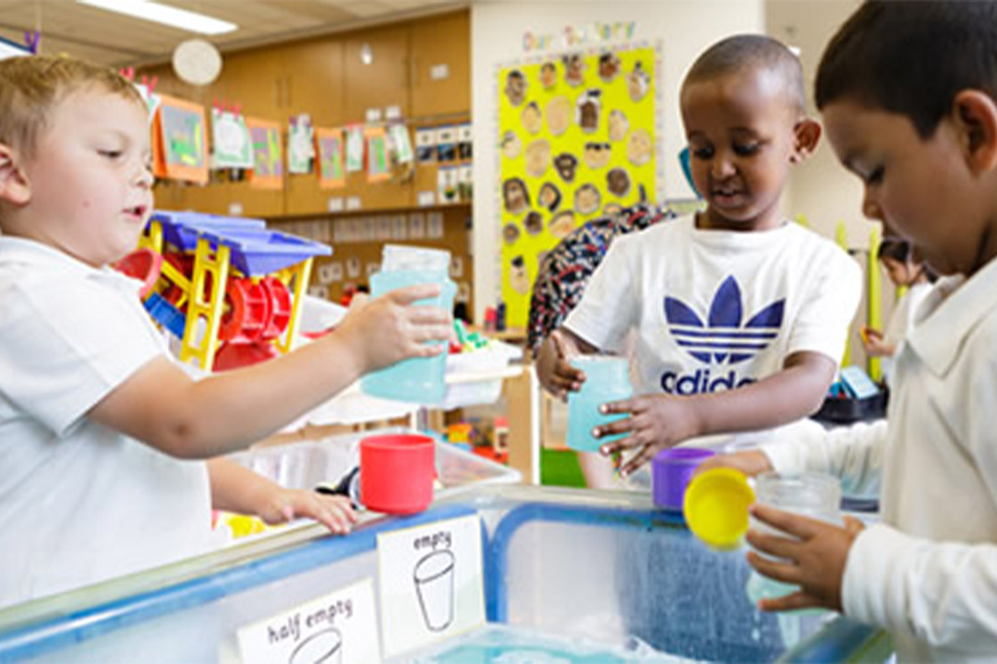
Measures
Comparing different aspects such as length, weight and volume, as a preliminary to using units to compare later
1o frames
Notes:
Mathematically, measuring is based on the idea of using numbers of units in order to compare attributes, such as length or capacity. Although young children engage with using rulers and experience being measured in centimetres, kilos – and years! – the measuring units themselves are hard to understand.
Children need to realise which attribute is being measured, e.g. weight as opposed to size, and the idea of conservation: that the amount stays the same, even if the appearance alters, e.g. if dough is stretched out or in bits. In order to understand units, they need to realise that two items can be compared using a third item, or ‘go between’, such as a stick.
Finally, children need to understand how equal size units are used repeatedly to express an amount as a number. While young children can engage actively in making comparisons and exploring equivalence of length, volume, capacity and weight in different ways, some of these ideas are challenging and will develop later in primary school.
For instance, weight (mass or density) is difficult to distinguish from size since it is invisible, and the concept of conservation is harder to understand for weight and capacity. Measuring with non-standard units of different sizes in order to appreciate the need for equal units is less effective with younger children, so centimetre cubes are recommended as accessible units. While time is also elusive to measure, young children can sequence events and, for example, count ‘sleeps’. (Money as a measure of value is too advanced to consider here.)

Slide 12
Ways to support your child at home
Practise suggested homework on the Newsletter.
Quick Fire subitising (a group of objects know without counting) 2 socks, 4 cups, 1 teddy.
Practise Number bonds to 5 then to 10. (1 and 4 makes 5. 4 and 1 makes 5)
Allowing children to have opportunities to be exposed to maths. Cooking, washing up (Playing with water), pairing socks.
Playing maths games, snakes and ladder, connect 4, ludo.
Exploring activities then asking “How do you know this?” “Tell me why” “Show me” Encouraging to talk about their reasoning and answers.

Slide 13
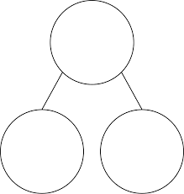
Resources used
5 frames
1o frames
Part Whole

Slide 14
Thank you

