Slide 1



WELCOME TO STREETHAY
TEAM DAISIES

Slide 2
Purpose of the session
  Who are the key people in school?
  What does learning look like in Daisies?
  What do I need to do before September?
  How can I prepare my child?
  What Wraparound Care is available?

Slide 3
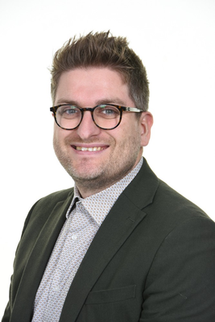
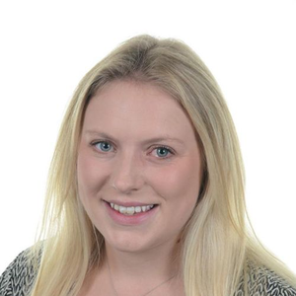
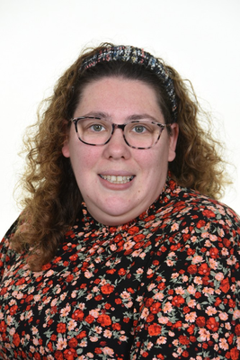
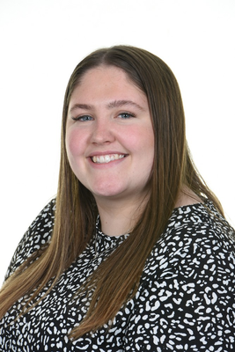
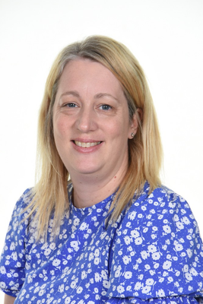
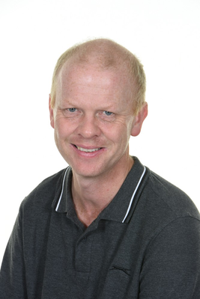
Meet the Team
Mr Taylor – Headteacher
Mrs Price – Reception Teacher and EYFS Leader
Mrs Jennings – Room Leader
Class Teaching Assistant - Miss Tabberer, Mrs McGill and Mr Coupland
Wraparound Staff - Mrs Jennings, Mrs McGill and Mr Coupland
Mrs Mole - Admissions Officer, Attendance Officer and Business Support and Pupil Services

Slide 4
Curriculum Themes
Autumn 1 | Autumn 2 | Spring 1 | Spring 2 | Summer 1 | Summer 2
Marvelous Me! | My local Area | Once Upon a Time | People Who Help us | In the Garden | Journeys

Slide 5
Curriculum Trips and Workshops
Autumn 1 | Autumn 2 | Spring 1 | Spring 2 | Summer 1 | Summer 2
Settling into Daisies | Parent workshops: Communication and language Festive Fun | Chicks | Parent workshop: Easter Bonnett parade and Easter Fun Little Town People who help us- dress up day | Parent workshop: In the garden Butterflies | Train time Sports day Teddy bears picnic Local walk to the park

Slide 6
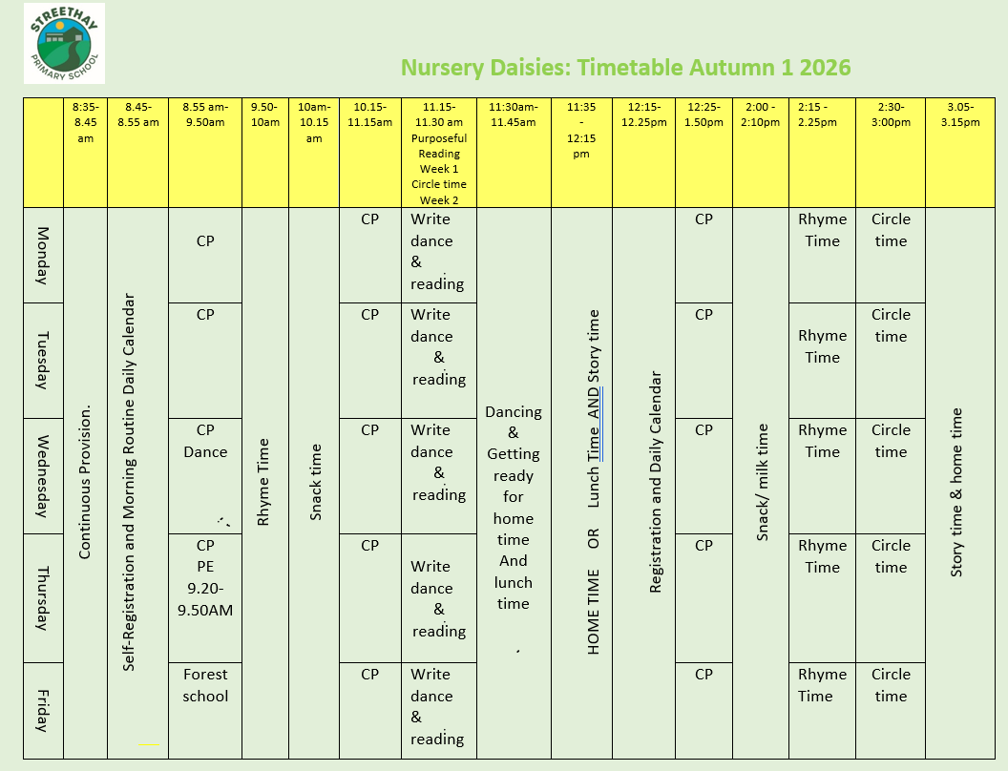
Timetable and Day to Day

Slide 7
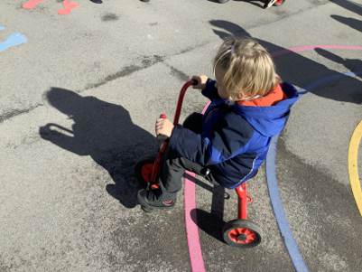
Areas of Learning and Characteristics of Effective Learning (CofEL)
Prime Areas | Prime Areas | Prime Areas
Personal, Social, Emotional Development | Communication and Language | Physical Development
Relationships. Manging emotions. Positive sense of self. Growing confidence. | Spoken Language. Back and forth interaction for language and cognitive development. | Gross and Fine Motor. Healthy Bodies. Oral Hygiene.
Specfic Areas | Specfic Areas | Specfic Areas | Specfic Areas
Literacy | Mathematics | Understanding the World | Expressive Arts and Design
Reading. Writing. | Mastery Maths. Numbers. Shape Space and Measure | World. Community. | Being Imaginative. Creativity.
CofEL | CofEL | CofEL
Playing and Exploring | Active Learning | Creating and thinking critically

Slide 8
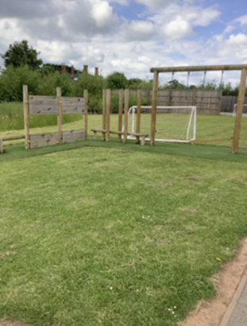
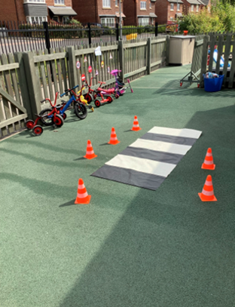
Outdoor Play
•Child initiated play – Discovered by their likes and interests.
•Enhanced and challenged through teacher modelling and interactions.
•Reduced / sprinted vocab signs to support imaginations and teachers to follow children play.
•Gross motor skill focused.
•Loose parts play is vital outside.

Slide 9

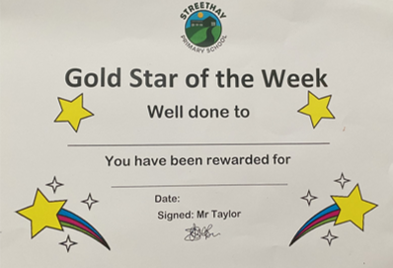
Expectations
In Daisies we follow the school expectations through following Ready, Respectful, Safe. These rules are used across the school and reinforced when we have conversations with the children about expectations.
We recognise that Personal, Social and Emotional development is a prime area of learning in the Early Years Foundation Stage and is fundamental to children’s development and having these boundaries and expectations helps to support your child’s development.
We follow the rest of the school and have a weekly Gold Star and also Half Term Superstars.

Slide 10



Essential Information
•Links to our Famly App have been sent our last week.
•Arbor is our payment system, for all chargeable provisions. Invoices are issued via Famly
Your Arbor account will be activated within the first week of the school term.
•Tax Free childcare/childcare vouchers can be used to pay for private provision.
•The office is open from 8am-4pm daily.
Please send your child in with Healthy snack daily.

Slide 11


Billing and Booking Lunches
An invoice will be generated on Famly for provision, but we use Arbor to bill for all payments.
Please book lunches via Arbor, lunches booked are an additional cost at £3.00 Please note that the system will allow you to book these for the entire half term, but at least 24 hours in advance.
There will be a £5 lunch childcare fee.
There will be an enrichment fee that will go on Arbor approx. £65. This will cover items such as butterflies, chicks, PE and Little Town, Train Time.

Slide 12

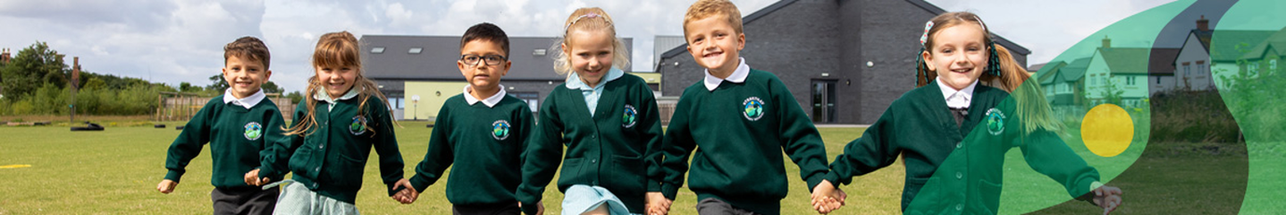
Uniform
At Streethay we have high expectations and believe that maintaining a smart uniform and appearance can contribute to the development of a respectful and purposeful learning atmosphere.
•Our uniform supplier is Uniform Plus.
•You can order via the internet or in a store. - https://www.uniformsplus.co.uk/category/school-uniforms/
•Local Supermarkets may also supply suitable and affordable items.
•Overview of uniform:
- Green jumper
- White polo shirt
- Grey trousers/skirt/pinafore dress
- Black smart shoes
- Additionally, children may choose to wear a green check summer dress in the warmer months

Slide 13
PE Kit
Your child will have P.E.
P.E. Kit overview:
•No branded sportswear.
•White t-shirt
•Black shorts, joggers or leggings
•Green Hoodie
•Trainers suitable for sports
•Coat
Please ensure all your child’s uniform is clearly labelled.

Slide 14
Reporting Absence
If a child is absent from school, we ask parents to:
•Contact the school office by 9:30am on the first morning of absence.
•Reply promptly to any requests or inquiry concerning an absence.
Holidays and absences…
If your child has a medical appointment or you need to request exceptional leave, or have booked a family holiday please complete a ‘Leave Request Form’ which can be found in the office area.
•At Streethay Primary School we aim to achieve 97% Attendance.
•Streethay work closely with the Staffordshire Education Welfare/Attendance Officers.

Slide 15
Wraparound Care
Wraparound Care Pricing - Before and After School
•Breakfast Club 7:30am to 8:35am - £6 (Breakfast included)
•Afterschool Club 3:15pm to 6pm - £12 (Light meal included)
•A month notice for changes –reduce sessions.
Payments
•Fees are invoiced on our Famly app and payment is made via Arbor. Payments are made in advanced of your booking and due 28th of each month.
•Late payments incur a fee of £15
•We use Arbor to track our payments, but you can use Tax Free Childcare accounts or Childcare Vouchers to pay some or all the balance.

Slide 16

Famly App- Learning Journey
•Observations
•Instant messaging between – 8am and 4pm.
•Interactive news feed with updates from the classroom.
•Consent for your children will be required.
•Care updates will be done daily for your child.
Parent partnership- Famly is used for sharing home experiences and home learning ideas from newsletter.

Slide 17
Transition Plan and Activities
•Meet The Teacher Stay and Play – Tuesday 7th July 9am-10am
•Daisies – Thursday 3rd and Friday 4th September AM and PM sessions. Please see letter.
•September Start Date – Monday 7th September
•Challenge – Please post on Famly your child ‘Get Caught Reading or Singing’
•Feel free to post lots of fun activities that you get up to on Famly. We can’t wait to interact.
•Welcome to the Streethay Family

Slide 18
ANY
QUESTIONS?

Slide 19
THANK
YOU

