Slide 1


Welcome to Streethay
Team Daffodils

Slide 2




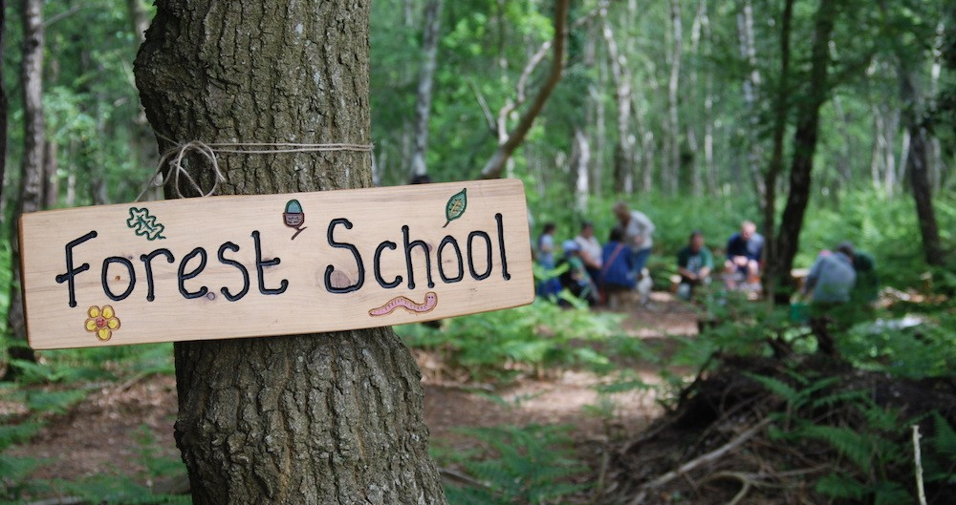
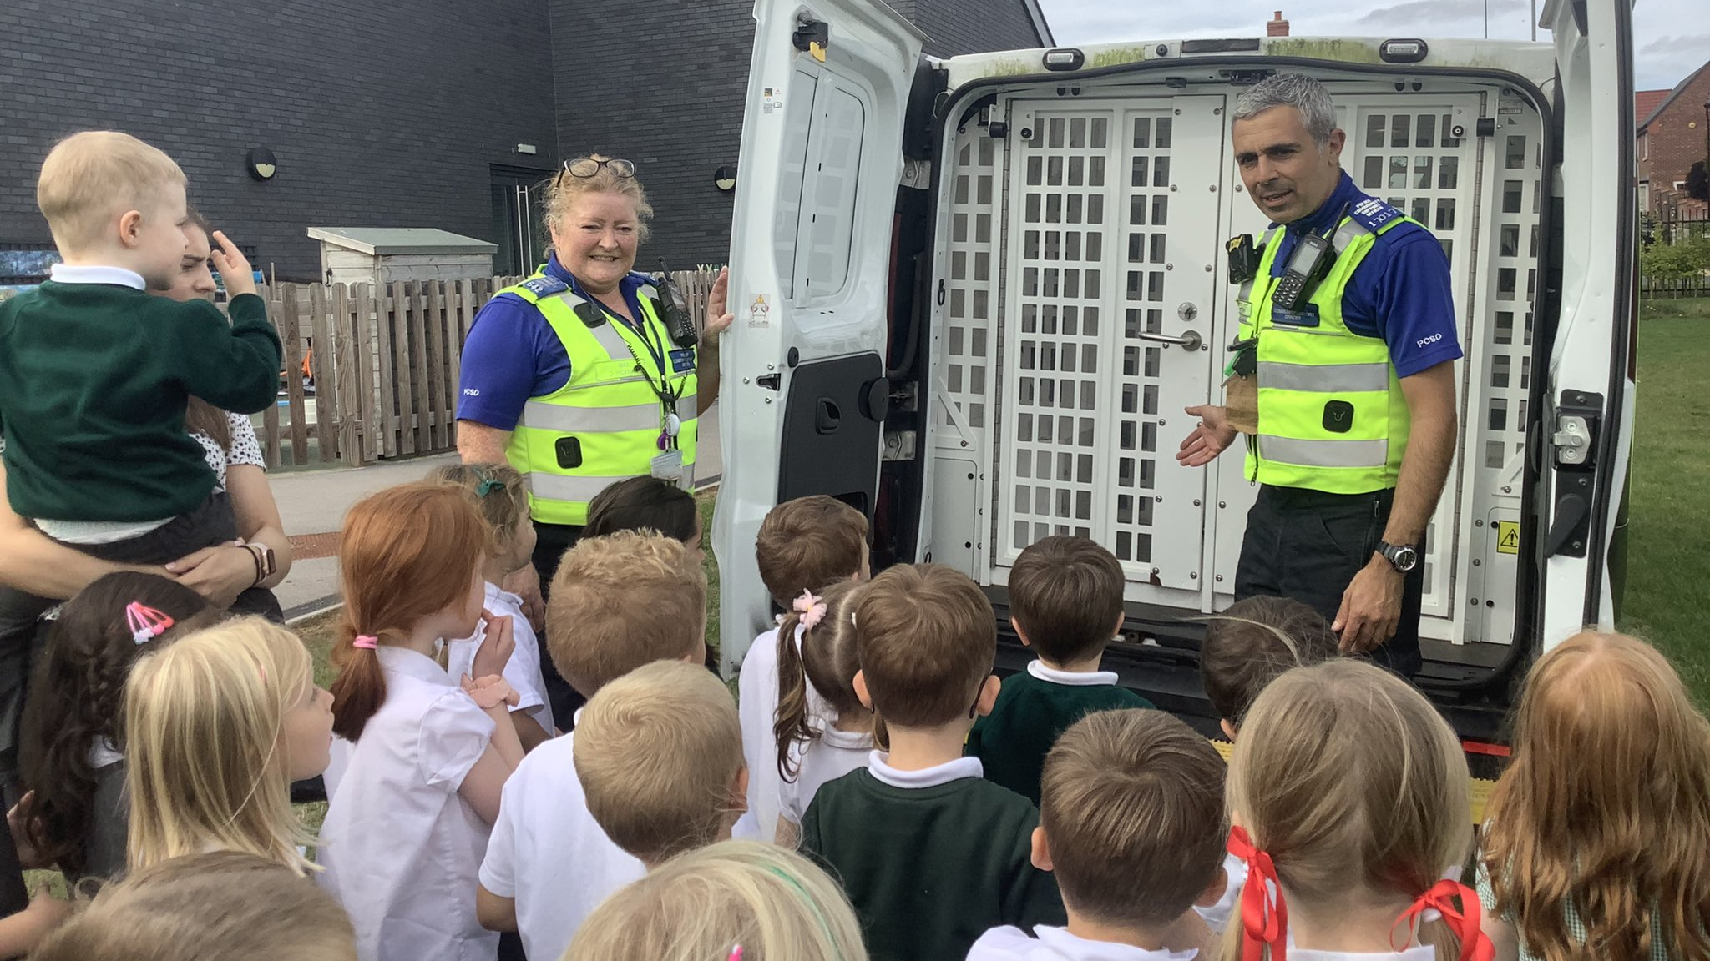


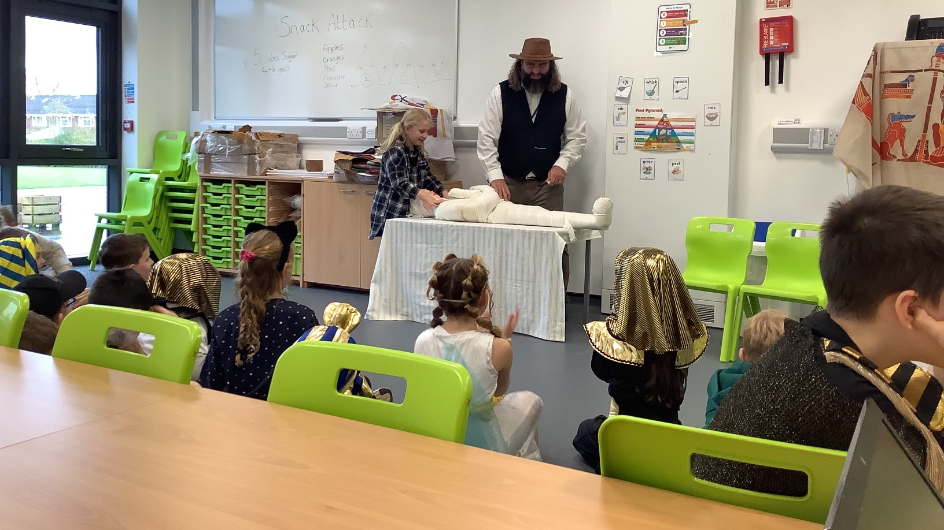


Nurture. | Inspire. | Prepare.

Slide 3
Meet the Team
Mr Taylor – Headteacher
Mrs Glaze – Class Teacher
Mrs Smith – Nursery Room Leader
Mrs Gilmore, Mrs Dale & Mrs Turton - Class Teaching Assistant
Mrs Price – Early Years Lead and Sunflowers Teacher
Mrs Mole - Admissions, Attendance, Business, and Pupil Services

Slide 4
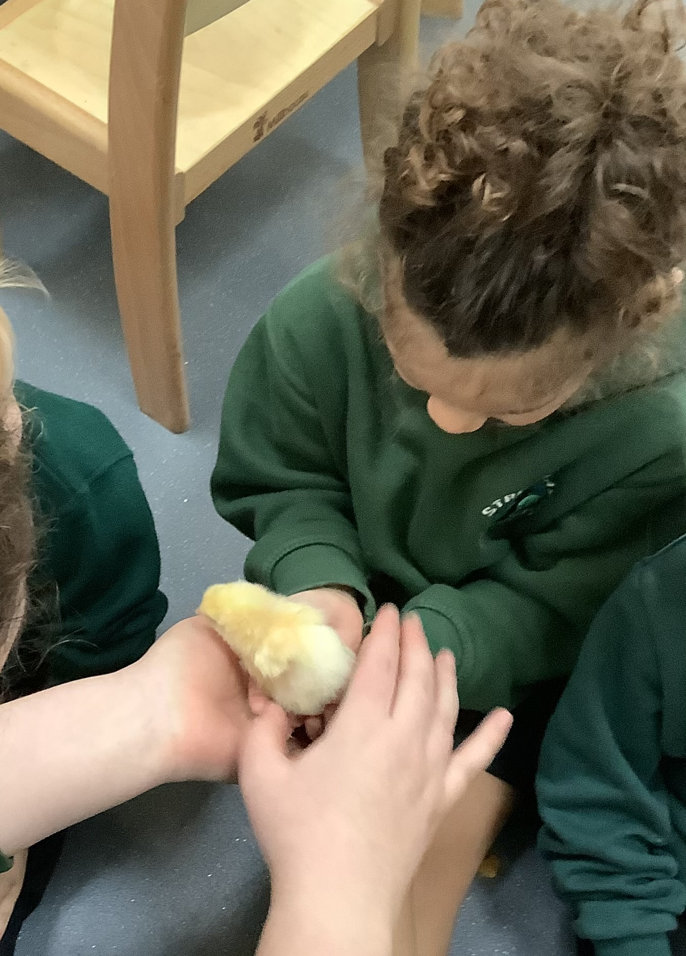
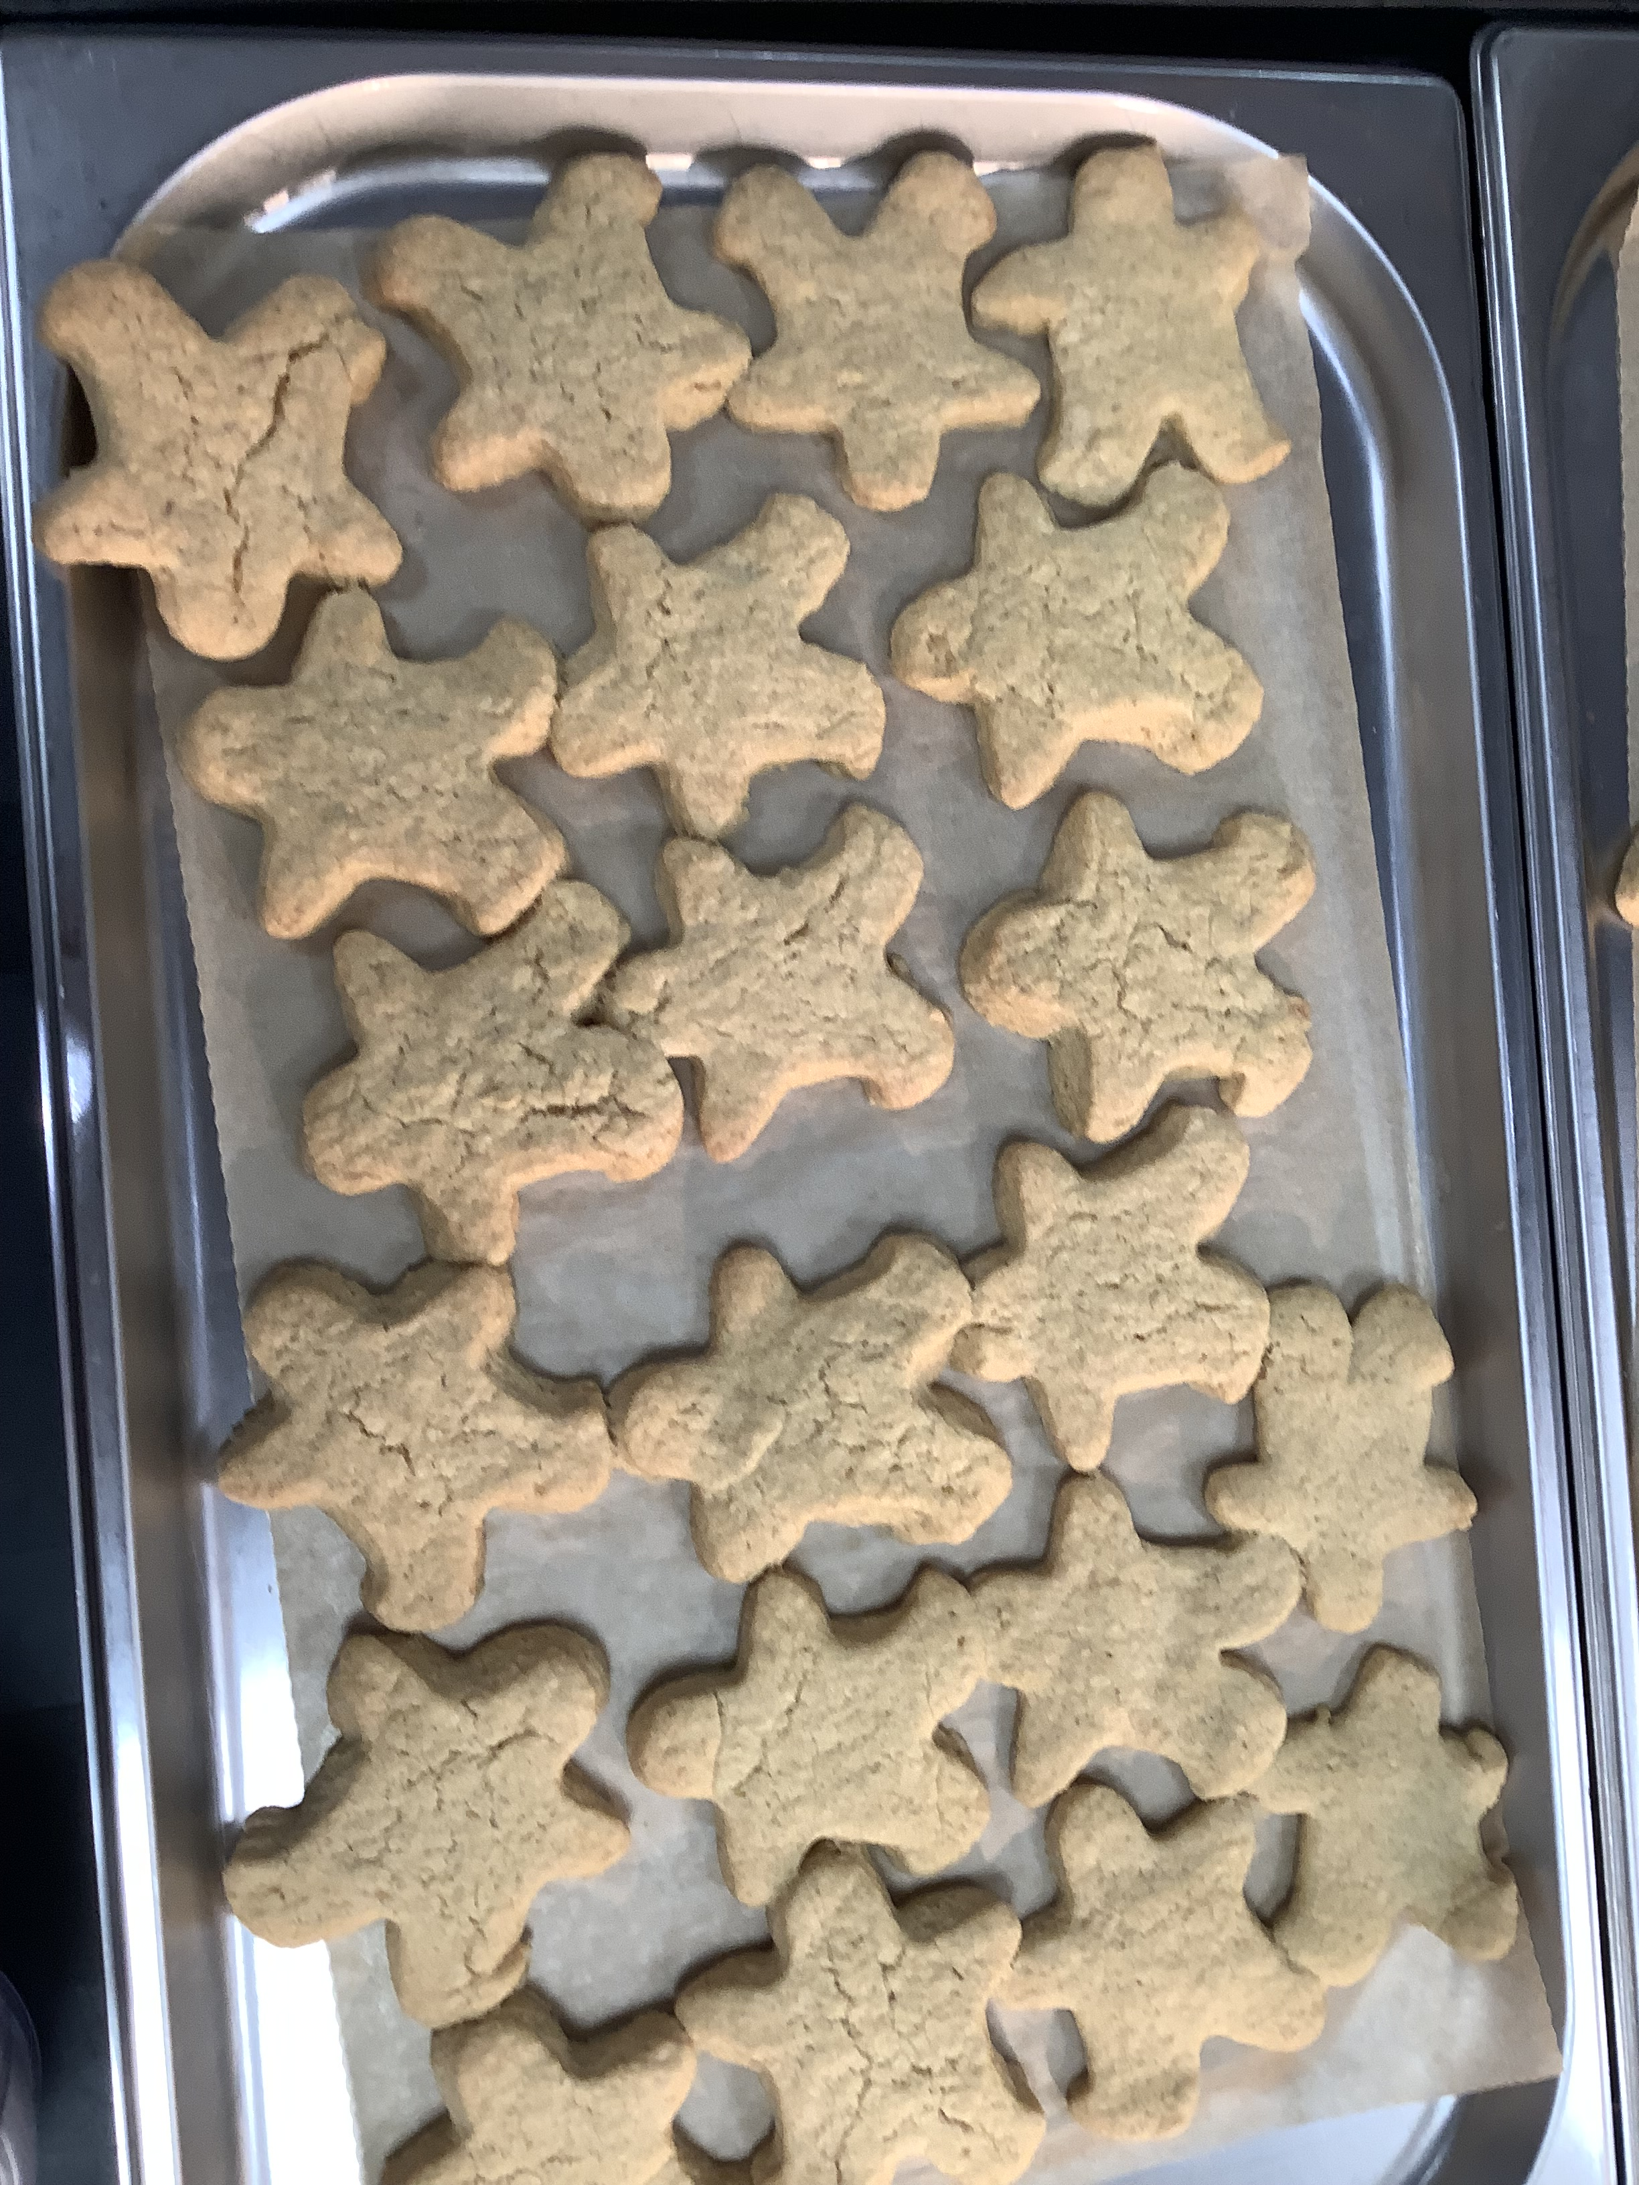
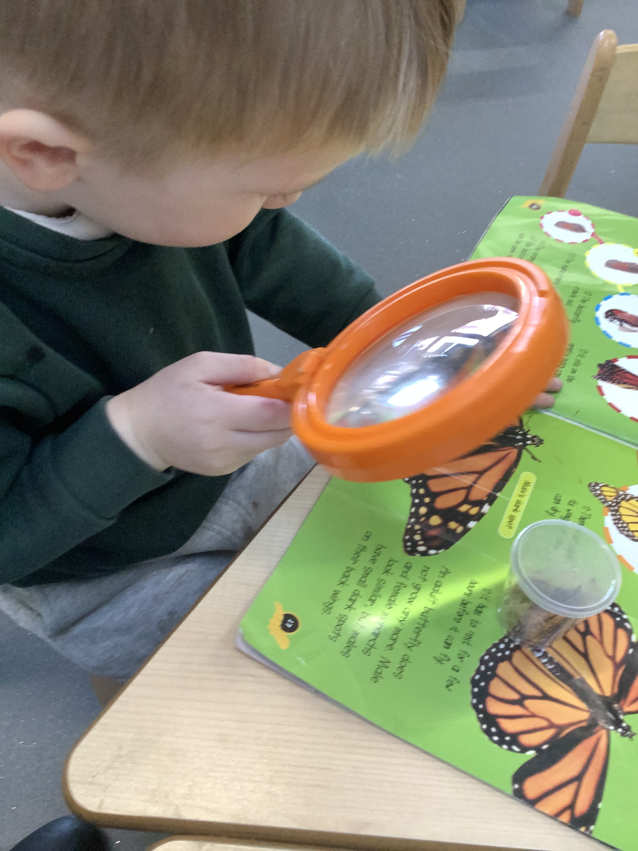
Curriculum Themes
Autumn 1 | Autumn 2 | Spring 1 | Spring 2 | Summer 1 | Summer 2
Marvelous Me! | My local Area | Once Upon a Time | People Who Help us | In the Garden | Around the world

Slide 5
Curriculum Trips and Workshops
Autumn 1 Marvellous me | Autumn 2 My local area | Spring 1 Once upon a time | Spring 2 People who help us | Summer 1 In the garden | Summer 2 Around the world
Settling in Transition Prime Areas Workshop Marvellous Me Boxes – Over the half term | Local walk to Streethay Park Festive Fun Parent Workshop | Foundation of Phonics Workshop Chicks hatching | World book day People Who Help Us Dress Up Day Little Kids Town Easter Bonnets & Crafts | Create your own garden space Butterflies | Ready for Reception Workshop Sports Day Daffodils’ Graduation EYFS Teddy Bear’s Picnic

Slide 6
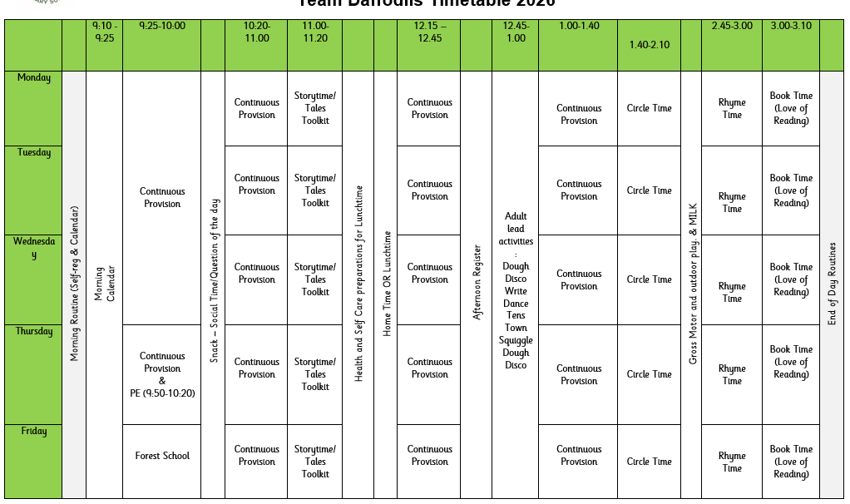
Timetable and Day to Day

Slide 7
Areas of Learning and Characteristics of Effective Learning (CofEL)
Prime Areas
Personal, Social, Emotional Development | Communication and Language | Physical Development
Relationships. Manging emotions. Positive sense of self. Growing confidence. | Spoken Language. Back and forth interaction for language and cognitive development. | Gross and Fine Motor. Healthy Bodies. Oral Hygiene.
Specific Areas
Literacy | Mathematics | Understanding the World | Expressive Arts and Design
Reading. Writing. | Mastery Maths. Numbers. Shape Space and Measure | World. Community. | Being Imaginative. Creativity.
CofEL
Playing and Exploring | Active Learning | Creating and Thinking Critically

Slide 8

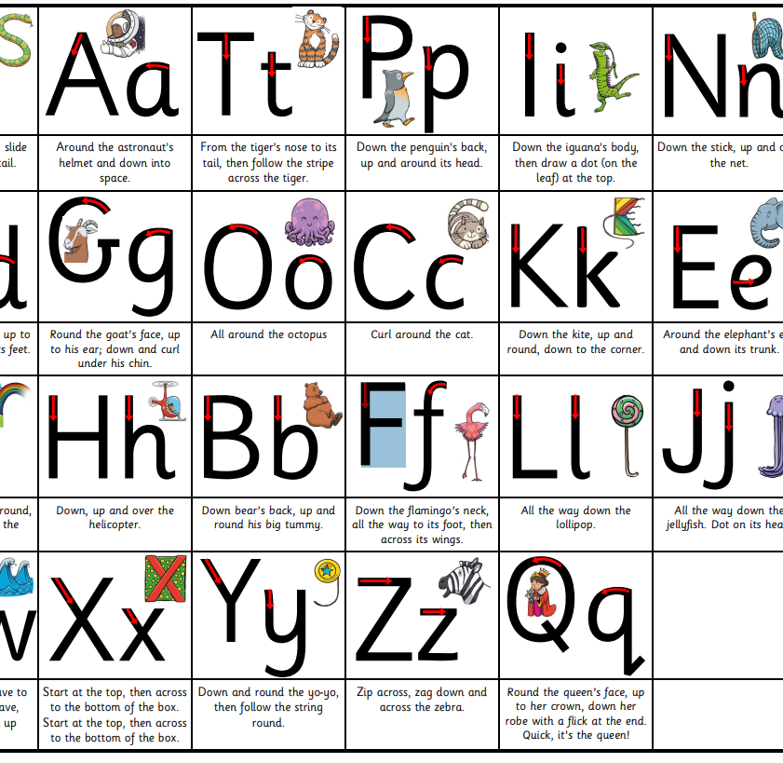
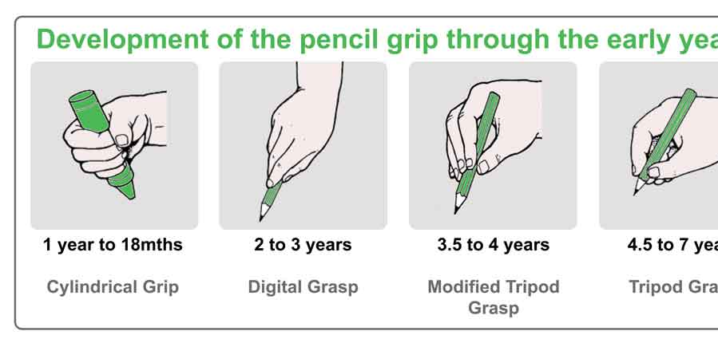
Little Wandle
We use Little Wandle Letters and Sounds Revised.
We follow the Foundation for Phonics in Daffodils. The activities we do are game based, such as Voice sounds. (Tick tock, tick tock. For a clock)
Phonics is making connections between the sounds of our spoken words and the letters that are used to write them down.
We teach children to write in print and work hard during the year to ensure your child forms letters correctly, holding their pencil with the tripod grasp.
We focus on letter formation within our Name Writing.

Slide 9
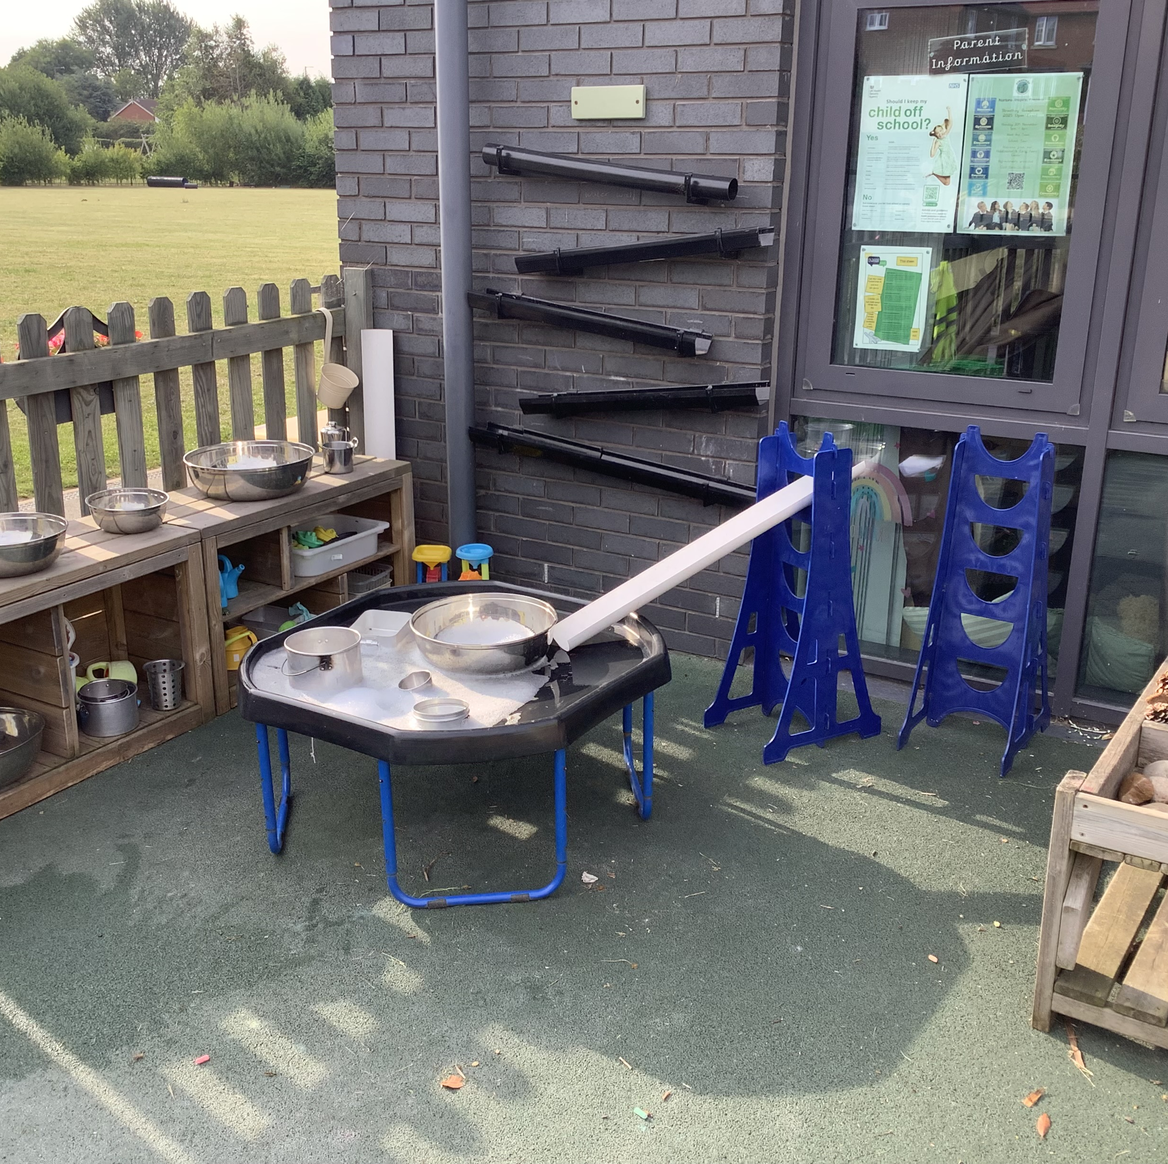
Outdoor Play
Child initiated play – Discovered by their likes and interests.
Enhanced and challenged through teacher modelling and interactions.
Reduced / sprinted vocab signs to support imaginations and teachers to follow children play.
Gross motor skill focused.
Loose parts play is vital outside.

Slide 10

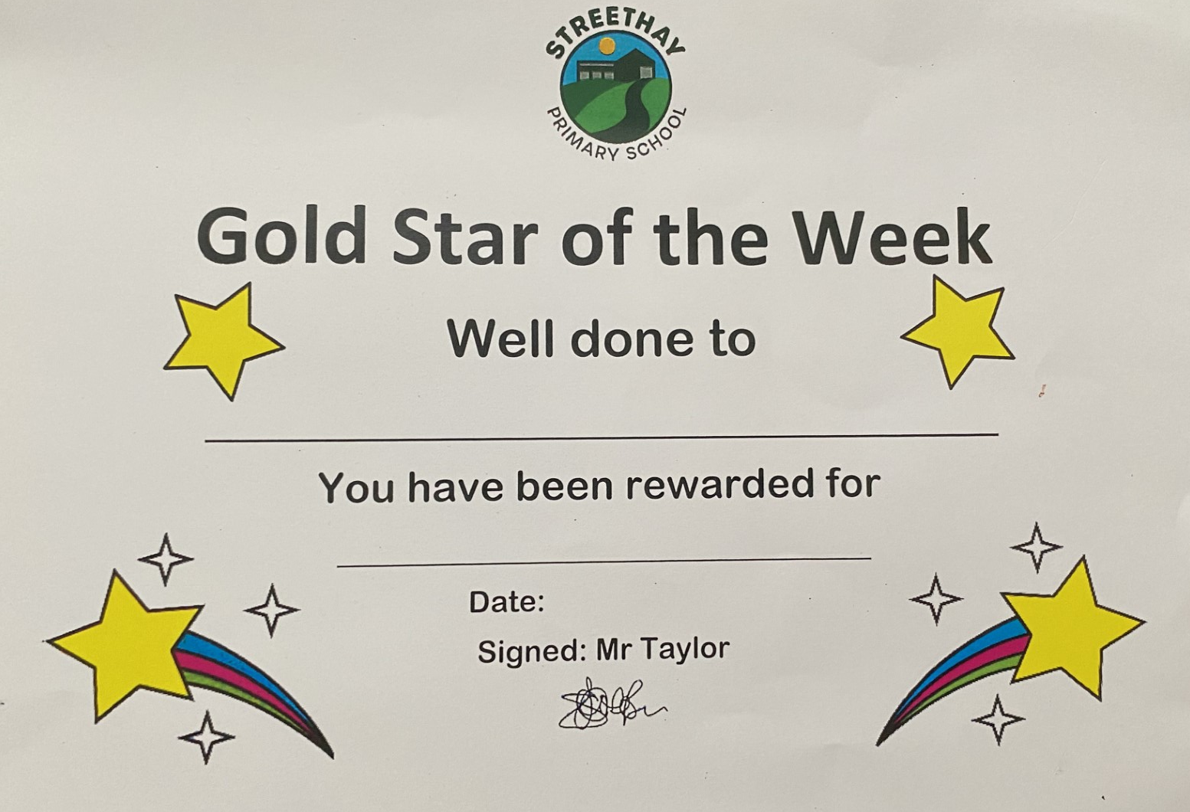

Behaviour and Regulation
Early Years have a bespoke behaviour strategy appropriate for the children’s age expectations.
We recognise that Personal, Social and Emotional development is a prime area of learning in the Early Years Foundation Stage and is fundamental to children’s development.
Following the whole school policy and adhering to the expectations of being: Ready, Respectful and Safe.’

Slide 11

Essential information
Famly links have been sent our last week. All invoices will be sent via Famly.
Arbor is our payment system, for all chargeable provisions. Your account will be activated within the first week of the school term.
Tax Free childcare/childcare vouchers can be used to pay for private provision.
The office is open from 8am-4pm daily.

Slide 12
Uniform
At Streethay we have high expectations and believe that maintaining a smart uniform and appearance can contribute to the development of a respectful and purposeful learning atmosphere.
Our uniform supplier is Uniform Plus.
You can order via the internet or in a store. - https://www.uniformsplus.co.uk/category/school-uniforms/
Local Supermarkets may also supply suitable and affordable items.
Overview of uniform:
- Green jumper
- White polo shirt
- Grey trousers/skirt/pinafore dress
- Black smart shoes
- Additionally, children may choose to wear a green check summer dress in the warmer months

Slide 13
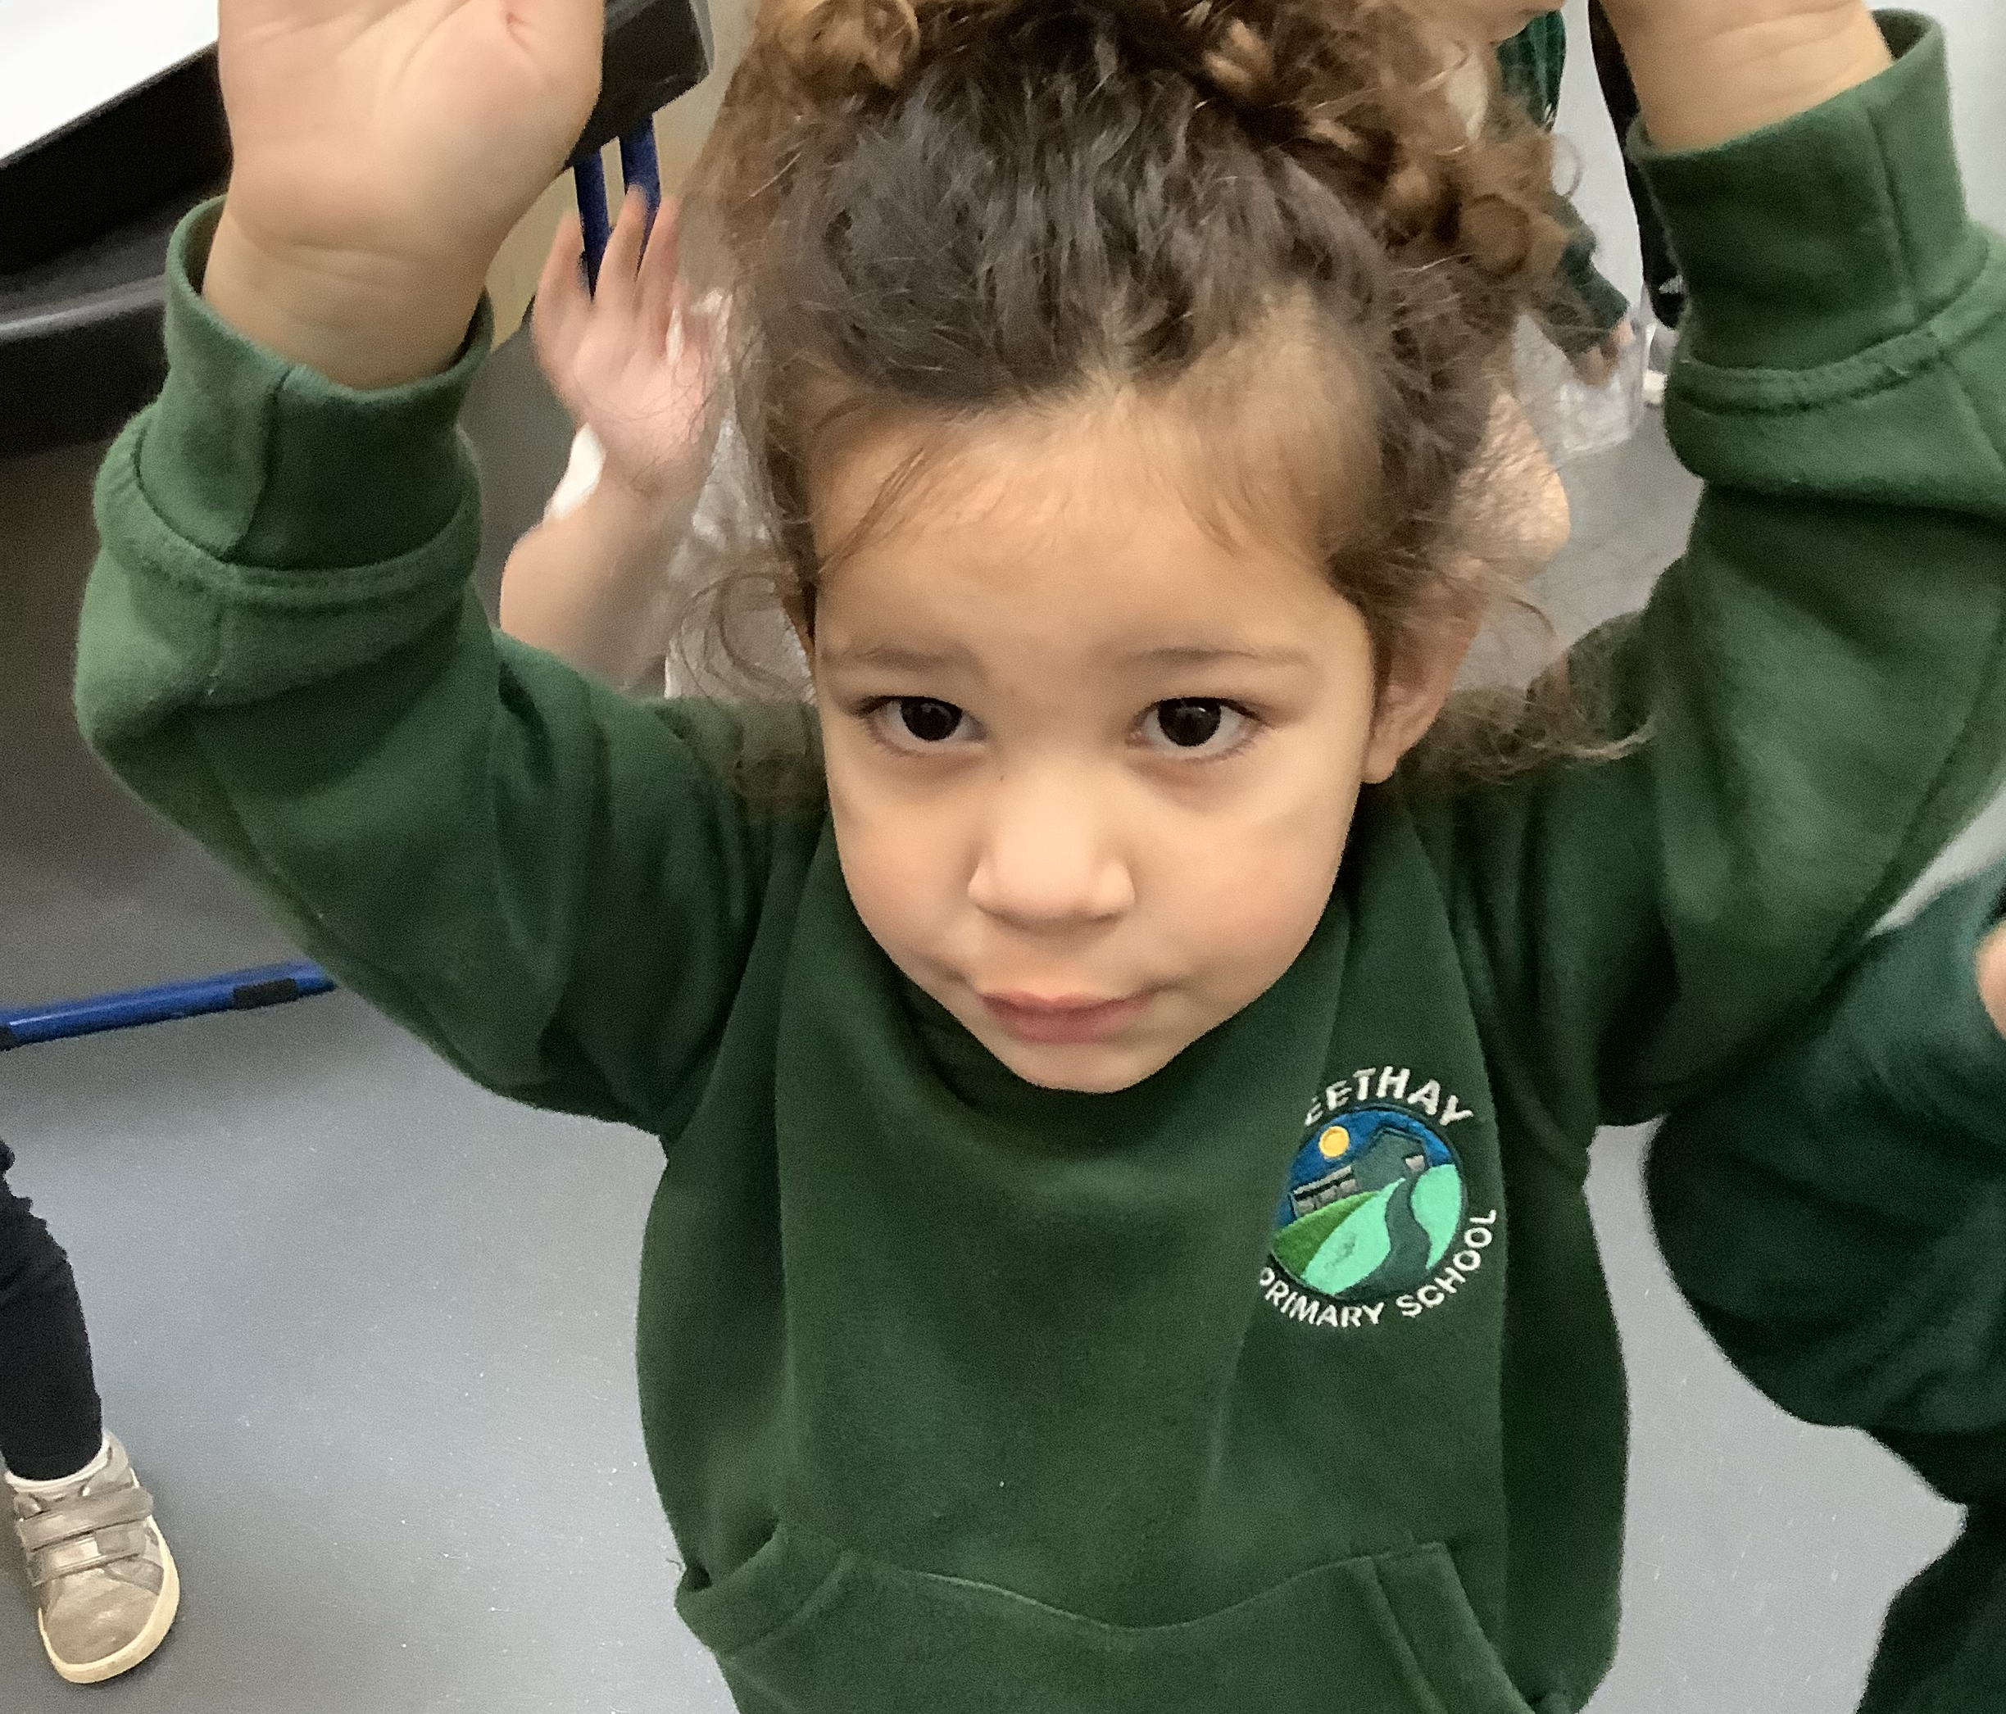
PE Kit
Your child will have P.E.
P.E. Kit overview:
No branded sportswear.
White t-shirt
Black shorts, joggers or leggings
Green Hoodie
Trainers suitable for sports
Coat
Please ensure all your child’s uniform is clearly labelled.

Slide 14
Reporting an absence
If a child is absent from school, we ask parents to:
Contact the school office by 9:30am on the first morning of absence.
Reply promptly to any requests or inquiry concerning an absence.
Holidays and absences…
If your child has a medical appointment, you need to request exceptional leave, or you’vw booked a family holiday, please complete a ‘Leave Request Form’ found in the office area.
At Streethay Primary School we aim to achieve 97% Attendance.
Streethay work closely with Staffordshire Education Welfare and Attendance Officer

Slide 15
Transition Plan and Activities
Meet The Teacher – Tuesday 7th July 9am-10.30am
September Start Date – Thursday 4th September
Challenge – Please post on Famly your child ‘Get Caught Reading or Singing’
Feel free to post lots of fun activities that you get up to on Famly. We can’t wait to interact.
Welcome to the Streethay Family

