Slide 1
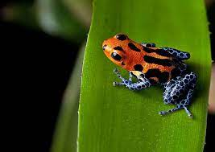
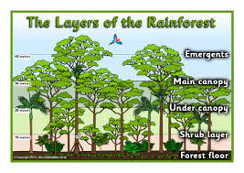
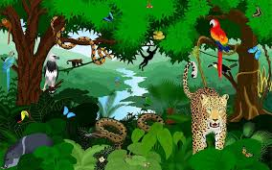
Learning overview for parents/carers
Autumn 1 21/22: Personal development focus: SMSC
SIS focus: Resilience
Springboard Class
English
Rainforests
Cross-curricular topic with Geography.
Research and record animal facts
Write non-chronological report
Describe animals in the rainforest
Compare rainforests with forests in England
Discuss characters feelings and expression
Letter writing
Brochures and leaflets
PE
Invasion games – Football/Rugby
Pupils will focus on;
Developing team attacking and defending strategies and techniques.
Select and apply their skills so that they can carry out tactics with the intention of outwitting their opponents.
Invade opponents’ territory and to outwit them.
Topic
Geography
Locating rainforests and exploring their relationships with the equator.
The layers of the rainforest.
Look at the effects humans are having on rainforests.
Follow us on Twitter @suttonhouseacademy
Maths
Place value
Addition and subtraction
Measure
Multiplication and division
Shape
fractions
* These topics cover bands 1-4, pupils may not cover all topics this half term.
RHSE – Relationships, Health and Sex education.
Year 2 – Digital well-being
Year 3 – E-safety
Year 4 – Resilience and E-safety
Year 5 – E-safety
Year 6 – safe relationships online and offline
Science
Living things and their habitats
Pupils will;
What it means to be living, dead or never alive.
Microhabitats.
Local habitats.
World habitats.
Animals and their habitats.
Food chains.
Arts Award
Pupils will gain knowledge of an artist and their work.
Events this term:
Thursday 2nd September 2021 Pupils return to school
Friday 15th October 2021 Last Day of Autumn 1
Harvest festival 3rd October 2021
Numeracy focus: Estimation
Literacy focus: Punctuation
Food Technology
Weekly lessons - Wednesdays

