Slide 1





Year 1 Autumn Newsletter
Class Teacher – Mrs Marshall
Learning Assistant – Mrs Hall
Year 1 have had a wonderful couple of days getting used to our new classroom and routine. They are demonstrating our school values of being ready, respectful and safe, but just as importantly they have been kind. They are also very good at reminding me my new name when I use the wrong one ☺
Autumn term theme
This Autumn term, our topic is: If you go down into the woods today. We will look at toys from the past to now (especially teddy bears), we will make fruit kebabs and investigate frogs using the story book Oi Frog. In maths we will be looking at place value, addition and subtraction within 10.
Outdoor learning & P.E
Outdoor learning– Every Wednesday afternoon
Children to come to school in their own clothes and bring their outdoor kits with them.
Please make sure the clothes and the bags are named
P.E – Thursday afternoon – children to come to school in their P.E Kits.
For more information on uniform, please see the Tanworth uniform policy
Spellings will start after October half term and will match the sounds the children are learning in their phonic sessions. More information to follow when the first set of spellings are sent home.
If you need to contact me or have any questions please pop in at the beginning or end of the day.
Alternatively, email me on Baird.f@welearn365.com
~Thank you, Mrs Marshall

Slide 2

Dates for your Diary
Tuesday 1st September Teacher Training Day
Wednesday 2nd September Teacher Training Day
Thursday 3rd September School & Nursery open
Tuesday 20th October Parents Meetings
Thursday 22nd October Parents Meetings
Thursday 22nd October Children break up for half-term
Friday 23rd October School & Nursery closed Teacher Training
Monday 2nd November School & Nursery open
Wednesday 9th December KS1 Christmas play morning performance
Thursday 10th December KS1 Christmas play afternoon performance
Friday 18th December School & Nursery close for Christmas
Monday 4th January Teacher Training Day
Tuesday 5th January School & Nursery open
Packed lunches
Some children at Tanworth opt to bring a packed lunch instead of having a school-provided meal. Whilst we would always encourage pupils to have a healthy school meal, we do understand that some prefer to bring a packed lunch from home.
Parents are encouraged to provide a healthy, well-balanced packed lunch that would include fruit, vegetables, protein, a starchy item (such as bread, wraps, rice cakes) and a dairy item. Water is available for children to drink at lunchtime.
We do not allow sweets, chocolate bars, fizzy drinks, items contacting nuts or energy drinks as part of a packed lunch.
Whilst we do not check lunch boxes, if we see any of the items above, we would ask children to not eat/drink them until they get home. If we do see nut products, these would be kept by the class teacher until the end of the day.
Please remember we are a NUT FREE school. ☺

Slide 3
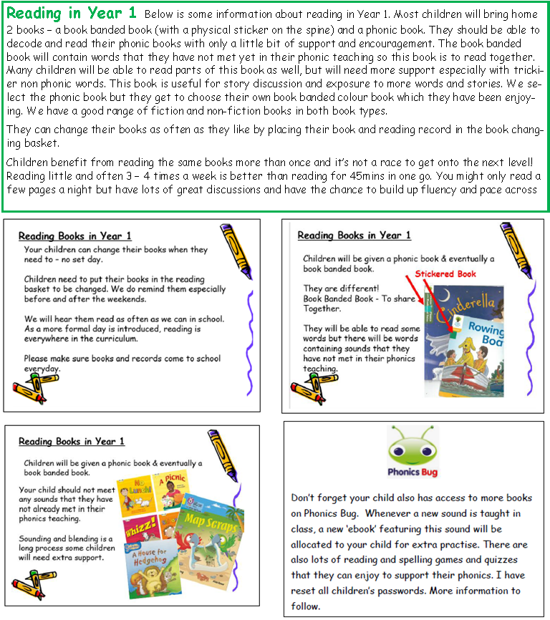
Please remember to check the class page on the school website for information and for digital copies of the newsletter. Lets go Year 1 :)
Thank you in advance for all your help.
~Mrs Marshall & Mrs Hall

