Slide 1
Accelerated Reading
Information for Parents

Slide 2
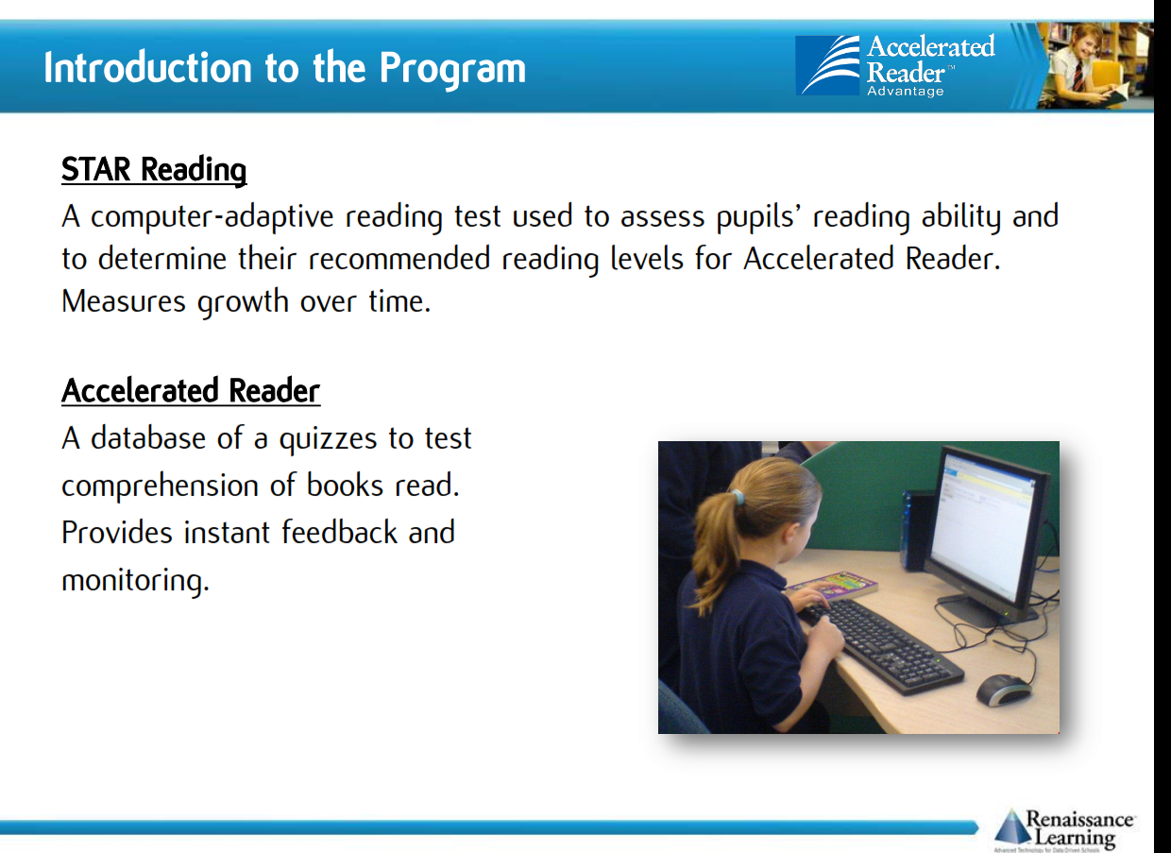

Notes:
What is Accelerated Reader (AR)? AR is a computer program that helps teachers manage and monitor children’s independent reading practice. Your child picks a book at his/her own level and reads it at his/her own pace. When finished, your child takes a short quiz on the computer - passing the quiz is an indication that your child has understood what has been read. AR gives both children and teachers feedback based on the quiz results which the teacher then uses to help the child set targets and ongoing reading practice.
Children using AR have a free choice of the books they read, rather than having one assigned to them. This makes reading a much more enjoyable experience as they feel in control and can choose books that are interesting to them.
Staff will help your child choose books that are at an appropriate reading level. These will be challenging without being frustrating and will also be at a level at which your child can pass the quiz and experience success.

Slide 3
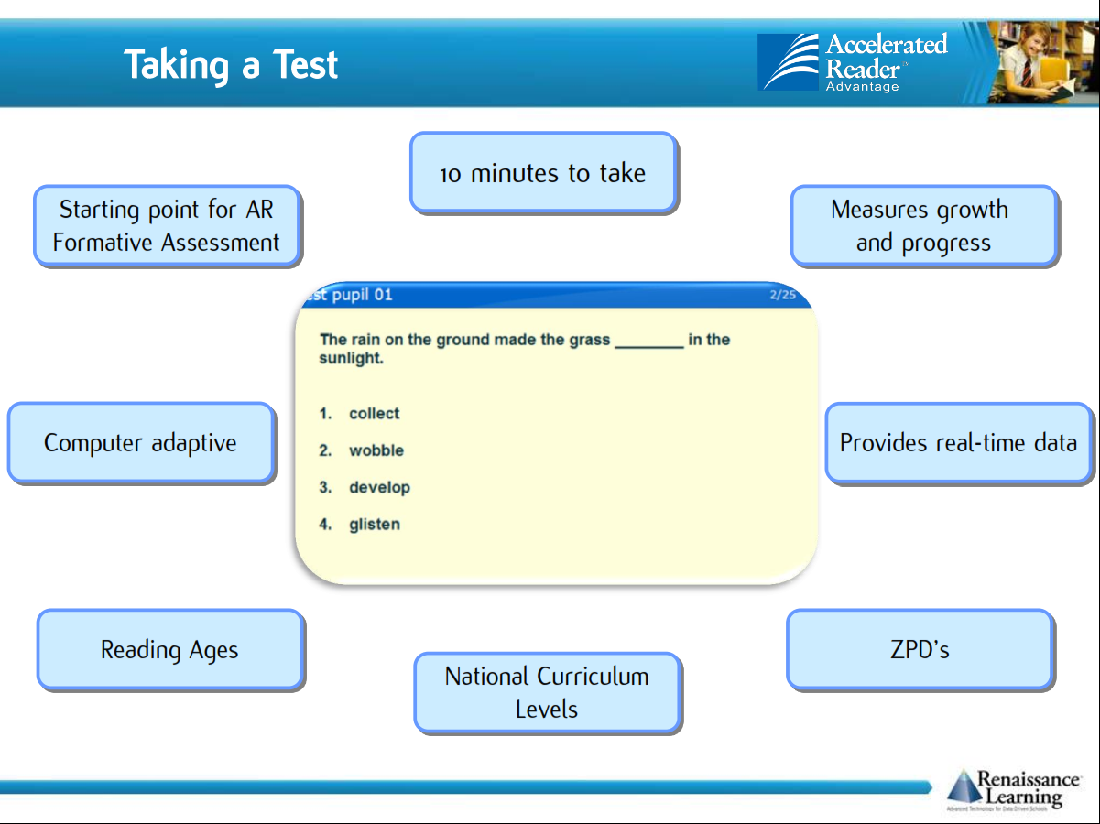
Notes:
In most cases, children really enjoy taking the quizzes. Since they are reading books at their own reading and interest levels, they are likely to be successful. This is satisfying for most children. Best of all they learn and grow at their own pace.
What is a STAR Reading test?
STAR Reading is a computer based reading assessment program that uses computer-adaptive technology. Questions continually adjust to your child’s responses. If the child’s response is correct, the difficulty level is increased. If the child cannot answer a question or answers incorrectly, the difficulty level is reduced. The test uses multiple-choice questions and takes approximately 10 minutes.
If your child does not do well on the quiz, the teacher may assist him/her by:
• Helping choose another book that is more appropriate
• Asking more probing questions as your child reads and before he/she takes a quiz
• Pairing your child with another pupil or even having the book read to your child.

Slide 4
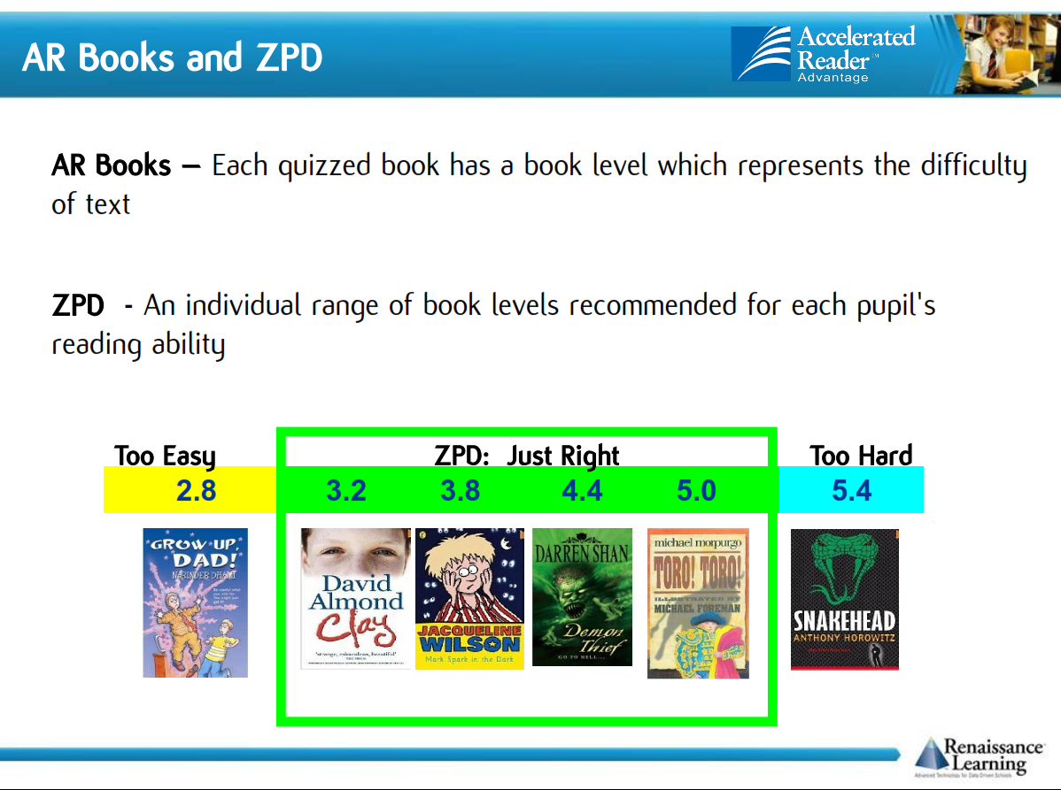

Slide 5
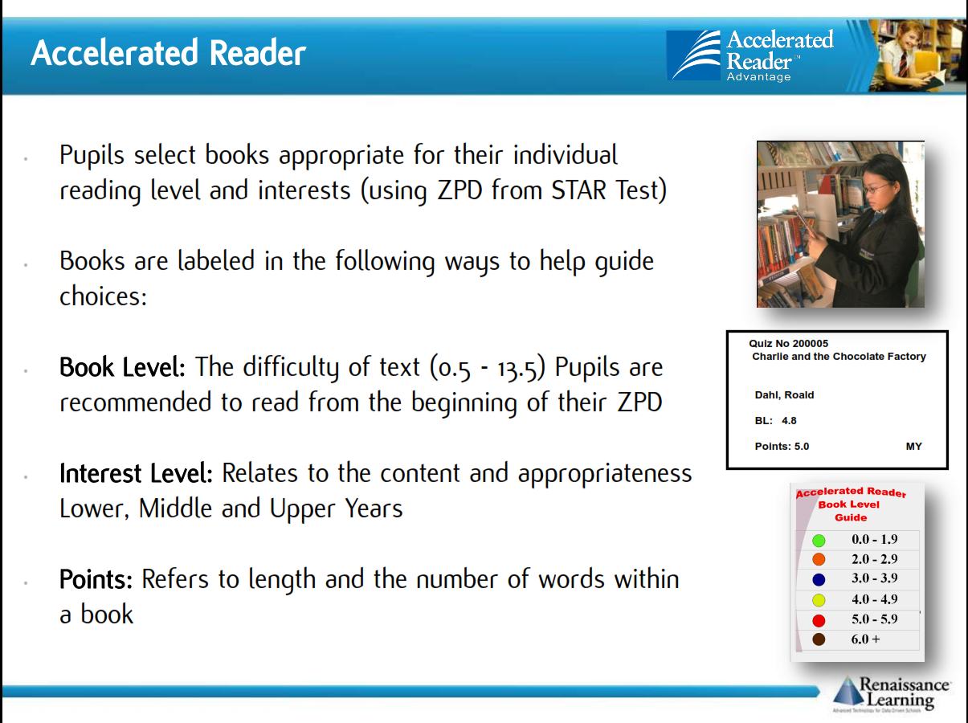
Notes:
What is a Book Level?
Book Levels are reported using the ATOS™ readability formula and represent the difficulty of the text. For example, a book level of 4.5 means that the text could likely be read by a pupil whose reading skills are at the level of a typical Year 5 pupil. Normally, however, books are chosen based on the ZPD range recommended for each pupil by STAR Reading.
What is a Zone of Proximal Development (ZPD)?
ZPD is the range of books that will challenge a child without causing frustration or loss of motivation. Your child will receive a ZPD range after taking a STAR Reading test or teachers can use their best professional judgment to determine a ZPD. It is important for children to read with a high degree of comprehension and within his/her ZPD. ZPDs should be adjusted based on the needs and ability of your child.
What are points?
Every book that has an AR Reading Practice Quiz is given a points value. AR points are based on the difficulty of the book (ATOS readability level) and the length of the book (number of words). You may notice that some popular books have more points assigned to them than some classic pieces of literature. David Copperfield (Unabridged), for example is a 66-point book while Shakespeare’s MacBeth is a 4-point book. Keep in mind that this does not mean we think David Copperfield (Unabridged) is a better book or more worthwhile to read than MacBeth, only that—at 339,112 words vs. 19,048 words—it is much longer and provides more reading practice time.

Slide 6
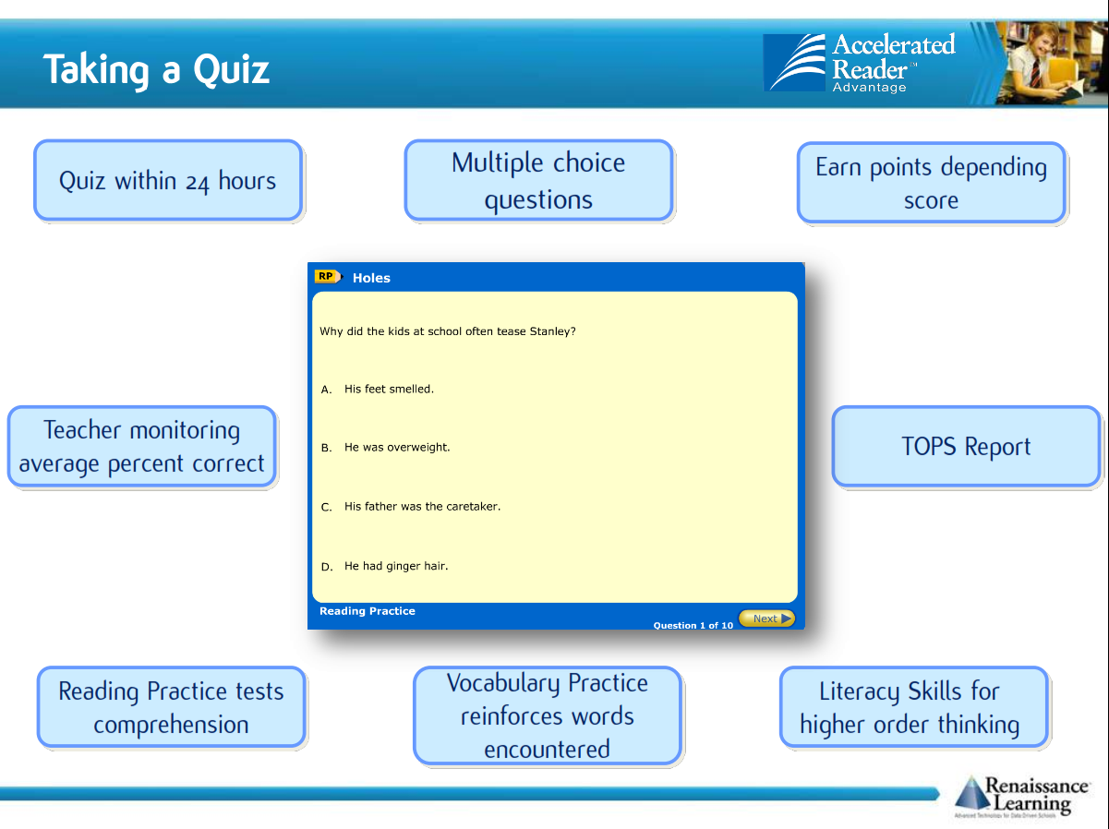
Notes:
Children earn points on a pro rata basis depending on how well they do on the Reading Practice Quiz. For example, a pupil who takes a 5-question quiz on a book worth 1 point will earn 1 point for 5 correct answers (100%), 0.8 point for 4 correct answers (80%) and so on. A pupil who reads a book worth 5 points and takes a 10-question quiz will earn 5 points for 10 correct answers (100%) 4.5 points for 9 correct answers (90%), etc. A child needs to pass a quiz with a score of 60% or higher to earn points.

Slide 7

How much should my child read each day?
According to Renaissance Learning’s research, children who read at least 20 minutes a day with a 90% comprehension rate on AR quizzes see the greatest gains.
Therefore, your child should have at least 20 minutes set aside for reading during day.

Slide 8
How you can help your child to become a better reader
As with anything, performance improves with practice.
Encourage your child to read at home.
Create a culture of reading in your household by reading with your child, starting a home library, visiting your local library or bookshop on a regular basis and by letting your child see you reading.
When reading with your child stop and ask questions to be sure your child comprehends what they have read and in general make a habit of discussing books that each of you has read.

Slide 9
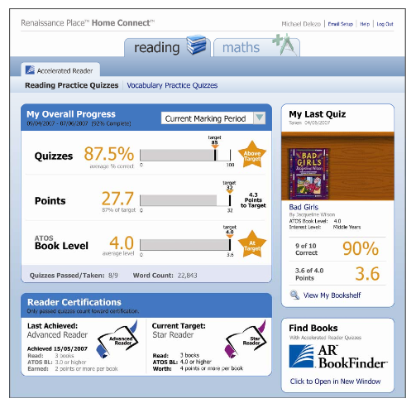
How will I know how my child is doing?
You can access your child’s AR information in Renaissance Place Home Connect from any web-enabled computer.
Once in the program, you can view your child’s progress towards targets, points and books read.
You can also access AR BookFinder to search for titles of interest.
You can only access information about your own child.

Slide 10
Can a child who is not a strong reader still use Accelerated Reader?
Accelerated Reader helps all children become better readers from pupils with special needs to those who are gifted and talented.
When children read books at their appropriate level, they experience success.
Furthermore, teachers work with children to set appropriate targets based on each child’s reading level.

