Slide 1






Slide 2
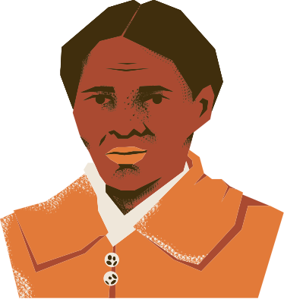
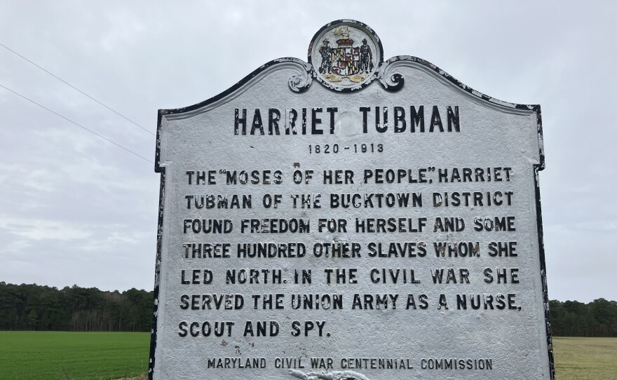
Harriet Tubman
Notes:
Harriet Tubman was born in Maryland, USA in 1822.
She was born into slavery but in 1849 Tubman escaped to Philadelphia. She returned to rescue her family.
Eventually, she guided small groups of slaves to freedom on what is known as the underground railroad and became known as the Moses of her people because she led them to freedom. In order to do this she changed her name and dressed as a boy. Saving 70 people on 13 different missions.
In later life she was an abolitionist and political activist.

Slide 3
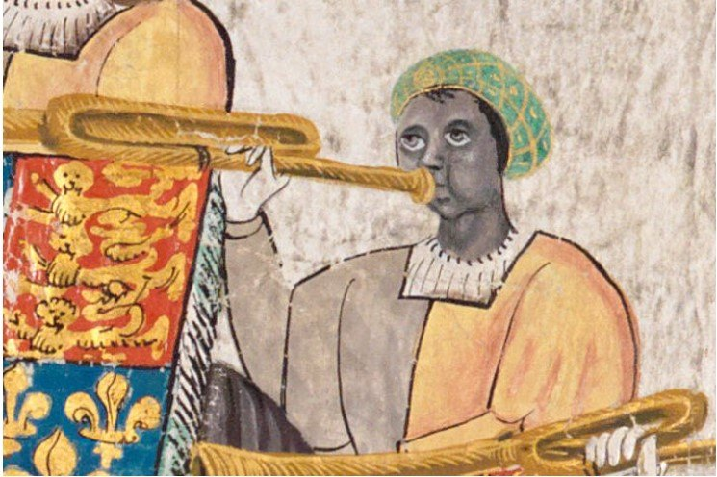
John Blanke
Notes:
John Blanke was a trumpeter in the Tudor court of Henry 8th. He played at Henry 8th's coronation in 1509.
His presence in the Tudor court is evidence that there is a long history of black people living in Britain.
He was well thought of by Henry 8th and was even gifted a wedding present by the king.

Slide 4
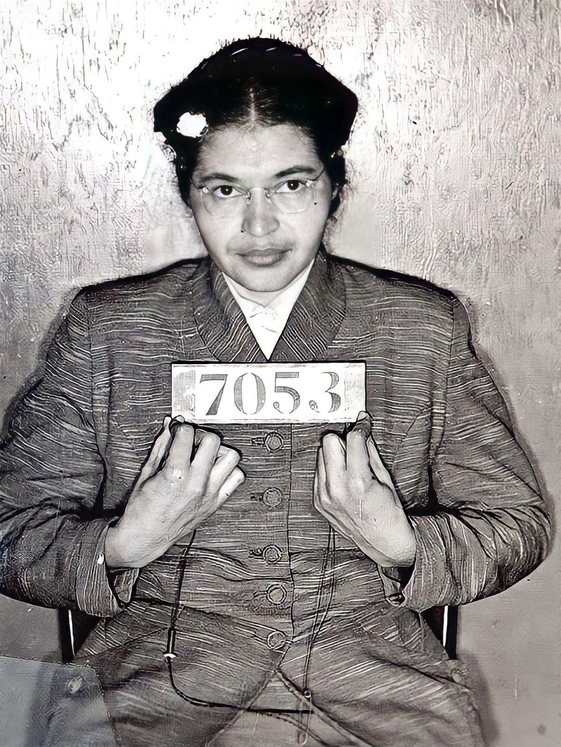
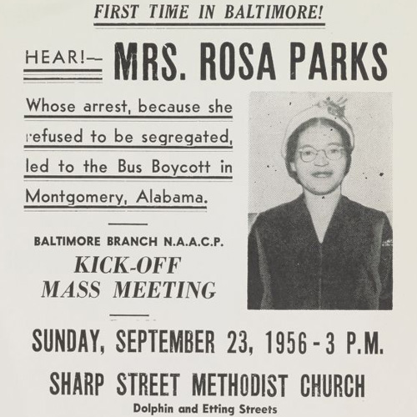
Rosa Parks
Notes:
Rosa Parks was born in Alabama, United States in 1913.
She is best known for her pivotal role in the Montgomery Bus Boycott when she refused to move for a white person boarding a bus simply because of the colour of her skin.
She became an activist for the civil rights movement in America.

Slide 5
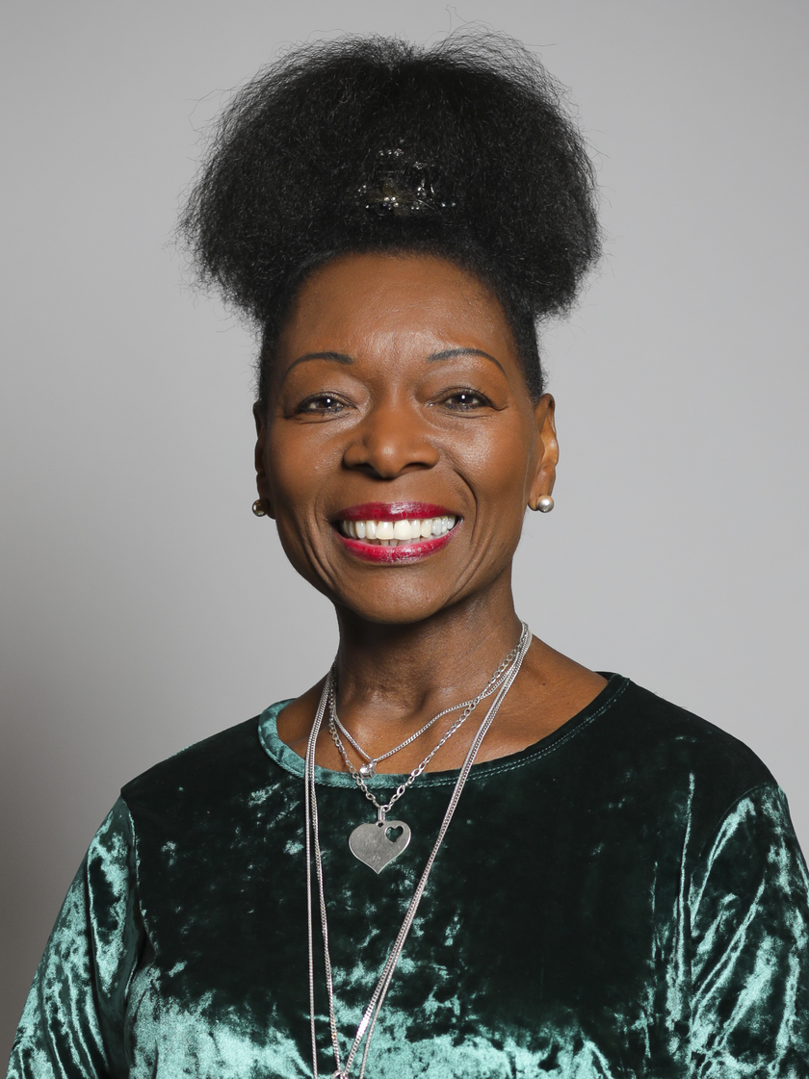

Floella Benjamin
Notes:
Floella Benjamin was born 23rd September 1949, born in the Carribean island of Trinidad.
She came to Britain in 1960 when she was 11 years old and considers herself to be part of the Windrush generation.
The windrush is a period after WW2 where there were an influx of migrants from the Caribean arriving in Britain.
Floella was an actor, presenter, writer, independent producer, worked in the House of Lords and an advocate for the welfare, care and education of children throughout the world.

Slide 6
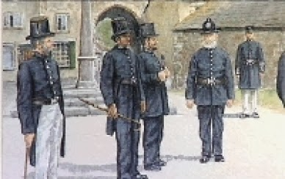
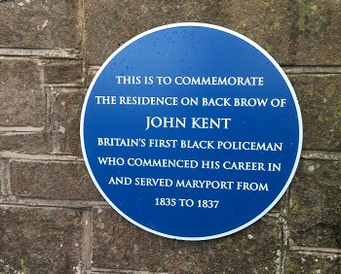
John Kent
Notes:
Britain's first black police officer.
He worked as a police constable during the Victorian period in Carlisle.
He was born in 1805 and died in 1886.

Slide 7
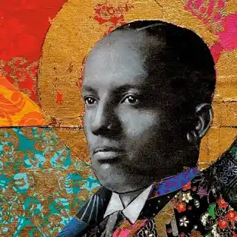
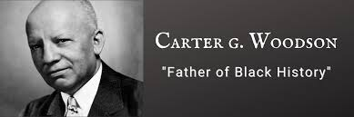
Carter G. Woodson
Notes:
Born December 19th 1875
Died April 3rd 1950 at the age of 74
Born in Virginia, USA.
An American historian, author, journalist.
Has been called the father of black history because in 1926 he launched the celebration of negro history week the front runner of Black history month.

